Slide 1

Major Project Presentation
On
Forensic Sketch Generator: An AI-Powered Approach
Using NLP and Conditional GAN
1. Tusharkanta Behera Regd. No.: 2301020601
2. Sradha Ram Regd. No.: 2301020808
3. Sandeep Kumar Swain Regd. No.: 2301020438
Under the supervision of Dr. Sukant Kishoro Bisoy
Department of CSE | C.V. Raman Global University, Bhubaneswar
Science and Technology Advancement — Assessment Review (STAAR)

Slide 2


Problem Statement
• Facial composites begin with a Cognitive Interview — hours of recall, catalog picking, and revision.
• Trained forensic sketch artists are scarce, costly, and introduce subjective bias.
• Hand and software composites (Identikit, E-FIT, FACES) still demand expert operators.
• Verbal memory often fails to map cleanly onto fixed feature libraries.
• Early investigation windows need usable likenesses in minutes, not multi-hour sessions.
• Gap: no artist-aligned AI that interviews → structures → sketches → refines with the witness.
Traditional composite creation
STAAR Assessment | Forensic Sketch Generator | C.V. Raman Global University
2

Slide 3

Motivation
1
2
3
Speed
Access
Fidelity
Cut composite turnaround from hours to minutes for time-critical leads.
Assist investigators where certified artists are unavailable.
Keep witness memory as the source of truth — not unconstrained prompts.
4
5
6
Practice Fit
Control
Research
Digitize CI / H-CI workflow instead of generic text-to-image.
Edit one facial trait at a time without discarding identity.
Enable measurable quality via FID, CLIP, and ArcFace metrics.
STAAR Assessment | Forensic Sketch Generator | C.V. Raman Global University
3

Slide 4

Existing Methods
Method | How it works | Limitation
Hand sketch + CI | Artist interviews & draws | Scarce talent; hours per session
Identikit / E-FIT / FACES | Catalog feature assembly | Needs expert; library gaps
EvoFIT / EFIT-V | Holistic evolutionary faces | Still operator-guided software
Text-to-Face GANs | Caption → photo face | Photo output; weak interview loop
Sketch → Photo nets | Translate existing sketches | Assumes sketch already exists
STAAR Assessment | Forensic Sketch Generator | C.V. Raman Global University
4

Slide 5

Literature Survey
Sl. | Venue / Year | Work | Method | Finding | Gap
1 | WJARR 2026 | Soppari et al. (Base paper) | SDXL → InsightFace → FAISS retrieval | Text→sketch→rank reduces artist need | Weak iterative refinement
2 | CVPR / arXiv | TediGAN; ST²FG | Text→StyleGAN; BERT + ACM edits | High-res control; user refinement | Photo-like; GAN instability
3 | Elsevier / IJCB | DCGAN STF; CLIP4Sketch | Sketch↔photo & CLIP matching | Strong once sketch exists | No text-to- composite start
4 | IEEE SPL 2017 | Galea & Farrugia | VGG-Face + 3DMM augment | 94.61% Rank-1 sketch–photo | Needs sketch; no generation
STAAR Assessment | Forensic Sketch Generator | C.V. Raman Global University
5

Slide 6

Research Gap
Dimension | Current State | Our Vision
Starting point | Needs hand / software composite first | AI-led forensic interview → first draft
Workflow | One-shot prompt generation | Interview → profile → construct → refine
Feature control | Opaque prompt / full regeneration | Living profile; edit one trait at a time
Output form | Photo faces or sketch-to-photo only | Explicit forensic pencil-style sketch
Product role | Artist replacement framing | Investigator assist; witness authority
Contribution: unify artist-style interviewing, controllable face construction, forensic sketch rendering, witness-in-the-loop refinement, and research-time biometric evaluation.
STAAR Assessment | Forensic Sketch Generator | C.V. Raman Global University
6

Slide 7

Proposed Solution
Digitize composite practice: interview → structure features → compose face → render sketch → refine
A
B
C
D
E
Interview Agent
Feature Profile
Face Composer
Sketch Renderer
Refinement
CI / H-CI protocol
structured dialogue
Living attribute
schema (13+ traits)
Controllable gen
StyleGAN2 / SD
Pencil forensic
composite styling
Selective edits
witness-approved
Assistive investigative tool — does not replace witness authority or legal identification.
Optional validation layer: FID · attribute consistency · ArcFace / FaceNet similarity.
STAAR Assessment | Forensic Sketch Generator | C.V. Raman Global University
7

Slide 8

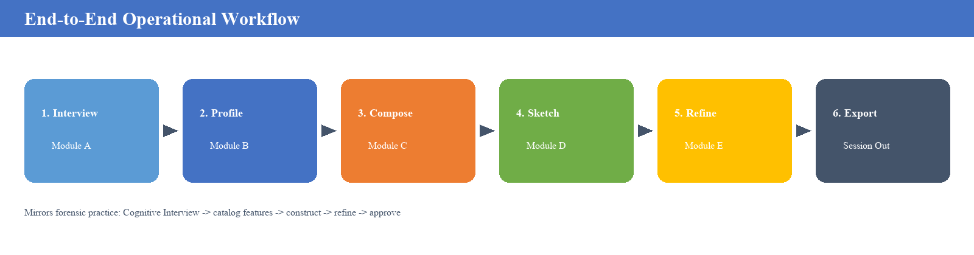
End-to-End Workflow Diagram
1. Session start with witness
2. Modules A–B build feature profile
3. Modules C–D synthesize & sketch
4. Module E refines until approval
5. Export approved composite
6. Optional research validation
STAAR Assessment | Forensic Sketch Generator | C.V. Raman Global University
8

Slide 9

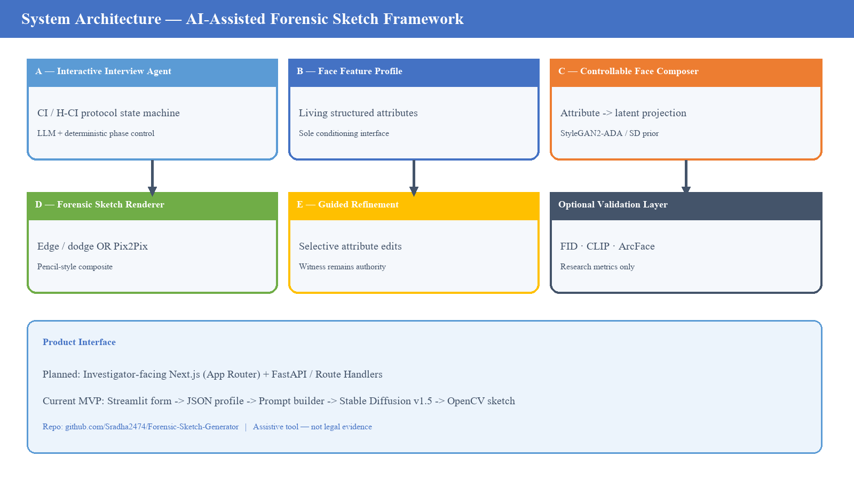
System Architecture Diagram
STAAR Assessment | Forensic Sketch Generator | C.V. Raman Global University
9

Slide 10


Technology Stack
Client UI
Next.js (planned) · Streamlit MVP (live)
API / Services
Next.js Route Handlers / FastAPI inference
ML Runtime
Python 3.10+ · PyTorch 2.0+ · Diffusers
Language / NLP
Protocol-constrained LLM · Transformers
Vision Models
StyleGAN2-ADA · SD v1.5 · OpenCV / PIL
Validation
ArcFace / FaceNet · FID / CLIP scores
Data & Ops
CelebA · FFHQ · CUFS · Docker + GPU worker
PyTorch · Diffusers · CV
STAAR Assessment | Forensic Sketch Generator | C.V. Raman Global University
10

Slide 11

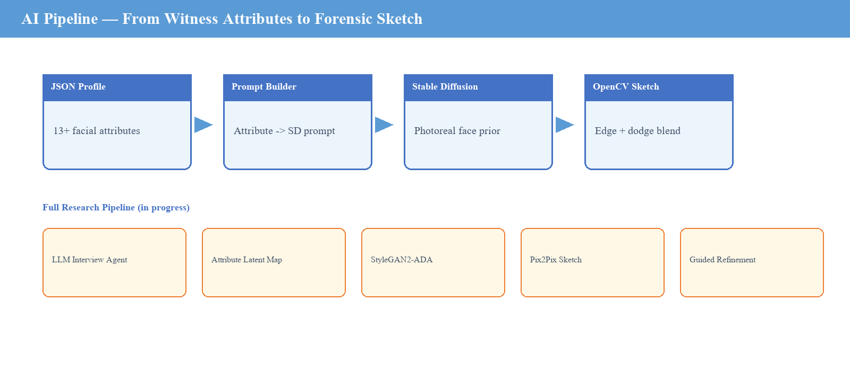
AI Pipeline
• MVP path: Witness attributes → JSON profile → prompt builder → Stable Diffusion face → OpenCV pencil sketch.
• Research path: LLM interview agent → attribute–latent map → StyleGAN2-ADA → Pix2Pix/CycleGAN sketch → guided refinement.
• Unknown attributes stay unknown — no forced hallucination of unstated features.
STAAR Assessment | Forensic Sketch Generator | C.V. Raman Global University
11

Slide 12

Datasets
Dataset | Role in Pipeline | Why it matters
CelebA | Attribute vocabulary & conditional supervision | Maps language traits to facial labels
FFHQ | High-fidelity face generation prior | Photoreal identity / quality backbone
CUFS / CUFSF | Photo–sketch translation & evaluation | Train / test forensic pencil domain
Witness profiles (MVP) | Structured interview JSON from live sessions | End-to-end prototype validation
Fairness note: public face corpora may under-represent demographics and rare marks (scars, tattoos) — addressed in future fairness analysis.
STAAR Assessment | Forensic Sketch Generator | C.V. Raman Global University
12

Slide 13

Current Progress (≈ 50% MVP)
✓
Streamlit investigator UI with structured witness interview form
✓
WitnessProfile JSON schema + save/load to outputs/
✓
Attribute → Stable Diffusion prompt builder
✓
SD v1.5 face generation (CPU/GPU) with model cache
✓
OpenCV edge-preserving forensic pencil sketch + download
✓
Extension stubs: interview agent, selective edit, eval, DB search
STAAR Assessment | Forensic Sketch Generator | C.V. Raman Global University
13

Slide 14

Future Work
1
Conversational Agent
2
StyleGAN2-ADA Control
3
Sketch Translation
Replace form with protocol-constrained LLM interview (Module A).
Attribute-level latent edits without identity drift.
Pix2Pix / CycleGAN on CUFS for stronger pencil domain.
4
Selective Inpainting
5
Evaluation Suite
6
Practitioner Studies
Region edits for scars, spacing, jaw — ControlNet hooks.
FID, CLIP attribute score, ArcFace identity metrics.
Controlled trials with forensic artists & witness-role users.
STAAR Assessment | Forensic Sketch Generator | C.V. Raman Global University
14

Slide 15

Expected Impact
Minutes, not hours
Procedural consistency
Wider access
Usable forensic-style composites for early investigation windows.
Protocol-constrained interviewing reduces operator drift.
Assist units lacking on-call composite artists.
Measurable quality
Ethical framing
Open research path
Research metrics enable objective iteration.
Witness-in-the-loop; assistive — not courtroom evidence.
Modular design allows model swap without UI rewrite.
STAAR Assessment | Forensic Sketch Generator | C.V. Raman Global University
15

Slide 16

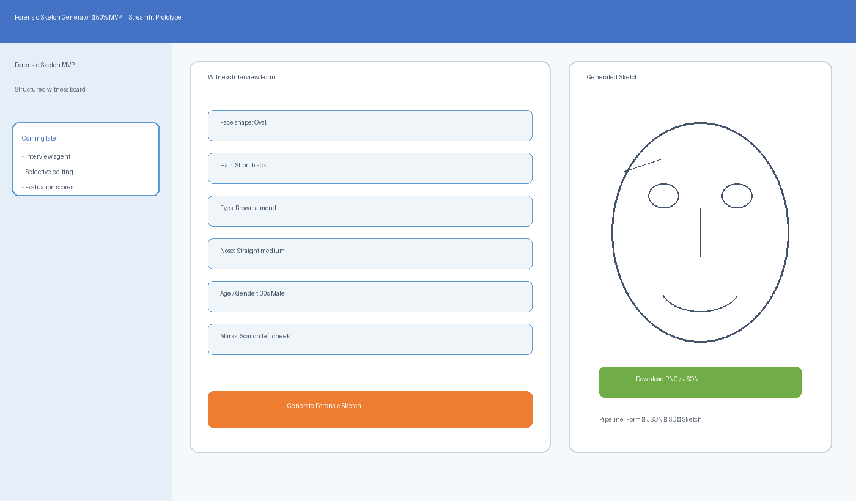
Demo / Prototype
Live MVP Highlights
• Witness interview board
• JSON profile export
• SD v1.5 generation
• Pencil sketch styling
• PNG + JSON download
• CPU & GPU support
github.com/Sradha2474/
Forensic-Sketch-Generator
STAAR Assessment | Forensic Sketch Generator | C.V. Raman Global University
16

Slide 17

Timeline
Phase 1
Phase 2
Phase 3
Phase 4
Phase 5
Lit. survey &
problem framing
MVP pipeline
Streamlit + SD
Sketch quality &
evaluation hooks
Interview agent &
selective edit
StyleGAN + CUFS
+ user study
Done
Done
In progress
Next
Planned
• Near-term: tighten sketch fidelity, add metric dashboard, polish interview UX.
• Mid-term: Module A conversational agent + Module E selective refinement.
• Long-term: StyleGAN2-ADA + CUFS sketch translation + practitioner validation study.
STAAR Assessment | Forensic Sketch Generator | C.V. Raman Global University
17

Slide 18


Conclusion
• Forensic composites remain vital when CCTV / biometrics are unavailable.
• We redesign Gen-AI sketching around real CI practice — not one-shot prompts.
• Modular pipeline: interview → profile → controllable face → pencil sketch → refine.
• 50% MVP demonstrates the full path with Streamlit + Stable Diffusion + OpenCV.
• Next: StyleGAN control, CUFS sketch translation, evaluation, and user studies.
• Positioning: investigator assistive tool with witness-in-the-loop authority.
STAAR Assessment | Forensic Sketch Generator | C.V. Raman Global University
18

Slide 19

References
• [1] Soppari et al. (2026). Forensic sketch generation using Gen-AI. WJARR.
• [2] Nasir et al. (2019). Text2FaceGAN. IEEE BigMM.
• [3] Chen et al. (2019). FTGAN: Fully-trained GAN for text-to-face. arXiv:1904.05729.
• [4] Xia et al. (2021). TediGAN. CVPR.
• [5] Oza et al. (2021). ST²FG — Semantic text-to-face GAN. arXiv:2107.10756.
• [6] Devakumar & Sarath (2023). Forensic sketch to real image using DCGAN. Procedia CS.
• [7] Jain et al. (2024). CLIP4Sketch. IJCB.
• [8] Galea & Farrugia (2017). Forensic face photo-sketch recognition. IEEE SPL.
• [9] Karras et al. (2020). Analyzing and improving StyleGAN. CVPR.
• [10] Deng et al. (2019). ArcFace. CVPR. | [11] Schroff et al. (2015). FaceNet. CVPR.
STAAR Assessment | Forensic Sketch Generator | C.V. Raman Global University
19

Slide 20
Thank You
Questions & Discussion
Team: Tusharkanta Behera · Sradha Ram · Sandeep Kumar Swain
Guide: Dr. Sukant Kishoro Bisoy | CSE, C.V. Raman Global University
Repo: github.com/Sradha2474/Forensic-Sketch-Generator

