Slide 1
Impact of U.S. Fed Rate Regimes on Market Returns
S&P 500 & NIFTY (2000–2025)
Prepared by: Srajal Dubey
Tools: Python | Power BI | Excel

Slide 2
Business Problem
Interest rate changes influence global capital markets
Simple correlation often fails to explain market behavior
Investors struggle to interpret different rate cycles
Objective:
Analyze how Fed rate regimes impact equity returns and volatility

Slide 3
Data & Tools
Datasets Used:
U.S. Fed Funds Rate (monthly)
S&P 500 monthly returns
NIFTY 50 monthly returns
Tools:
Python, Excel, Power BI

Slide 4
Methodology
1. Monthly alignment of datasets
2. Calculation of monthly returns
3. Fed rate regime classification:
• Low (<2%)
• Medium (2–4%)
• High (>4%)
4. Regime-wise return & volatility analysis
5. Crisis period evaluation (2008, 2020)

Slide 5
Data Validation & Assumptions
All datasets aligned to monthly frequency
Simple arithmetic averages used (not CAGR)
Volatility measured as 12-month rolling standard deviation
Analysis assumes public, inflation-unadjusted index returns

Slide 6
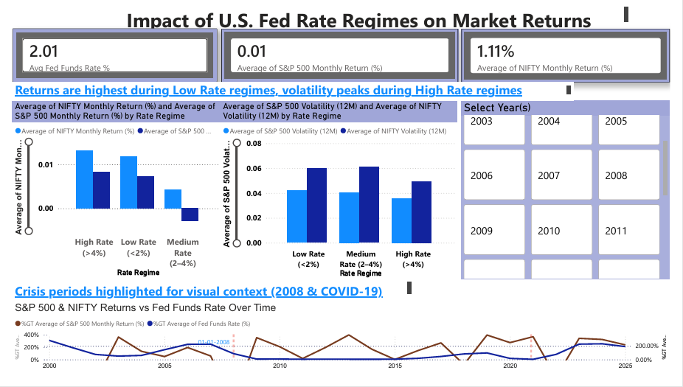
Power BI Dashboard Overview
Volatility represents 12-month rolling standard deviation of monthly returns(not annualized).
This dashboard visualizes the impact of U.S. Fed rate regimes on equity market returns and volatility, highlighting regime-based behavior and crisis periods.
Data period: 2000–2025

Slide 7
Key Findings – Market Returns
Equity returns are strongest in low-rate regimes
Medium-rate regimes show unstable performance
High-rate regimes suppress average returns
Consistent across S&P 500 & NIFTY

Slide 8
Key Findings – Volatility
Volatility increases significantly in high-rate regimes
Crisis periods amplify volatility beyond rate effects
Risk rises even when returns appear stable

Slide 9
Crisis Period Analysis
2008 Global Financial Crisis: extreme volatility
2020 COVID shock: sudden market disruption
Rate levels alone cannot explain crisis behavior
Volatility is the dominant short-term driver

Slide 10
Key Takeaways
Fed rate regimes matter more than rate levels
Low rates support returns; high rates amplify risk
Regime analysis explains weak correlations
Provides clearer market interpretation

Slide 11
Limitations of the Analysis
Inflation and currency effects are not explicitly modeled
Market behavior is influenced by multiple macroeconomic variables
Fed rate regimes are descriptive, not predictive
Short-term market reactions may differ from long-term trends

Slide 12
Future Enhancements
Add inflation & GDP indicators
Extend to sector-level analysis
Predict regime shifts using ML models

