Slide 1

ATM SIMULATION
SIMULATION
DUMMY
DUPLICATE

Slide 2
INTRODUCTION

Slide 3
The topic “ATM Simulation” has been chosen keeping the functions of an ATM machine and kiosk in mind. When we swipe our card through the machine, we are able to extract all the relevant information of our account. A same attempt has been made through this application to simulate those functions.

Slide 4
OBJECTIVE

Slide 5
The proposed system (ATM Simulation) will be able to perform all operations of the current manual system effectively with reduced cost. Also it will require less manpower and low maintenance. The proposed system will be very user friendly and it will require less effort to get acquainted with the system.
Application Software
The ATM Simulation is application software, in which various activities are performed through machine. Registrar user can login, mini statement, Deposit amt and withdraw amt. the results are done automatically through this software. The nature of this software is to solve the particular problem that is why its category is application software.

Slide 6
MODULES & DESCRIPTIONS

Slide 7
MODULES & ITS DESCRIPTIONS
Smarter Hiring System is composed of mainly twelve modules. Each module is designed for specific purpose. Each one is supposed to perform a complete task. These modules are as:
Number One
Account Verification Module
Number Two
Account Detail Module
Number Three
Amount Deposit Module
Number Four
Amount Withdrawal Module

Slide 8
Description of the data objects
First Step
Account & Pin number entered by the user.
If the Account number does not match with Pin number or vice versa, the application cleanly exits to the system with a proper user message like “Invalid Account / Pin no. entered”.
If the inputted details are correct, they are passed to the “Main Menu” process and further to different modules which serve the customer’s requests individually using those details.
Second Step
Third Step
Account information & details like Present Balance, Last Deposit & Last Withdrawal.

Slide 9
Description of the data objects
Fourth Step
Deposit details & account balance after deposit.
This is withdrawal details & account balance after the withdrawal in case the withdrawal amount entered is correct.
Fifth Step
If the withdrawal amount entered is incorrect or invalid like greater than the balance, a message is displayed to the user like “Invalid amount entered”.
Sixth Step

Slide 10
PROCESS LOGIC

Slide 11
Account Verification
Amount Deposit
In Account Verification form, First user enter own Account number and password. If your entered Account number and password matched from backend. Then project will process next step. If user put wrong account number then project will be show error message. On Go, validation for each text box is carried out and attention is focused on to respective text box that does not meet validation requirement, thus chances of error are eliminated.
In Amount Deposit module, User can deposit the amount but user can deposit maximum three notes. When user choice the Amount Deposit Then this module will be show three statement: user present balance, Enter the amount to be deposited and Enter new balance after deposit. If user click add without deposit amount then this project will display the error message.
Account Detail
Amount Withdrawal
In this, module display the account detail with user’s account number.
Account detail module display the Last Deposit, Last withdrawal, Present Balance etc. regarding account number and user name.
By use of module, User can withdraw amount but if entered amount is available in bank.
If entered amount is not available then this project will be display error message. So user can withdraw minimum amount than available in bank.
EXIT
This module will be work of EXIT. If user’s processing work have finish. Then user will be exit from own Account.
.

Slide 12
IMPLEMENTATION

Slide 13
Implementation is a process that carries out the operational plans developed at the end of the information systems planning process. Therefore, implementation is an important step in assuring the successful development of information systems for end users.
01
02
IMPLEMENTATION
Implementation involves a variety of acquisition, testing, documentation, installation and conversion activities. Thus, implementation is a vital step in assuring the success of new systems. Even a well-designed system can fail if it is not properly implemented.

Slide 14
POST IMPLEMENTATION
MAINTENANCE

Slide 15
Implementation of system means putting up system on user’s site. Therefore, the system requires periodic maintenance. Maintenance can be for software or hardware. User priorities, changes in organizational requirements or changes in environmental factors call for system enhancements. This is very crucial for system’s life.

Slide 16
TEST CASE

Slide 17
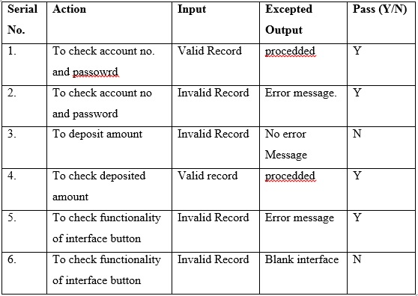
It describes an input description and an expected output description. These are derived during all phases of the development cycle. It helps in determining expected results before running a test case.
Some of the test cases for this project are:

Slide 18
SCOPE OF FUTURE
APPLICATION

Slide 19
We can hereby conclude that:
The proposed software is completely modular and therefore it facilitates for extendibility i.e. activities for new establishment can be easily added without affecting the main program with less effort and cost.
The system effectively automated the functions involved in the processes being handled manually before.
The cost & benefit analysis shows that the system was quite successful in saving costs for the bank & generate equivalently huge benefits.
Changes in GUIs based screen can be easily incorporated but it will be treated as changed request and it will be charged.
The system is secure & scalable. The system design has been done keeping user-friendliness and efficiency in mind.
It will be portable can be implemented on most of the available web based platform.
One year maintenance and software support for the proposed application software will be provided free of cost (provided change of scope is not raised).
Some part of the proposed Application System can be converted to web based software by using web based scripting languages and tools.

Slide 20
TEAM MEMBERS
RUCHI RAI
0105CS181086
SRAJAL SHARMA
0105CS181108
PRAGYA AGARWAL
0105CS181076

Slide 21


OFFERING IDEAS THAT RAISE YOUR BUSINESS ABOVE THE EXPECTED
The key is always you

