Slide 1
Photo Dump

Slide 2
Project Details
A database for a System that collects the photos from multiple devices in one place. The system will keep records of photos like date, time, device type, and category.
It also provide a user wise photo dump option. Two users can collaborate and add photos together. It can automate the process when the bulk of photos are dumped together.
It has features to club the photo’s location and date time-wise. It is also able to give a count of photos for a particular location or time, or user.
It is like a web where photographers can store similar pictures for the exact location. It has a subscription plan for users who wish to store more than n number of photos.
Assumption: We have used Trigger Stored Procedure. That will automatically update the result in the table as soon as the queries are processed.

Slide 3
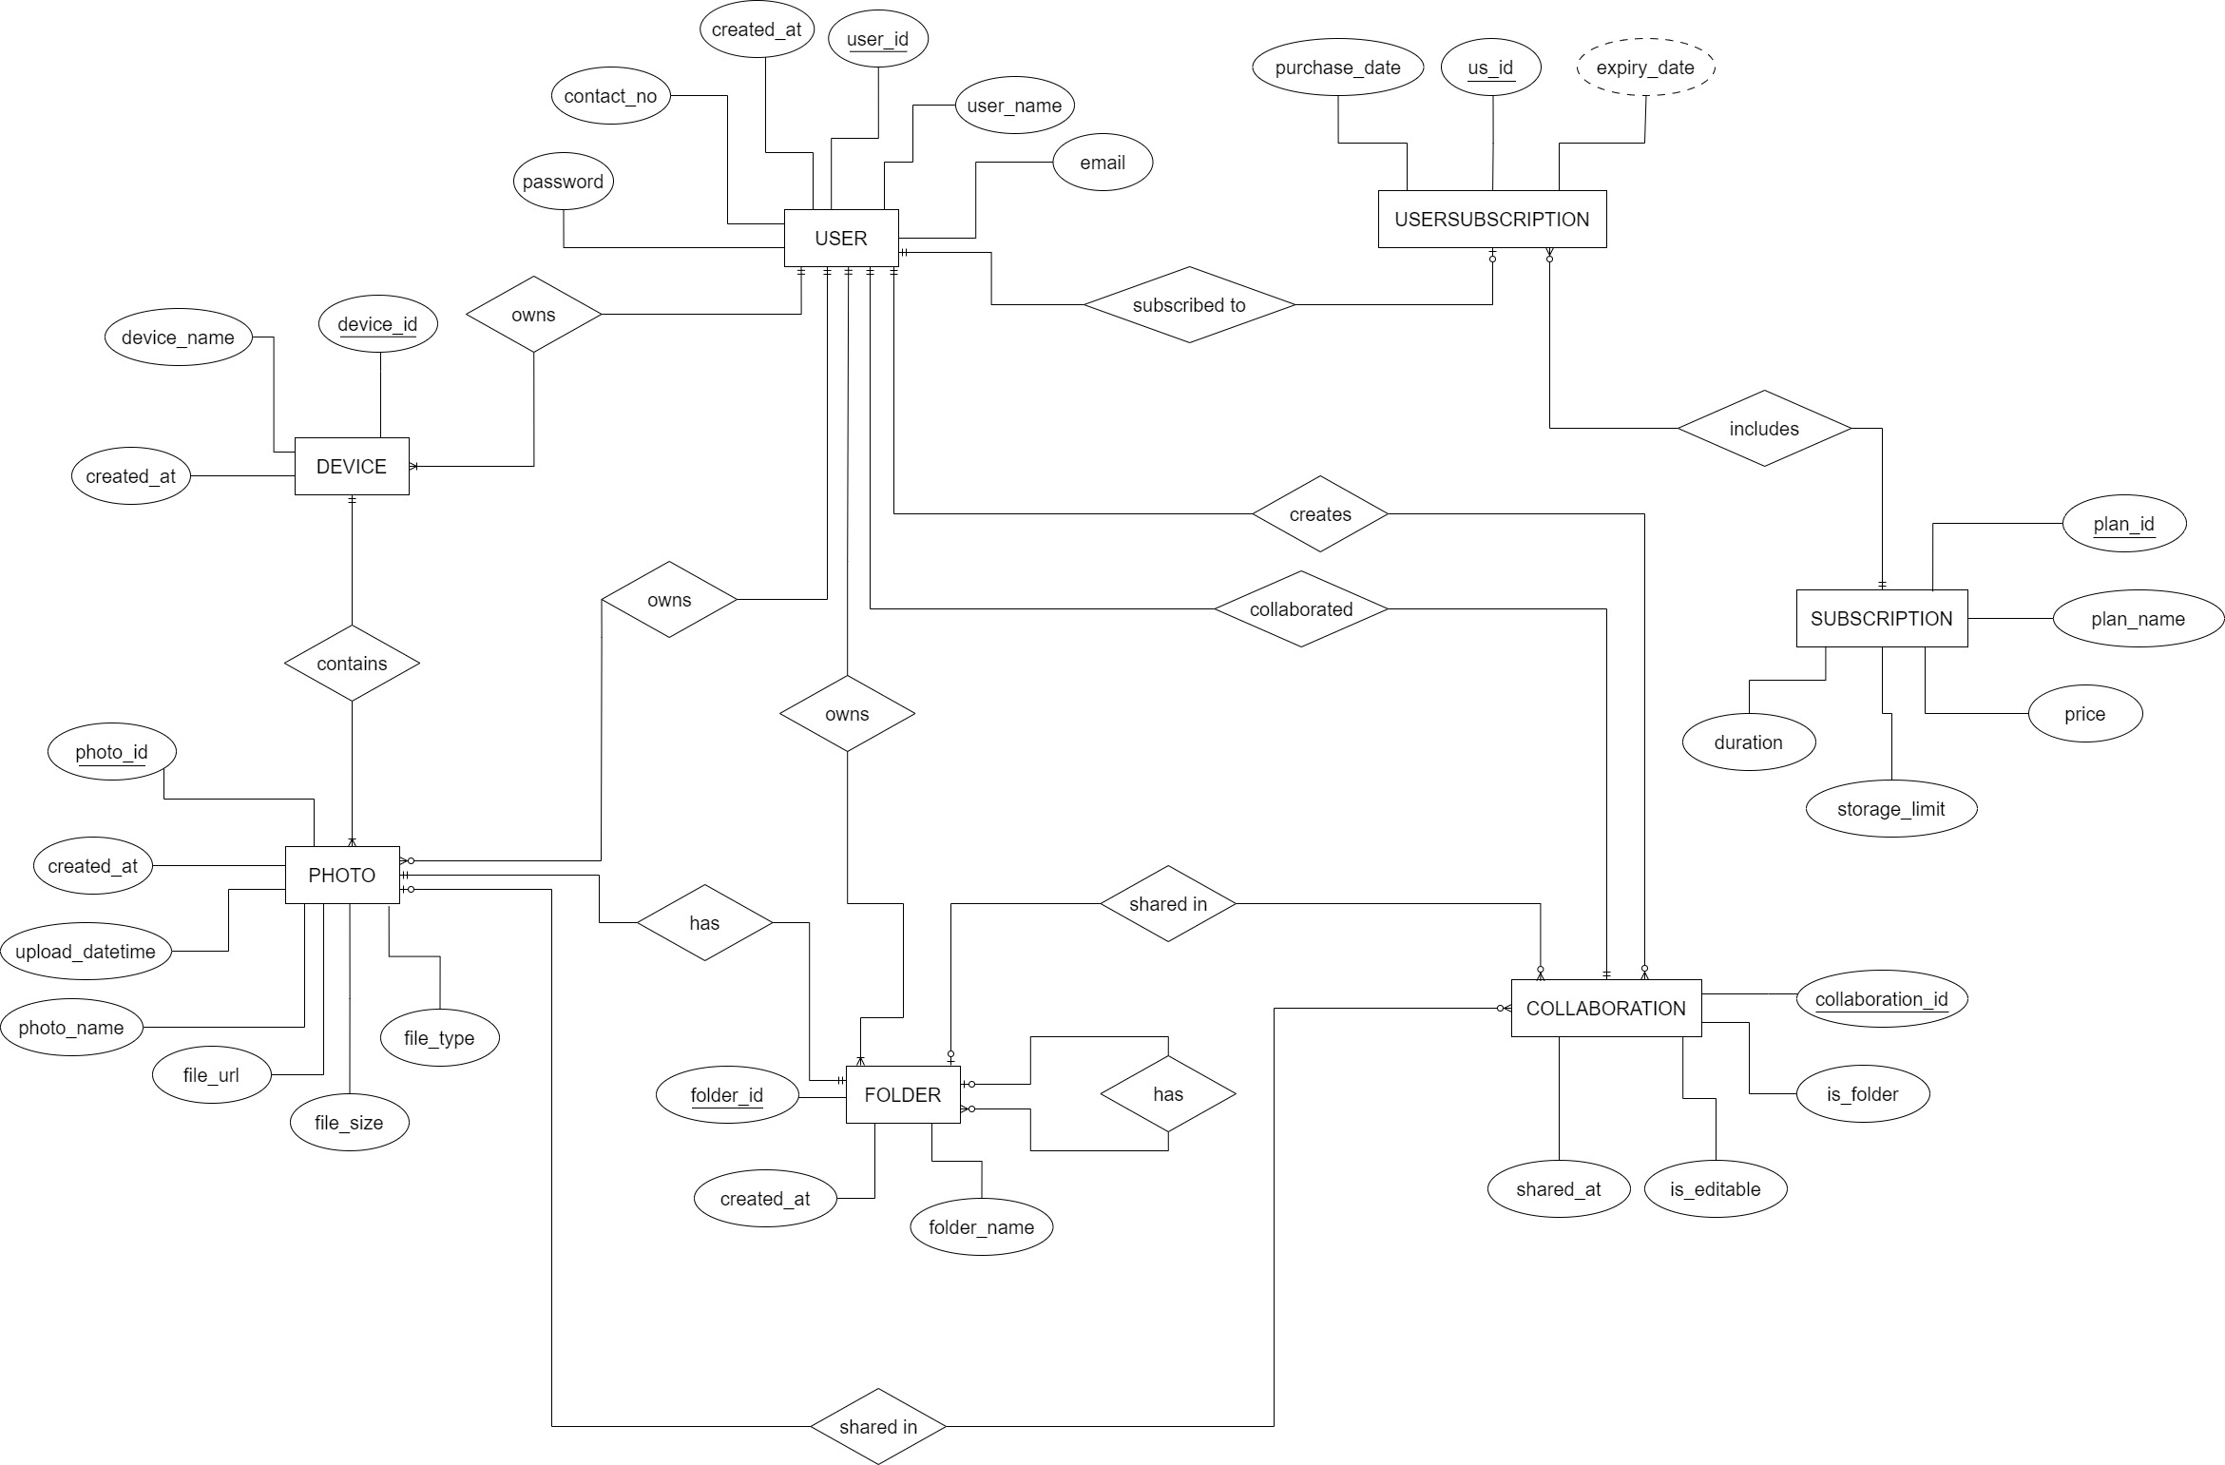
ER Diagram

Slide 4
SQL Tables
Users Table
UserID - Primary key
Name
Email
Password
Phone No
Created at
Devices Table
Device ID - Primary Key
Name
User ID - Foreign Key (Users)
Created at
Subscription Plan Table
Plan ID - Primary key
Name
price
storage limit
duration
Folders Table
Folder ID - Primary Key
name
User ID - Foreign Key (Users)
Parent Folder ID - Foreign Key (Folders)
user id
Photos Table
Photo ID - Primary Key
Photo name
USer ID - Foreign Key (Users)
Device ID - Foreign Key (Devices)
File Type
File Size
File URL
Upload Date
Created at
Collaborations Table
Collaboration ID - Primary key
Item ID
is_folder
collaborator ID - Foreign key (Users)
user ID - Foreign key (Users)
is_editable
shared at
User Subscription Table
US ID - Primary key
user ID - Foreign key (Users)
plan ID - Foreign key (Subscription Plan)
purchase Date
expiry date

Slide 5
Retrieve all the data from USERS Table :-
SELECT * FROM Users;
Retrieve collaborations with a specific collaborator ID :- SELECT * FROM Collaborations WHERE CollaboratorID = 2;
Retrieve collaborations with editable access:-
SELECT * FROM Collaborations WHERE IsEditable = TRUE;
Retrieve photos with a file size greater than 2000 :-
SELECT * FROM Photos WHERE FileSize > 2000;
Retrieve all photos uploaded on or after a specific date:-
SELECT * FROM Photos WHERE UploadDate >= '2023-01-01';
SQL Queries (Simple)

Slide 6
π UserID, Name, Email, Password, PhoneNo, CreatedAt (Users)
π CollaborationID, ItemID, IsFolder, CollaboratorID, UserID, IsEditable, SharedAt (σCollaboratorID= 2 (Collaborations))
σ IsEditable = TRUE (Collaborations)
σ FileSize > 2000(Photos)
σ UploadDate >= ‘2023-01-01’ (Photos)
Relational Query(Simple)

Slide 7
SQL Queries (Complex)
Find the names and email addresses of users who have collaborated on at least one item with user ID 1 and the collaboration is editable.*
SELECT DISTINCT U.Name, U.Email FROM Users U JOIN Collaborations C ON U.UserID = C.CollaboratorID
WHERE C.UserID = 1 AND C.IsEditable = TRUE;
Retrieve the names and URLs of photos uploaded by user ID 3 and taken with a device named 'Tablet’.
SELECT P.PhotoName, P.FileURL FROM Photos P JOIN Devices D ON P.DeviceID = D.DeviceID WHERE P.UserID = 3 AND D.Name = 'Tablet’;
List all the folders (with their names and parent folder names) created by user ID 2.
SELECT F.Name AS FolderName, PF.Name AS ParentFolderName FROM Folders F LEFT JOIN Folders PF ON F.ParentFolderID = PF.FolderID WHERE F.UserID = 2;
Calculate the total storage used by user ID 1 based on the file sizes of their photos.
SELECT SUM(P.FileSize) AS TotalStorageUsed FROM Photos P WHERE P.UserID = 1;
Find the names and prices of subscription plans purchased by user ID 4 along with the purchase date
and expiry date.
SELECT SP.Name, SP.Price, US.PurchaseDate, US.ExpiryDate FROM UserSubscription US JOIN SubscriptionPlan SP ON US.PlanID = SP.PlanID WHERE US.UserID = 4;

Slide 8
π(Name, Email)(σ(UserID=1 AND IsEditable=TRUE)(Users ⨝ (CollaboratorID=UserID) Collaborations))
π(PhotoName, FileURL)(σ(UserID=3 AND Name='Tablet')(Photos ⨝ (DeviceID=DeviceID) Devices))
π(Name AS FolderName, Name AS ParentFolderName)(Folders ⨝ (ParentFolderID=FolderID) ρ(Name->ParentFolderName, FolderID->FolderID, Folders)F)
π(SUM(FileSize) AS TotalStorageUsed)(σ(UserID=1)(Photos))
π(Name, Price, PurchaseDate, ExpiryDate)(σ(UserID=4)(UserSubscription ⨝ (PlanID=PlanID) SubscriptionPlan))
Relational Query(Complex)

Slide 9

THANK YOU

