Slide 1
ReachSync
A website that helps user to send messages and emails in bulk

Slide 2
Table of contents
01
Title
02
Group Info
03
Objectives
04
Milestones
05
Use Case Diagram
06
DFD Diagram
07
Screenshots
08
Take Away
09
Achievements
10
Mistakes

Slide 3
REACHSYNC
01

Slide 4
Group Information
02
202312006 | Sakshi | Group Leader Backend
202312033 | Kashish | Database
202312073 | Drashti | Frontend
202312067 | Vaishnavi | API Integration

Slide 5
Objectives
03
Efficiency: Streamline the process of sending bulk SMS and emails.
Scalability: Build a system that can handle large volumes of messages and emails.
Automation: Reduce manual effort by automating the sending process.
Reliability: Ensure messages and emails are sent accurately and reliably.
Cost-effectiveness: Minimize costs associated with sending bulk communications.
User-Friendly Interface: Develop a user-friendly interface for easy management and monitoring of bulk messaging activities.

Slide 6
Milestones
04
Research and Planning: Understanding requirements, selecting appropriate technologies, and planning the project roadmap.
Development: Building the web application using MySQL for data storage, HTML, CSS, JAVASCRIPT for frontend and Node.js APIs for backend development.
Integration: Integrating APIs or services for sending bulk SMS and emails.
Testing: Conducting comprehensive testing to ensure the application functions as expected.
Optimization: Optimizing performance and scalability based on usage patterns.
Maintenance: Providing ongoing support and maintenance to ensure smooth operation.

Slide 7
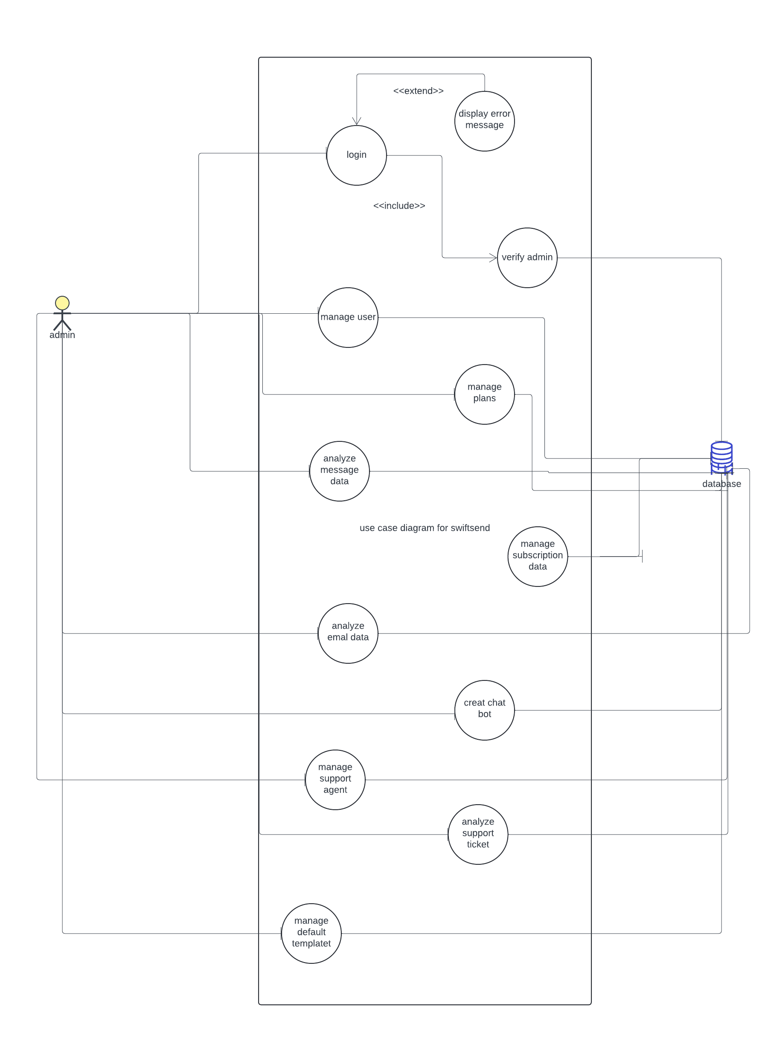
Use Case Diagram
05
ADMIN

Slide 8
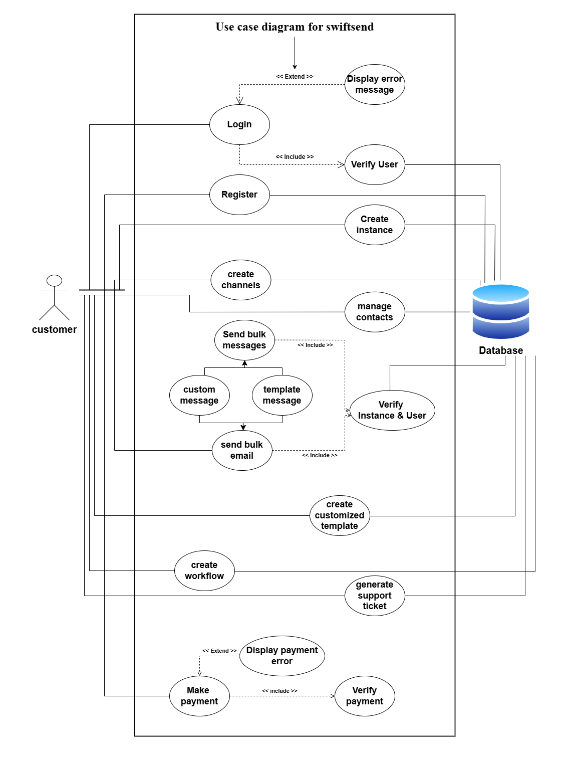
Use Case Diagram
05
USER

Slide 9
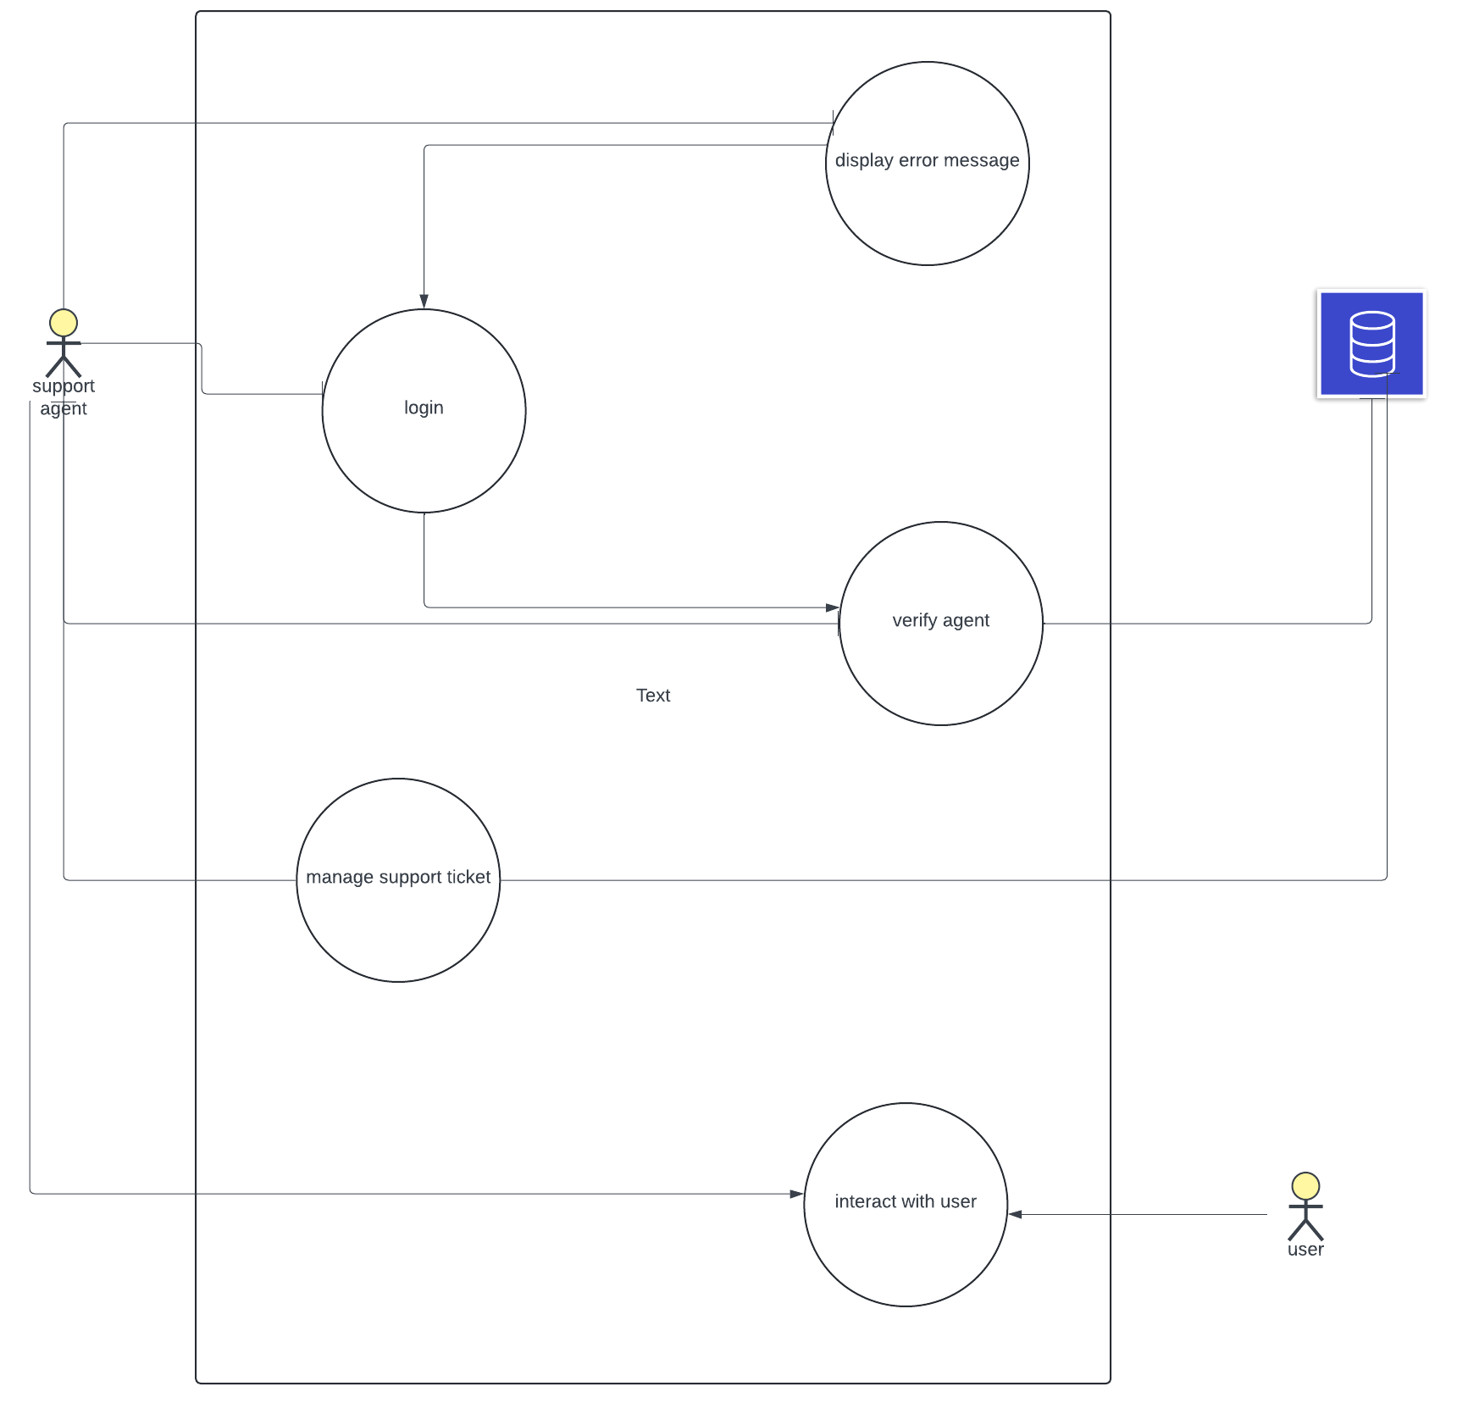
Use Case Diagram
05
SUPPORT AGENT

Slide 10
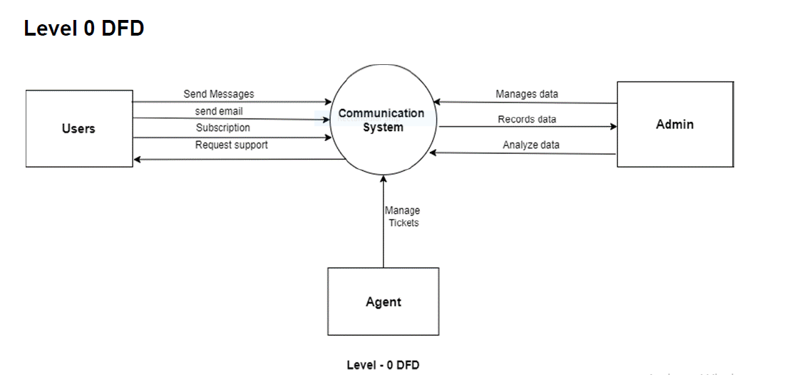
Data Flow Diagram – Level 0
06

Slide 11
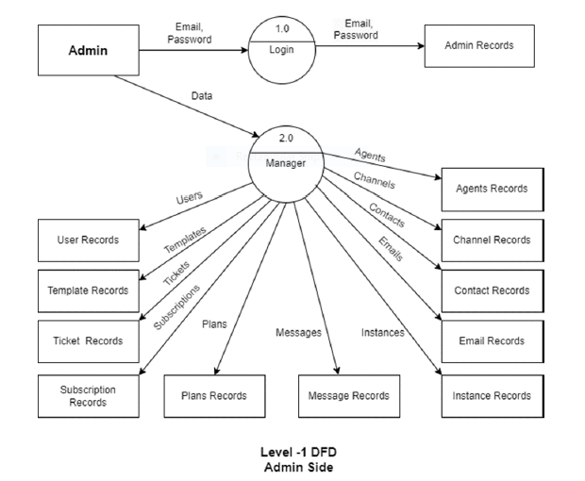
Data Flow Diagram – Level 1
06

Slide 12
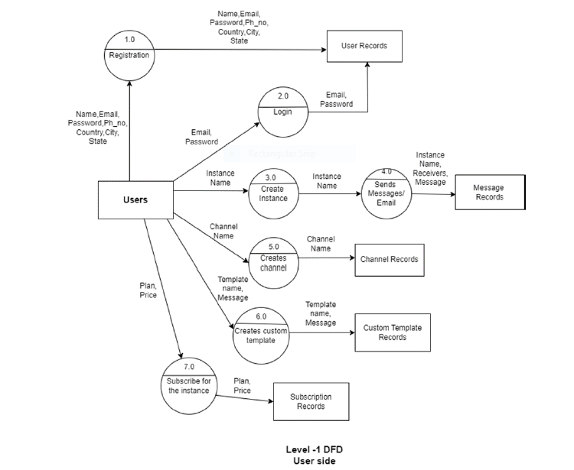
Data Flow Diagram – Level 1
06

Slide 13
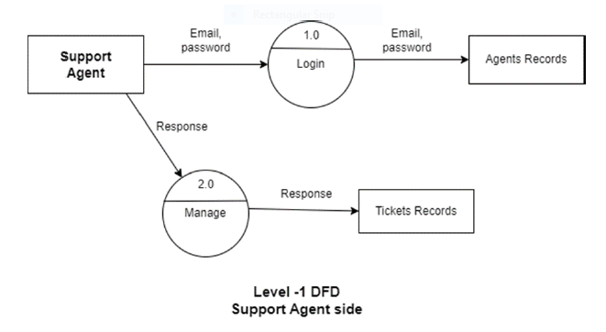
Data Flow Diagram – Level 1
06

Slide 14
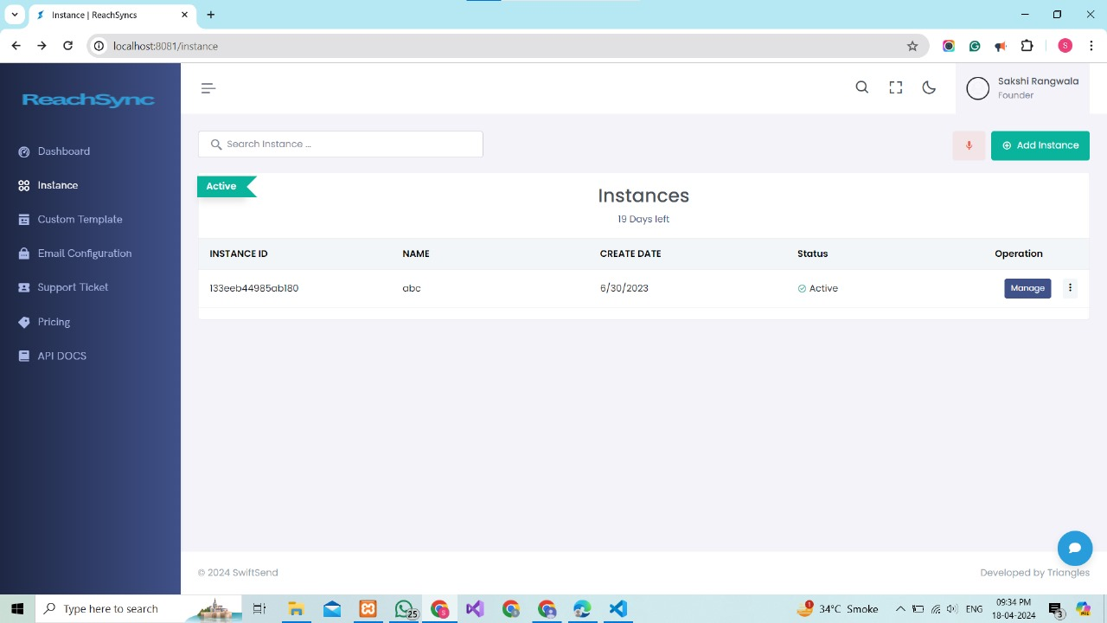
Implementation of software
07
User View and functionalities

Slide 15
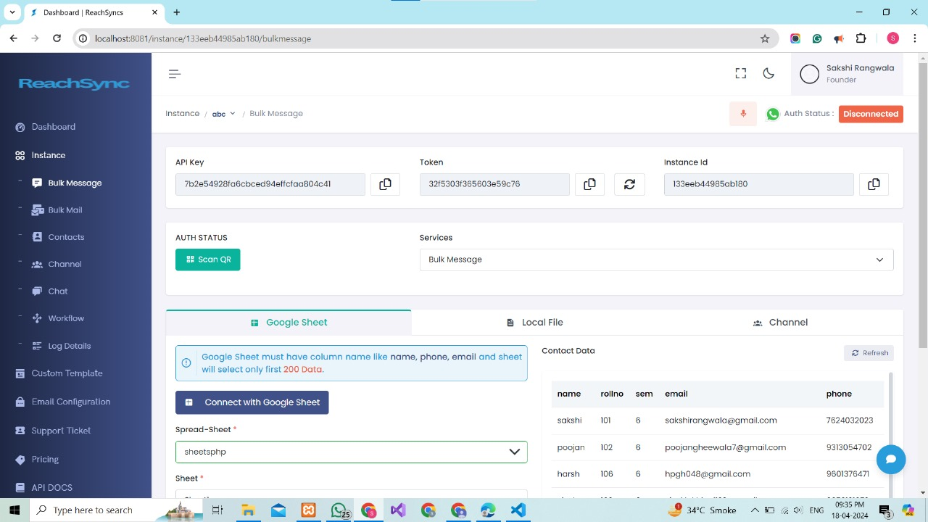

Slide 16
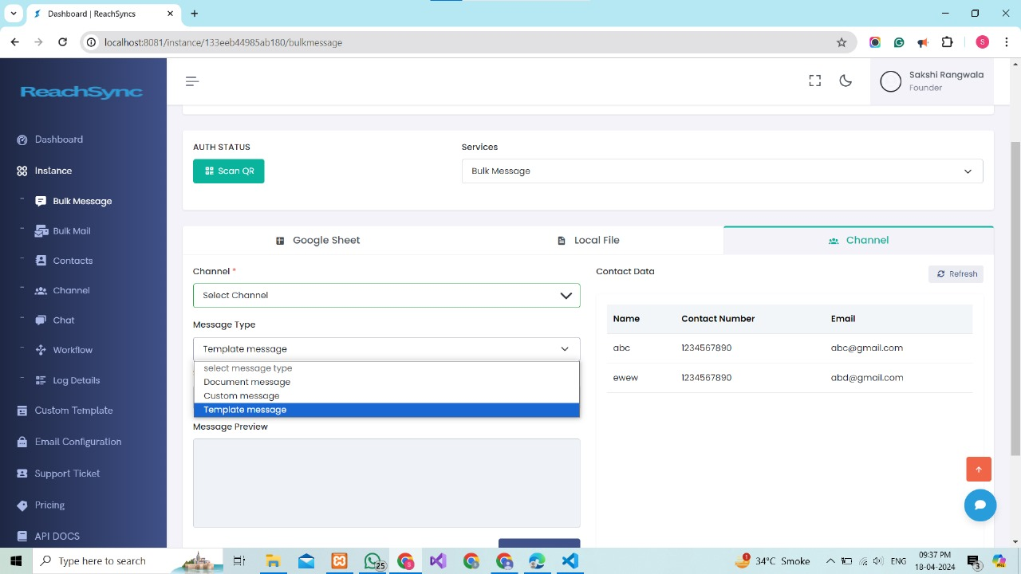

Slide 17
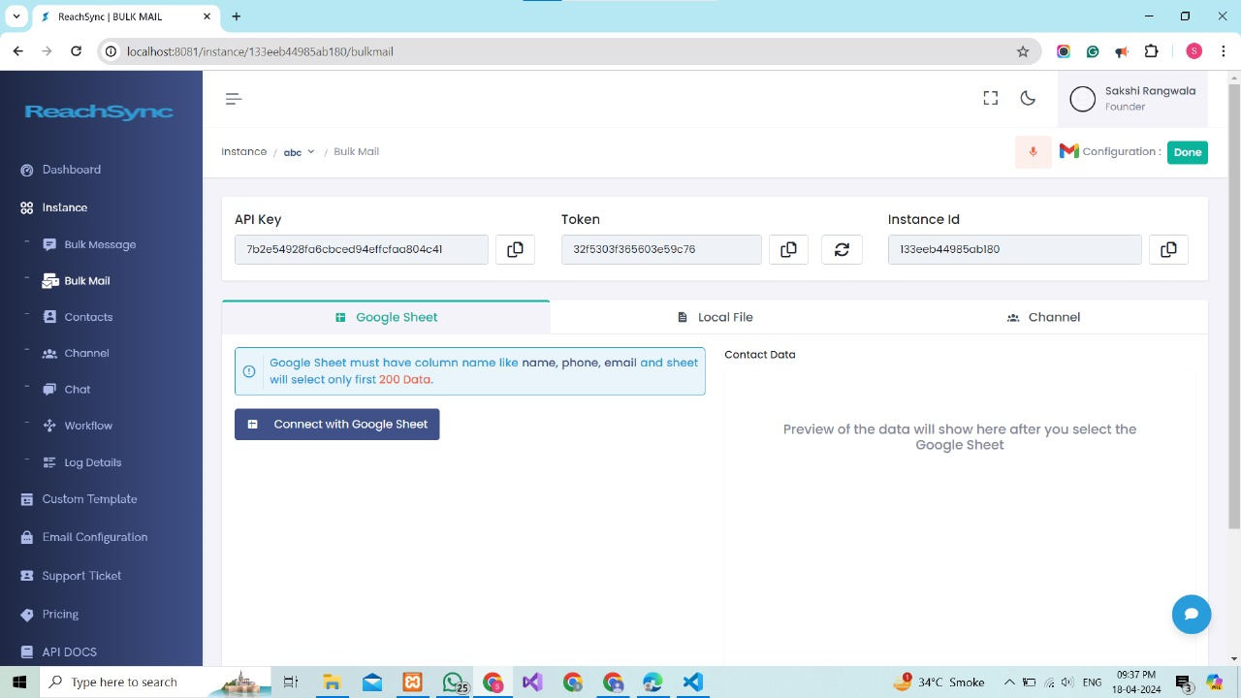

Slide 18
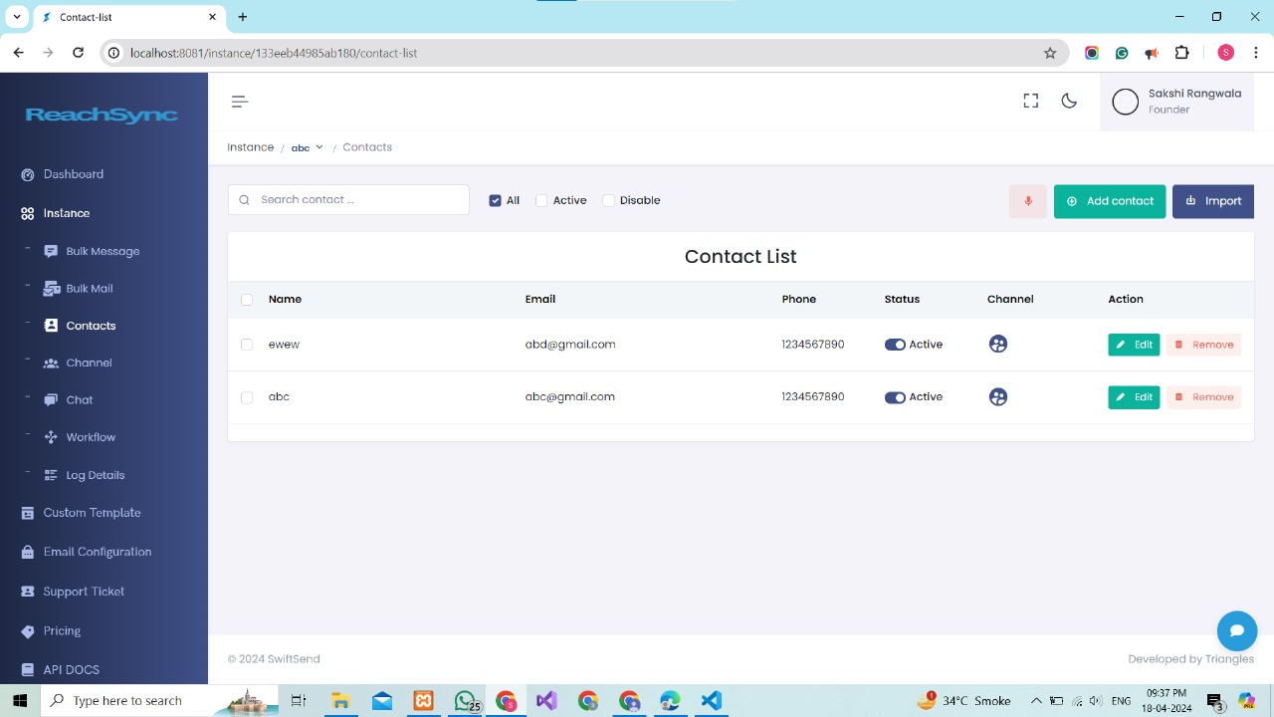

Slide 19
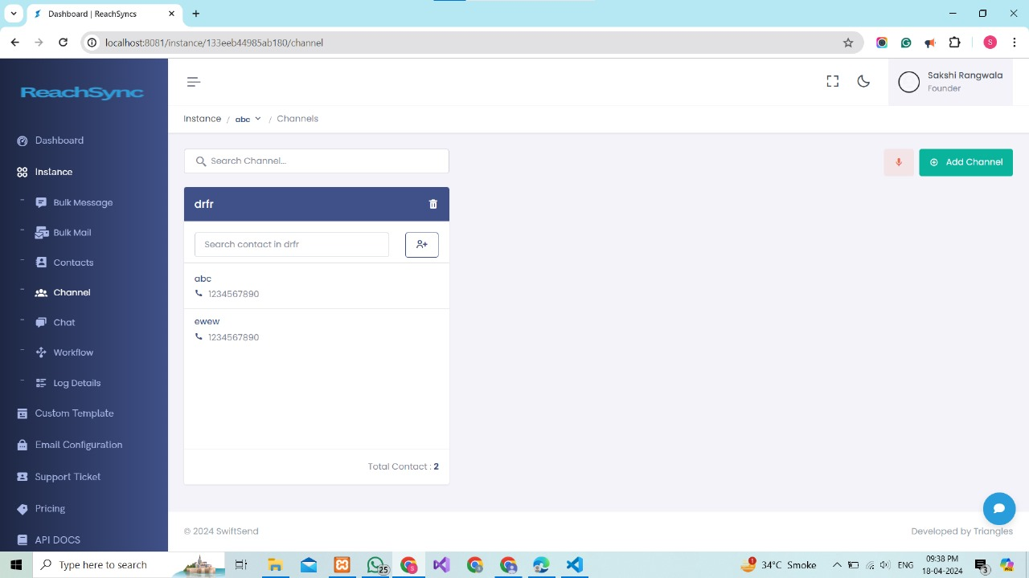

Slide 20
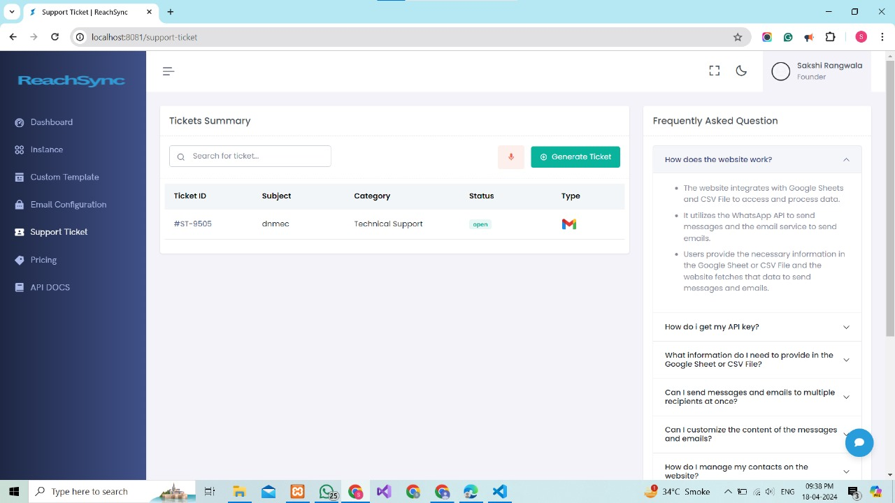

Slide 21
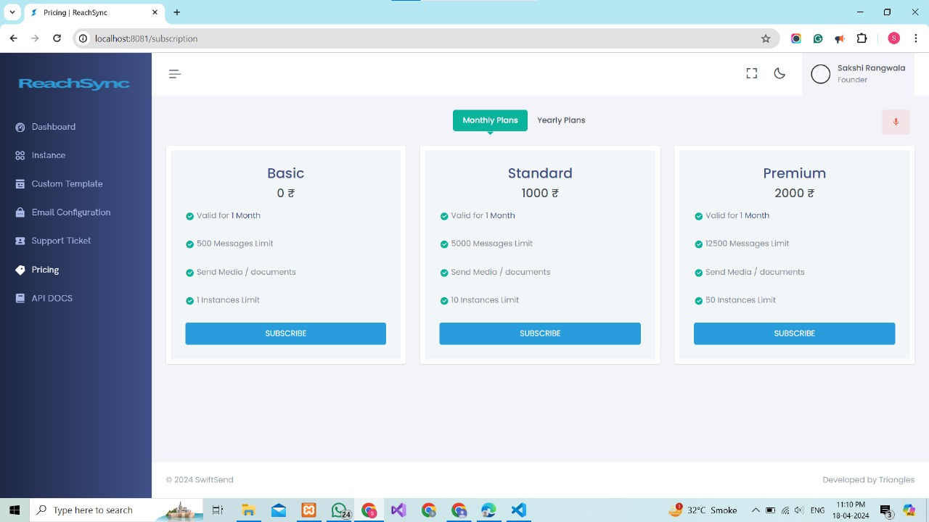

Slide 22
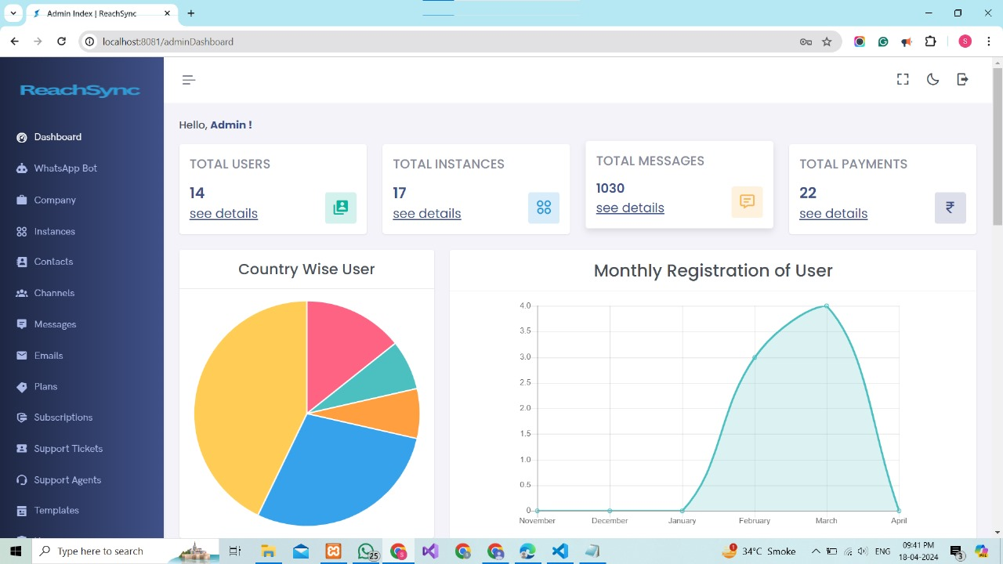
Implementation of software
Admin View and functionalities

Slide 23
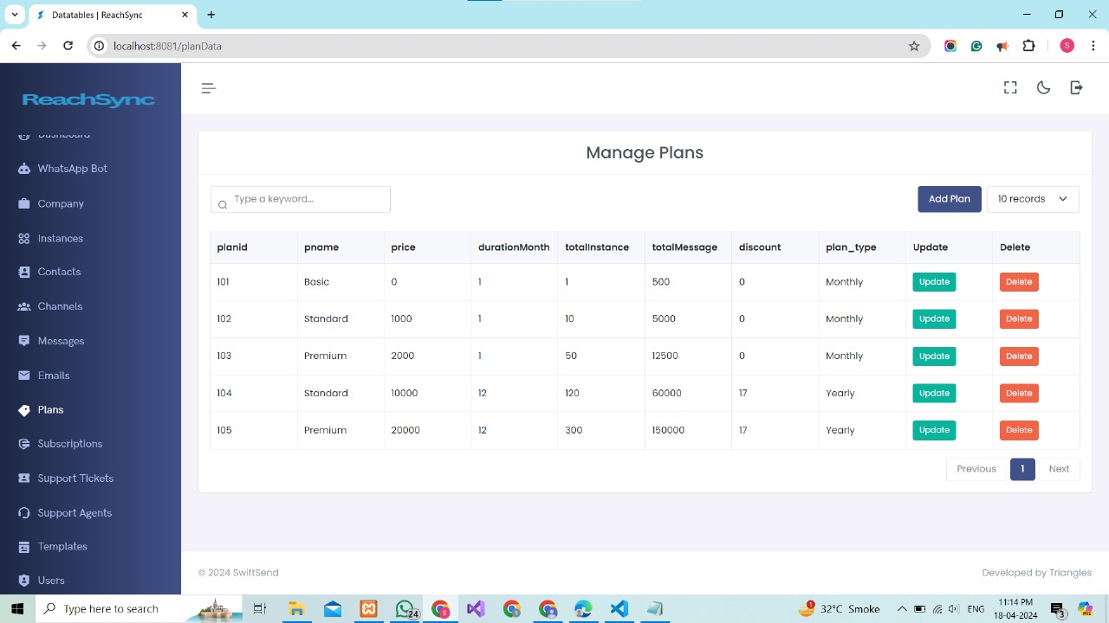

Slide 24
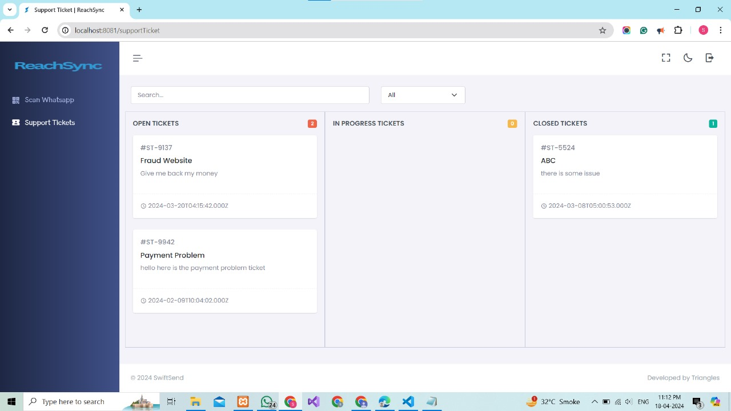
Implementation of software
Support Person View and functionalities

Slide 25
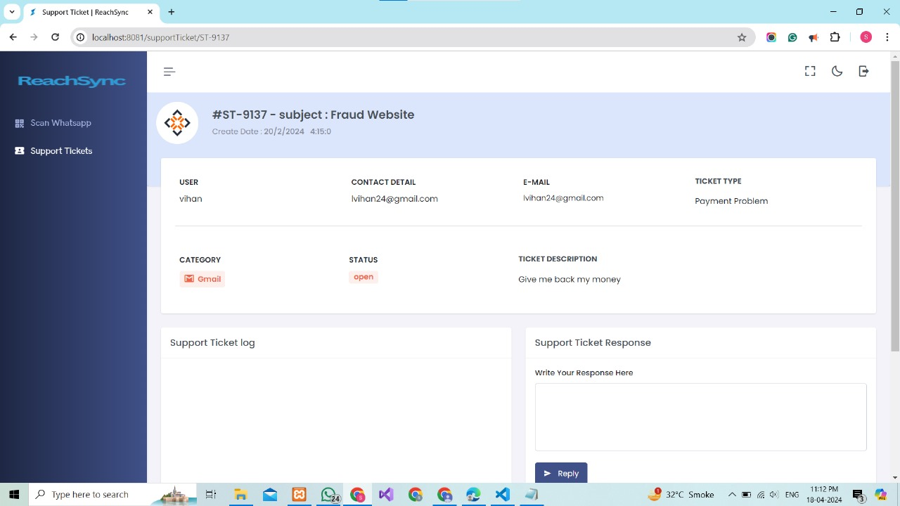

Slide 26
Take Away
08
Technical Skills Gained:
Proficiency in MySQL database management.
Expertise in Node.js for backend development.
Experience in frontend development using HTML, CSS and JavaScript.
Understanding of integrating APIs for WhatsApp and email delivery.
Project Management Experience:
Planning and organizing tasks effectively.
Prioritizing features based on user requirements.
Collaborating with team members for seamless development.
Adapting to changes and resolving challenges promptly.

Slide 27
Achievements
09
Successful implementation of Key Features
Meeting deadlines
Bug fixes and Issue resolutions
Integration achievements

Slide 28
Mistakes
10
In our journey, we faced challenges that taught us valuable lessons. We learned the importance of thorough testing for device compatibility and optimized database queries for better performance. Strengthening security measures and fostering open communication were also pivotal lessons. These experiences have empowered us to continuously enhance Reachsync for our user’s benefit.

