Slide 1



INTEL PRODUCTS
SENTIMENT ANALYSIS
FROM ONLINE REVIEWS
Presented by: Sakshi Rangwala

Slide 2

Overview
Data Scrapping
Data Cleaning
Sentiment Analysis
Why VADER is best suited ?
Polarity and Intensity score
Data Analytics
Outcomes

Slide 3


1 | Product URLs are stored in urls.txt file.
2 | Requests module is used for loading html page.
3 | Iterate over the URLs and load each page. Wait for the page to load and check availability. Extract reviews using BeautifulSoup.
4 | Stop execution if the page is not found.
5 | Print error messages and stop execution on failure.
6 | Save reviews to a CSV file.
Data Scrapping

Slide 4







Data Cleaning
01
02
03
04
05
06
Remove the column adorned with the most ethereal null values.
Remove rows where given column value is null.
Remove duplicate rows to ensure data uniqueness.
Parse the ‘review_date’ column to extract the date and country.
Derive the year from the ‘date’ column for temporal analysis.
Classify product names into categories based on models.

Slide 5
Why VADER is best suited for this project?
VADER (Valence Aware Dictionary and sEntiment Reasoner) is a lexicon and rule-based sentiment analysis tool that is specifically designed to analyze sentiments expressed in social media texts. It uses polarity score and intensity scores to analyze the text.
Designed for Informal Text :
Handles slang, abbreviations, and emoticons in reviews effectively.
Ease of Implementation :
Simple to deploy using the nltk library, ideal for quick projects.
Speed and Efficiency :
Fast and computationally efficient, suitable for large volumes of reviews.
No Need for Training Data :
Uses a predefined lexicon, saving time on data preparation and training.
Comprehensive Scoring :
Positive, Negative and Neutral
Sensitivity to Context :
Understands negations and sentiment intensity for nuanced analysis.

Slide 6
Polarity Score
The polarity score indicates the sentiment orientation of a word or phrase, whether it is positive, negative, or neutral. In VADER, each word in the lexicon is assigned a polarity score that represents its sentiment polarity. The polarity score ranges from -1 to +1, where:
Negative polarity scores (close to -1) indicate a negative sentiment. Words associated with anger, sadness, or dissatisfaction typically have negative polarity scores.
Positive polarity scores (close to +1) indicate a positive sentiment. Words associated with happiness, satisfaction, or excitement typically have positive polarity scores.
Neutral polarity scores (close to 0) indicate a neutral sentiment. Words that do not convey a strong positive or negative sentiment have neutral polarity scores.
Intensity Score
The intensity score indicates the strength or magnitude of the sentiment expressed by a word or phrase. In VADER, each word in the lexicon is also assigned an intensity score that reflects the intensity of the sentiment it conveys. The intensity score provides additional information about the degree to which a word or phrase influences the overall sentiment of the text. Intensity scores are typically non-negative values, with higher scores indicating stronger sentiment intensity.

Slide 7
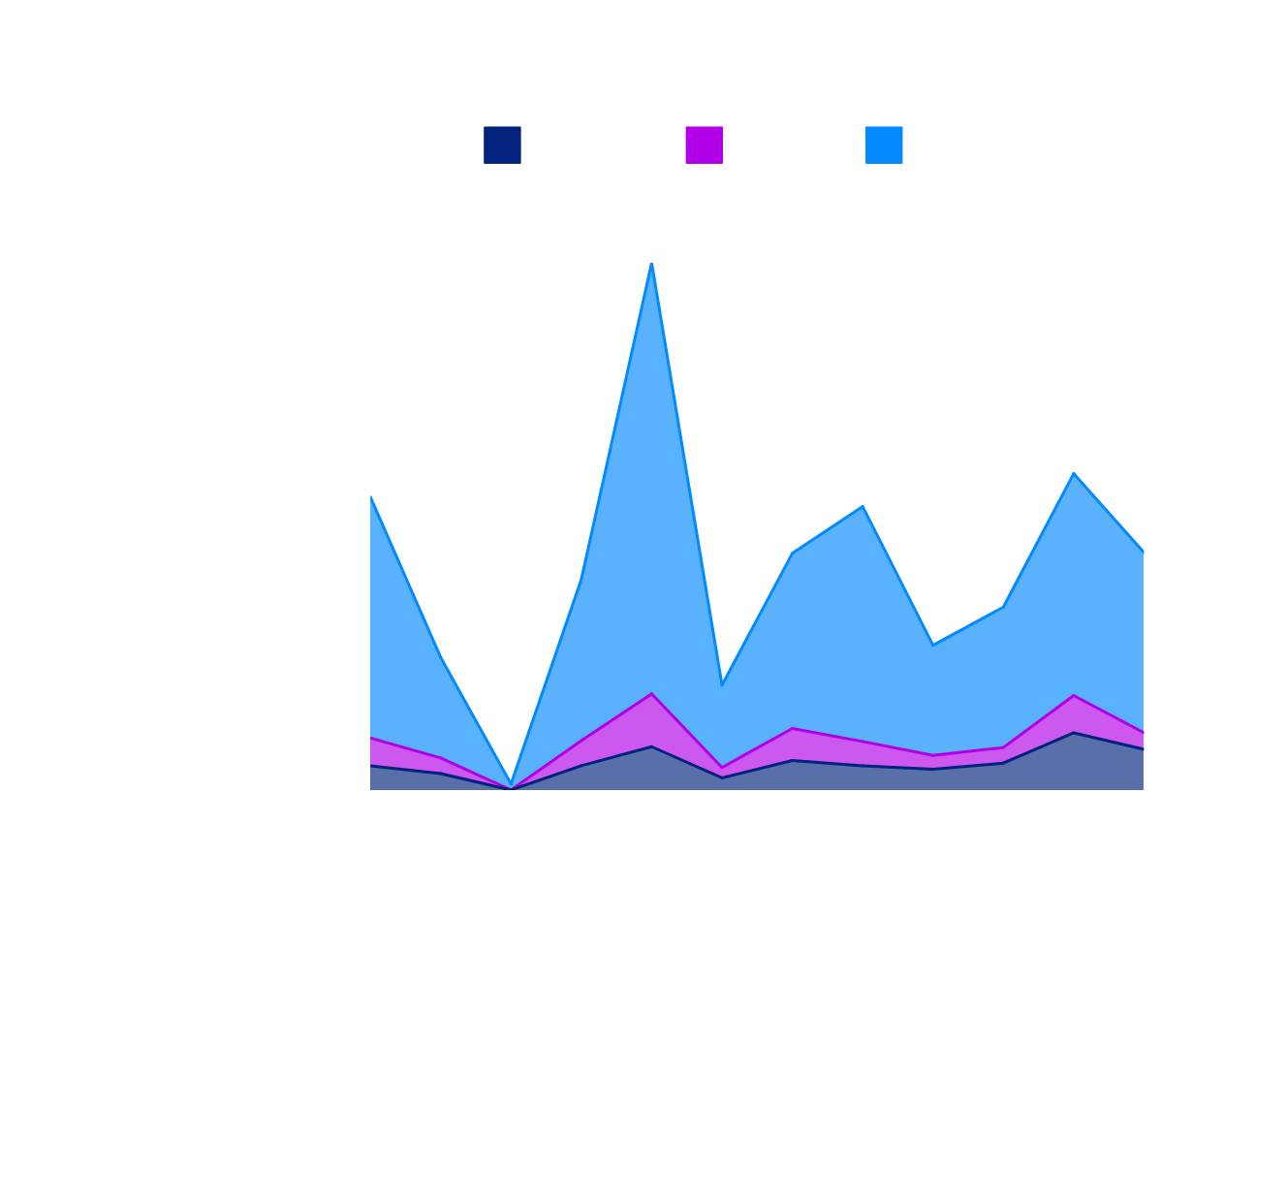
Data analytics
Category wise sentiment analysis
77.91%
Customer Satisfaction
11.95%
Negative Reviews

Slide 8
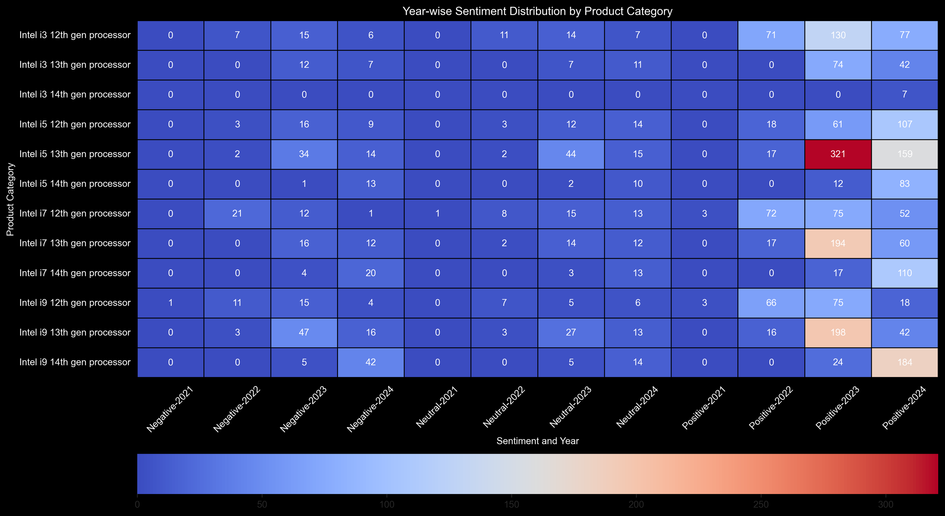

Slide 9
Outcomes
Improvements Needed
Strengths
Keyfeature | Counts
CPU | 693
Processor | 530
Performance | 171
Gaming | 62
Price | 59
Keyfeature | Counts
CPU | 119
Processor | 71
Performance | 27

Slide 10


THANK YOU
For watching this presentation
202312006@daiict.ac.in
https://github.com/Srangwala02/sentimentAnalysis.git

