Slide 1
FUNCTION GENERATOR

Slide 2
Table of contents
01
02
03
04
ABSTRACT
CIRCUITS
COMPONENTS
APPROXIMATED COST

Slide 3
ABSTRACT
Function Generator with Adjustable Waveforms and Noise Generation Circuit-
This project introduces a multifunctional signal generator designed to produce sine, square, triangle, pulse and sawtooth waves.The device enables users to manipulate both amplitude and frequency within predefined ranges, offering a flexible and comprehensive tool for various applications.
The primary focus of this function generator is to provide a wide range of waveforms essential for signal processing, testing, and educational purposes. The inclusion of sine, square, triangle, and sawtooth waves caters to the diverse needs of users across different disciplines. The waveform generator is capable of delivering precise and stable signals, ensuring accuracy in experimental setups and circuit testing.

Slide 4
A key feature of this device is the integrated noise generator circuit, allowing users to introduce controlled levels of noise to their signals. This feature proves invaluable in scenarios where real-world conditions involve background noise or in applications where noise modulation is desired. The amplitude and frequency parameters of the noise signal can be easily adjusted within specified ranges, enhancing the versatility of the overall system.
The tuning range of the function generator is :
Amplitude range: 0 to 23V(peak to peak)
Frequency range: (0 to 50KHZ)

Slide 5
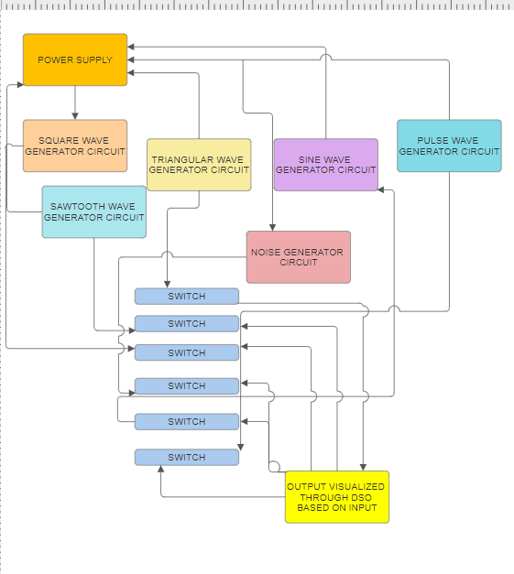
BLOCK DIAGRAM

Slide 6
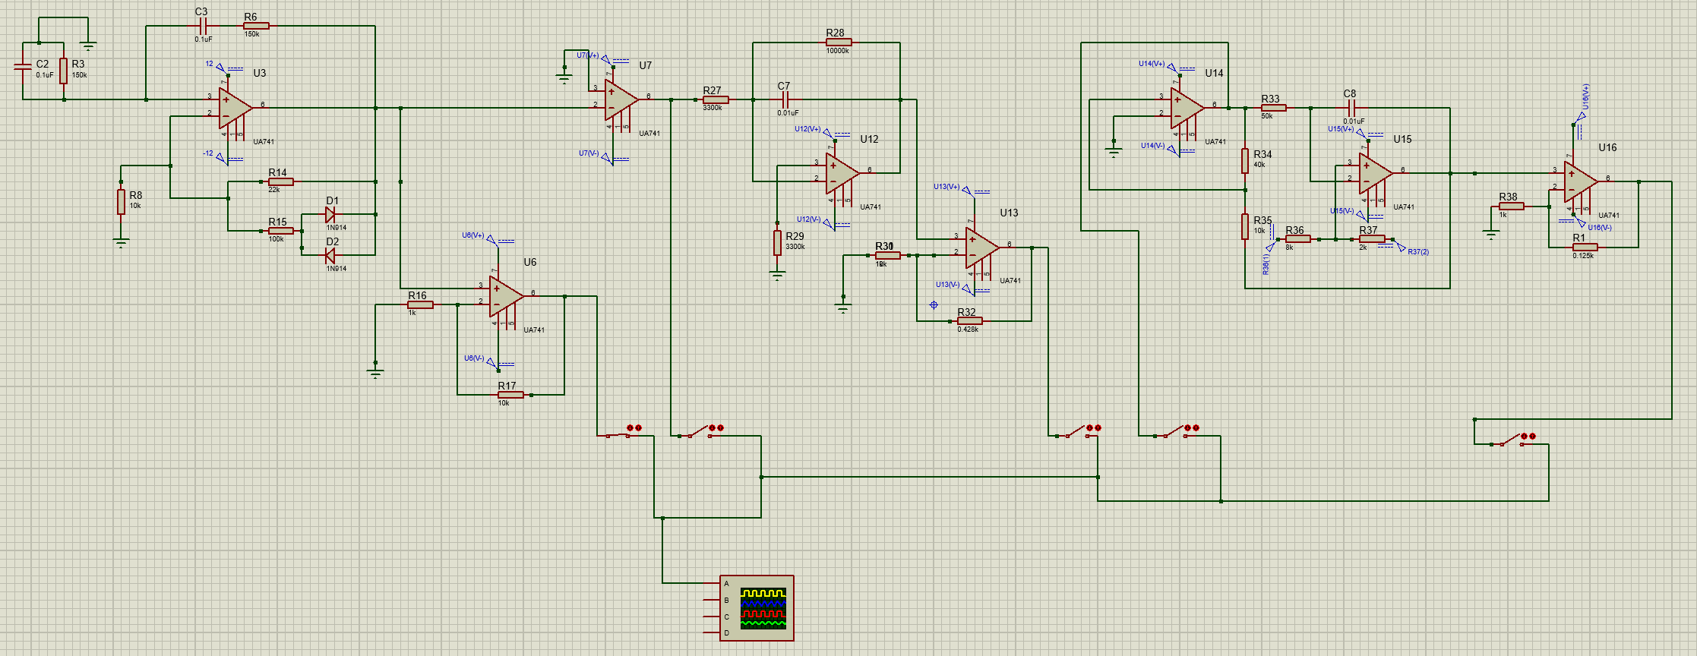
FINAL SIGNAL GENERATOR CIRCUIT

Slide 7
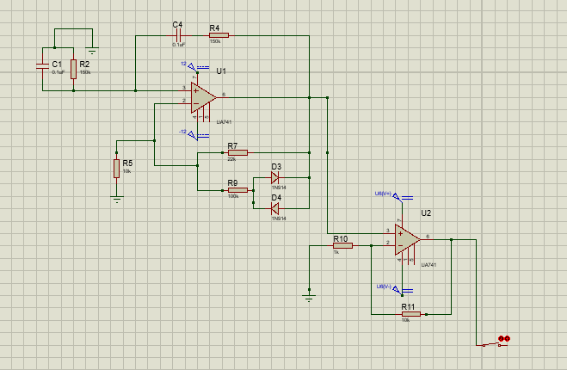
SINE WAVE GENERATOR CIRCUIT

Slide 8
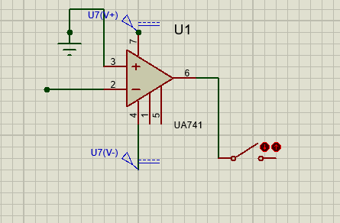
SQUARE WAVE GENERATOR CIRCUIT

Slide 9
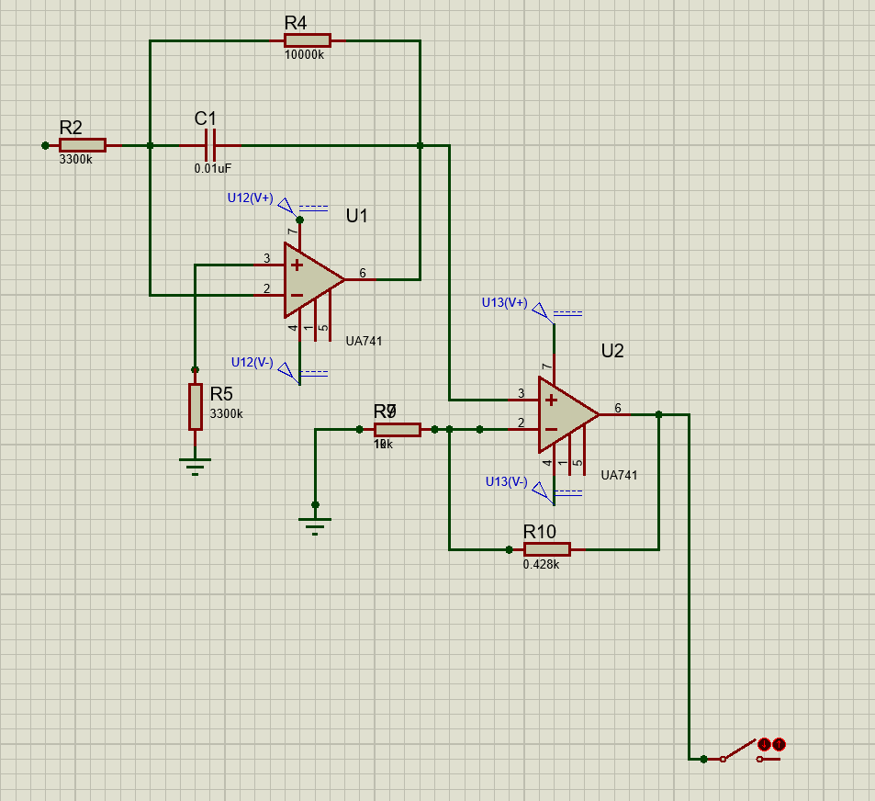
TRIANGULAR WAVE GENERATOR CIRCUIT

Slide 10
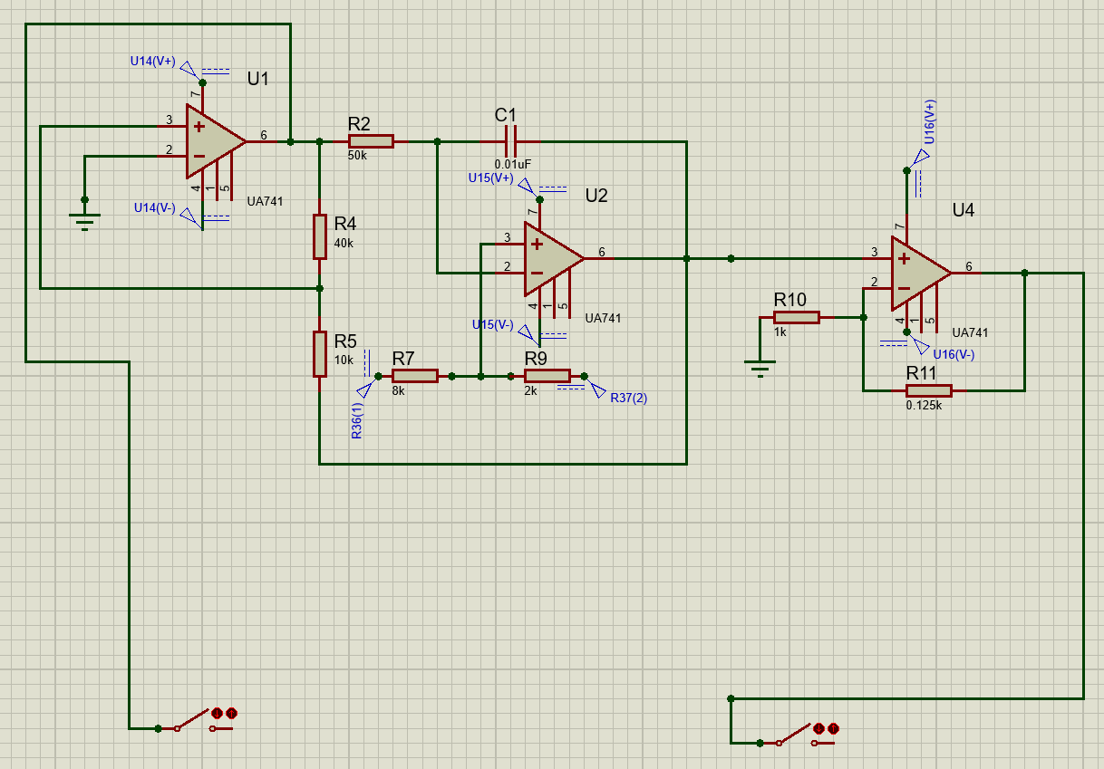
RECTANGLE AND SAWTOOTH WAVE GENERATOR CIRCUIT

Slide 11
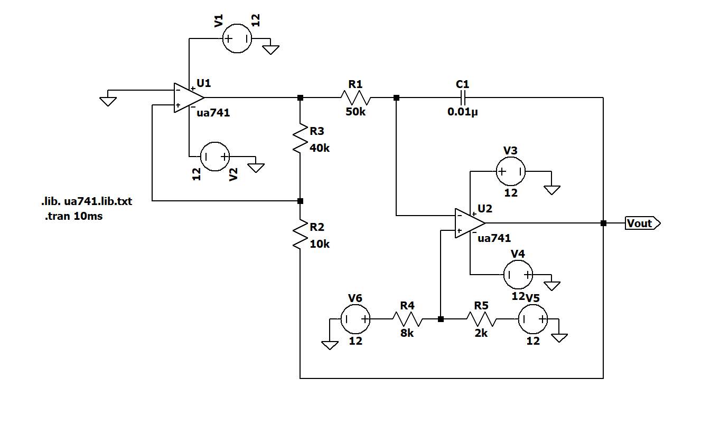
SAWTOOTH GENERATOR CIRCUIT

Slide 12
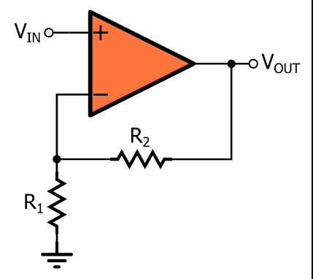
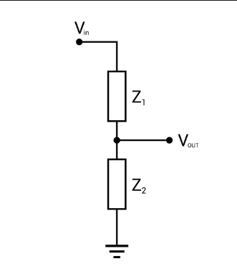
GAIN STAGE AND AMPLITUDE CONTROL

Slide 13
References
Microelectronic circuits / Adel S. Sedra, University of Waterloo, Kenneth C. Smith, University of Toronto. — Seventh edition.
H. Bhavanishankar and J. Manikandan, "Design and development of low-cost portable function generator," 2021 IEEE Mysore Sub Section International Conference (MysuruCon), Hassan, India, 2021, pp. 692-696, doi: 10.1109/MysuruCon52639.2021.9641085. keywords: {Industries;Electronic equipment;Microcontrollers;IEEE Sections;Touch sensitive screens;Maintenance engineering;Signal generators;Function generator;Test equipment;Embedded system design},

