Slide 1
Smart Analyzer !!
An AI enabled Search
Agenda
Use Case
Workflow/Architecture
User Journey
Technologies used
.NET 6 MVC
.NET Core 6.0
Azure Cognitive Services(Language)
Azure Blob Storage

Slide 2
Smart Analyzer- Team
Sravan Kumar
Bhaskar Kondakindi
Nagaraju Malyala
Vijay Singh

Slide 3
Use Case

Slide 4
Resume Search Use Case
Resume Persona: In this mode
Prerequisites :
When the Job Seeker uploads the Resume in Workday it will be stored in Azure Blob Storage.
HR Workday Portal :
HR/Recruitment specialists can use the application by giving the requirements to search in context which will filter with the matching criteria where output will be the best match resumes there after they can see the screen and filter or shortlist .

Slide 5
Jds search Use Case
Jd Persona - In this mode,
Candidates can use the application by giving the requirements(ex :skillset,roles) to search in context which will filter the available jds and can be used to apply the job positions.

Slide 6
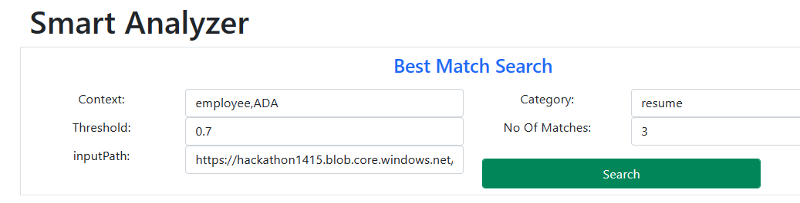
Smart Analyzer Flow
Documents exists?
Get the documents from blob storage
Pass the text and search based on criteria for best match by using trained models
Read the document and convert to Text
Store the results data
Score
> Threshold
?
Display in UX

Slide 7
Smart Analyzer Architechture
UX - Search by User Input
Blob storage Service
Document Converter Service
Predicative Api for Trained Models
Score Service
COSMOS DB/Redis Cache
UX – Results search screen

Slide 8
User Journey

Slide 9
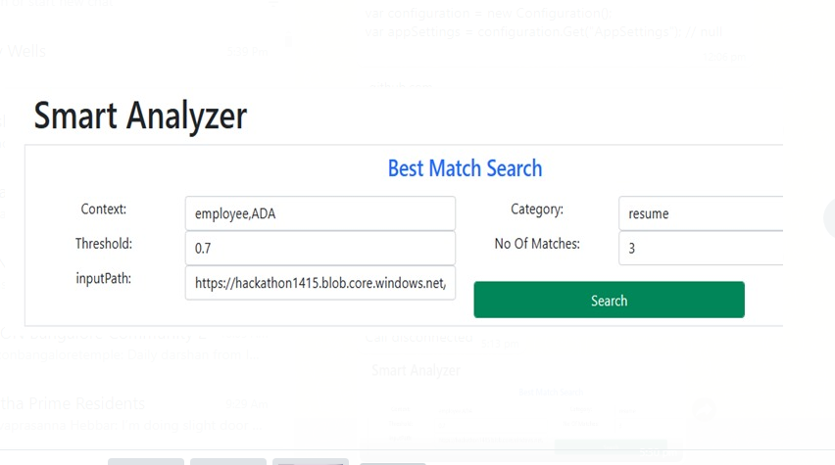

Slide 10
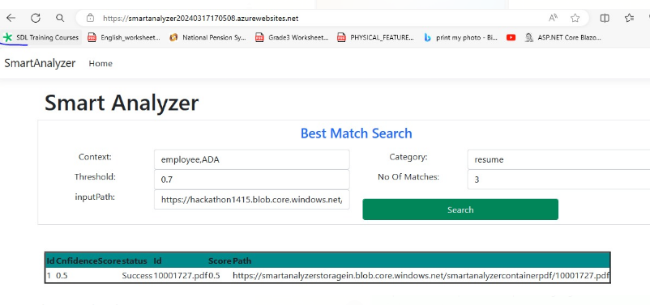

Slide 11
Azure Cognitive Services

Slide 12
Azure Cognitive Services

Slide 13
NLP(prebuilt) Model used
Entity extraction prebuilt model
The prebuilt entity extraction model recognizes specific data from text that's of interest to your business. The model identifies key elements from text, and then classifies them into predefined categories. This can help to transform unstructured data into structured data that's machine-readable. You can then apply processing to retrieve information, extract facts, and answer questions.

Slide 14
Azure Resources used
Method | Request URI | Description
App service | smartanalyzer20240317170508.azurewebsites.net
Language Service | https://smartanalyzer.cognitiveservices.azure.com/

