Slide 1
Serialisation Isolation Level In Sql

Slide 2
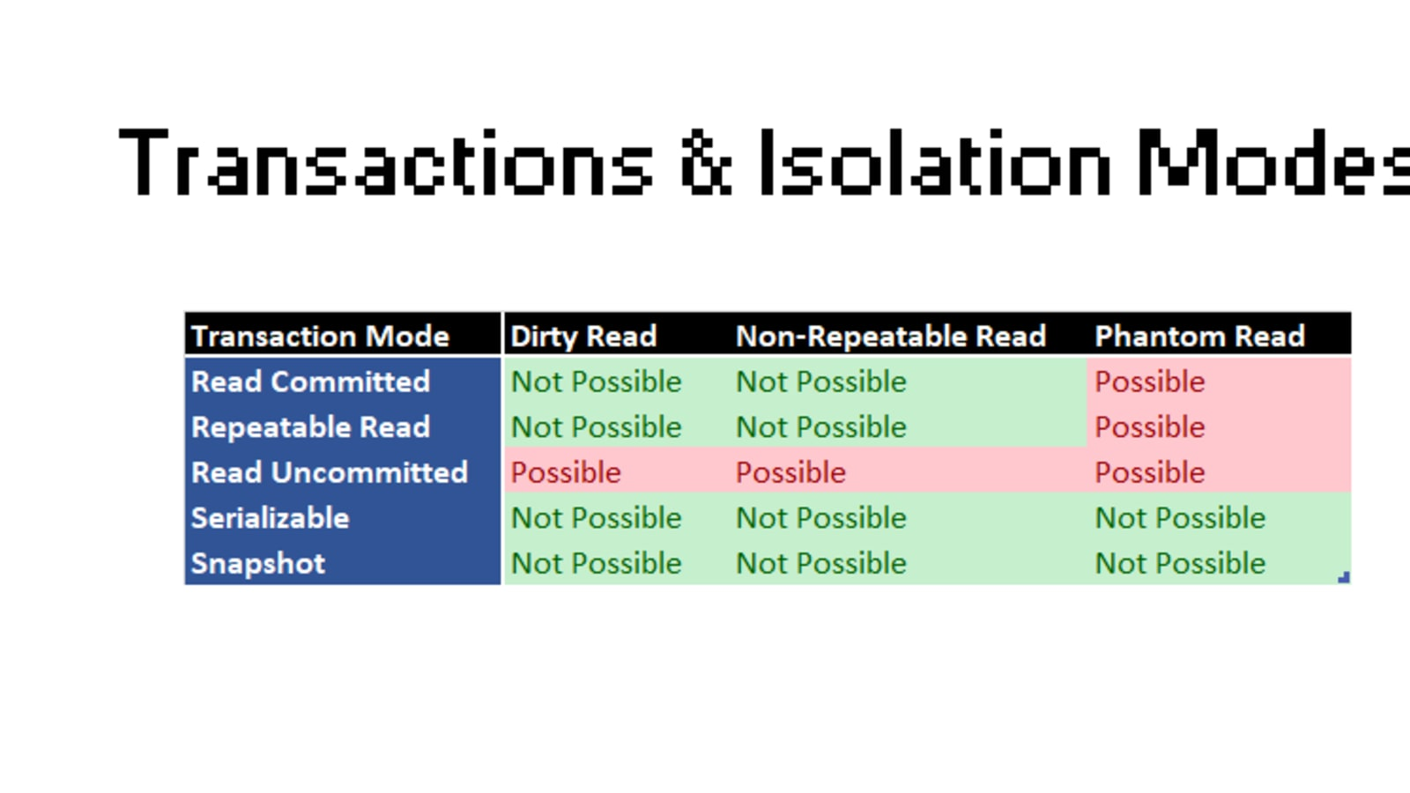
Introduction to Serialisation Isolation Level
Serialisation isolation level is the strictest isolation level in SQL.
It ensures that transactions are executed in a way that prevents any conflicts or concurrency issues.
Transactions are executed one after the other, in a serial manner, to maintain consistency and integrity of the data.
1
Notes:
Image source: https://aniyadesnhholloway.blogspot.com/2022/04/explain-different-isolation-levels-sql.html

Slide 3
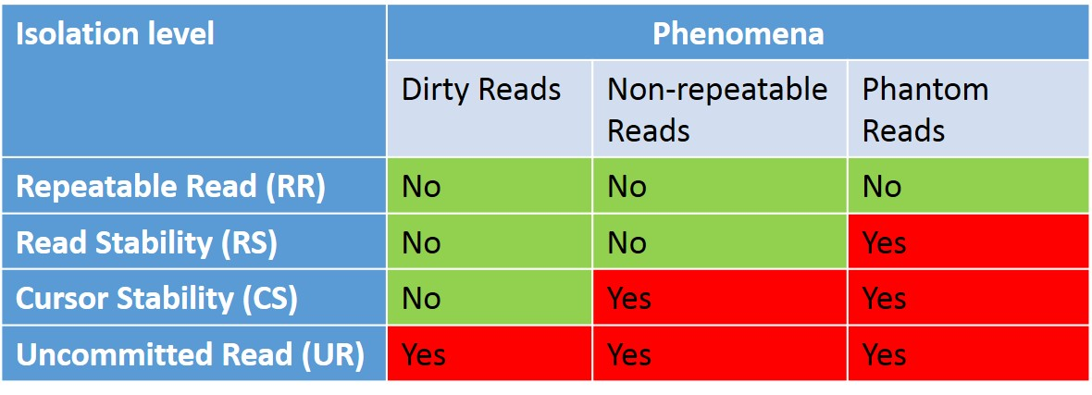
Purpose of Serialisation Isolation Level
The main purpose of serialisation isolation level is to prevent phenomena like dirty reads, non-repeatable reads, and phantom reads.
It ensures that transactions are executed in a serial manner, without any overlap or interference.
This level of isolation guarantees that transactions are executed as if they were the only transaction running on the system.
2
Notes:
Image source: https://datageek.blog/en/2016/06/28/db2-basics-isolation-levels-and-concurrency-phenomena/

Slide 4
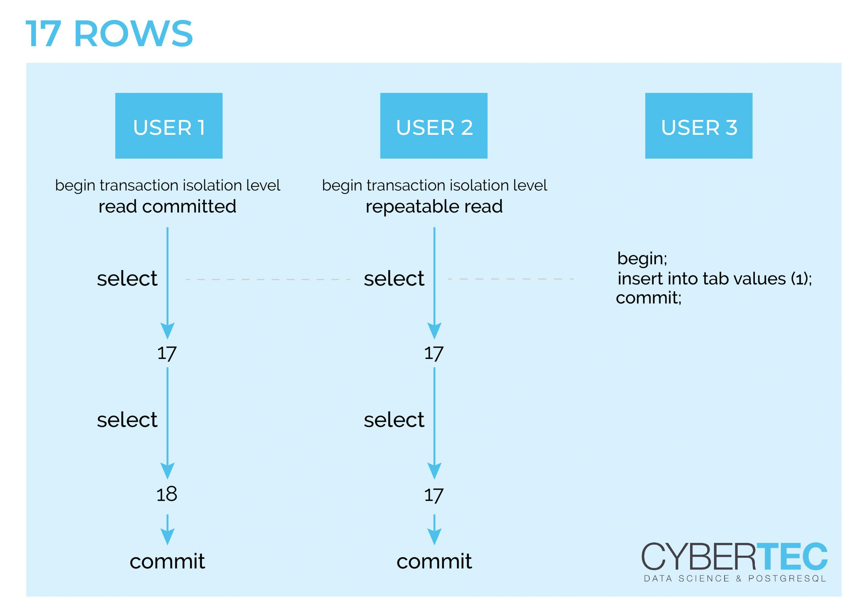
How Serialisation Isolation Level Works
When a transaction is executed with serialisation isolation level, it acquires exclusive locks on the data it accesses.
These locks prevent other transactions from accessing or modifying the same data until the transaction completes.
This ensures that only one transaction can access a particular data item at a time, preventing any conflicts or inconsistencies.
3
Notes:
Image source: https://www.cybertec-postgresql.com/en/transactions-in-postgresql-read-committed-vs-repeatable-read/

Slide 5
Benefits of Serialisation Isolation Level
Provides the highest level of data consistency and integrity.
Prevents issues like lost updates and data anomalies.
Ensures that transactions are executed in a predictable and deterministic manner.
4
Notes:
Image source: https://www.researchgate.net/figure/Serializable-isolation-level_fig14_343891226

Slide 6
Drawbacks of Serialisation Isolation Level
Can lead to performance degradation in systems with high concurrency.
May result in increased waiting times for transactions due to exclusive locks.
Requires careful monitoring and tuning to balance consistency and performance.
5
Notes:
Image source: https://www.researchgate.net/figure/Serializable-isolation-level_fig14_343891226

Slide 7
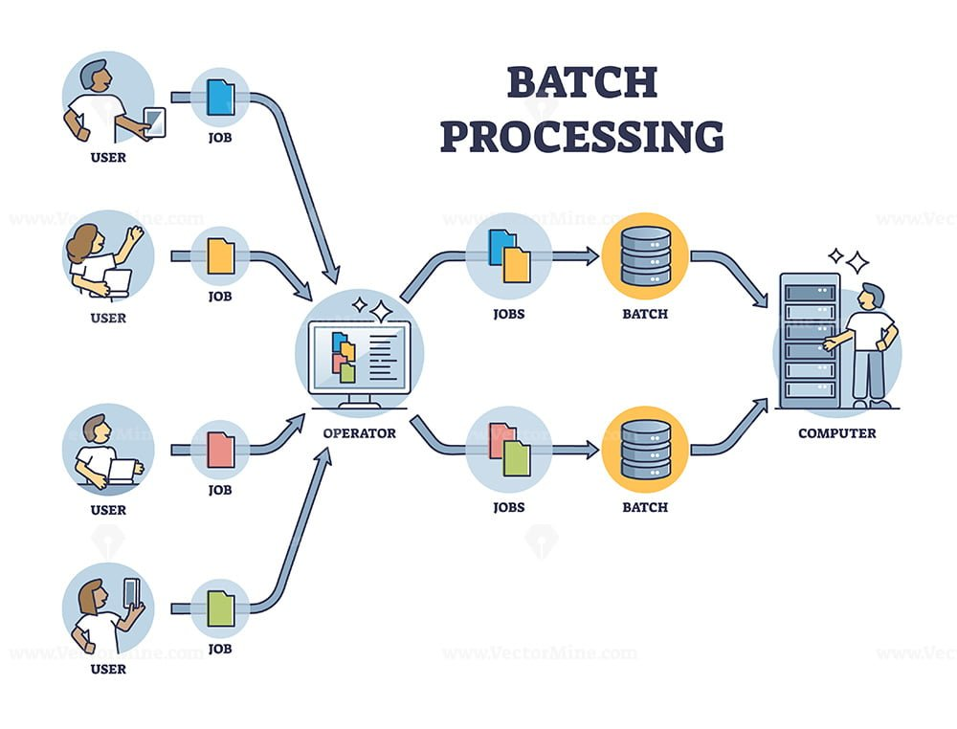
Use Cases for Serialisation Isolation Level
Critical financial transactions where data integrity is paramount.
Batch processing systems where data consistency is crucial.
Applications with complex business logic that require strict control over data access.
6
Notes:
Image source: https://vectormine.com/item/batch-processing-method-and-data-transactions-in-a-group-outline-diagram/

Slide 8
Implementing Serialisation Isolation Level in SQL
In SQL, serialisation isolation level can be set using the appropriate transaction isolation level settings.
For example, in PostgreSQL, you can set the isolation level to SERIALIZABLE.
It is important to understand the implications and performance considerations before setting serialisation isolation level.
7
Notes:
Image source: https://www.slidemake.com

Slide 9
Best Practices for Using Serialisation Isolation Level
Understand the requirements of your application and the level of data consistency needed.
Test the performance impact of serialisation isolation level in your specific environment.
Consider alternative isolation levels like Repeatable Read or Serializable Snapshot Isolation if strict serialisation is not necessary.
8
Notes:
Image source: https://www.slidemake.com

Slide 10
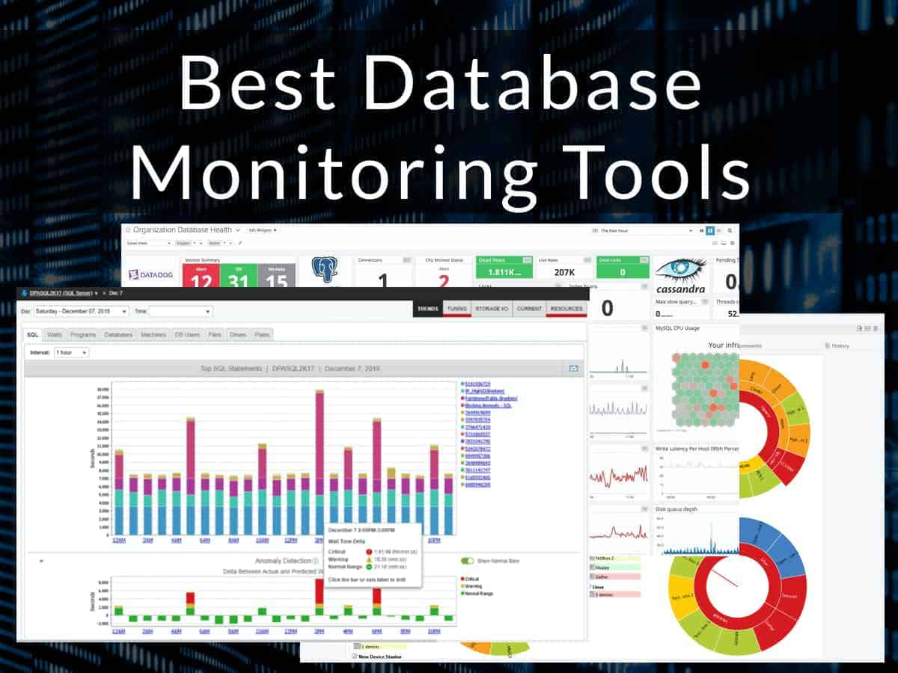
Monitoring and Troubleshooting Serialisation Isolation Level
Use database monitoring tools to track the performance of transactions using serialisation isolation level.
Monitor for any deadlocks or long wait times that may indicate issues with serialisation.
Troubleshoot any performance issues by tuning the database configuration or adjusting transaction logic.
9
Notes:
Image source: https://www.netadmintools.com/best-database-monitoring-tools/

Slide 11
Conclusion
Serialisation isolation level in SQL provides the highest level of data consistency and integrity.
It ensures that transactions are executed in a serial manner to prevent conflicts and concurrency issues.
By understanding the benefits, drawbacks, and best practices of serialisation isolation level, you can effectively use it to maintain data integrity in your SQL environment.
10
Notes:
Image source: https://aniyadesnhholloway.blogspot.com/2022/04/explain-different-isolation-levels-sql.html

