Slide 1



News Article summarization using Fine tuning and LoRA

Slide 2

Dataset and Model Selection
The Model is picked from Hugging Face Text Summarization model which is developed by facebook
The model was pretrained on large datasets to gain the Summarizational capabilities
The Dataset used is CNN Daily Mail dataset which is extracted from Hugging Face

Slide 3
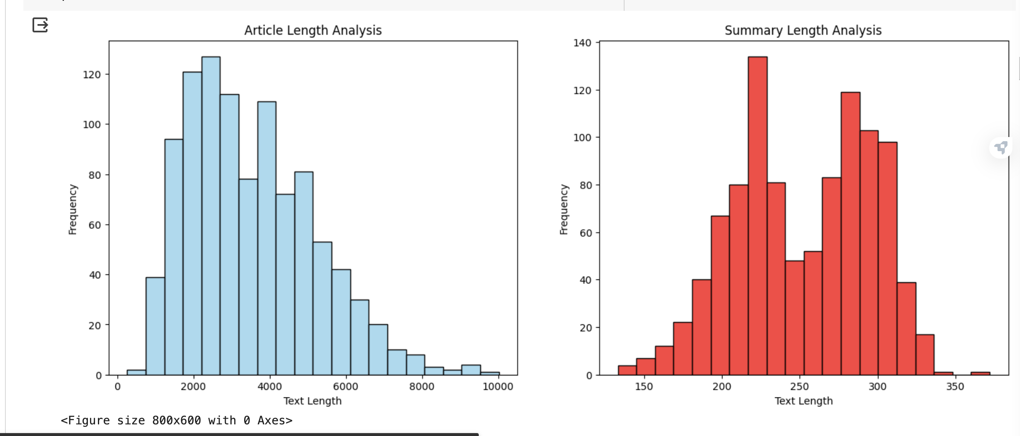
Dataset Overview

Slide 4
The Dataset Consists of 3 columns, which are articles, hightlights and id
Articles column is the actual NEWS article and highlights are their summaries. Id column is a unique id
This is a huge dataset with article length varying between 1000 to 10000 words and summaries length ranging around between 30 to 450 words

Slide 5




Strategies Used
Fine Tuning is used to train the Model which is pre trained on a huge and generic dataset. The model is fine tuned to perform dataset.
LoRA(Low Rank Adaption method) is a Parameter Efficient Fine Tuning model which uses few parameters to train the model by injecting Rank Decompostion Matrix.
Rouge score is used for Evaluating Summarization tasks which is based on Recall score.
Human Inspection over the Generated Results is necessary

Slide 6
















Fine Tuning Methodology
PreProcess the Data
Tokenization of Data
Set up the Training Arguments
Train the Trainer class by passing the Training Arguments (Fine Tuning)
Test the Model using Test Data
Evaluate the Model

Slide 7











PEFT Methodology(LoRA)
1
2
3
4
5
6
Use the same pre-processed data
Define LoRA
configurations
Pass the LoRA configurations along with Training Arguments
Train the LoRA model using Training data
Test the LoRA model using Test Data
Ev luate the
LoRA model

Slide 8

Setting up Model and Training Arguments
The same model 'facebook/bart-large-cnn' is used to generate the tokens
The dataset is divided into batches and passed to the model even while Testing
DataCollatorForSeq2Seq is used for Batch Collation and batch Processing
During Fine Tuning , Along with input encodings, The encodings of the summaries is also sent to ensure Supervised Learning
Along with Training data, validation data is also sent during Training
The Maximum length of the summary generation is set to 350 to accommodate all summaries
During LoRA implementation, The Rank Decomposition factor is set to 16

Slide 9

Evaluation Metric – Rouge Score
Rogue Score Along with Human Evaluation is used to evaluate the performance of the model
The Rogue score of a pretrained model is around 30.78% and a Fine Tuned Model is 34.45%and LoRA model is 30.9%
Though the Rouge Scores are low we compared the performance of the models by incorporating Human Evaluation

Slide 10

Evaluation Metric – Human Evaluation
We Randomly Picked the Summaries Generated by Fine Tuned Model and PEFT Model (LoRA)
We compared the summaries with the existing summaries
We found that the model is not going out of scope and is generating almost correct summaries.
Though it uses different words to summarize and are of different lengths, it preserves the meaning of the article
All the models are picking up the articles and trying to preserve the analogy of the article

Slide 11
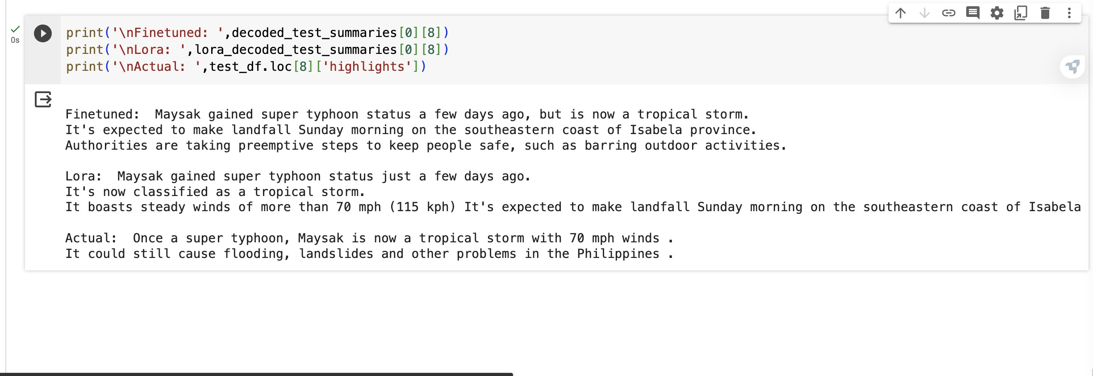

Slide 12

Conclusion
We can observe that Fine Tuned model generates better results when compared to PEFT . But PEFT(LoRA) method reduces training time and trainable parameters
It is hard to evaluate the performance of the model if we only depend on the rouge score, we have to incorporate the Human Evaluation

Slide 13

Thank You

