Slide 1
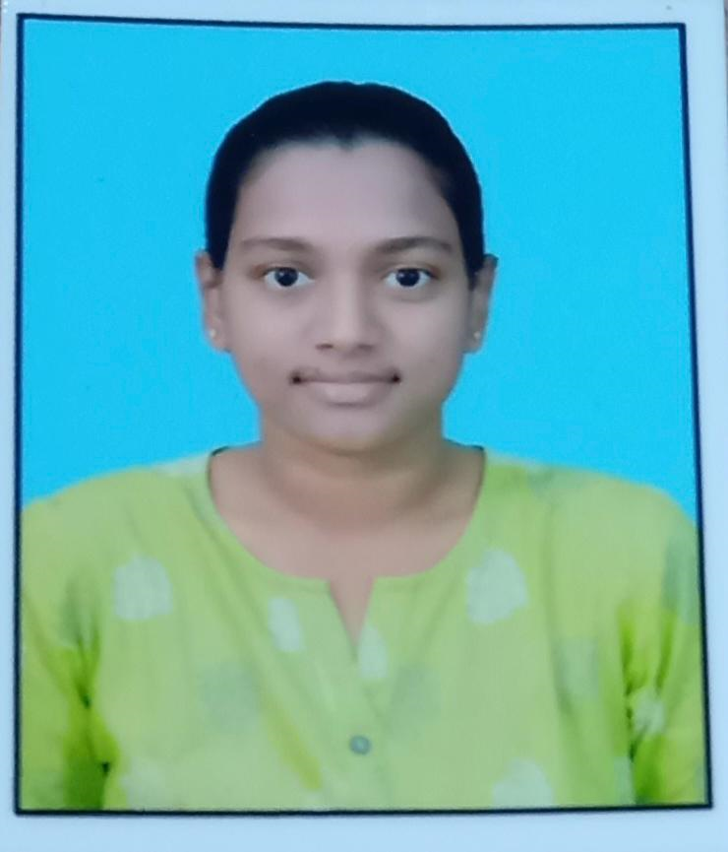
Student Details
NAME: B.SRAVANI
SKILLSBUILD EMAIL ID: sravanibobba04@gmail.com
COLLEGE NAME: Koneru Lakshmaiah Education Foundation
COLLEGE STATE: Andhra Pradesh
INTERNSHIP DOMAIN: Cyber Security with Kali Linux
GITHUB: https://github.com/Sravani2540/apssdc.git
GMAIL: sravanibobba04@gmail.com
(K L University)

Slide 2
PROJECT TITLE/Problem Statement :
Hiding Text Inside an Image Using Steganography
An officer wants to send a secret text message to his undercover agent without alerting any other 3rd person. Traditional communication methods are easily intercepted or monitored, so, he is conveying it through a process called steganography,i.e hiding the message inside an image.

Slide 3
AGENDA
The agenda of this project to send a secret text to higher officials using the steganography concept ensuring that criminals or others cannot identify the image or its hidden content.
Thus project will involve encoding the secret text into the image’s pixels. Additionally it enhance the security of the hidden message.
Finally, the project will include a mechanism for decoding and retrieving the hidden message, ensuring that only authorized person with the correct key can access the concealed information.

Slide 4
PROJECT OVERVIEW
The Image Steganography Project aims to create a system for securely embedding and extracting hidden messages within digital images. It involves researching existing techniques, developing robust algorithms for data embedding and extraction, and ensuring security through cryptographic methods. The project includes designing a user-friendly interface and testing for performance and robustness. Comprehensive documentation and user guides will be prepared. The final system will be deployed, ensuring the secure and imperceptible concealment of messages within images.

Slide 5
WHO ARE THE END USERS of this project?
Government and Military: Hide classified information to avoid interception.
Journalists and Activists: Transmit sensitive information securely.
Avoiding Censorship- Share information discreetly.
Healthcare Providers: Patient Privacy - Safeguard medical data.
Individuals:
Personal Privacy: Hide personal messages and files.
Secure Communication: Exchange sensitive information discreetly.
Cybersecurity Professionals Forensics: Detect and analyze hidden data in digital investigations.

Slide 6
YOUR SOLUTION AND ITS VALUE PROPOSITION
Solution:
The solution involves developing a comprehensive image steganography system that securely embeds and extracts hidden messages within digital images. This system will include robust algorithms for data embedding and extraction, ensure high security through cryptographic techniques, and maintain the visual quality of images.

Slide 7
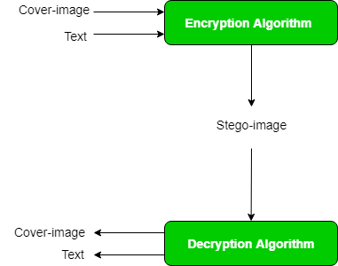
How did you customize the project and make it your own
I customized the project for an officer who wants to send a secret text message to his undercover agent without alerting any other 3rd person.
By using problem statement this project is created to hide a text inside an image using RGB, LSB method is used for imperceptible to the human eye. And here XOR operation is used for hide and unhide the image.

Slide 8
MODELLING
Importing some libraries like cv2.
Convert encoding data into 8-bit binary form using ASCII value of characters
Read the image from it’s path and hiding the image using XOR operation
Putting modified pixels in the new image/A secret is created to avoid unauthorized users.
To unhide the image user wants to enter the secret key.
Finally, user can able to see the secret message.

Slide 9
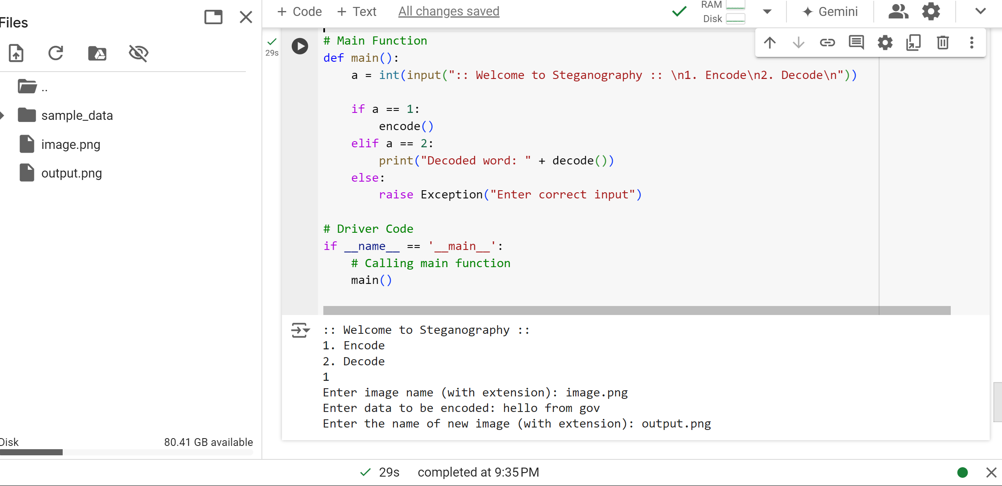
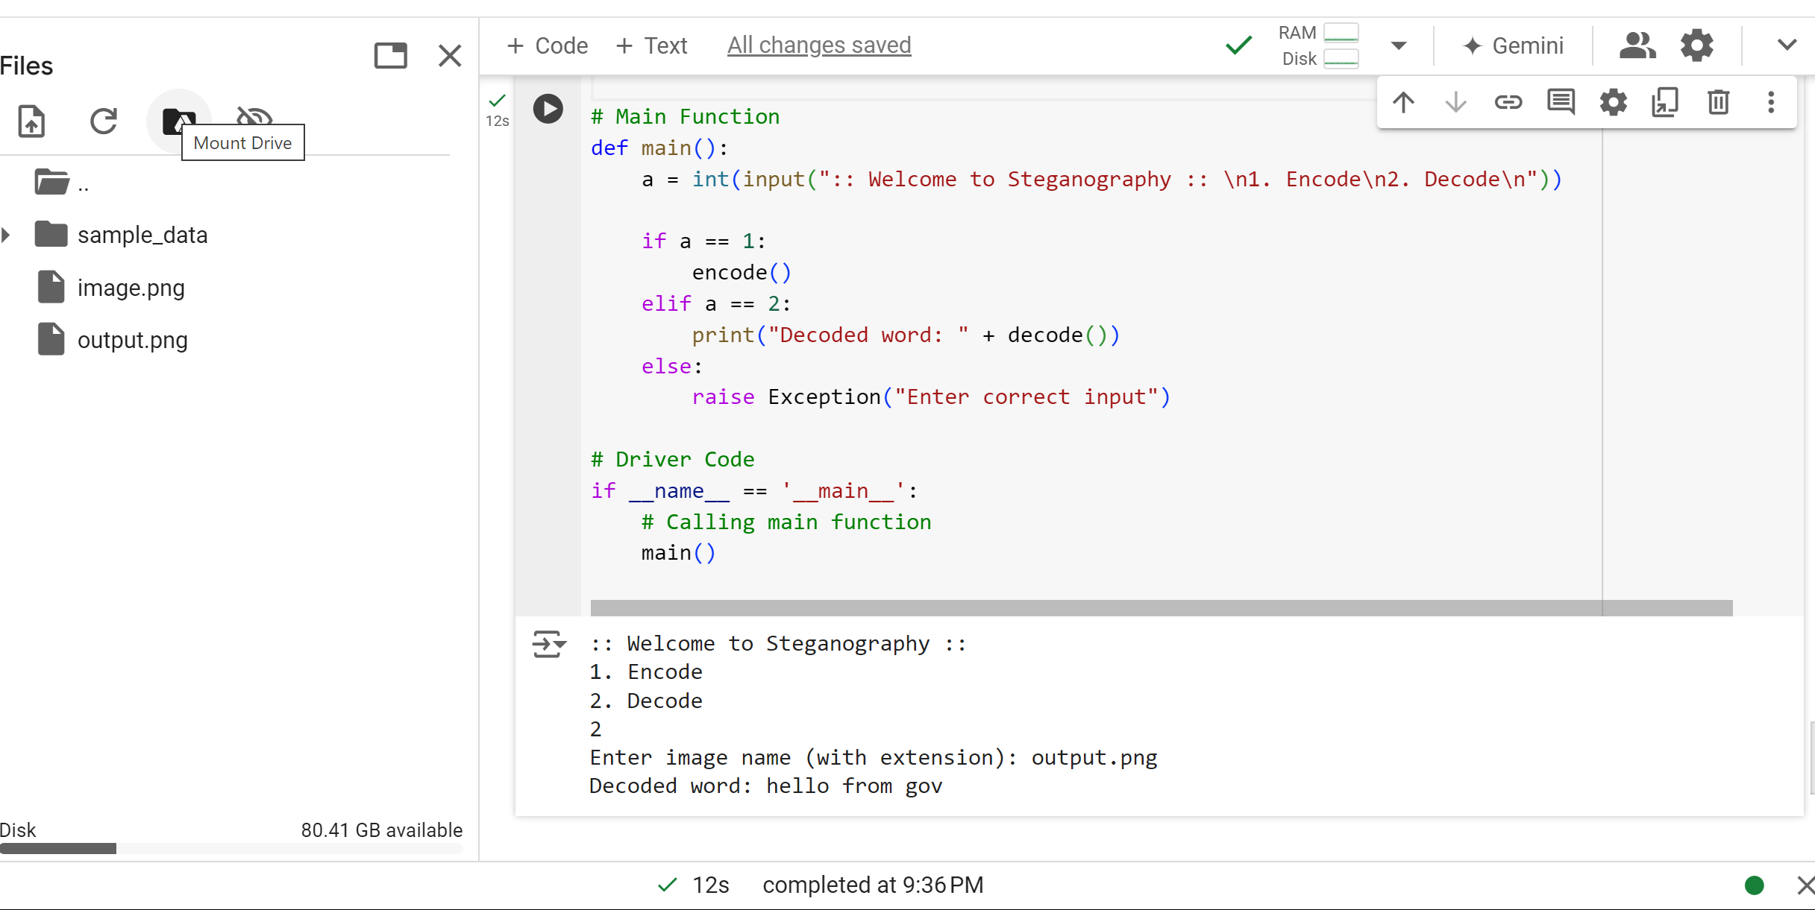
Results
1.

Slide 10


Original image:
ENCODED IMAGE:

Slide 11
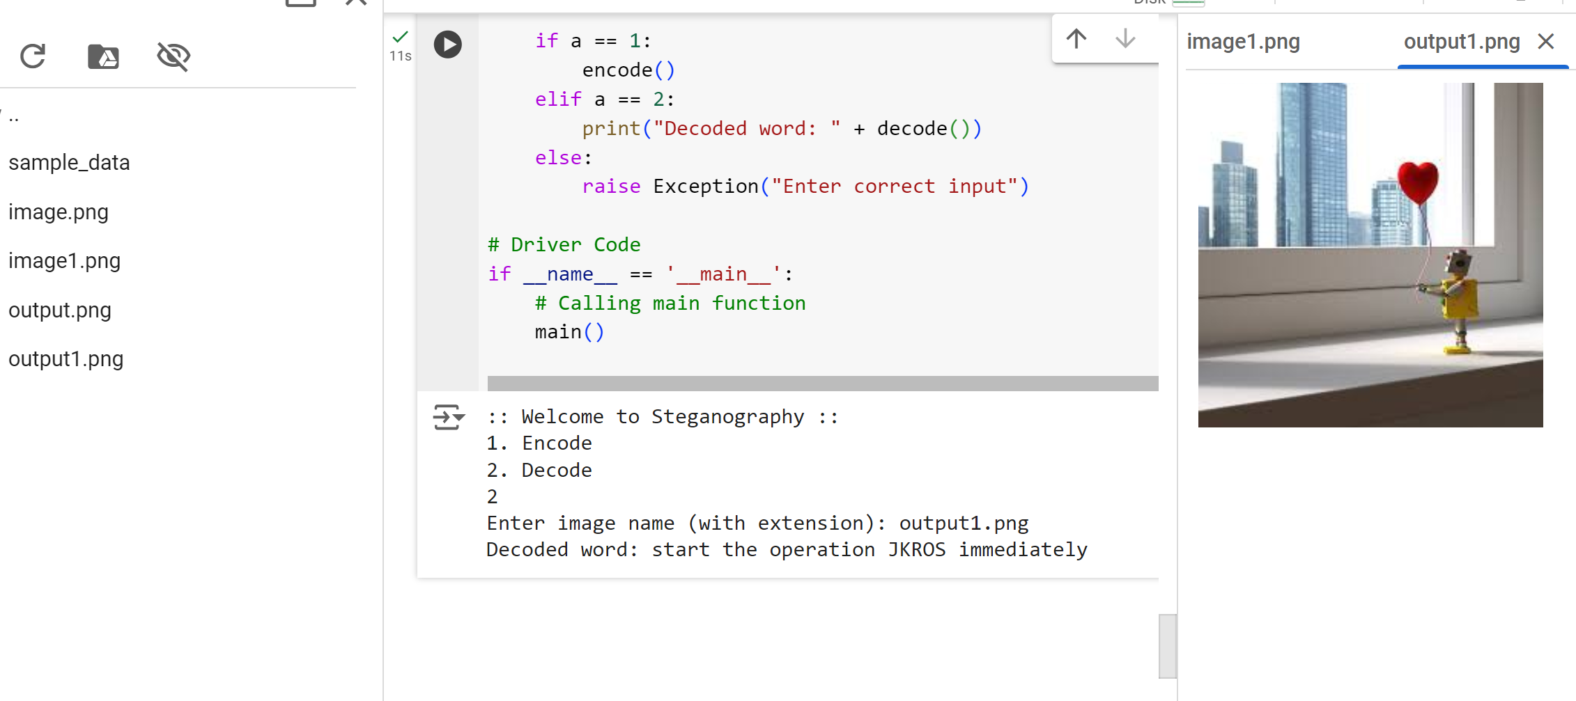
2.

Slide 12


Original image:
ENCODED IMAGE:

Slide 13
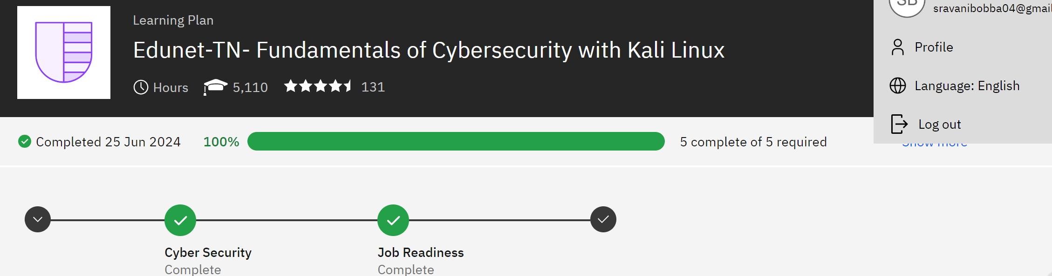
links
REFERRED: https://www.geeksforgeeks.org/image-steganography-in-cryptography/
https://www.iitmjanakpuri.com/iitmjournal/data/2021_Vol12_No1_it10a.pdf
IBM LEARNING:

