Slide 1
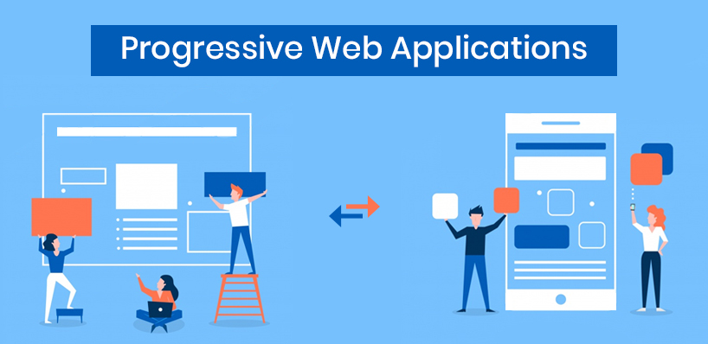
Workshop Team 2

Slide 2



Team Slide:
Kavya Reddy
Sravani Jaidi
Satish Kumar

Slide 3
Outline
What is PWA
Why do we need PWA
Steps to build PWA
Caching Strategies
Architectural Patterns
Conclusion
Demo Slide

Slide 4
What is PWA...
Provide an installable, app-like experience on desktop and mobile that are built and delivered directly via web.
-Kavya Reddy

Slide 5

Why do we need PWA ?
-Kavya Reddy

Slide 6
PWA because...
Fast
Engaging
Reliable
Reach
Conversion
-Kavya Reddy

Slide 7
PWA are...
Progressive
Responsive
Connectivity independent
Re-engageable
Installable
Discoverable
Safe
-Kavya Reddy

Slide 8
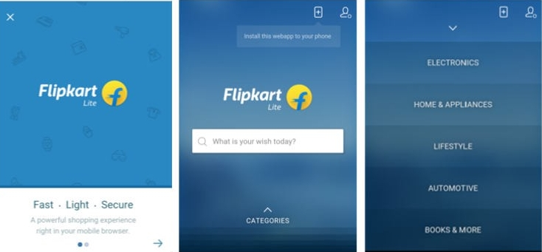
The lighter versions help increase the potential reach and hence help in better conversions.
-Kavya Reddy

Slide 9
Steps to build PWA
We can divide this stage into 2 major parts
Our Specific need.
Challenges we might face.
-Kavya Reddy

Slide 10
Need
A. Starting from the scratch
B. Simple/Single additional feature
-Kavya Reddy

Slide 11
Challenges
Limited Functionality
Cross Browser Support
Limited Legitimacy
Cross Application Login Support
-Kavya Reddy

Slide 12
Principles
Web App Manifest
Add to Home Screen banner
Service Worker
Push Notification
-Kavya Reddy

Slide 13
Web App Manifest
Simple JSON file that tells the browser about your web application and how it should behave when “installed”on the user's mobile device or desktop.
-Kavya Reddy

Slide 14
What is a Service worker?
Programmable network proxy, allowing you to control how a network request from a page is handled.
JavaScript worker
It manages cache efficiently to allow error free app display during offline access.
-Sravani Jaidi

Slide 15
Service worker lifecycle
Register
Fetch/Push
Installing
Yes
Activated
Idle
Terminates
No
Error
-Sravani Jaidi

Slide 16
What service workers can do?
Service workers depend on two APIs to make an app work offline: Fetch and Cache
Improve performance of your application/site
Make your app "offline-first“
Act as the base for advanced features
-Sravani Jaidi

Slide 17
Working with Fetch API
Fetch is a replacement for XMLHttpRequest.
Promise based (cleaner code)
Handles redirection, decodes common formats, etc.
Used by service workers, cache API, etc.
Implements Cross Origin Resource Sharing (CORS)*
-Sravani Jaidi

Slide 18
Add to Home Screen Banner
Makes it easy for users to install your PWA on their mobile or desktop device.
After the user accepts the prompt, your PWA will be added to their launcher and it will run like any other installed app.
Sravani Jaidi

Slide 19
Push Notification
Push messaging provides a simple and effective way to re-engage with the users of the page.
-Sravani Jaidi

Slide 20
Working with cache
lets you create stores of responses keyed by request.
There are different ways of serving files from the cache. They are
Cache falling back to network
Network falling back to cache
Cache then network
Generic fallback
-Sravani Jaidi

Slide 21
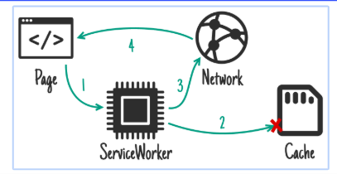
Cache falling back to network
-Sravani Jaidi

Slide 22
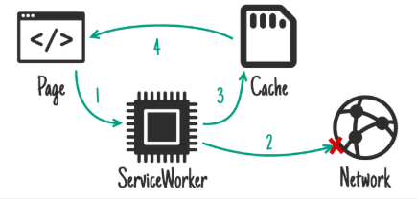
Network falling back to cache
-Sravani Jaidi

Slide 23
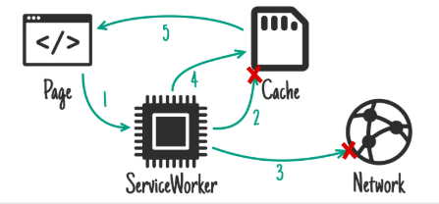
Generic Fallback
-Sravani Jaidi

Slide 24
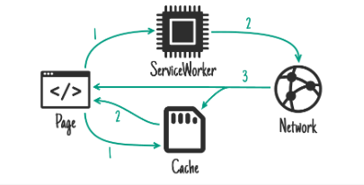
Cache then network
-Sravani Jaidi

Slide 25
Architectural patterns
Server-side Rendering (SSR):
Server returns a complete page
Page loads CSS, JavaScript, and all content. Updates and reloads DOM.
Client-side Rendering (CSR):
Server returns "template page" with CSS & JavaScript
JavaScript makes request to get content, adds to page
Page updates reload only the dynamic content
-Sravani Jaidi

Slide 26





Websites using PWA
-Satish Kumar

Slide 27
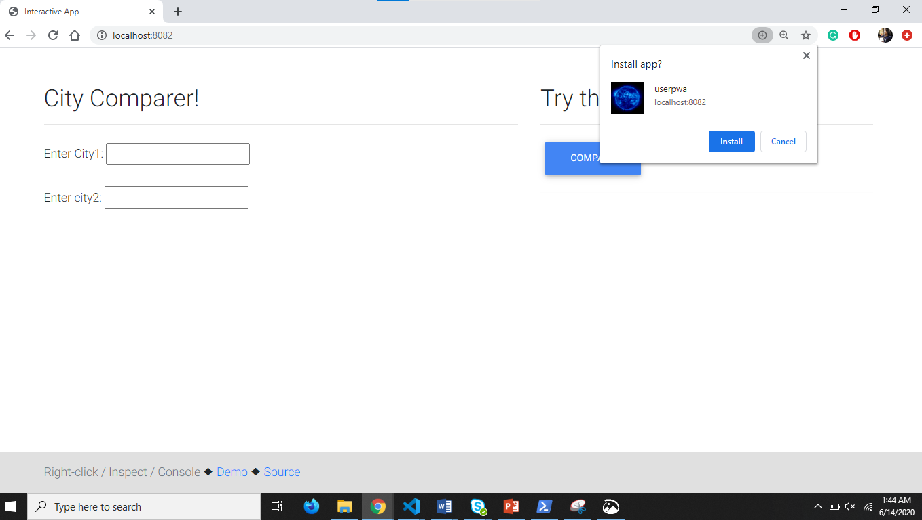
Demo

Slide 28
Advantages
Increase in mobile experience
Behave like native apps
No distribution store required
Easy and cheap
Satish Kumar

Slide 29
Disadvantages
Limited browser support.
Limited hardware and software support.
No download store presence.
Loss of confidence when installing Apps
Satish Kumar

Slide 30
Conclusion
PWAs, we can say they are still in their infancy with a long way to go and lot of challenges to be addressed yet. Having said that, they do have a great potential to create remarkable changes in the way web works.
They might not be killing the Native apps in future, but we can sense wide growing interest for this approach in the web development community.
Satish Kumar

Slide 31
References
https://developers.google.com/web/ilt/pwa
https://blog.heroku.com/how-to-make-progressive-web-app
https://blog.pusher.com/introduction-progressive-web-apps/
Satish Kumar

Slide 32




Thank you for your attention! Any Questions?

