Slide 1
STATISTICAL ANALYSIS AND EXPLORATORY DATA ANALYSIS OF MENTAL HEALTH AND DEPRESSION USING NHANES DATA
Authors:
Sravani Mahankali
Sai Rupesh Kavuturi
Vaishnavi Gannavaram

Slide 2
INTRODUCTION
This study analyses whether there is an impact of each factor such as annual income, marital status, and gender on depression in adults or not using the 2013-2014 data of mental health – depression screener data file from NHANES data sets.
The dependent variable in the data set is feeling down/depressed/hopeless (DPQ020), as these are measured or tested in this research. The demographic data which are age (RIAGENDR), gender (RIDAGEYR), marital status (DMDMARTL), and household income (INDHHIN2) are the independent variables in the dataset as they might influence the results.

Slide 3
Project Roadmap
Q1
Q2
Q3
Q4
Task 1
Task 2
Task 3
Task 4
Two Sample t-Test
Chi-Square test
Binary Logistic Regression
Data Cleaning, Descriptive Statistics, and Data Visualization

Slide 4
TASK 1 Data Cleaning, Descriptive statistics, and Data Visualization
Data Cleaning
The data is filtered by age, and the adults (aged above 20 years) initially, and then the independent variables, age (RIDAGEYR), gender (RIAGENDR), marital status (DMDMARTL), household income (INDHHIN2), and the outcome variable i.e., feeling down/depressed/hopeless (DPQ020) are selected. Also, the groups in which people answered 'Yes' to the outcome variable are merged and recoded again to 'Yes' and 'No'. The variables are cleaned by removing NA values and recoded the variables.

Slide 5
Descriptive statistics
Descriptive statistics for the independent variables namely, age (RIAGENDR), gender (RIDAGEYR), marital status (DMDMARTL), household income (INDHHIN2) and the outcome variable i.e., feeling down/depressed/hopeless (DPQ020) are calculated.
after performing some visualizations such as creating histograms for every variable to check for skewness and kurtosis. If the variables are normal, then the mean and variance will be calculated, as the mean value would be a good representation of the middle of the data.
Otherwise, the median and interquartile range will be calculated for the variables using a non-normal function.
All these statistics will be produced as a table using CreateTableOne.

Slide 6
Data Visualization
Histograms
In the data that we have taken, people with more than 100,000 salary are higher in proportion overall. People with 75,000 to 99,000 and 25,000 to 34,000 salaries are closely same in proportions i.e., 400 to 550 approximately. Married people are in leading position in terms of the sample population count. Whereas there are very less people who got separated with their partners in the population. Moreover, people who never got married takes the second place in the population count. Also, Female population is slightly more than male population with the difference of 100 approximately and Nearly 1200 people responded with yes to the question that if they are suffering from the symptoms of depression or not.
We can also observe that people in their 30's, 60's and 80's are higher in proportions in terms of population count in the data and the data in age variable is not normal. Therefore, we transformed the variable to check if we can find the normal distribution. But no normal distribution found in the transformed variables too. Hence, we took the original variable without any transformation.

Slide 7

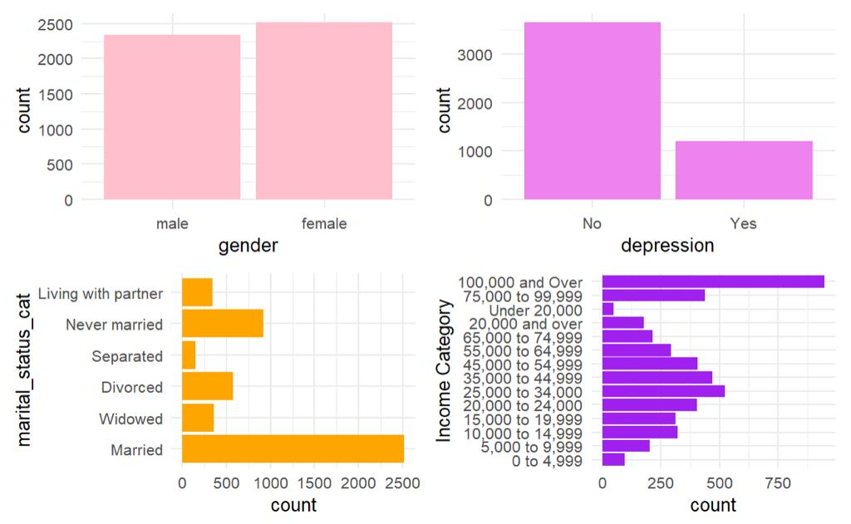

Slide 8
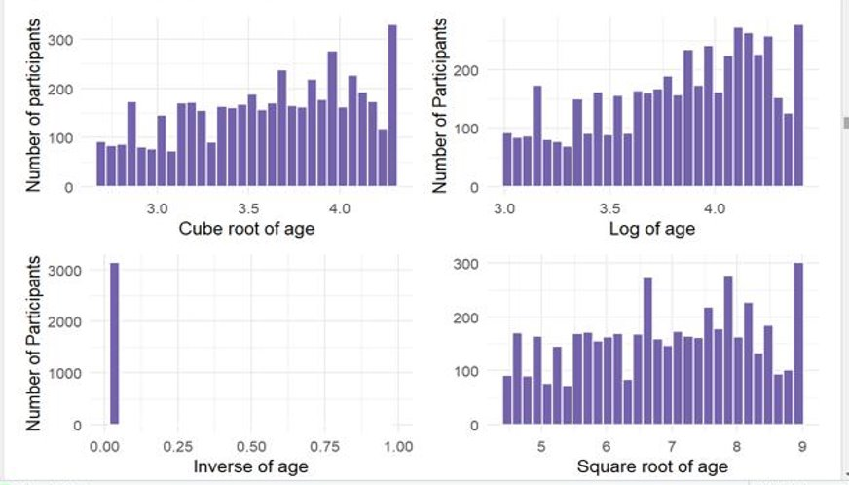
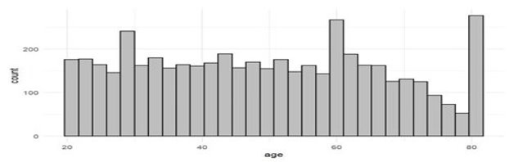

Slide 9
Box Plots
Used Box plots to show the co-relation between income, marital status, gender and depression.
The major things that we noticed through box plots are:
There were more depressed people in the range of 10,000 - 60,000 income range than other ranges. And people with more than 100,000 income were not facing any depression.
There were more depressed people in ones who were married. And there was significant people with depression in the categories never married and Divorced.
There were more depressed females than males. But the people without depression were equal.

Slide 10
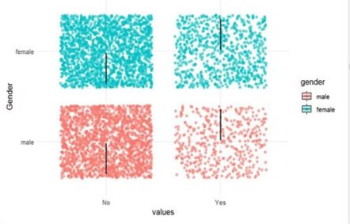
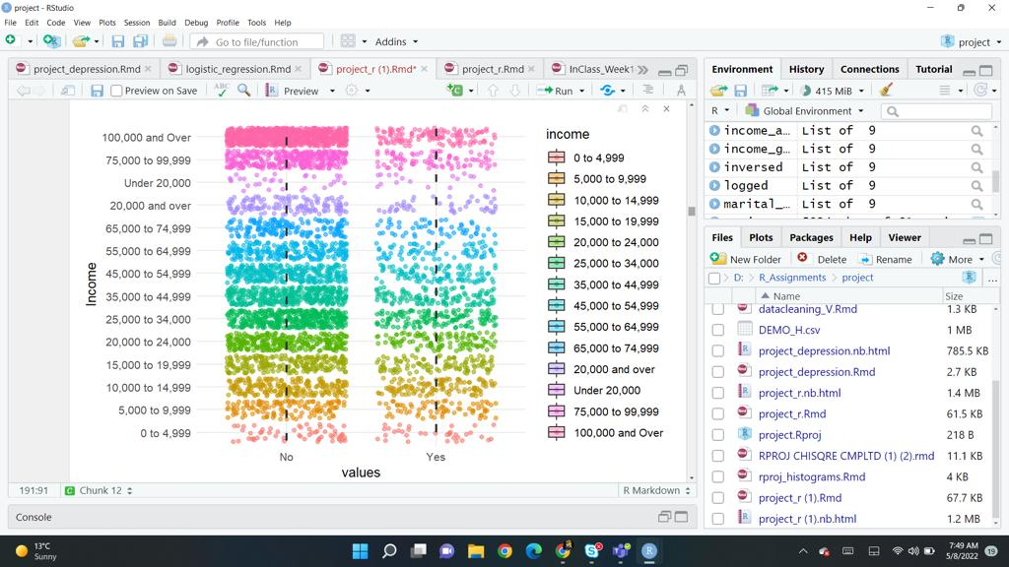
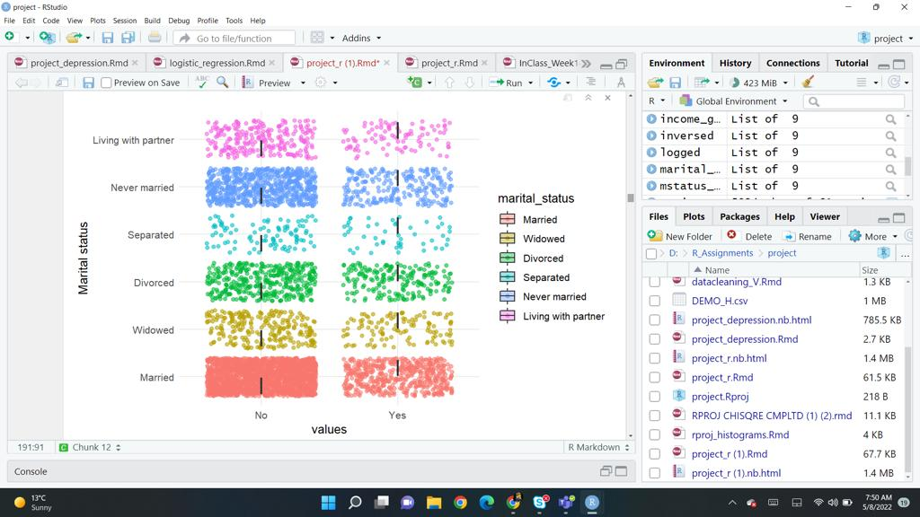

Slide 11
TASK 2 Chi-Square Test
The chi-squared test is used to test if there is a statistical relationship between two categorical variables i.e., income and depression or not.
The chi-squared test is based on the observed values, and the values expected to occur if there were no relationship between the variables.

Slide 12
If there were no relationship between income and depression, the observed and expected values would be the same. However, differences between observed values and expected indicates that there may be a relationship between the income and depression variables .
ASSUMPTIONS OF CHI-SQUARED TEST OF INDEPENDENCE
Assumption 1:
The variables must be nominal or ordinal.
('INCOME VARIABLE' has categories that are in particular order, so it is ORDINAL. The outcome variable - DEPRESSION has categories that are in no particular order, so it is nominal. This assumption is met.)
Assumption 2:
The expected values should be 5 or higher in at least 80% of groups.
In this INCOME, there are 14 groups, so 80% of this would be 11.2 groups. Since there is no way to have .4 of a group. Therefore , assumption is met.
Assumption 3:
The observations must be independent. Income is an independent variable hence the assumption is met.

Slide 13
Computing Chi square test using R
The test statistic is χ2 : 145.59.
Degree of freedom : 13.
p < 2.2e-16 or p < .05.
The probability that the null is true is very small, i.e., less than 5%, rejecting the null hypothesis.
There was a statistically significant association between income and depression [χ2(3) = 145.59 ; p < .05].

Slide 14
What do we infer from this?
We used the chi-squared test to test the null hypothesis that there was no relationship between INCOME and DEPRESSION. We rejected the null hypothesis and concluded that there was a statistically significant association between people's income and depression. [χ2(3) = 145.59; p < .05].

Slide 15
TASK 3 Two-Sample t-Test
A two-sample t-test is used when you want to compare two independent groups to see if their means are different.
Test statistic: (x₁ – x₂) / s_{p}(√1/n₁ + 1/n₂)
Where:
x₁ and x₂ are the sample means,
n₁ and n₂ are the sample sizes,
where s_{p} is calculated as:
s_{p} = √ (n₁-1)s₁² + (n₂-1)s₂² / (n₁+n₂-2)
where s₁² and s₂² are the sample variances.

Slide 16
Two Sample T-Test
The function used to perform the two-sample t-test in R studio is the t.test().
The output comes as the image shown on the right which itself is self-explanatory.

Slide 17
Assumptions for Two-Sample T-Test
There are two assumptions for the Two-Sample T-Test:
Normality Checked using histograms
Equal Variance Checked using Levene's test

Slide 18
Alternate Tests
As the t-test fails to satisfy the assumptions we had to go with the alternate test. Here is the Wilcoxon rank-sum test/ Mann Whitney U Test.
"wilcox.test()" is the function used to perform the test in the R studio. The output is as follows

Slide 19
What do we infer from this?
From the t-test, we find that there is not much statistical significance between the mean age of people with and without depression. Age does not have any statistical significance on people with depression.

Slide 20
TASK 4 Binary Logistic Regression
The statistical model for the logistic model in Equation
p(y)=1/1+e−(b0+b1x1+b2x2)
Where:
y : the binary outcome variable (e.g., depression)
p(y) : the probability of the outcome (e.g., probability of depression)
b0 : the y-intercept
x1 and x2 : predictors of the outcome (e.g., age, gender, marital status, income)
b1 and b2 : coefficients for x1 and x2

Slide 21
Assumptions of logistic Regression
There are three assumptions for logistic regression:
independence of observations Checked using Durbin Watson Test
linearity, Checked using Scatter plot
no perfect multi-collinearity. Checked using GVIF
We will also perform model diagnostics to know about any influential values

Slide 22
Age and Depression model
The age variable was not significant

Slide 23
The chi-squared test statistic for a logistic regression model with age predicting depression had a p-value of more than 0.001. The null hypothesis is therefore accepted i.e., the model is not better than the baseline at predicting depression. A logistic regression model including age was not statistically significantly better than a null model at predicting depression [χ2(1) = 3.506; p = >.001].
The odds ratio for age is 1.00 with a 95% CI of .99–1.00. The confidence interval shows the range where the odds ratio likely is in the population. Because the confidence interval include 1, this indicates that the odds ratio is statistically not significantly different from 1.

Slide 24
Checking assumptions for the model
Since, the p-value is greater than 0.05, we assume that the observations are independent [p-value = 0.252]. Hence, the independent assumption is met.
The linearity assumption is met, as the graph is linear.
We couldn't check the multicollinearity assumption ,as the variable had less than 2 observations.

Slide 25
Interpretation
The chi-squared test statistic for a logistic regression model with age predicting depression had a p-value of more than 0.001. The null hypothesis is therefore accepted i.e., the model is not better than the baseline at predicting depression. A logistic regression model including age was not statistically significantly better than a null model at predicting depression [χ2(1) = 3.506; p = >.001].The odds ratio for age is 1.00 with a 95% CI of .99–1.00. The confidence interval shows the range where the odds ratio likely is in the population. Because the confidence interval include 1, this indicates that the odds ratio is statistically not significantly different from 1.
so, age is not statistically significant. Assumption checking revealed linearity of the age predictor. The other assumptions were met.
Diagnostics found no problematic outlying or influential observations. We couldn't find any multi-collinearity for the variable as model contains fewer than 2 terms

Slide 26
Marital Status and Depression model
All the groups of the marital status variable were significant

Slide 27
The chi-squared test statistic for a logistic regression model with marital status predicting depression had a p-value of less than 0.001. The null hypothesis is therefore rejected i.e., the model is better than the baseline at predicting depression. A logistic regression model including marital status was statistically significantly better than a null model at predicting depression [χ2(1) = 72.791; p = <.001]. All the groups in the variable are statistically significant
The odds ratio for all the groups in the variable is between 1.00 and 2.06 with a 95% CI of all groups are between either 1 and 2, or 1 and 1.9. The confidence interval shows the range where the odds ratio likely is in the population. Because the confidence interval include 1, this indicates that the odds ratio is statistically not significantly different from 1.

Slide 28
Checking assumptions for the model
As, the p-value is greater than 0.05, we assume that the observations are independent [p-value = 0.382]. Hence, the independent assumption is met.
The linearity assumption is met, as the graph is linear.
We couldn't check the multicollinearity assumption ,as the variable had less than 2 observations.

Slide 29
Interpretation
The chi-squared test statistic for a logistic regression model with, marital status predicting depression had a p-value of less than 0.001. The null hypothesis is therefore rejected i.e., the model is better than the baseline at predicting depression. A logistic regression model including marital status was statistically significantly better than a null model at predicting depression [χ2(1) = 72.791; p = <.001]. The odds ratio for all the groups in the variable is between 1.00 and 2.06 with a 95% CI of all groups are between either 1 and 2, or 1 and 1.9. The confidence interval shows the range where the odds ratio likely is in the population. Because the confidence interval include 1, this indicates that the odds ratio is statistically not significantly different from 1.
so, marital status is statistically significant. Assumption checking revealed linearity of the marital status predictor. The other assumptions were met.
Diagnostics found no problematic outlying or influential observations. We couldn't find any multi-collinearity for the variable as model contains fewer than 2 terms

Slide 30
Income and Depression model
The groups income25,000 to 34,000, income35,000 to 44,999, income45,000 to 54,999, income55,000 to 64,999, income65,000 to 74,999, income75,000 to 99,999, and income100,000 and Over of income are significant.

Slide 31
The chi-squared test statistic for a logistic regression model with, income predicting depression had a p-value of less than 0.001. The null hypothesis is therefore rejected i.e., the model is better than the baseline at predicting depression. A logistic regression model including marital status was statistically significantly better than a null model at predicting depression [χ2(1) = 151.759; p = <.001].
The confidence interval of the groups income25,000 to 34,000, income35,000 to 44,999, income45,000 to 54,999, income55,000 to 64,999, income65,000 to 74,999, income75,000 to 99,999, and income100,000 and Over the confidence interval does not include 1, this indicates that the odds ratio is statistically significantly different from 1.

Slide 32
Checking assumptions for the model
As, the p-value is greater than 0.05, we assume that the observations are independent [p-value = 0.306]. Hence, the independent assumption is met.
The linearity assumption is met, as the graph is linear.
We couldn't check the multicollinearity assumption ,as the variable had less than 2 observations.

Slide 33
Interpretation
The chi-squared test statistic for a logistic regression model with, income predicting depression had a p-value of less than 0.001. The null hypothesis is therefore rejected i.e., the model is better than the baseline at predicting depression. A logistic regression model including marital status was statistically significantly better than a null model at predicting depression [χ2(1) = 151.759; p = <.001].The groups, income25,000 to 34,000, income35,000 to 44,999, income45,000 to 54,999, income55,000 to 64,999, income65,000 to 74,999, income75,000 to 99,999,and income100,000 and Over are significant. The confidence interval of the groups income25,000 to 34,000, income35,000 to 44,999, income45,000 to 54,999, income55,000 to 64,999, income65,000 to 74,999, income75,000 to 99,999, and income100,000 and Over the confidence interval does not include 1, this indicates that the odds ratio is statistically significantly different from 1. so, income is not statistically significant.
Assumption checking revealed linearity of the income predictor. The other assumptions were met.
Diagnostics found no problematic outlying or influential observations. We couldn't find any multi-collinearity for the variable as model contains fewer than 2 terms.

Slide 34
Gender and Depression model
Female group of gender is significant.

Slide 35
The chi-squared test statistic for a logistic regression model with, gender predicting depression had a p-value of less than 0.001. The null hypothesis is therefore rejected i.e., the model is better than the baseline at predicting depression.
A logistic regression model including gender was statistically significantly better than a null model at predicting depression [χ2(1) = 81.662; p = <.001].
female group is significant. The confidence interval of gender is 1.61- 2. 10 and the odds ratio is 1.84. The confidence interval include 1, this indicates that the odds ratio is not statistically significantly different from 1.

Slide 36
Checking assumptions for the model
As, the p-value is greater than 0.05, we assume that the observations are independent [p-value = 0.298]. Hence, the independent assumption is met.
The linearity assumption is met, as the graph is linear.
We couldn't check the multicollinearity assumption ,as the variable had less than 2 observations.

Slide 37
Interpretation
The chi-squared test statistic for a logistic regression model with, gender predicting depression had a p-value of less than 0.001. The null hypothesis is therefore rejected i.e., the model is better than the baseline at predicting depression. A logistic regression model including gender was statistically significantly better than a null model at predicting depression [χ2(1) = 81.662; p = <.001].female group is significant.
The confidence interval of gender is 1.61- 2. 10 and the odds ratio is 1.84. The confidence interval include 1, this indicates that the odds ratio is not statistically significantly different from 1. Assumption checking revealed linearity of the gender predictor. The other assumptions were met.
Diagnostics found no problematic outlying or influential observations. We couldn't find any multi-collinearity for the variable as model contains fewer than 2 terms

Slide 38
Independent variables and depression model
The significant variables in this model are gender(female), income35,000 to 44,999, income45,000 to 54,999, income75,000 to 99,999, income100,000 and Over, marital_status Divorced, marital_status Living with partner.

Slide 39
The chi-squared test statistic for a logistic regression model with, gender predicting depression had a p-value of less than 0.001. The null hypothesis is therefore rejected i.e., the model is better than the baseline at predicting depression. A logistic regression model including gender was statistically significantly better than a null model at predicting depression [χ2(1) = 240.772; p = <.001].
The odds ratio of the group income35,000 to 44,999 is 0.6, and the 95 percent confidence intervals is 0.37-0.97,The odds ratio of the group income75,000 to 99,999 is 0.466, and the 95 percent confidence intervals is 0.2874805- 0.7649859. The odds ratio of the group income100,000 and Over is 0.282, and the 95 percent confidence intervals is 0.1778079 0.4548451. All the other groups have 1 either of the confidence intervals, this indicates that the odds ratio is not statistically significantly different from 1

Slide 40
Checking assumptions for the model
As , the p-value is greater than 0.05, we assume that the observations are independent [p-value = 0.352].Hence, the independent assumption is met.
The linearity assumption is met, as the graph is near to linear.
None of the values in the right-hand column have a value of 2.5 or higher, so there is no discernable problem with multicollinearity.

Slide 41
Interpretation
The chi-squared test statistic for a logistic regression model with, gender predicting depression had a p-value of less than 0.001. The null hypothesis is therefore rejected i.e., the model is better than the baseline at predicting depression. A logistic regression model including gender was statistically significantly better than a null model at predicting depression [χ2(1) = 240.772; p = <.001]. The significant variables in this model are gender(female), income35,000 to 44,999, income45,000 to 54,999, income75,000 to 99,999, income100,000 and Over marital_status Divorced, marital_status Living with partner.
The odds ratio of the group income35,000 to 44,999 is 0.6, and the 95 percent confidence intervals is 0.37-0.97,The odds ratio of the group income75,000 to 99,999 is 0.466, and the 95 percent confidence intervals is 0.2874805- 0.7649859. The odds ratio of the group income100,000 and Over is 0.282, and the 95 percent confidence intervals is 0.1778079 0.4548451. All the other groups have 1 either of the confidence intervals, this indicates that the odds ratio is not statistically significantly different from 1.
None of the variables, gender, dfb.i2t2, dfb.i2t3, dfb.i3t4, dfb.i4t5, dfb.i5t6, dfb.i6t7, dfb.i7t9, dfb.i1aO, dfb.mr_D, dfb.mr_S had df-betas less than 2, so, by the df-beta measure, there were influential observations. Rest all the variables did not have influential observations.

Slide 42
What do we infer from this?
A logistic regression model including age was not statistically significantly better than a null model at predicting depression [χ2(1) = 3.506; p = >.001]. A logistic regression model including marital status was statistically significantly better than a null model at predicting depression [χ2(1) = 72.791; p = <.001]. A logistic regression model including marital status was statistically significantly better than a null model at predicting depression [χ2(1) = 151.759; p = <.001]. A logistic regression model including gender was statistically significantly better than a null model at predicting depression [χ2(1) = 81.662; p = <.001]. A logistic regression model including gender was statistically significantly better than a null model at predicting depression [χ2(1) = 240.772; p = <.001]. Hence, seeing the model results, we can predict that the final model is better than the other models although it has some outliers and influential values.

Slide 43
Conclusion
From the results of the Chi-squared test and the logistic regression model including all the variables, we can understand that under marital status people under Divorced and Living with a partner are more prone to depression. Where are coming to the income variable, from the chi-squared test and logistic regression model we can see that income 35,000 to 44,999, income 45,000 to 54,999, income 75,000 to 99,999, and income 100,000 and over are the groups that are most affected by depression. Also, from the gender category females are more affected than males. Coming to age, from the t-tests and the logistic regression models we understand that age does not have any relation to depression in adults. These conclusions cannot be generalized to the entire population as the data is not that accurate. It has many missing values and many confusing answers from the participants.

Slide 44

THANK YOU

