Slide 1

WELCOME TO DEPARTMENT OF MASTER OF COMPUTER APPLICATIONS
ANNAMACHARYA P.G. COLLEGE OF COMPUTER STUDIES NEW BOYANAPALLI, RAJAMPET - 516126.

Slide 2
IDENTIFYING ABNORMAL CLOUD FILE MIGRATION AND REPLICATION ACTIVITIES
Under the Guidance of
Ms. V. Nirmala,
ASSISTANT PROFESSOR,
DEPT of MCA ,
APGCCS, Rajampet.
Presented by
Ms. C.SRAVANI,
(Regd.No:225N1F0097).
II MCA, IV Semester,
APGCCS, Rajampet.

Slide 3
CONTENTS
Abstract
Introduction
Software Requirement Analysis and Specification
System Design
Testing
Implementation
Conclusions

Slide 4
ABSTRACT

Slide 5
ABSTRACT
Cloud Computing is ever increasing popularity the demand for cloud storage has to increased exponentially. Computing firms are no longer the only consumers of cloud storage and cloud computing, but rather average business, and even end-users are taking advantage of the immense capabilities the cloud services can provide. In existing Data location in the cloud environment has been recognized as an important factor in providing users with assurance of data security and privacy Instead of verifying file locations afterwards, it is to require users to encrypt their data before uploading it to the cloud. Users are typically unable to control the actual locations of their data In proposed system most widely adopted cloud data storage systems–Hadoop distributed file system (HDFS), and design an enhanced HDFS system.

Slide 6
INTRODUCTION

Slide 7
INTRODUCTION
With the ever-increasing popularity of cloud computing, the demand for cloud storage has also increased exponentially. Computing firms are no longer the only consumers of cloud storage and cloud computing, but rather average businesses, and even end-users, are taking advantage of the immense capabilities that cloud services can provide. While enjoying the flexibility and convenience brought by cloud storage, cloud users release control over their data, and particularly are often unable to locate the actual their data; this could be in-state, in-country, or even out-of-country. Lack of location control may store sensitive data (e.g., medical records) that are governed by laws to remain within certain geographic boundaries and borders.

Slide 8
Purpose
Proposed work, the system infiltrates into one of the most widely adopted cloud data storage systems–Hadoop Distributed File System (HDFS), and design an enhanced HDFS system, called LAST-HDFS. proposed approach is that, once data is allocated per users’ location preferences, our framework monitors real time file transfers in the cloud and is capable of detecting potential illegal transfers.

Slide 9
Scope
Implemented our proposed framework and carried out an extensive experimental evaluation in a large-scale real cloud environment to demonstrate the effectiveness and efficiency of our proposed system . The proposed system achieves efficient Illegal File Transfer Detection Algorithm to secure the data.

Slide 10
Existing System
Implemented our proposed framework and carried out an extensive experimental evaluation in a large-scale real cloud environment to demonstrate the effectiveness and efficiency of our proposed system . The proposed system achieves efficient Illegal File Transfer Detection Algorithm to secure the data.

Slide 11
Disadvantages
In the existing work, the system doesn’t have Location-aware File Loading techniques.
There is no authentication and key agreement for Location-aware Load Balancing.

Slide 12
Proposed System
In the proposed work, the system infiltrates into one of the most widely adopted cloud data storage systems–Hadoop distributed file system (hdfs), and design an enhanced hdfs systemthe idea of proposed approach is that, once data is allocated per users’ location preferences, our framework monitors real time file transfers in the cloud and is capable of detecting potential illegal transfers.

Slide 13
Advantages
The proposed system achieves efficient Illegal File Transfer Detection Algorithm to secure the data.
The system is more secured since it is IMPLEMENTING THE LAST-HDFS SYSTEM.

Slide 14
SOFTWARE REQUIREMENTS
ANALIYSIS AND SPECIFICATION

Slide 15
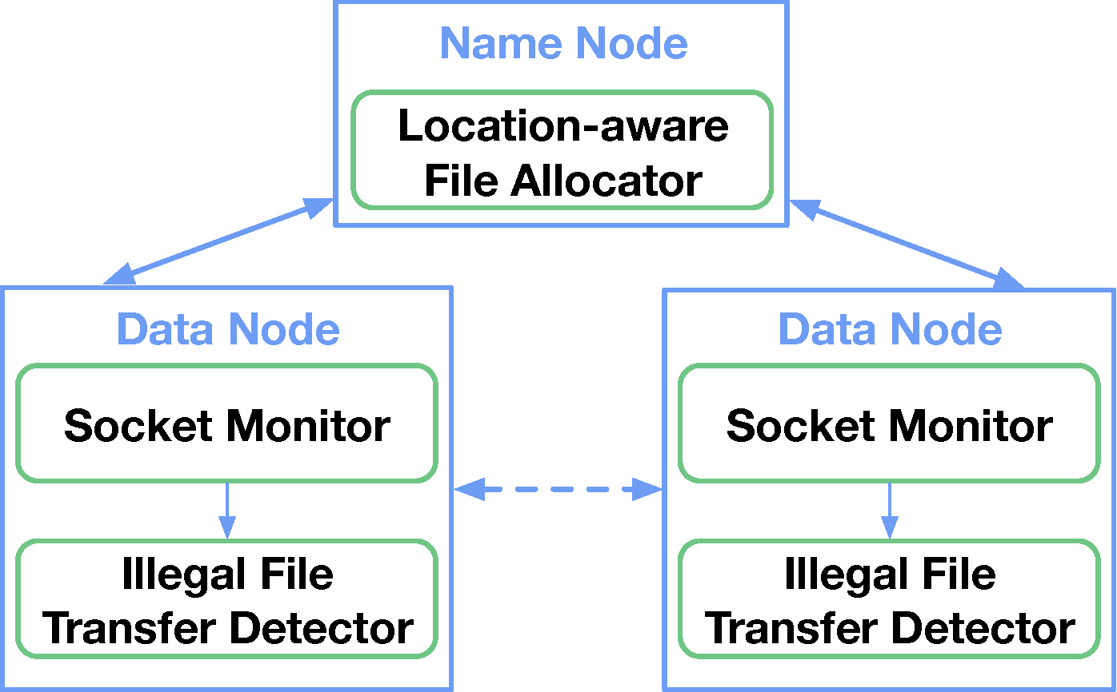
System Architecture

Slide 16
Modules
User module
1. Register module
2. upload module
3. Login module
4. View File Module
Admin Module

Slide 17
Admin
Administrator Module Provides Add Image, View all Images with Policy, View All Images Ranking, View All Image Details, View Search History, View All Users.

Slide 18
User
User Module Provides Add Images, Trust Value Acceptance to Users, Sharing of Images, Search of Images and View of Images Based on trust Value.

Slide 19
Hardware Requirements
System : I3 or More
Hard Disk : 500 GB
RAM : 2 GB

Slide 20
Software Requirements
Operating System : Windows 10 or Above
Server : Apache Tomcat
Programming : Java
FrontEnd : HTML/DHTML
IDE : NetBeans
Database : MySQL

Slide 21
NON FUNCTIONAL REQUIREMENTS
Non-functional requirements are the constraints that must be adhered during development. They limit what resources can be used and set bounds on aspects of the software’s quality.
User Interfaces
The User Interface is a GUI developed using HTML.
Software Interfaces
The main processing is done in Java and console application.
Manpower Requirements
1 members can complete the project in 2 – 4 months if they work fulltime on it.

Slide 22
SYSTEM DESIGN

Slide 23
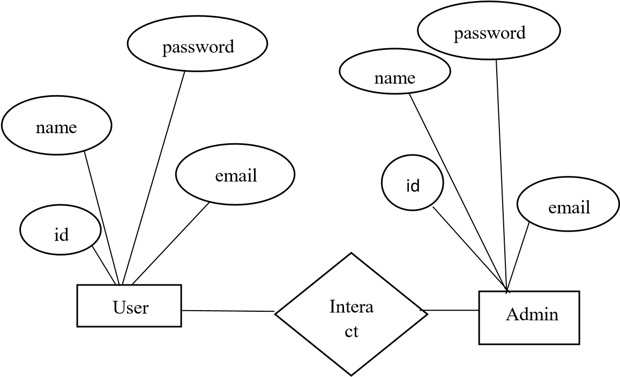
ER-Diagram

Slide 24
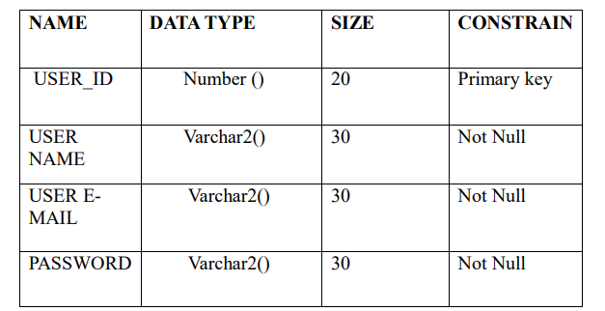
Table Name : User

Slide 25
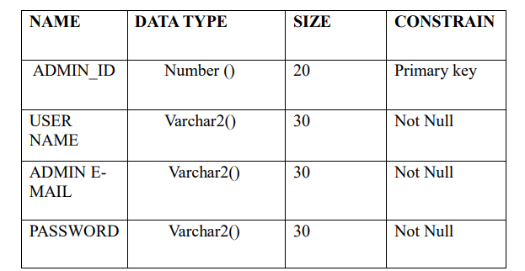
Table Name : Admin

Slide 26
UML DIAGRAMS

Slide 27
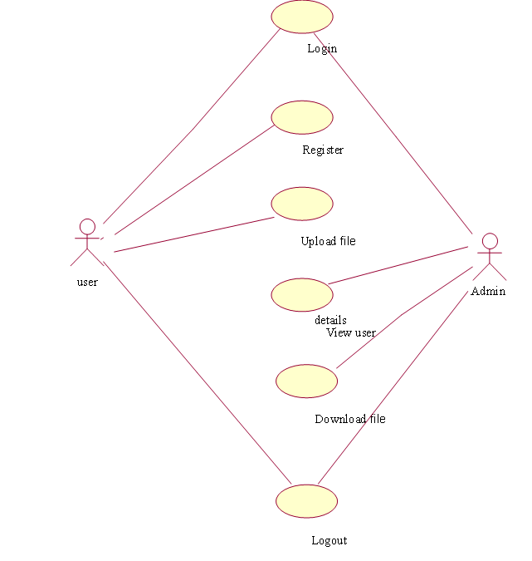
Use case diagram for overall system

Slide 28
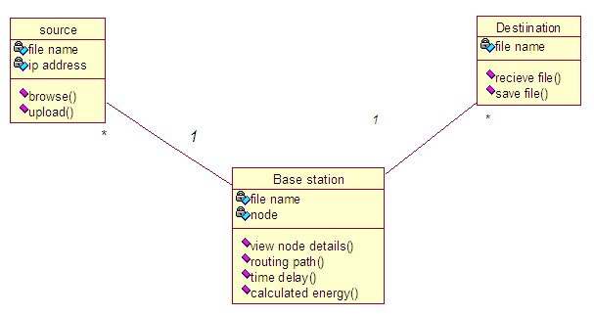
Class Diagram for overall system

Slide 29
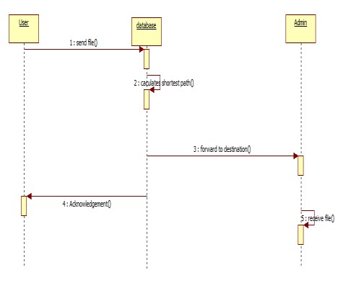
Sequence Diagram for overall system

Slide 30
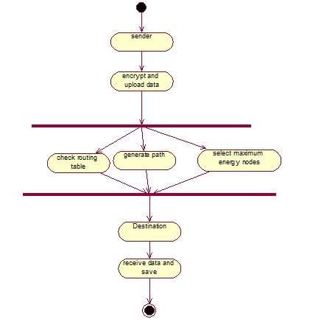
Activity Diagram for overall system

Slide 31
Deployment Diagram

Slide 32
TESTING
Testing is a process, which reveals errors in the program. It is the major quality measure during software development. During software development, during testing, the program is executed with a set of test cases and the output of the program for the test cases is evaluated to determine if the program is performing as it. expected to perform.

Slide 33
Testing Techniques
White box testing
Black box testing
Validation testing

Slide 34
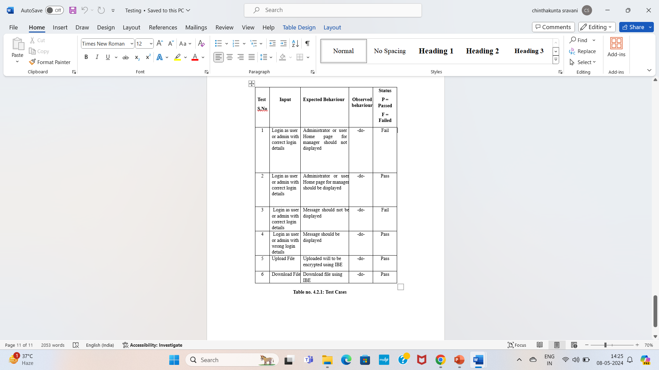
Test cases

Slide 35
IMPLEMENTATION
Implementation is the process of assuring the information system which is operational and then allowing user take its operation for its operations for use and evaluation.

Slide 36
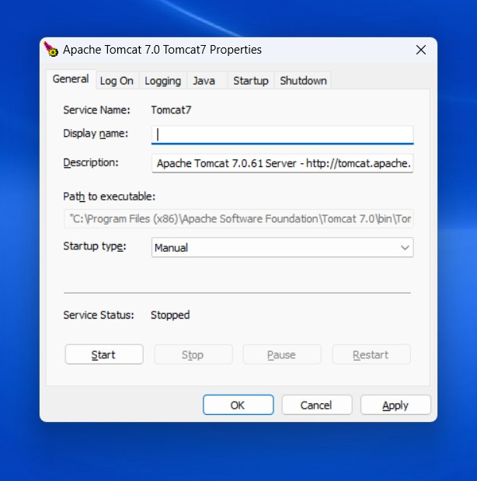
Tomcat Page

Slide 37
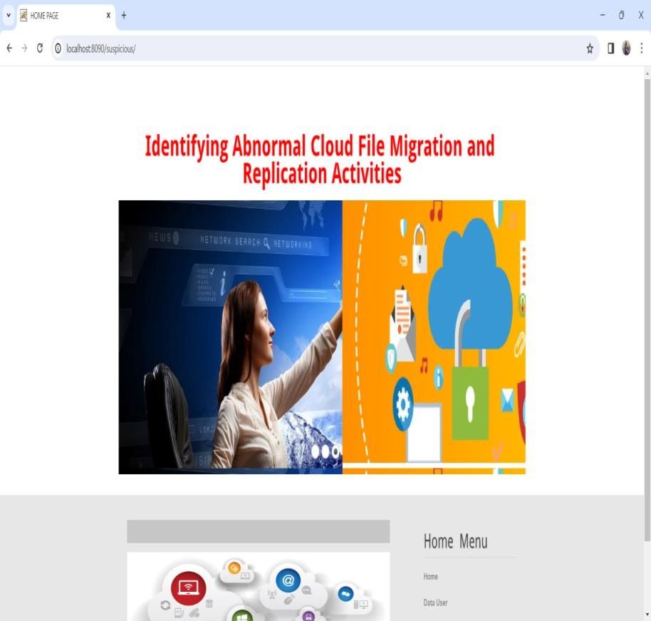
Home Page

Slide 38
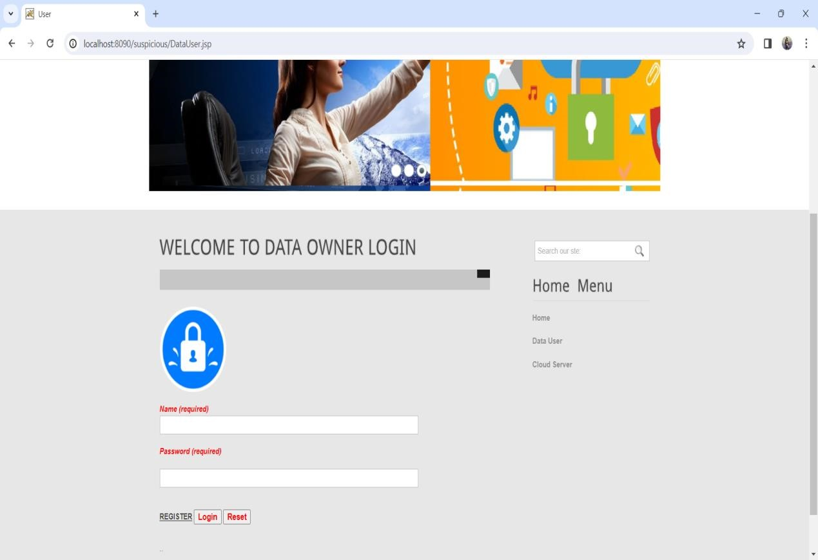
Data UserLogin Page

Slide 39
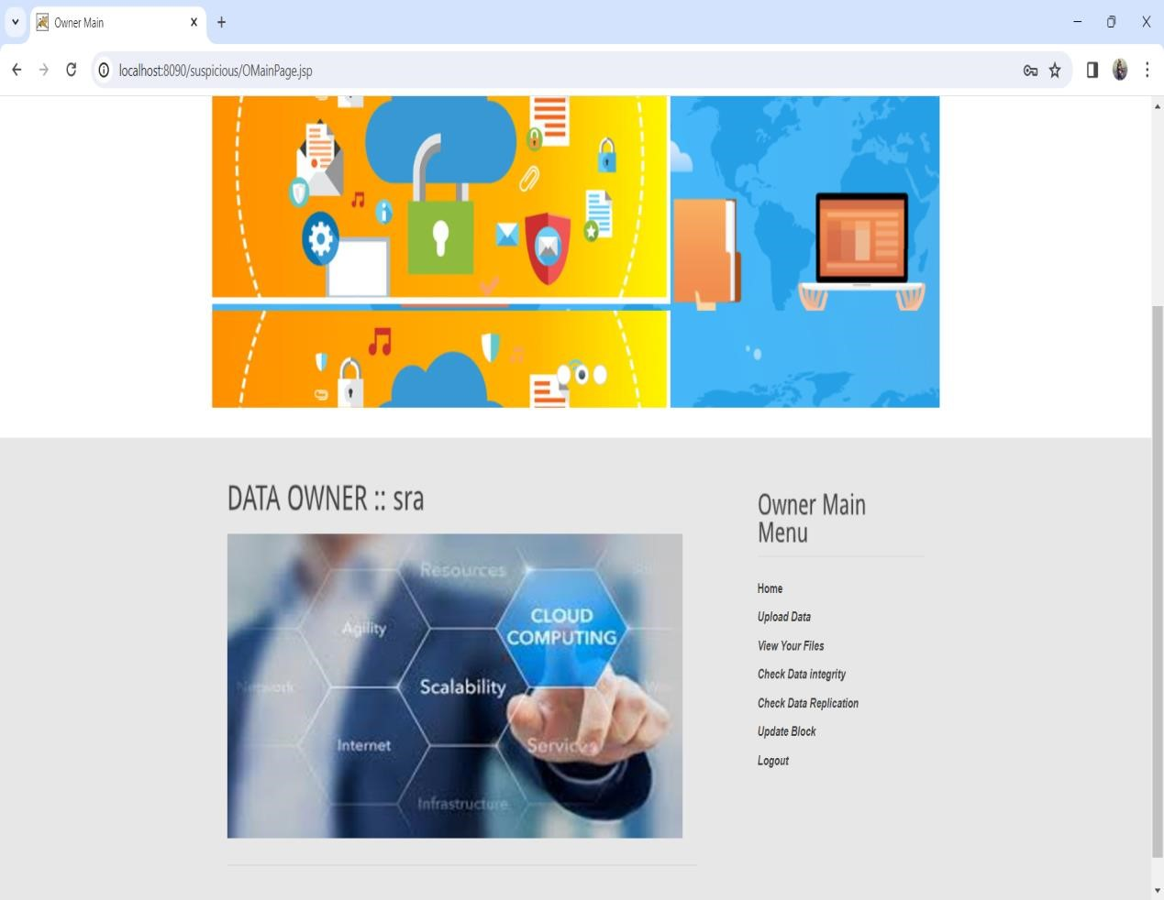
Data Owner

Slide 40
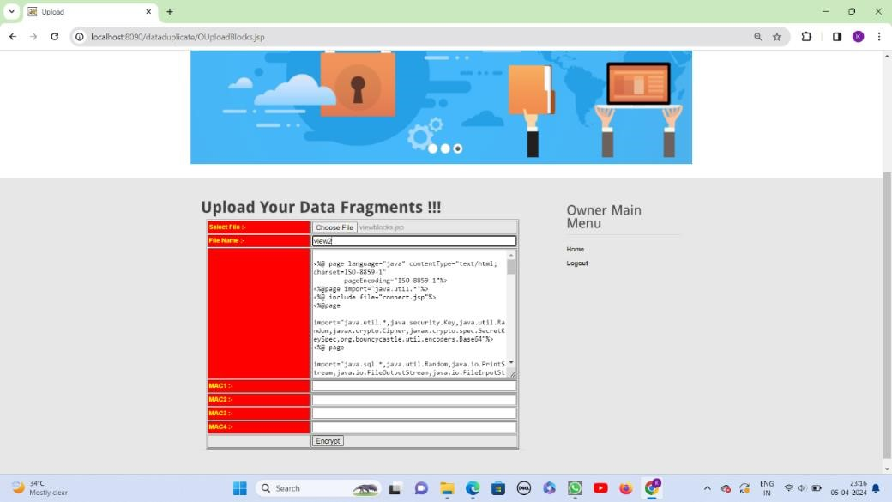
Encrypt The Fragment

Slide 41
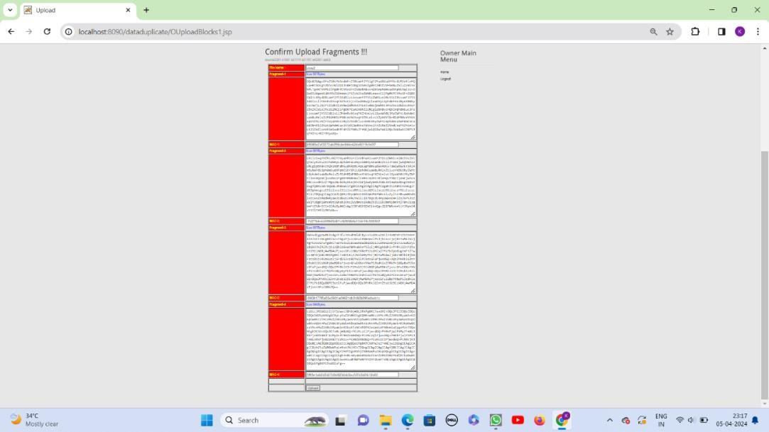
Uploading The Fragment

Slide 42
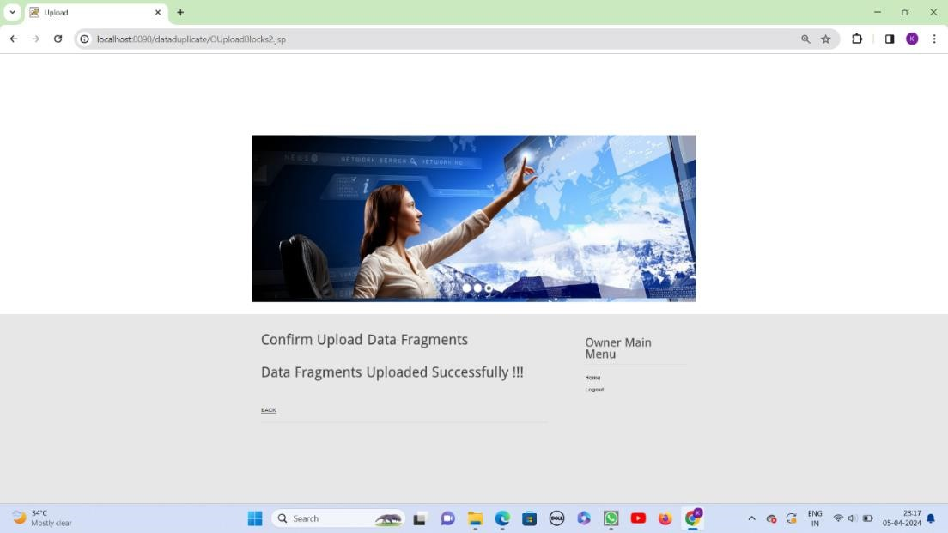
Upload Successfully

Slide 43
Data User Page

Slide 44
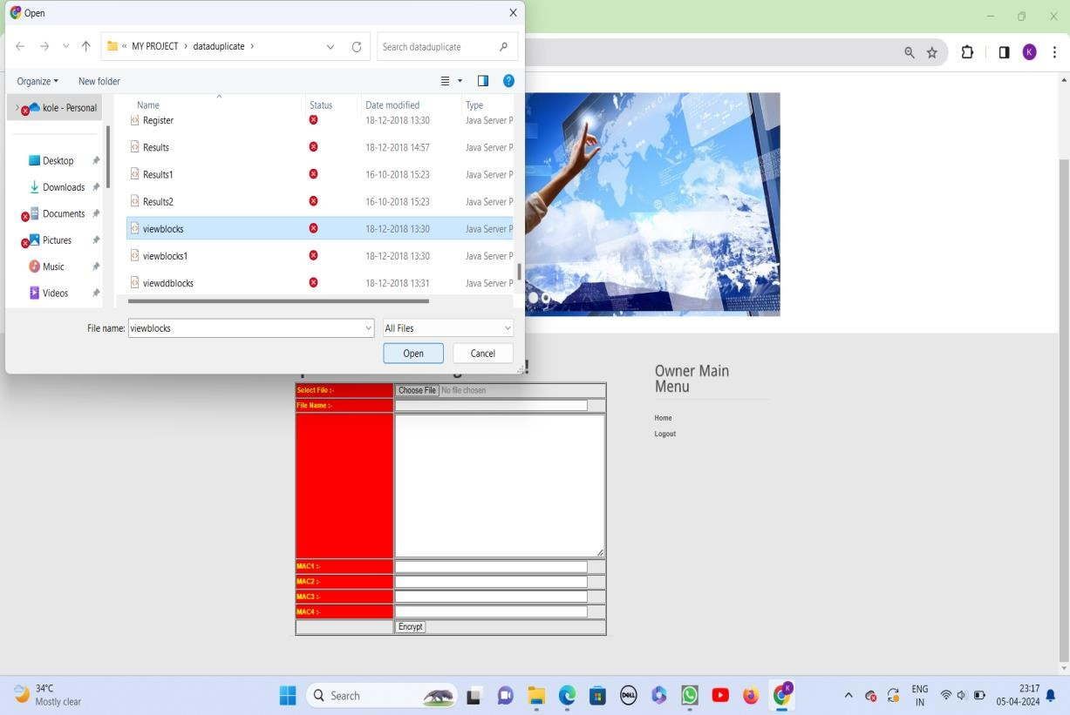
Selecting The Code

Slide 45
Encrypt With Another Name

Slide 46

Upload The Fragment

Slide 47
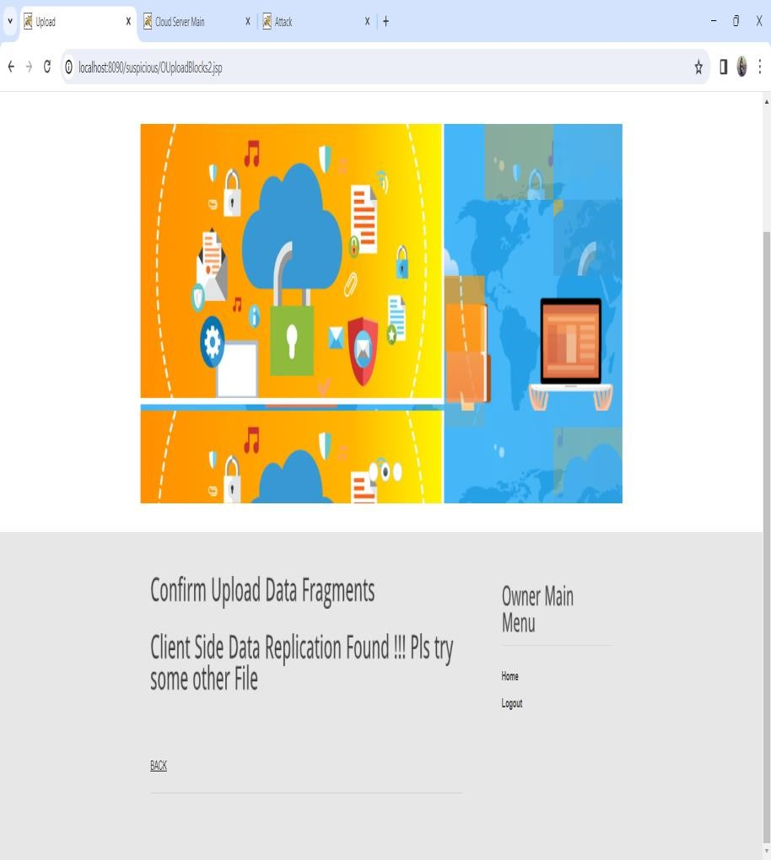
Duplicate Data Found

Slide 48
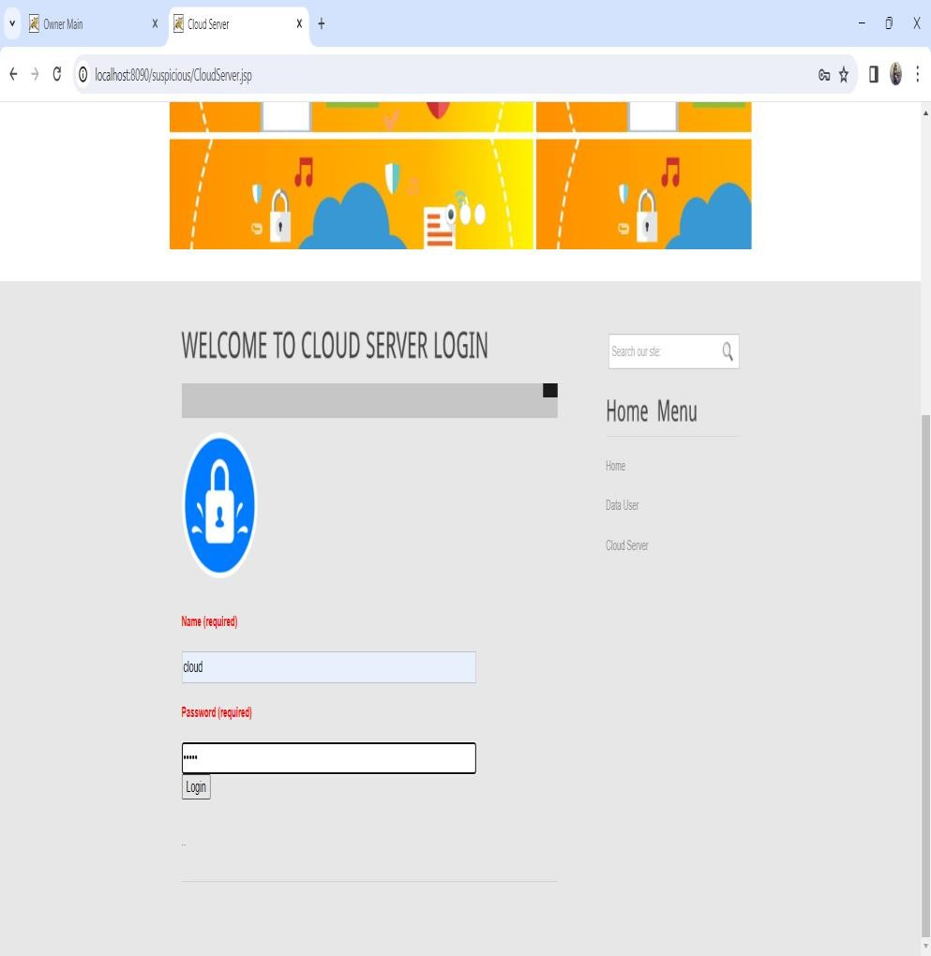
Cloud Server login Page

Slide 49
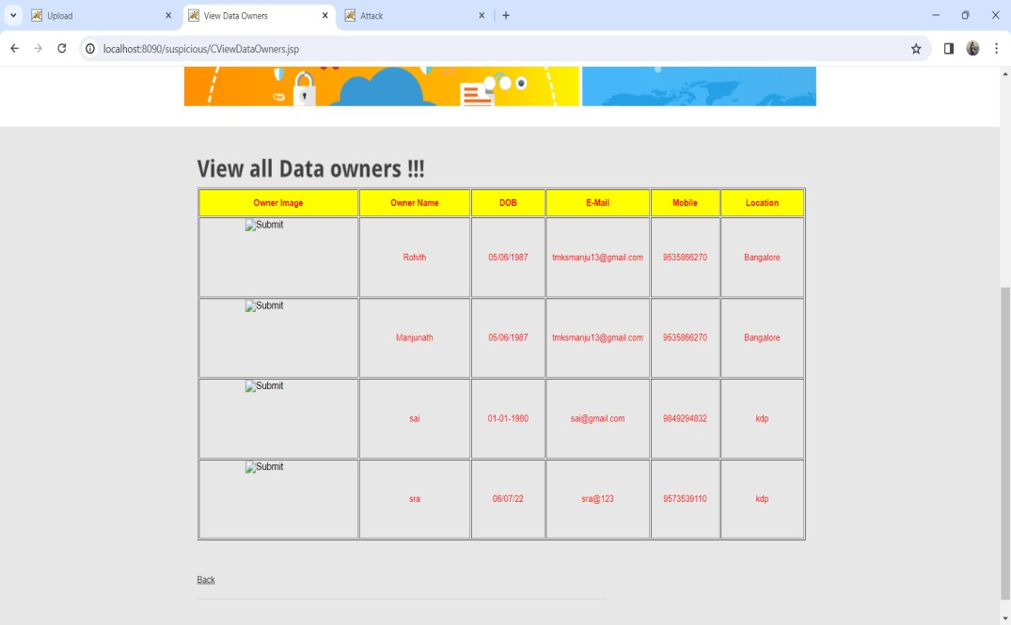
View All Data Owners

Slide 50
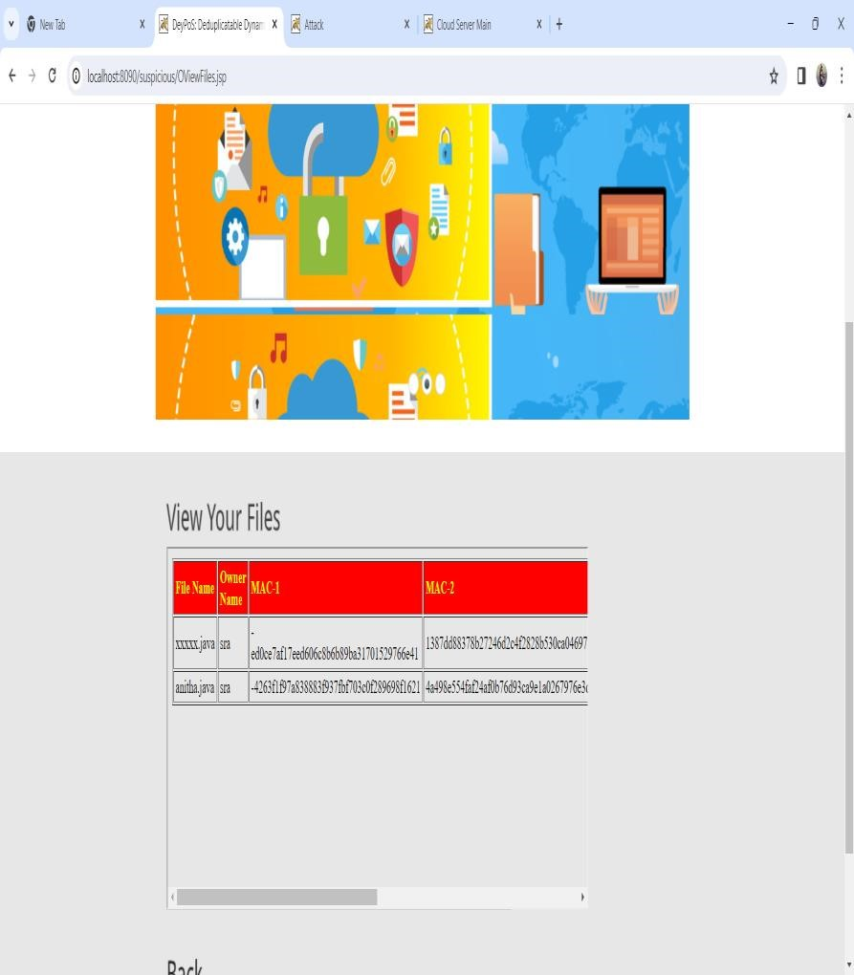
View Your Files

Slide 51
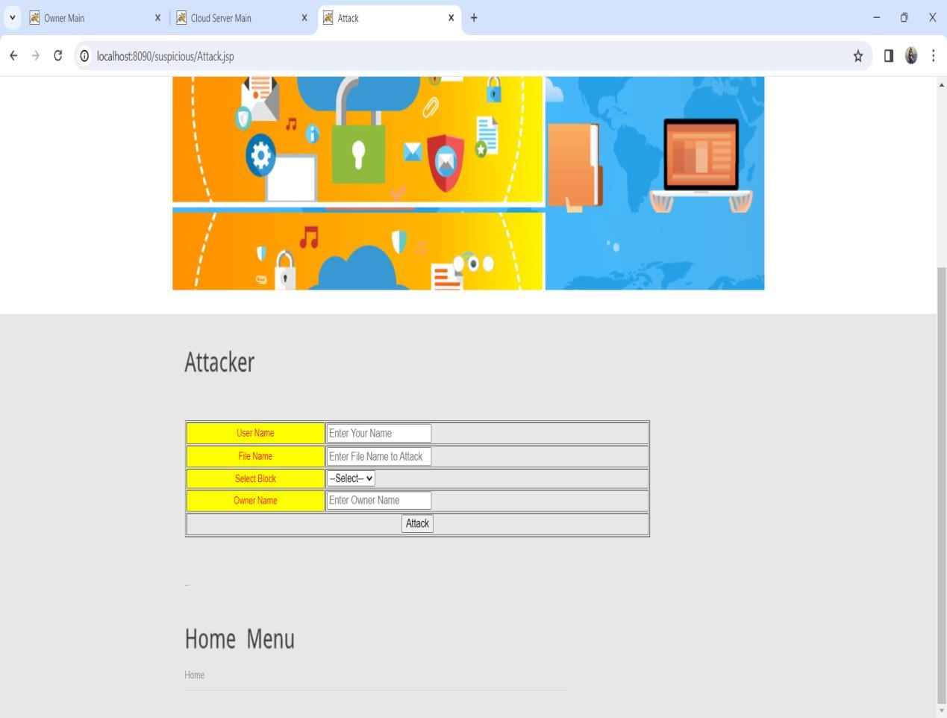
View Attackers Page

Slide 52
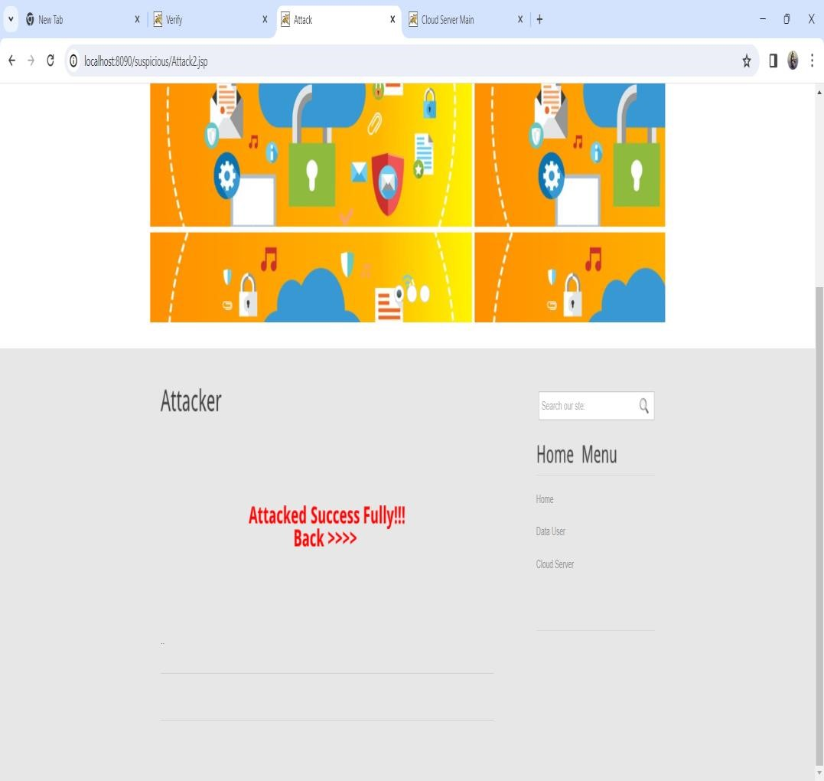
Attacking Your Files

Slide 53
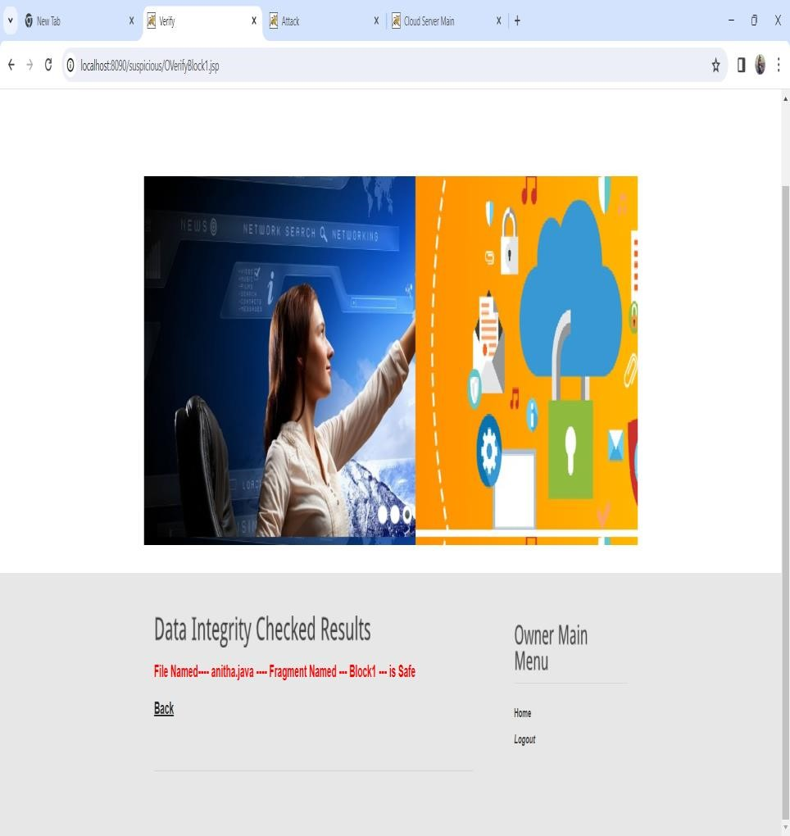
Data Integrity Check

Slide 54
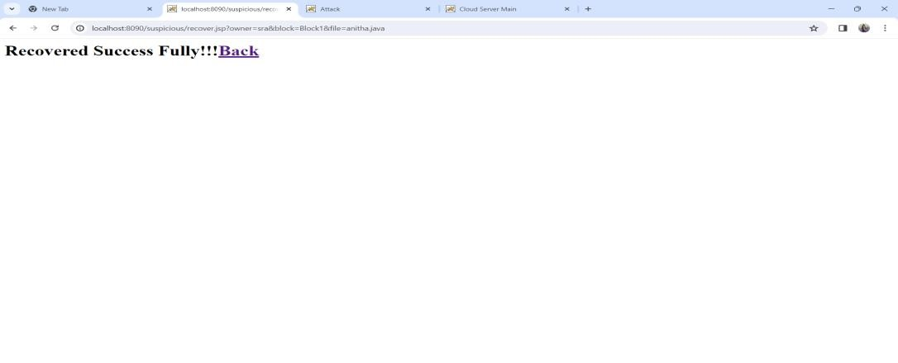
Recovered Your Files

Slide 55
CONCLUSION
In this project, we build, on top of the existing HDFS, a novel LAST-HDFS system to address the data placement control problem in the cloud. LAST-HDFS supports policy-driven file loading that enables location-aware storage in cloud sites. More importantly, it also ensures that the location policy is enforced regardless of data replication and load balancing processes that may affect policy compliance. Specifically, an efficient LP-tree and Legal File Transfer graph were designed to help optimally allocate files with similar location preferences to the most suitable cloud nodes which in turn enhance the chance of results have shown the effectiveness and efficiency of the proposed LAST-HDFS system.

Slide 56
Thank you

