Slide 1

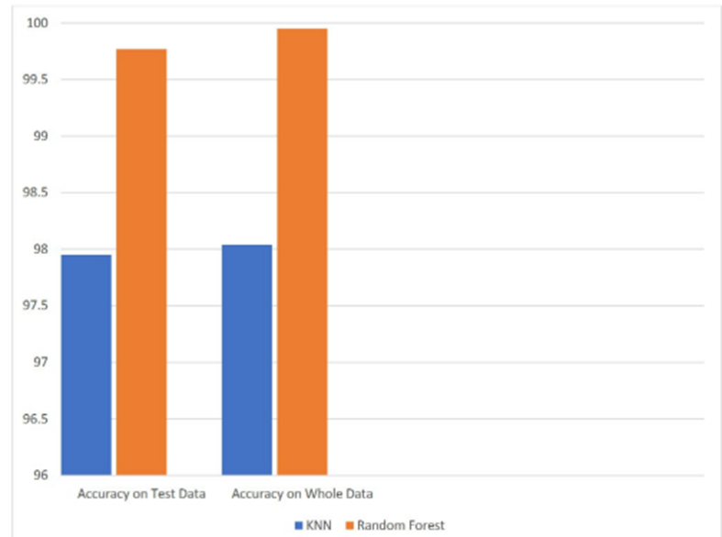
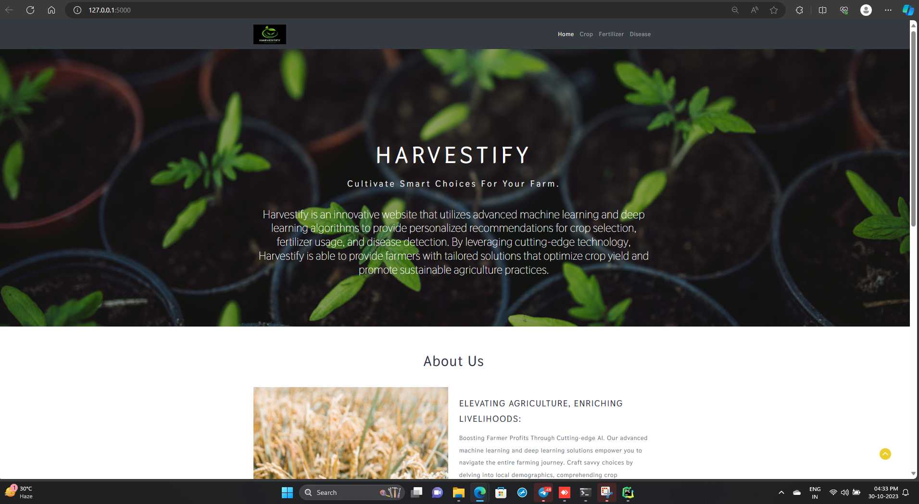
Koneru Lakshmaiah Education Foundation, Hyderabad(Aziz Nagar, Off Campus)
HARVESTIFY
P MOUNIKA REDDY, MEKALA SRAVANI
Department of Computer Science and Engineering, Koneru Lakshmaiah Education Foundation, Hyderabad-500075, Telangana, India.
Abstract
Methods and Materials
Problem Statement
Agriculture is a crucial part of the global economy, providing food and raw materials for various industries. Precision agriculture techniques have gained significant attention to enhance productivity and sustainability. Machine learning is a valuable tool in this context, optimizing crop selection and fertilizer usage.
This project develops a Crop and Fertilizer Recommendation System (CFRS) that uses machine learning algorithms to assist farmers in making informed decisions. The CFRS collects data from various sources, including soil characteristics, climate conditions, historical crop performance, and expert knowledge, to provide personalized recommendations to farmers.
⋄ Precision in Crop Selection: Harvestify aims to employ ML and DL algorithms to analyze various environmental factors and historical data, providing users with accurate recommendations on the best crops to cultivate based on their location and soil conditions.
⋄ Smart Fertilizer Suggestions: It uses machine learning algorithms to analyze soil samples and provide customized fertilizer recommendations based on the specific nutrient needs of your crops. It ensures to provide specific application rates for each recommended fertilizer, ensuring that you use the correct amount for optimal crop growth and health.
⋄ Early Detection of Crop Diseases: Harvestify strives to be a proactive guardian for crops. By leveraging deep learning, the platform aims to identify potential diseases at an early stage, enabling farmers to take preventive measures and minimize crop loss.
Taking on the formidable challenge of sustainable agriculture, our mission is to pioneer a cutting-edge machine learning project. This initiative is poised to redefine farming practices by offering a bespoke solution: personalized recommendations for both crops and fertilizers. The crux of our endeavor lies in not just optimizing yields but doing so with an unwavering commitment to resource efficiency and eco-friendly farming practices.
By harnessing the power of machine learning, we aspire to provide farmers with tailored insights, empowering them to make informed decisions that transcend the limitations of traditional approaches.
Introduction
Results
Conclusions
From ancient period, agriculture is considered as the main and the foremost culture practiced in India. Ancient people cultivate the crops in their own land and so they have been accommodated to their needs. Since the invention of new innovative technologies and techniques in the agriculture field is slowly degrading.
Utilizing machine learning methods and examining agricultural datasets, our objective is to establish a crop yield prediction system. We have developed this system through the implementation of machine learning algorithms with the aim of benefiting farmers. Our system is designed to provide recommendations for the most appropriate crop to cultivate on a particular parcel of land, taking into account its composition and prevailing weather conditions.
In this project, we present a website in which the following applications are implemented; Crop recommendation, Fertilizer recommendation respectively
In the crop recommendation application, the user can provide the soil data from their side and the application will predict which crop should the user grow.
To predict crop, ML algorithms such as KNN and Random Forest is used. Both KNN and Random Forest classifier provides a good result. Accuracy was greater than 90cases. Random Forest classifier proves to be better in terms of accuracy.
For test data as well as for the whole dataset, random forest proves to be much better algorithm for crop predication. Random Forest performed quite well and reaching accuracy of 99%. For fertilizer recommendation, again the same ML algorithms KNN and Random Forest is used.
From ancient period, agriculture is considered as the main and the foremost culture practiced in India. Ancient people cultivate the crops in their own land and so they have been accommodated to their needs. Since the invention of new innovative technologies and techniques in the agriculture field is slowly degrading. Both KNN and Random Forest performed quite well. But random forest performed a little more than KNN with 3-4% more accuracy. The dataset was balanced and didn’t cause any problem however entries in the dataset were less. Although the accuracy is very high, it would be much better if there was a much better datasets available. The UI of the web application is quite simple and easy to use. With the help of the sensors in the agriculture land there would be no need to enter the values manually.
Figure 1. KNN vs Random forest - Crop
Figure 2 Home Page of Website
Future Scope
The scope of the project is to develop a machine learning system that recommends suitable crops and fertilizers based on soil and environmental data for optimal agricultural yield.
Contact Information
References
Acknowledgements
P. MOUNIKA REDDY
Y20 - CSE
KL UNIVERSITY, HYDERABAD
Email: 2010030485@klh.edu.in
SRAVANI MEKALA
Y20 - CSE
KL UNIVERSITY, HYDERABAD
Email: 2010030104@klh.edu.in
S. M. PANDE, P. K. RAMESH, A. ANMOL, B. R. AISHWARYA, K. ROHILLA and K. SHAURYA, ”Crop Recommender System Using Machine Learning Approach,” 2021 5th International Conference on Computing Methodologies and Communication (ICCMC), 2021, pp. 1066-1071, doi: 10.1109/ICCMC51019.2021.9418351. https://ieeexplore.ieee.org/docu
Dasari, Anantha Reddy Dadore, BhagyashriWatekar, Aarti. (2019).Crop Recommendation System to Maximize Crop Yield in Ramtek region using Machine Learning. International Journal of Scientific Research in Science and Technology. 485-489. 10.32628/IJSRST196172.https://www.researchgate.net/publication/331426761CropRecommendationSystemtoMaximiz
M. Keerthana, K. J. M. Meghana, S. Pravallika and M. Kavitha, ”An Ensemble Algorithm for Crop Yield Prediction,” 2021 Third International Conference on Intelligent Communication Technologies and Virtual Mobile Networks (ICICV), 2021, pp. 963-970, doi: 10.1109/ICICV50876.2021.9388479.https://ieeexplore.ieee.org/document/9388479
S. Bhanumathi, M. Vineeth and N. Rohit, ”Crop Yield Prediction and Efficient use ofFertilizers,” 2019 International Conference on Communication and Signal Processing(ICCSP), 2019, pp. 0769-0773, doi: 10.1109/ICCSP.2019.8698087.
We would like to thank the following people for their support and guidance without whom the completion of this project in fruition would not be possible. Dr.G.Madhukar, our project guide, for helping us and guiding us in the course of this project . Dr.Arpita Gupta, the Head of the Department, Department of Computer Science. Our internal reviewers, Dr.kakali das, Dr.Figlu Mohanty , MR.Sasidhar K, Mr.Chanda Raj Kumar for their insight and advice provided during the review sessions. We would also like to thank our individual parents and friends for their constant support.

