Slide 1
ENERGY-EFFICIENT ADAPTIVE CLUSTERED ROUTING FOR WSNs USING GENETIC BEE COLONY AND AQUILA VULTURE OPTIMIZATION
Presented by
BATCH NO: 06
D.Sravani 21NG1A0474
SK.Praveen 21NG1A04A4
K.Sai Venkat 22NG5A0413
V.Siva Sai Kumar 21NG1A04B0
UNDER THE ESTEEMED GUIDANCE OF
Dr. B. NANCHARAIAH, B.E, M.TECH, Ph.D.
Professor & Head of the department
DEPARTMENT OF ELECTRONICS AND COMMUNICATION ENGINEERING

Slide 2
CONTENTS
ABSTRACT
INTRODUCTION
LITERATURE SURVEY
EXISTING SYSTEM
EXISTING SYSTEM BLOCK DIAGRAM
EXISTING SYSTEM DRAWBACKS
PROPOSED SYSTEM NECESSITY(Problem Identification)
PROPOSED SYSTEM BLOCK DIAGRAM
PROPOSED SYSTEM EXPLANATION/DESCRIPTION
PROJECT REQUIREMENTS ( SOFTWARE)
RESULTS AND ITS ANALYSIS
ADVANTAGES
APPLICATIONS
CONCLUSIONS
REFERENCES

Slide 3
1. ABSTRACT
Wireless Sensor Networks have been used for sensing and gathering data about an environment from a remote location for many years in a variety of engineering applications.
In WSN, nodes must overcome energy consumption to function efficiently. To resolve these issues and extend the use fulness of the network, clustering and routing algorithms are promising.
One of the main issues with WSNs is that they lack restricted energy sources. To overcome this issue, a Hybrid Optimized Energy Efficient Adaptive Clustered Routing approach (HOEEACR) has been proposed for WSNs.
This paper presents the Genetic Bee Colony(GBC) Algorithm for Cluster Head Selection by considering distances to neighbors, residual energy, node degrees, and node centralities. Furthermore, an optimal routing path for the cluster heads is found by utilizing the Aquila with African Vulture Optimization (AAVO) algorithm.
The AAVO optimizes network performance using residual energy, node degree, and distance. The proposed HOEEACR method has been extensively tested to ensure network lifetime and energy efficiency.

Slide 4
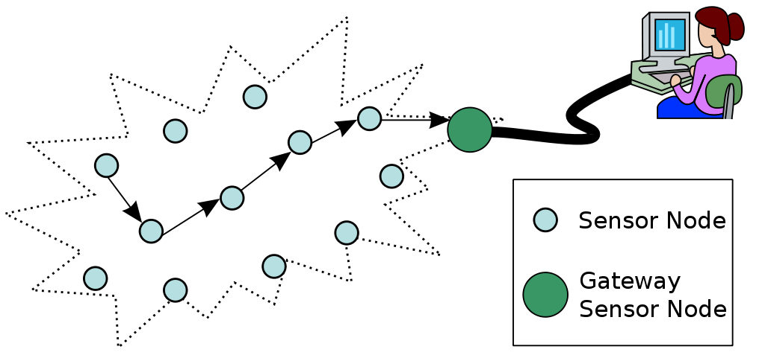
2. INTRODUCTION
WSN involves hundreds or thousands of sensor nodes distributed throughout the environment and used to collect, process, and retrieve data.
These sensor nodes are cost effective and have a large capacity to collect, process, and transmit information.
All environmental data packets are sent to a network node, commonly called a base station (BS), for further processing. Sensor nodes are typically used in locations where human interaction is difficult or impossible.
The entire area of interest needs to 941be covered, but the sensor’s battery power is limited. Moreover, the life time of WSNs is energy-dependent and distributed sensor nodes are more susceptible to damage.
Figure 1 : The diagram of WSN

Slide 5
When a large number of sensors are placed for sensing purposes in sensor network applications, hierarchical
cluster-based routing techniques are crucial.
Reduced node energy usage during data transmission is the goal of this research. As a result, sensor nodes use less energy and more packets are transmitted to the BS overall.
A Hybrid Optimized Energy Efficiency Adaptive Cluster Routing (HOEEACR) method for large-scale WSNs has been proposed.
The HOEEACR approach improves the performance of sensor networks by selecting the best nodes and optimizing routing paths for energy efficiency and longevity.

Slide 6
3. LITERATURE SURVEY
GAPSO-H:A hybrid approach towards optimizing the cluster-based routing in wireless sensor network
(B. M. Sahoo, H. M. Pandey, and T. Amgoth,2021)
Techniques Used:
Hybrid of GA & PSO (Genetic Algorithm & Particle Swarm Optimization)used for optimizing sink mobility and selecting CH
Improved Parameters:
Energy Efficiency, Network Lifetime, Routing Overhead, Cluster Formation
Drawbacks Identified:
Computational Complexity, Slower Convergence, Scalability Issues
2. Multi-objective derived energy efficient routing in wireless sensor networks using hybrid African vultures-cuckoo search optimization,(A. Asha, N. Verma, and I. Poonguzhali,2023)
Techniques Used:
Hybrid African Vultures & Cuckoo Search Optimization used for to optimize energy-efficient routing in wireless sensor networks.
Improved Parameters:
Energy Efficiency, Network Lifetime, Routing Optimization
Drawbacks Identified:
High Complexity, Tuning Parameters Required

Slide 7
3. Energy-Efficient Cluster-Based Routing Using Moth Levy and Grey Wolf Optimization
(N.Malisetti,ans V.K.pamula,2022)
Technique Used:
Moth Levy Optimization for exploring optimal cluster formations with Grey Wolf Optimization
Improved Parameters:
Energy consumption, network lifetime.
Drawbacks:
Higher computational complexity compared to HOEEACR, particularly in real-time scenarios.
4.“Energy efficient cluster-based routing protocol for WSN using butterfly optimization algorithm and ant colony optimization”,(P. Maheshwari, A. K. Sharma, and K. Verma, 2021)
Techniques Used:
Butterfly Optimization & Ant Colony Optimization (ACO) used to reduce energy usage and increase network
longevity.
Improved Parameters:
Energy Efficiency, Routing Efficiency
Drawbacks Identified:
High Computational Cost, Parameter Sensitivity

Slide 8
5.Energy-efficient cluster-based routing protocol for wsn based on hybrid bso–tlbo optimization model,(K. Krishnan, B. Yamini, W. M. Alenazy, and M. Nalini,2021)
Techniques Used:
BSO (Brain Storm Optimization) & TLBO (Teaching-Learning Based Optimization) to lengthen the network’s lifespan.
Improved Parameters:
Energy Efficiency, Network Lifetime,Throughput.
Drawbacks Identified:
Complex Implementation, Parameter Sensitivity.
6.Energy efficient cluster-based routing protocol for WSNusing firefly algorithm and ant colony
optimization,( Z. Wang, H. Ding, B. Li, L. Bao, Z. Yang, and Q. Liu,2021)
Techniques Used:
Firefly Algorithm & Ant Colony Optimization (ACO) was capable of balancing network energy consumption extending network lifetime
Improved Parameters:
Energy Efficiency, Routing Optimization
Drawbacks Identified:
High Complexity, Longer Convergence Time

Slide 9
7. “Improved metaheuristic driven energy-aware cluster-based routing scheme for IoT assisted wireless sensor networks,”(K. Lakshmanna, N. Subramani, Y. Alotaibi, S. Alghamdi, O.I. Khalafand, and A. K. Nanda,2022)
Techniques Used:
Metaheuristics for Energy-Aware Cluster Routing approach that combines energy-aware clustering and optimized routing to enhance the efficiency and performance .
Improved Parameters:
Energy Efficiency, Routing Performance
Drawbacks Identified:
Complex Algorithms, Scalability Issues
8. “Multi-objective derived energy efficient routing in wireless sensor networks using hybrid African vultures-cuckoo search optimization”,(A. Asha, N. Verma, and I. Poonguzhali,2023)
Techniques Used:
Hybrid African Vultures-Cuckoo Search Optimization
Improved Parameters:
Energy Efficiency, Network Lifetime
Drawbacks Identified:
High Computational Cost, Difficulty in Parameter Selection

Slide 10
9. F2SO: An energy efficient cluster-based routing protocol using fuzzy firebug swarm optimization algorithm
in WSN”,(K. Suresh, S. S. Sreeja Mole, and A. J. S. Kumar,2023)
Techniques Used:
Fuzzy Logic: Determines Cluster Head (CH) selection based on residual energy, distance, and node degree.
Firebug Swarm Optimization: Optimizes clustering and routing
Improved Parameters:
Energy Efficiency, Cluster Head Selection Optimization
Drawbacks Identified:
Limited performance in large-scale WSNs due to higher processing overhead.
10. “Slime mould algorithm based fuzzy linear CFO estimation in wireless sensor networks”, (M. Prabhu,
B. Muthu Kumar, and A. Ahilan,2023)
Techniques Used:
Slime Mould Algorithm & Fuzzy Logic for CFO Estimation to optimize energy-efficient routing and cluster head
selection in wireless sensor networks
Improved Parameters:
Accuracy in CFO Estimation
Drawbacks Identified:
Not Directly Related to Routing

Slide 11
LITERATURE SURVEY
S.NO | TITLE | YEAR OF PUBLISH | TECHNIQUES | PARAMETERS | ADVANTAGES
1 | Energy efficient cluster-based routing protocol for WSN using butterfly optimization algorithm and ant colony optimization | 2021 | Ant Colony Optimization + Butterfly Optimization | Residual energy, distance, cluster head selection | Increases energy efficiency and network lifetime
2 | Energy-efficient cluster-based routing protocol for wsn based on hybrid bso–tlbo optimization model | 2021 | BSO+ TLBO | Energy consumption, node degree, distance, node centrality | Improves energy use, network data rate
3 | GAPSO-H: A hybrid approach towards optimizing the cluster-based routing in wireless sensor network | 2021 | Genetic Algorithm +Particle Swarm Optimization | Fitness function (energy, distance), cluster quality | Reduces CH re-selection costs and adapts well to sink mobility
4 | Hybridization of metaheuristic algorithm for dynamic cluster-based routing protocol in wireless sensor networks | 2021 | Hybrid Metaheuristic Cluster-Based Routing | Energy consumption, node degree. | Ensure network longevity and dynamic
5 | Energy-aware cluster-based routing protocol for WSN based IoT | 2022 | Energy Aware Cluster Based Routing | Residual Energy,Distance to Base Station | Prolongs Network Lifetime by Balancing Energy Consumption

Slide 12
S.NO | TITLE | YEAR OF PUBLISH | TECHNIQUES | PARAMETERS | ADVANTAGES
6 | Hybridization of metaheuristic algorithm for dynamic cluster-based routing protocol in wireless sensor networks | 2021 | Hybrid Metaheuristic Cluster-Based Routing | Energy consumption, node degree. | Ensure network longevity and dynamic
7 | F2SO: An energy efficient cluster-based routing protocol using fuzzy firebug swarm optimization algorithm in WSN | 2023 | Fuzzy Firebug Swarm Optimization (F2SO) algorithm | Network Load and Traffic Patterns | Enhances Packet Delivery Ratio and Reduces End-to-End Delays
8 | Energy efficient cluster-based routing protocol for WSN using firefly algorithm and ant colony optimization | 2022 | Firefly + Ant Colony Optimization | Energy Efficiency, network lifetime | Balances energy, improves data delivery
9 | Slime mould algorithm based fuzzy linear CFO estimation in wireless sensor networks | 2023 | Slime Mold Optimization | Node residual energy | Extends network life
10 | Multi-objective derived energy efficient routing in wireless sensor networks using hybrid African vultures-cuckoo search optimization, | 2023 | African Vulture + Cuckoo Search Optimization | Residual energy, transmission range, link quality | High packet delivery ratio, stable data transmission

Slide 13
4. EXISTING SYSTEM
In this existing the energy-efficient method which utilizes the Brainstorm algorithm in order to adopt the ideal CH to reduce energy-draining.
Further, the effectiveness of the Brain Storm Optimization (BSO) algorithm is enhanced with the incorporation of the Modified Teacher-Learner Optimized(MTLBO) algorithm with it.
The modified BSO-MTLBO algorithm can be used to attain an improved throughput, network lifetime, and to reduce the energy consumption by nodes and CH, death of sensor nodes, routing overhead.
People from different background are grouped together Produce a maximum number of ideas corresponding to the above norms Analyze the problem to select the best ideas.
The BSO algorithm is exploited to form the clusters of effective sensor nodesThe TLBO algorithm is used to fine-tune the parameters of BSO for a better selection of CH.
The fitness functions used in the ranking phase are used to improve the energy efficiency of the system. optimal routing is selected by the modified BSO algorithm.

Slide 14
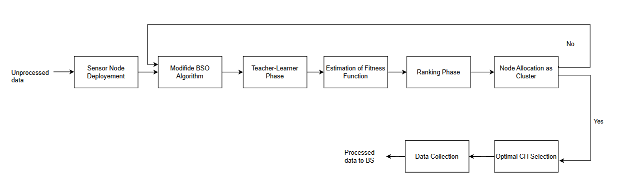
5. EXISTING SYSTEM BLOCK DIAGRAM
Energy Efficient Cluster based Routing Protocol for WSN based on Hybrid BSO-TLBO Optimization Model
Figure 2 :Block diagram of Hybrid BSO-TLBO Optimization Model

Slide 15
IT’S WORKING
Sensor Node Development: This phase involves the deployment of sensor nodes in the test area. Test area which will check the active nodes to collect data and communication modules to transmit data to other nodes and the base station (BS).
Application of Modified BSO Algorithm: The Brain Storm Optimization (BSO) algorithm is applied on the test area.By clustering phase it will check energy of each nodes in the network for better selection of cluster head.
Teacher-Learner Phase: It involves a learning process where nodes learn from each other to improve their fitness values. The fitness function is likely based on factors like energy consumption, data transmission distance, and network coverage.
Ranking Phase: In this phase, nodes are ranked based on their fitness values. Nodes with higher fitness values are more likely to be selected as CHs.
Estimation of Fitness Function: The fitness function is estimated using various parameters, including residual energy, node degree (number of neighbors), node centrality (importance in the network), distance between nodes, and distance between the CH and the BS.
Node Allocation: Based on the fitness values, nodes are allocated to clusters. Nodes with higher fitness values are more likely to be selected as CHs.
Optimal CH Selection: If the weight of the fitness function of a sensor node is higher, it is selected as the CH. Otherwise, it becomes a non-CH node.
Data Transfer to BS: Once the clusters are formed and CHs are selected, data is collected from sensor nodes and forwarded to the base station through the CHs.

Slide 16
6. EXISITING SYSTEM DRAWBACKS
High Computational Complexity
Energy Imbalance
Limited Scalability
Potential Convergence Issues
It takes more amount of looping period when compare with HOEEACR
Increased Communication Overhead

Slide 17
7. PROPOSED SYSTEM NECESSITY (Problem Identification)
Problem Identification:
Energy Scarcity in WSNs:Wireless Sensor Networks (WSNs) are heavily constrained by limited energy resources, making energy management crucial for extending network lifetime.
Inefficient Data Transmission:Existing routing and clustering methods often fail to optimize energy consumption effectively, leading to unbalanced energy usage and reduced network performance.
Challenges in Routing:Reliable data transmission suffers due to limited battery life, increased transmission delays, and reduced packet delivery rates.
Need for Optimization:Traditional methods lack advanced optimization techniques for selecting cluster heads and routing paths, resulting in significant overhead and inefficiency.

Slide 18
Necessity :
To address these challenges, a Hybrid Optimized Energy-Efficient Adaptive Clustered Routing (HOEEACR) approach is proposed. It leverages advanced algorithms for:
Cluster Head Selection: Using Genetic Bee Colony (GBC) optimization for energy-efficient clustering.
Optimal Routing: Employing Aquila and African Vulture Optimization (AAVO) for maximizing network lifetime and performance.
Key Features of the Proposed System:
Energy Balancing: Prevents early depletion of nodes by evenly distributing energy usage across the network.
Dynamic Adaptability: Adjusts cluster head selection and routing paths as the network state changes.
Performance Optimization: Combines the strengths of GBC and AAVO algorithms to maximize network efficiency and lifetime.

Slide 19
8. PROPOSED SYSTEM
The HOEEACR system is designed to improve the energy efficiency and lifetime of Wireless Sensor Networks (WSNs) by addressing challenges related to energy constraints and inefficient routing. It achieves this by combining two key optimization algorithms: the Genetic Bee Colony (GBC) Algorithm for cluster head selection and the Aquila with African Vulture Optimization (AAVO) Algorithm for routing.
The proposed method integrates the Genetic Bee Colony (GBC) Algorithm for efficient cluster head selection and the Aquila with African Vulture Optimization (AAVO) Algorithm for optimal inter-cluster routing.
The GBC algorithm ensures energy-efficient cluster head selection by considering multiple parameters, including residual energy, node centrality, and neighborhood distance.
The AAVO algorithm optimizes the routing path to balance energy consumption and improve overall network performance.
The Aquila with African Vulture Optimization (AAVO) Algorithm, minimizing energy consumption and ensuring reliable data transmission to the base station.

Slide 20
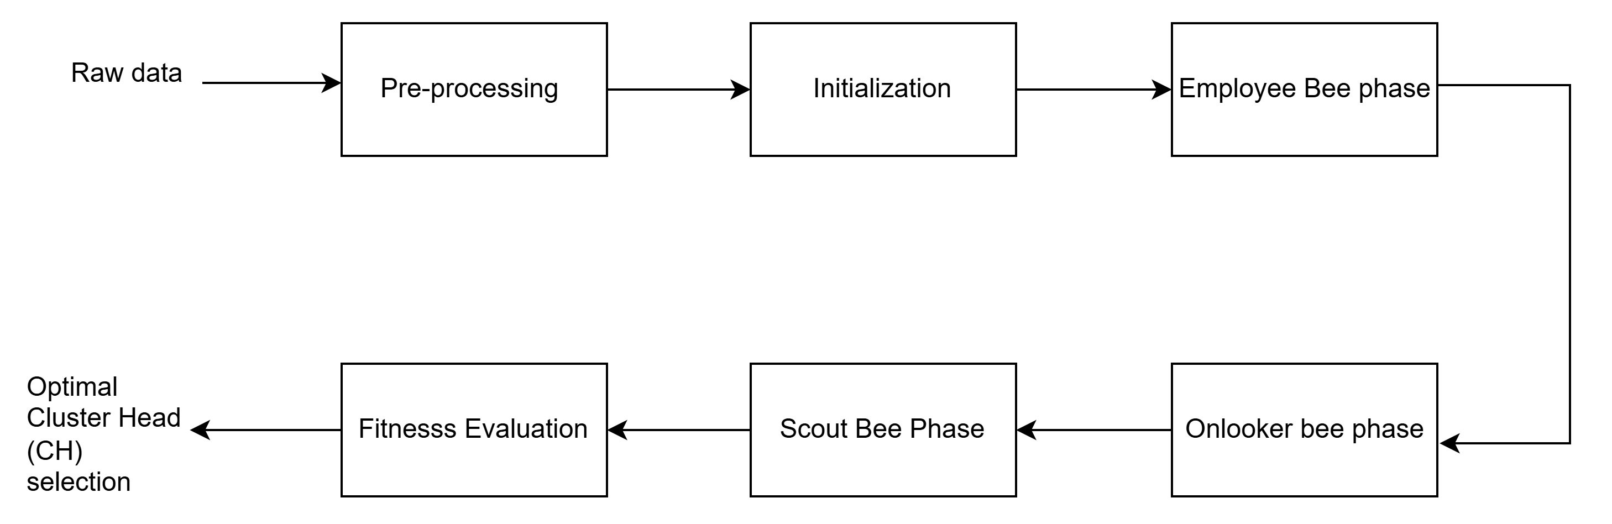
9. Proposed system block diagram
Figure 3: Block diagram of GBC

Slide 21
Working of GBC:
The Genetic Bee Colony (GBC) Algorithm approach is used in the HOEEACR technique to choose Cluster Heads (CHs) anmain aim to enhance the overall efficiency and longevity of the network or system.
1. Pre-processing Phase (MRMR Method):
The Minimum Redundancy Maximum Relevance (MRMR) technique is used to filter out redundant and irrelevant nodes.
Relevance: Measures how important a node is based on its connections.
Redundancy: Ensures selected nodes are unique and non-overlapping.
2. Initialization:
Each candidate CH is represented by a solution, and its position is optimized.
3. Employee Bee Phase:
Worker bees search for better food sources (better CHs) by effective current solutions.
Fitness of each CH is calculated to assess its quality.
4. Onlooker Bee Phase:
Bees prioritize the most promising food sources based on their fitness values.
Solutions are further improved using crossover (combination of solutions).
5. Scout Bee Phase:
Random exploration is performed to introduce diversity and avoid getting stuck in poor solutions.
Mutation operations (random changes) are used to discover new CH candidates

Slide 22
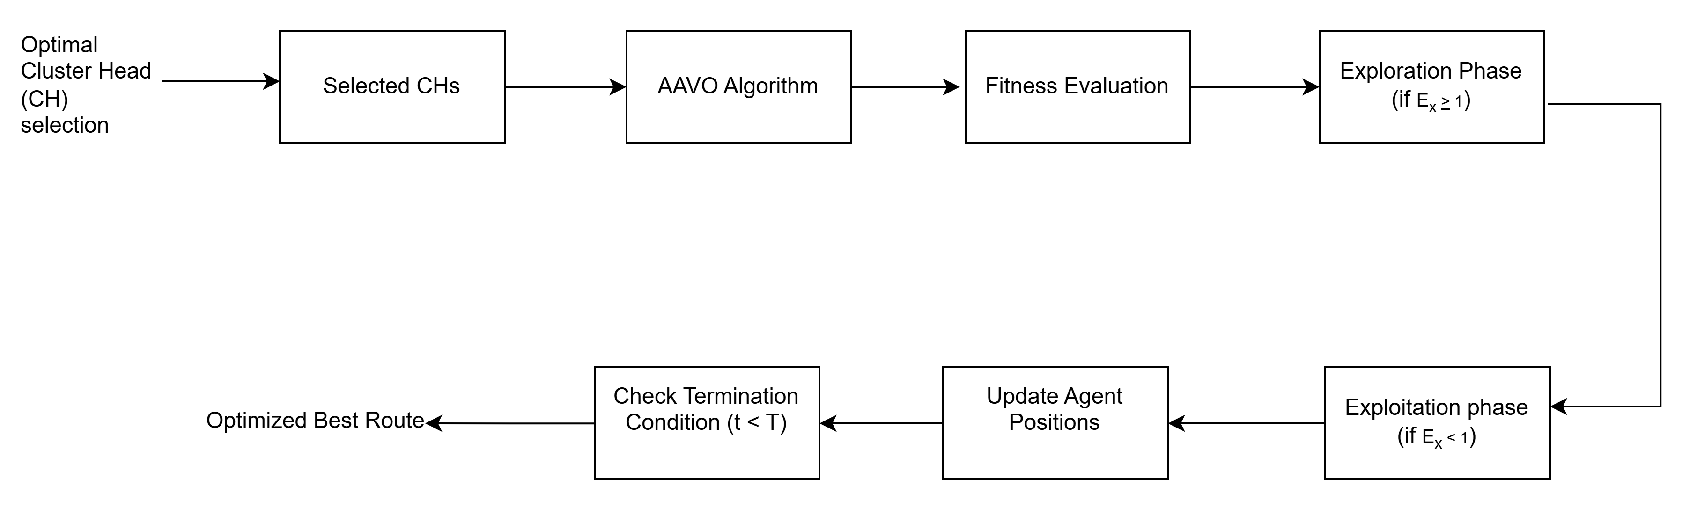
Figure 4:Block diagram of AAVO algorithm

Slide 23
Working of AAVO:
The Aquila with African Vulture Optimization (AAVO) algorithm is designed to find the most energy-efficient routes from CHs to the Base Station (BS). This hybrid algorithm leverages the strengths of both Aquila Optimizer (AO) and African Vulture Optimization Algorithm (AVOA)..
Selected CHs: The output from the GBC algorithm, which serves as input to the AAVO algorithm.
AAVO Algorithm: This algorithm optimizes routing paths based on the selected CHs.
Two vultures are chosen as the best and second-best solutions from the initial population of routes.
Fitness Evaluation: The positions of these vultures are updated using fitness values (energy, node degree, and distance)
Exploration Phase :Search widely to find the best possible routing paths.
Exploitation Phase: Focus on refining and improving the routes that were found during exploration.
Update Agent Positions:Based on the exploration or exploitation phases of AO and AVOA, the algorithm updates the
positions (characteristics) of the "agents" – which represent the candidate solutions (routes).
Optimized Best Route:If the termination condition is met (t < T), the algorithm stops and outputs the best solution (route) found across all iterations. This is the optimized route that meets the defined objectives and constraints.

Slide 24
10. PROJECT REQUIREMENTS(SOFTWARE)
Operating system : Windows
Coding Language : MATLAB
Software : MATLAB R2023a

Slide 25
11. RESULTS AND ITS ANALYSIS
Table1: Performance Comparison of Proposed and Existing Systems
METRIC | HOEEACR (Pro) | BSO-TLBO | GAPSO-H | EECRAIFA | IMD-EACBR | HAV-CSO
Network Lifetime (rounds) | 2800 | 2500 | 2200 |  | 1800 | 1600
Alive Nodes | 900 | 800 | 750 | 700 | 600 | 500
End-to-End Delay (ms) | 0.6-0.9 | 1.1 | 1.0 | 0.95 | 0.85 | 0.8
Energy Consumption (mJ) | 0.6 | 1.1 | 1.0 | 0.9 | 0.85 | 0.8
Throughput (Mbps) | 0.18 | 0.15 | 0.14 | 0.13 | 0.12 | 0.11
Packet Delivery Ratio (%) | 90% | 80% | 75% | 70% | 65% | 60%
Residual Energy (J) | 0.75 | 0.6 | 0.55 | 0.5 | 0.45 | 0.4
2000

Slide 26
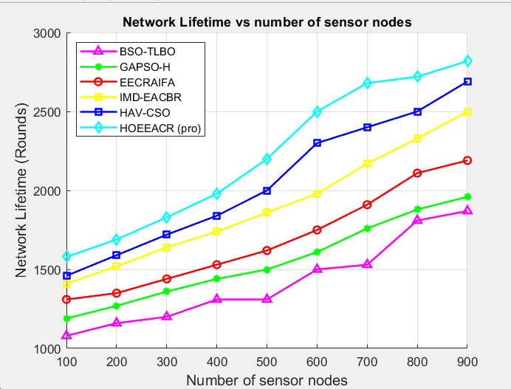
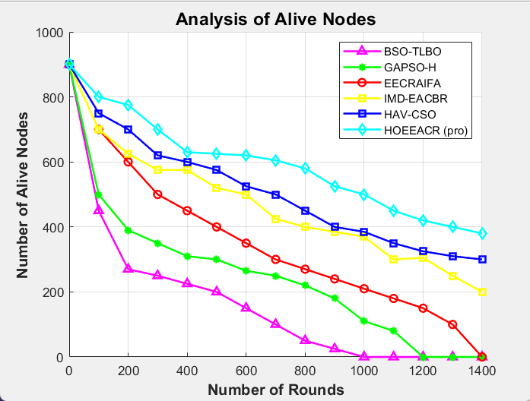
Figure5 : Network lifetime
Figure6 : Analysis of Alive nodes

Slide 27
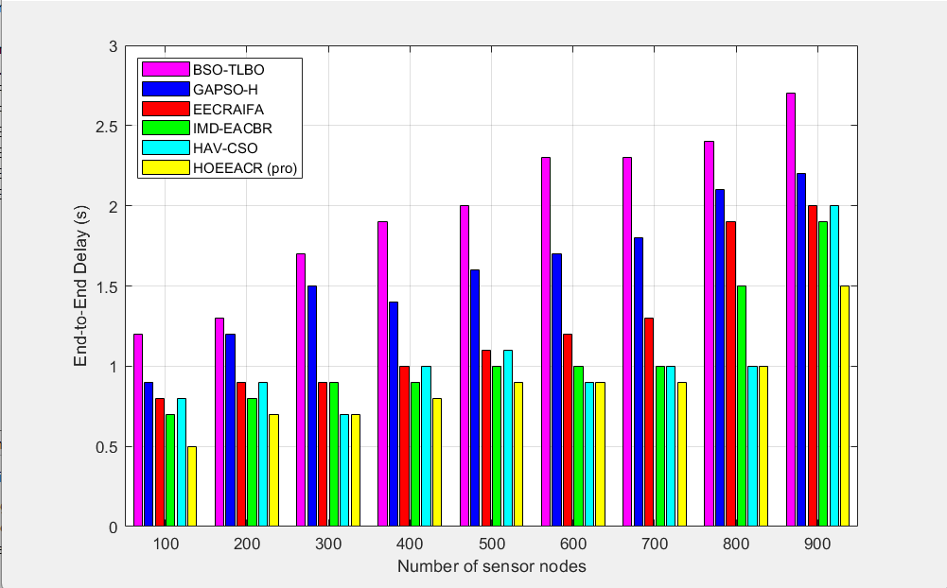
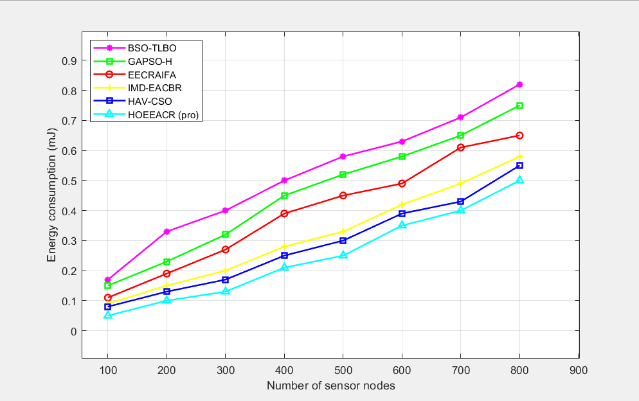
Figure 7: End-to-end delay analysis
Figure 8: Energy consumption analysis

Slide 28
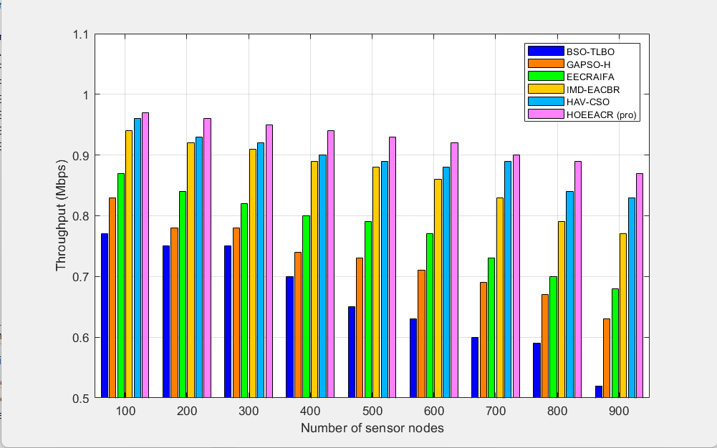
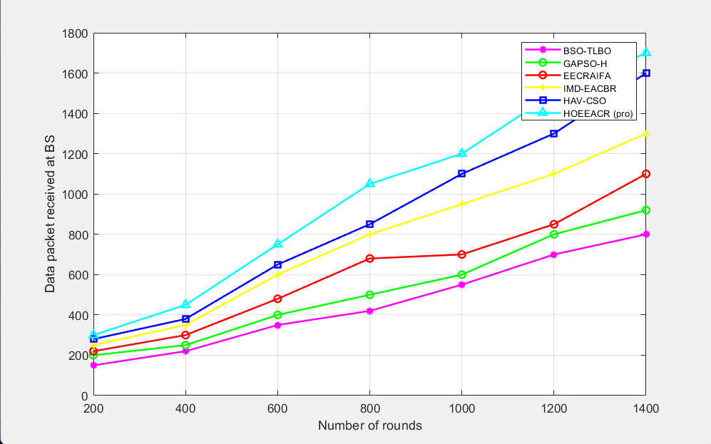
Figure 9: Throughput analysis of the proposed
method with the existing method
Figure 10:Data packet received by base station

Slide 29
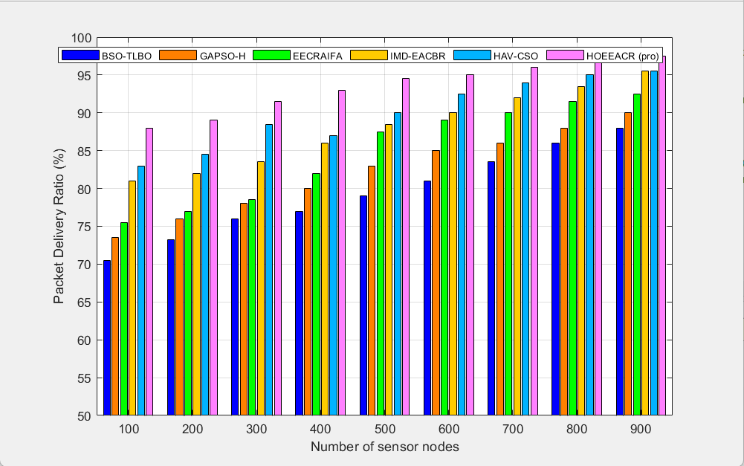
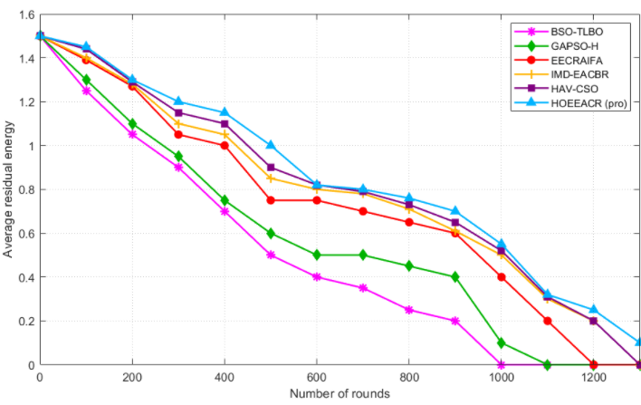
Figure 11 :Packet delivery ratio (%) with varying nodes
Figure 12 :Comparison of residual energy

Slide 30
12. ADVANTAGES
Energy Efficiency: Reduces energy consumption by optimizing cluster head selection and routing paths.
Prolonged Network Lifespan: Balances energy usage across nodes, extending the operational life of the network.
Improved Data Transmission: Ensures reliable, faster communication with minimal delays.
Improved Packet Delivery Ratio: Achieves higher PDR, ensuring reliable data transmission
Reduced End-to-End Delay: Efficient routing minimizes delays in data delivery.

Slide 31
13. APPLICATIONS
Environmental Monitoring: Tracks weather, pollution, or wildlife efficiently over large areas.
Industrial Monitoring: Monitors equipment performance in factories or power plants to prevent failures.
Smart Agriculture: Observes soil conditions, temperature, and crop health using minimal energy.
Surveillance Systems: Enhances security by enabling long-lasting sensor networks for area monitoring.
IoT Applications: Supports smart cities and homes by optimizing connectivity and power usage.

Slide 32
14. CONCLUSIONS
The HOEEACR (Hybrid Optimized Energy-Efficient Adaptive Clustered Routing) approach is proposed to improve energy efficiency and network lifespan in large-scale Wireless Sensor Networks (WSNs).
The proposed HOEEACR method enhances energy efficiency and network lifetime in WSN. Achieved 2800 rounds of network lifetime, outperforming existing methods (~1200 rounds).
Improved Packet Delivery Ratio (PDR) up to 98.7% with 900 nodes.
Reduced End-to-End Delay to 1.9s compared to 2.7s in traditional methods.
Enhanced residual energy by 25.15%, ensuring longer network lifespan.
Future Scope: The method shows potential for future applications in networks with mobile nodes and diverse sink environments, broadening its real-world usability.

Slide 33
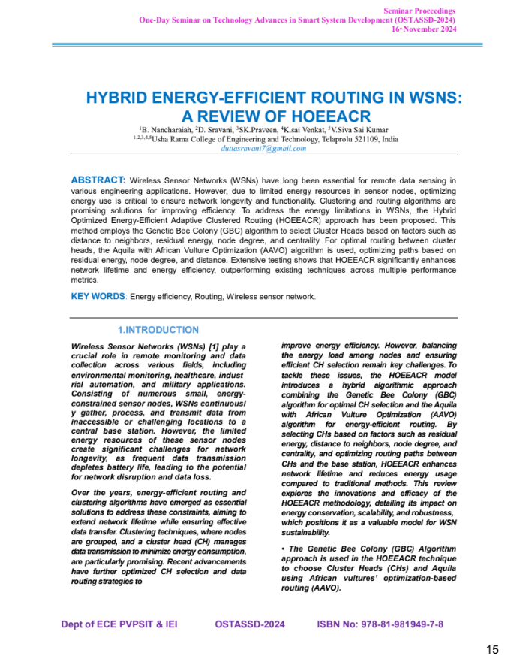

Slide 34



Slide 35



Slide 36
REFERENCES
K. Anusha, P. Ajay, M. Ramesh, N. Muthukumaran, C. Rajeshkumar,K. Sangeetha, G. Rajeshkumar & A. Ahilan (10 Mar 2024): HOEEACR: Hybrid Optimized Energy-Efficient Adaptive Clustered Routing for WSN, IETE Journal of Research
K. Krishnan, B. Yamini, W. M. Alenazy, and M. Nalini,“Energy-efficient cluster-based routing protocol for wsnbased on hybrid bso–tlbo optimization model,” Comput.J., Vol. 64, no. 10, pp. 1477–93, 2021.
S. Al-Otaibi, A. Al-Rasheed, R. F. Mansour, E. Yang, G.P. Joshi, and W. Cho, “Hybridization of metaheuristic algorithm for dynamic cluster-based routing protocol in wireless sensor networks,” IEEE. Access., Vol. 9,pp. 83751–61, 2021.
B. M. Sahoo, H. M. Pandey, and T. Amgoth, “GAPSO-H:A hybrid approach towards optimizing the cluster-based routing in wireless sensor network,” Swarm Evol. Comput.,Vol. 60, pp. 100772, 2021.
Z. Wang, H. Ding, B. Li, L. Bao, Z. Yang, and Q. Liu,“Energy efficient cluster-based routing protocol for WSN using firefly algorithm and ant colony optimization,” Wireless Pers. Commun., Vol. 125, no. 3, pp. 2167–200, 2022.

Slide 37
M. Prabhu, B. Muthu Kumar, and A. Ahilan, “Slime mould algorithm based fuzzy linear CFO estimation in wireless sensor networks,” IETE J. Res., DOI:10.1080/03772063.2023.2194279
A. Asha, N. Verma, and I. Poonguzhali, “Multi-objective_x0002_derived energy efficient routing in wireless sensor networks using hybrid African vultures-cuckoo search opti_x0002_mization,” Int. J. Commun. Syst., Vol. 36, no. 6, pp. e5438,2023.
S. Sennan, Y. Alotaibi, D. Pandey, and S. Alghamdi, “EACR_x0002_LEACH: Energy-aware cluster-based routing protocol forWSN based IoT,” Comput. Mater. Continua, Vol. 72, no. 2,pp. 2159–2174, 2022.
P. Maheshwari, A. K. Sharma, and K. Verma, “Energy efficient cluster-based routing protocol for WSN using butterfly optimization algorithm and ant colony optimization,”Ad. Hoc. Netw., Vol. 110, pp. 102317, 2021
K. Suresh, S. S. Sreeja Mole, and A. J. S. Kumar, “F2SO: Anenergy efficient cluster-based routing protocol using fuzzyfirebug swarm optimization algorithm in WSN,” Comput.J., Vol. 66, no. 5, pp. 1126–38, 2023.

Slide 38
ANY QUERIES?

Slide 39
THANK YOU

