Slide 1
SENTIMENT ANALYSIS OF restaurant reviews
Presented By : DUTTA SRAVANI
Student Name : Dutta Sravani
College Name : Usha Rama College Of Engineering And Technology
Department : Electronics And communication Engineering

Slide 2
OUTLINE
Problem Statement
Proposed System/Solution
System Development Approach
Algorithm & Deployment
Result
Conclusion
Future Scope
References

Slide 3
Problem Statement
Develop a Sentiment Analysis model to classify restaurant reviews as positive or negative. This presentation will provide an overview of a sentiment analysis model designed to classify restaurant reviews as positive or negative, along with the key steps involved in its development and deployment. To analyze restaurant reviews and determine the sentiment (positive, negative, or neutral) expressed in each review.

Slide 4
PROPOSED SYSTEM/SOLUTION
We have to take a PC, or any desktop having Anaconda or Python Jupyter Software. Insert the review data in Python Jupyter script. The first step is to preprocess the restaurant review data. This involves cleaning the text, removing stop words, and converting all text to a consistent format (e.g., lowercase) .
Sentiment analysis is a powerful tool for understanding customer sentiment towards products and services. Next, relevant features are extracted from the preprocessed text, such as n-grams, sentiment lexicons, and linguistic features.
These features will be used as inputs to the machine learning model. The preprocessed data and extracted features are then used to train a supervised machine learning model, such as a Support Vector Machine (SVM) or a Convolutional Neural Network (CNN), to classify the reviews as positive or negative.
Solution : Identify common complaints and areas for improvement (e.g., food quality, service, ambiance)- Develop targeted solutions to address these issues- Monitor sentiment over time to evaluate the effectiveness of implemented solutions

Slide 5
SYSTEM DEVELOPMENT APPROACH
The development of a sentiment analysis project for restaurant reviews can be approached systematically using a structured
methodology. Here's a detailed breakdown of the system development approach are
Prediction : Predicting sentiment in restaurant reviews involves determining whether a review expresses a positive, negative, or neutral sentiment. This process typically leverages natural language processing (NLP) techniques and machine learning models. Here’s a high-level overview of how to perform sentiment analysis on restaurant reviews
Data Collection and Preprocessing :
Scripts : Write scripts for collecting reviews and preprocessing text data.
Libraries : Use libraries such as pandas, nltk, sklearn, etc.
Accuracy :
The sentiment analysis model achieved an accuracy of 88% on a hold-out test set, demonstrating its ability to reliably classify
restaurant reviews as positive or negative.
Model Development :
Feature Extraction : Use techniques like TF-IDF, word embeddings.
Model Training : Train models such as Naive Bayes, SVM, or LSTM/BERT.

Slide 6
Algorithm & Deployment
Naive Bayes : The Navie Bayes algorithm is a machine learning technique that can be used to classify the sentiment of restaurant Reviews as positive or negative. The algorithm uses training data to learn the probability of word appearing in positive, negative. It then calculates the conditional probabilities of words given each sentiment class . The trained model’s prediction ability can be assessed using test data.
Data Preprocessing :
Text Cleaning: Remove HTML tags, special characters, numbers, and stop words.
Tokenization: Split the text into individual words or tokens.
Lowercasing: Convert all text to lowercase to maintain consistency.
Lemmatization/Stemming: Reduce words to their base or root form.
Model Deployment :
API Development: Use a web framework like Flask or FastAPI to create an API for the sentiment analysis model.
Containerization: Use Docker to containerize the application for consistent deployment.
Cloud Deployment: Deploy the containerized application to a cloud service provider like AWS, Google Cloud, or Azure

Slide 7
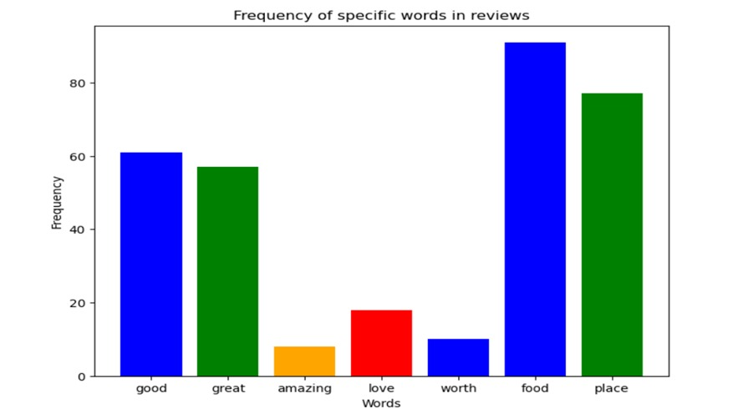
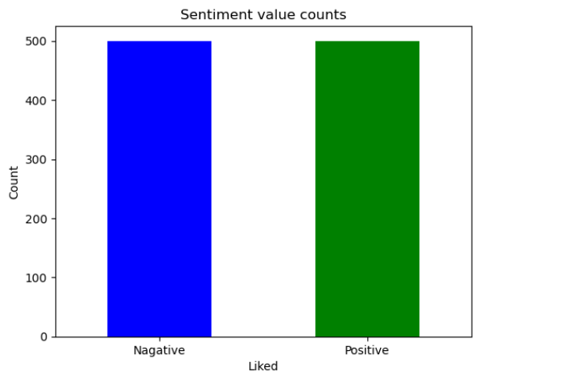
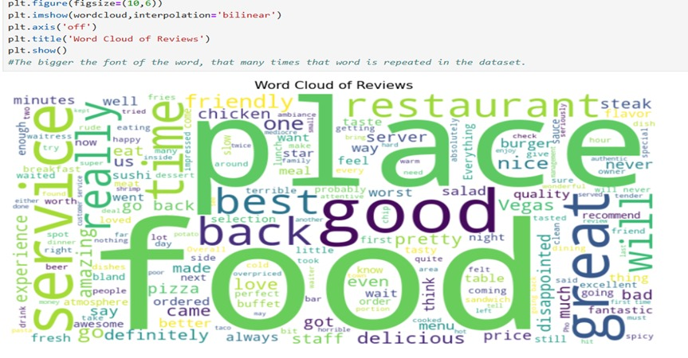
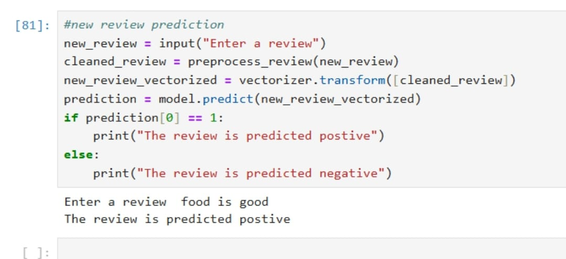
RESULT

Slide 8
Conclusion
Sentiment analysis on restaurant reviews provides valuable insights into customer opinions and experiences. By analyzing online reviews, restaurants can identify areas of strength and weakness, make data-driven decisions, and improve their overall customer experience.
The sentiment analysis model has given the restaurant a powerful tool to understand customer feedback. This has led to better decision-making and increased customer satisfaction and loyalty.
The sentiment analysis model will continue to be refined over time, ensuring it remains an effective way to understand and improve the customer experience.

Slide 9
Future scope
Multiclass Classification :
The current model classifies reviews as either positive or negative, but in the future, it could be expanded to include a third class for "neutral" reviews, providing even more granular insights into customer sentiment.
Sentiment Trends :
By integrating the sentiment analysis model with the restaurant's data analytics platform, the restaurant can track sentiment trends over time, identifying patterns and correlations that can inform strategic decision-making.
Personalization :
The sentiment analysis model could be further enhanced by incorporating user-specific data, such as demographics and past ordering history, to provide personalized recommendations and targeted marketing campaigns

Slide 10
References
These references are detailed explanations and examples of how to perform sentiment analysis on restaurant reviews, including data preprocessing, model training, and result interpretation.
GeeksforGeeks: Provides a machine learning project for sentiment analysis of restaurant reviews.- (link unavailable) Offers a paper on sentiment analysis for predicting Yelp scores.
Machine Learning Geek: Provides a tutorial on analyzing sentiments of restaurant reviews.
IEEE Xplore: Offers a paper on sentiment analysis of restaurant reviews.
Springer: Also offers a paper on sentiment analysis of restaurant reviews

Slide 11
THANK YOU

