Slide 1

Item Based Collaborative Filtering Algorithm
Sravani Gangaraju
Chinmai Diddi

Slide 2

Introduction
Recommender Systems – Apply knowledge discovery techniques to the problem of making personalized recommendations for information, products or services, usually during a live interaction
Collaborative Filtering – Builds a database of users’ preference for items. Thus, the recommendation can be made based on the neighbors who have similar tastes

Slide 3
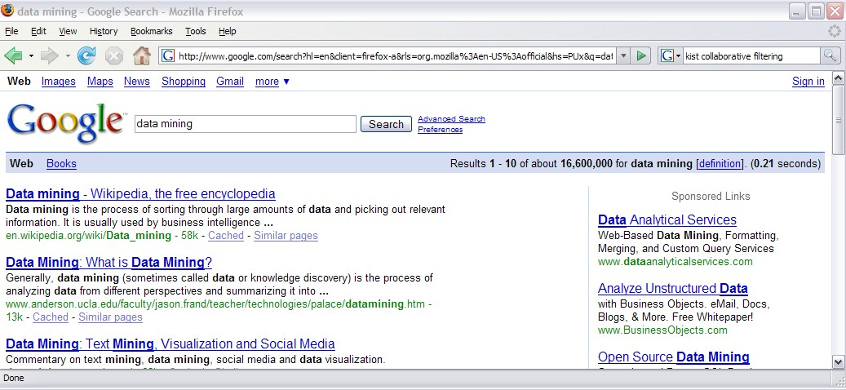
Collaborative Filtering in our life

Slide 4
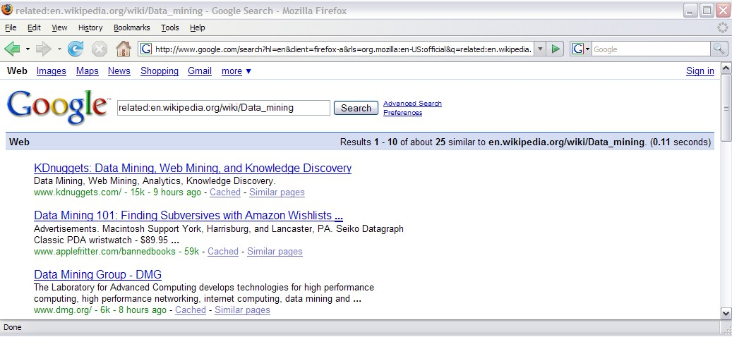
Collaborative Filtering in our life

Slide 5
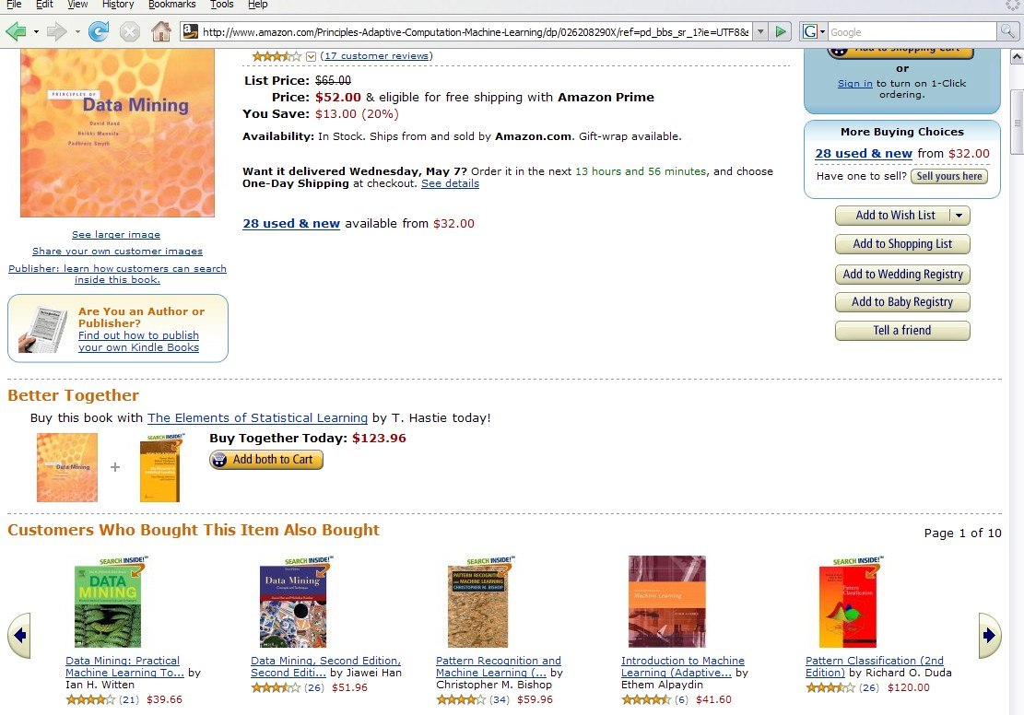
Collaborative Filtering in our life

Slide 6
Motivation of Collaborative Filtering (CF)
Need to develop multiple products that meet the multiple needs of multiple consumers
Recommender systems used by E-commerce
Multimedia recommendation
Personal tastes matters

Slide 7

Basic Strategies
Predict and Recommend
Predict the opinion: how likely that the user will have on the this item
Recommend the ‘best’ items based on
the user’s previous likings, and
the opinions of like-minded users whose ratings are similar

Slide 8
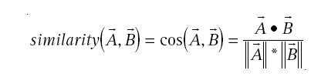
Traditional Collaborative Filtering
Nearest-Neighbor CF algorithm (KNN)
Cosine distance
For N-dimensional vector of items, measure two customers A and B

Slide 9

Traditional Collaborative Filtering
If we have M customers, the complexity will be O(MN)
Reduce M by randomly sampling the customers
Reduce N by discarding very popular or unpopular items
Can be O(M+N), but …

Slide 10
Clustering Techniques
Work by identifying groups of consumers who appear to have similar preferences
Performance can be good with smaller size of group
May hurt accuracy while dividing the population into clusters
But…

Slide 11
How about a Content based Method?
Given the user’s purchased and rated items, constructs a search query to find other popular items
For example, same author, artist, director, or similar keywords/subjects
Impractical to base a query on all the items
But…

Slide 12
User-Based Collaborative Filtering
Algorithms we looked into so far
2 challenges:
Scalability: Complexity grows linearly with the number of customers and items
Sparsity: The sparsity of recommendations on the data set
Even active customers may have purchased well under 1% of the total products

Slide 13
Item-to-Item Collaborative Filtering
No more matching the user to similar customers
build a similar-items table by finding that customers tend to purchase together
Amazon.com used this method
Scales independently of the catalog size or the total number of customers
Acceptable performance by creating the expensive similar-item table offline

Slide 14
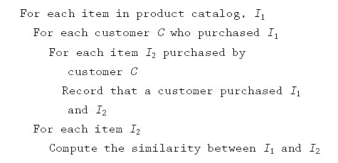
Item-to-Item CF Algorithm
O(N^2M) as worst case, O(NM) in practical

Slide 15
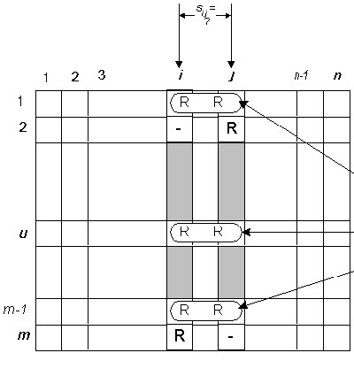
Item-to-Item CF Algorithm Similarity Calculation
Computed by looking into
co-rated items only. These co-rated pairs are obtained from different users.

Slide 16

Item-to-Item CF Algorithm Similarity Calculation
For similarity between two items i and j,

Slide 17
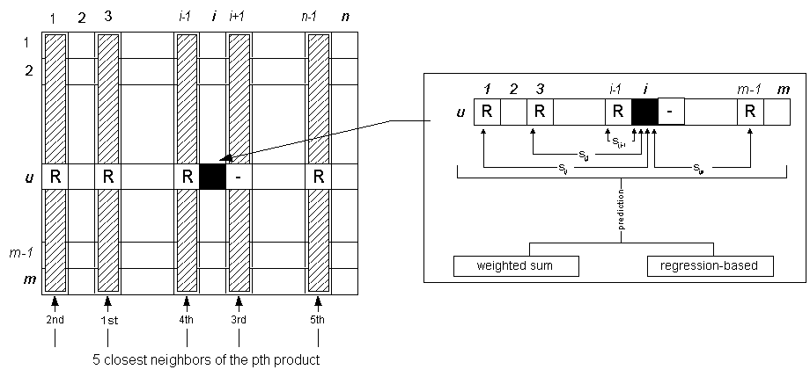
Item-to-Item CF Algorithm Prediction Computation
Recommend items with high-ranking based on similarity

Slide 18

Item-to-Item CF Algorithm Prediction Computation
Weighted Sum to capture how the active user rates the similar items
Regression to avoid misleading in the sense that two rating vectors may be distant yet may have very high similarities

Slide 19
The item-item scheme provides better quality of predictions than the user-user scheme
Higher training/test ratio improves the quality, but not very large
The item neighborhood is fairly static, which can be pre-computed
Improve the online performance

Slide 20

Conclusion
Presented and evaluated a new algorithm for CF-based recommender systems
The item-based algorithms scale to large data sets and produce high-quality recommendations

Slide 21

References
E-Commerce Recommendation Applications: http://citeseer.ist.psu.edu/cache/papers/cs/14532/http:zSzzSzwww.cs.umn.eduzSzResearchzSzGroupLenszSzECRA.pdf/schafer01ecommerce.pdf
Amazon.com Recommendations: Item-to-Item Collaborative Filtering http://www.win.tue.nl/~laroyo/2L340/resources/Amazon-Recommendations.pdf
Item-based Collaborative Filtering Recommendation Algorithms
http://www.grouplens.org/papers/pdf/www10_sarwar.pdf

