Slide 1
How Demographics Affect COVID-19-Related Anxiety
By Group 10,
Samantha Zocher, Sravani Pendyala, Preethi Nigam Errala, Sai Ganesh Vugge, Nuthan Vikas Reddy Matta
Notes:
sam

Slide 2
Background
COVID-19 has caused an uptick in stress and mental health issues¹
Some studies have been conducted on social determinants of health and how that may affect COVID stress, but it is still a new area of research
This is because the pandemic was so recent
Income is a variable that has not been examine in relation to other variables, so our study will be unique
Research Question: How do demographic and socioeconomic factors like age, income, and sex affect COVID-19 related anxiety?
Data source: Social and psychological effects of the COVID-19 pandemic in Turkey (N = 2,817).
Independent variables: sex, income, age
Dependent variable: anxiety
Dataset link: https://data.mendeley.com/datasets/sv95c7ydpy/9/files/1a9b4a65-7145-4aa4-ae5e-5e6fcf044762
Notes:
Sam

Slide 3
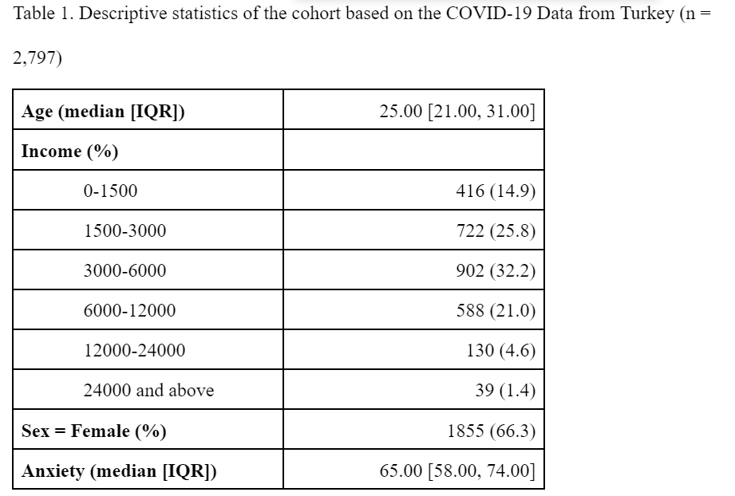
Methods: Descriptive Statistics
Age and anxiety were non-normally distributed across the sample
More female participants
Possible range of anxiety scores: 30-120
Less individuals with a higher income
Notes:
Sam

Slide 4
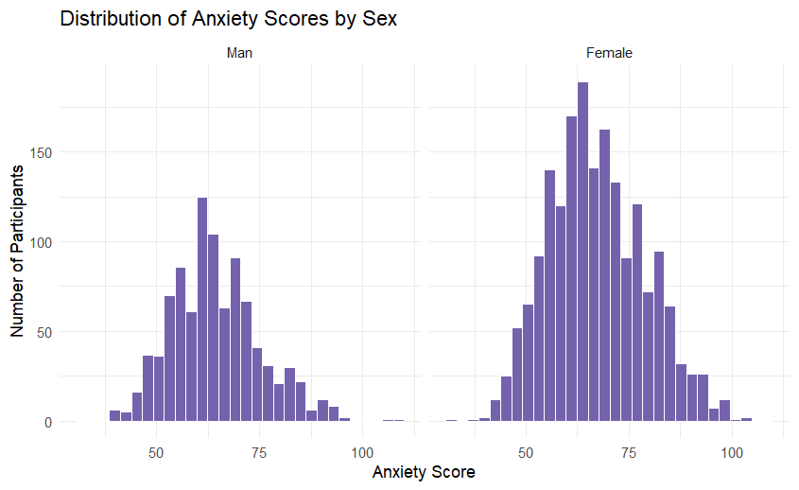
Methods: Data visualization
Figure 1
In this data visualization:
It appears both groups are normally distributed
There were more females in the sample than males
Notes:
Preethi

Slide 5
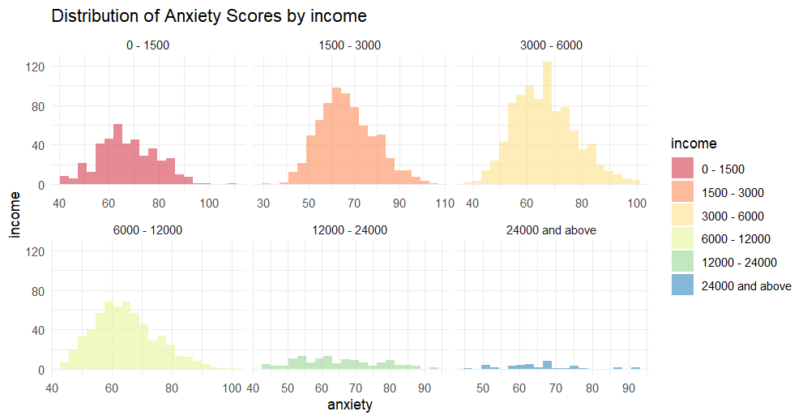
Methods: Data visualization
Figure 2
Observing trends in anxiety by income
No group is normally distributed
There were fewer participants in the two higher income categories
Notes:
Preethi

Slide 6
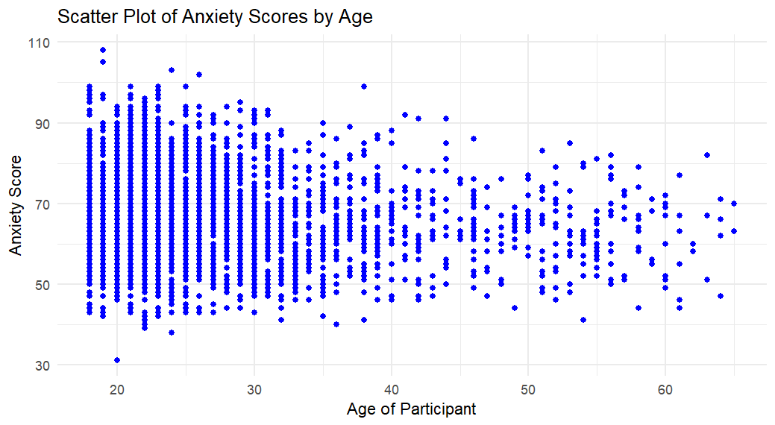
Methods: Data visualization
Figure 3
There is a wider range in anxiety scores in younger participants
Notes:
Preethi

Slide 7
Anxiety and Gender: Independent Samples T-Test
Welch Two Sample t-test:
data: COVID_19_data_clean$anxiety by COVID_19_data_clean$sex
t = -6.5014, df = 2026.7, p-value = 9.994e-11
alternative hypothesis: true difference in means between group
Man and group Female is not equal to 0
95 percent confidence interval:
-3.746985 -2.010300
sample estimates:
mean in group Man mean in group Female
64.34076 67.21941
H0: There is no difference in the anxiety score after COVID-19 between men and women.
H1: There is a difference in the anxiety score between men and women.

Slide 8
There was a statistically significant difference [t(2026.7) = -6.5014, p < .01] in the mean anxiety score between males (m = 64.34) and females in the sample (m = 67.22). The difference between male and female anxiety score was 2.88 in the sample. In the overall population, male mean anxiety scores are likely to be between 3.75 and 2.01 lower than the female mean anxiety scores (d = 2.88; 95% CI: -3.75--2.01).
Difference = Mean
Test Results: Female – Male : 67.22 - 64.34 = 2.88
Description | Value
t-value | -6.5014
Degrees of Freedom | 2026.7
p-value | < 0.00001
Mean Anxiety - Males | 64.34
Mean Anxiety - Females | 67.22
Cohen's d (small effect size) | 0.2568
Notes:
Nuthan

Slide 9
Alternative Test for T-Test
Assumptions:
Continuous variable
Two independent groups
Independent observations
Normal distribution in each group
Equal variances for each group
We must check for normal distribution and equal variances
Normal distribution: Z-scores were calculated and were between -7 and 7 for both male and female groups. This assumption was met
Equal variances: Levene’s test was used.
The p-value < .001, therefore the null hypothesis that there were equal variances was rejected.
Alternative test when equal variances failed:
Kolmogorov-Smirnov
H0: The distribution of anxiety scores for males and females is the same. HA: The distribution of anxiety scores for males and females is not the same.
Asymptotic two-sample Kolmogorov-Smirnov test: D = 0.11222, p-value = 2.936e-07 alternative hypothesis: two-sided
A Kolmogorov-Smirnov test comparing the anxiety scores for males and females found a statistically significant difference between the two gropus (D = 0.11; p < .05). The distribution of anxiety scores was different between males and females.
\
Notes:
Sam

Slide 10
Anxiety and Income: ANOVA
HO: There is no difference in the anxiety score after COVID 19 across income.
HA: There is a difference in the anxiety score across income.
One-way analysis of means data:
anxiety and income F = 4.0476, num df = 5,
denom df = 2791,
p-value = 0.001158
The probability of an F-statistic this large or larger if the null were true, the p-value reported in the output is 0.001158.
As the p-value is less than 0.05, the F-statistics would be considered statistically significant.
Notes:
Sai

Slide 11
Performing Post-hoc test
Using Bonferroni test as a type of post-hoc test, it is pairwise test for each pair of means but adjusts the threshold for statistical significance to ensure that there is a small enough risk of Type I error.
Pairwise comparisons using t tests with pooled SD data:
Significant difference was found only in one income group ranged '6000-12000' (p < 0.05). This group tend to have lower anxiety levels compared to other groups.
 | 0-1500 | 1500-3000 | 3000-6000 | 6000-12000 | 12000-24000
1500 - 3000 | 1.0000 | - | - | - | -
3000 - 6000 | 1.0000 | 1.0000 | - | - | -
6000 - 12000 | 0.0016 | 0.0016 | 0.0437 | - | -
12000 - 24000 | 0.2004 | 0.9462 | 1.0000 | 1.0000 | -
24000 and above | 1.0000 | 1.0000 | 1.0000 | 1.0000 | 1.0000

Slide 12
ANOVA Assumptions
Assumptions:
Continuous variables and independent groups
Independent observations
Normality
Homogeneity of variance
Notes:
Sai

Slide 13
ANOVA Assumptions
Normality test: Using histogram and shapiro test to test normality assumptions
Income | Shapiro.pval
0 - 1500 | 2.725067e-02
1500 - 3000 | 1.719012e-04
3000 - 6000 | 1.122371e-06
6000 - 12000 | 2.585694e-06
12000 - 24000 | 1.859341e-02
24000 and above | 1.028745e-01
Not all groups are normally distributed.
Hence, the normality assumption is not met.
Notes:
Sai

Slide 14
ANOVA Assumptions
Homogeneity of variance:
- Using levene’s test to test the equal variance
- The p-value < .001, therefore the null hypothesis that there were equal variances was rejected.
Hence, this assumption is failed.
Notes:
Sai

Slide 15
Alternative tests when assumptions are failed:
KRUSKAL-WALLIS TEST:
- Using when normality assumption is failed.
HO: There is no difference in the anxiety score after COVID 19 across income.
HA: There is a difference in the anxiety score across income.
Interpretation:
Based on the results, we found that there is difference in anxiety levels across income status [H(5) = 20.55; p < .05]. Like the ANOVA results, the K-W test identifies whether there is a difference somewhere among the means, but it does not identify which groups are different from one another.
Kruskal-Wallis rank sum test data:
anxiety by income
Kruskal-Wallis chi-squared = 20.55, df = 5,
p-value = 0.0009849

Slide 16
Alternative tests when assumptions are failed:
Comparison of x by group
(Bonferroni)
Col Mean-|
Row Mean | 0 - 1500 12000 - 1500 - 3 24000 an 3000 - 6
---------+-------------------------------------------------------
12000 - | 2.537559
0.0837
1500 - 3 | 1.417687 -1.760257
1.0000 0.5877
24000 an | 0.898872 -0.572054 0.384840
1.0000 1.0000 1.0000
3000 - 6 | 1.675712 -1.659248 0.241284 -0.313153
0.7035 0.7280 1.0000 1.0000
6000 - 1 | 4.009191 0.019420 3.052981 0.643014 2.972315
0.0005* 1.0000 0.0170* 1.0000 0.0222*
Dunn’s Post-hoc test:
Kruskal-Wallis rank sum test data: x and group
Kruskal-Wallis chi-squared = 20.5501, df = 5, p-value = 0
Interpretation:
It is evident from the results that, individuals earning between 0 - 1500 and 6000 - 12000 show significantly different levels of anxiety (p < 0.05). However, no significant differences were found between individuals earning 3000 - 6000 and 12000 - 24000, or between any other income groups (p > 0.05).

Slide 17
Effect size for Kruskal-Wallis
Eta-squared works for Kruskal-Wallis (Cohen, 2008)
The cutoff values are the same as for the omega-squared: η2 = .01 to η2 < .06 is a small effect η2 = .06 to η2 < .14 is a medium effect η2 ≥ .14 is a large effect.
ηH2=(20.5501−6+1)/(2797−6)= 0.00557
where 20.5501 - H test statistic
6 - Income groups
2797 observations
Interpretation: There was a small effect size for the relationship between income groups and anxiety rate (η2 = 0.0056).

Slide 18
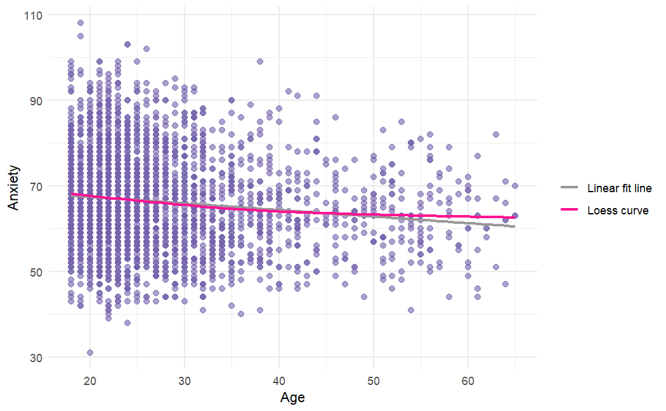
Linear Regression Model: Anxiety and Age
From the graph, it is evident that the curve is relatively flat, indicating that anxiety levels do not significantly increase or decrease with age.
The LOESS curve is almost parallel to a linear fit line, suggesting that anxiety levels change little across the age range.
Notes:
Sravani

Slide 19
Anxiety and Age: Linear Regression
H0: There is no significant relationship between age and anxiety.
HA: There is a relationship between age and anxiety.
Linear Regression model:
lm(formula = anxiety ~ age, data = COVID_19_data_clean)
Residual standard error: 11.34 on 2795 degrees of freedom Multiple R-squared: 0.01598, Adjusted R-squared: 0.01563,
F-statistic: 45.4 on 1 and 2795 DF, p-value: 1.946e-11
The model would predict the rate of anxiety according to the age. It appears that the anxiety levels decrease by an estimated -0.153 units as the age increases by year. The p-value from the results shows that is it less than the threshold value (<0.05), hence indicating that there is a statistically significant (negative) relationship between these two variables meaning that the model is statistically significant. However, the model's coefficient of determination (R-squared) is low (0.01598), implying that age accounts for only a small portion of the variance in anxiety levels. These results suggest that the people aged from 18 to 50 tend to have more anxiety symptoms than people who are aged above 50 to 64 years.

Slide 20
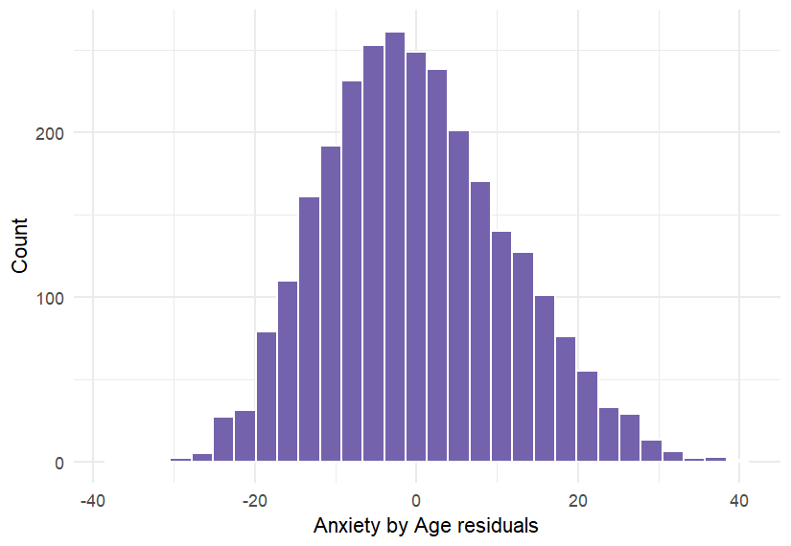
Linear Regression Assumptions
Independent assumptions: met
Continuous outcome: met
Linear relationship: not met
Homoscedasticity: not met
Breusch-Pagan test
Very small p-value
Independence of residuals: met
Durbin-Watson test
P = 0.9006
Normality of residuals: not met
Right skewed as shown on histogram

Slide 21
Linear Regression Model
A larger model was created including multiple predictors to determine to help predict anxiety levels in people.
lm(formula = anxiety ~ age + income, data = COVID_19_data_clean)
Coefficients:
(Intercept) age income1500 - 3000
70.8999 -0.1377 -0.6820
income3000 - 6000 income6000 - 12000 income12000 - 24000
-0.5522 -1.7840 -1.7280
income24000 and above
0.2869
Interpretation: The model was statistically significant, with an F-statistic of F(6, 2790 = 8.867 and a p-value of < 0.01. The Radj2=0.0166 indicated that 1.16% of the variation accounted for by this model that has both anxiety and income in it, which is slightly higher than the Radj2 from the previous model. a linear regression model incorporating age and income status significantly improved in explaining anxiety rates. Age increases led to a decrease in anxiety levels by 0.09 to 0.18 units. Income groups also had different effects on anxiety, with individuals earning between 1500 and 3000 experiencing fluctuations between 2.05 and 1.88 units.

Slide 22
Linear Regression Model
Performing diagnostics:
Added standardized residuals and compared to residuals
132 people in the sample had large standardized residuals. These people may be influencing the model.

Slide 23
Results
There was a significant 2.88 difference in mean anxiety levels between female and male individuals. The Kolmogorov-Smirnov test showed statistical significance (D = 0.11; p <.05) in the distribution disparity.
ANOVA analysis found a significant difference across income groups [F(5, 2791)=4.0476, p<.05]. The Kruskal-Wallis test revealed significant differences in anxiety levels between income categories (χ² = 20.55, df = 5, p = 0.0009849). Individuals earning between 0 - 1500 and 6000 - 12000 reported significantly different anxiety levels (p < 0.05).
The correlation coefficient test showed a weak negative relation between age and anxiety variables, but the simple linear regression failed to meet assumptions.
The final regression model (full model) which included age and income predictors showed a slight accuracy in predicting the anxiety levels than the baseline model (created for age and anxiety variables).
To generalize these results to a larger population, more data would be needed.
Notes:
Preethi

Slide 24
Discussion
Gender Differences in Anxiety Levels: The study found a significant difference in anxiety levels between male and female participants. Females had higher anxiety scores than males, indicating that gender influences how people respond to COVID-19-related stressors. This finding is consistent with previous research indicating that females are more susceptible to anxiety disorders.
Effects of Socioeconomic status: The study also discovered a significant link between income and anxiety. Individuals in the lowest income group reported higher levels of anxiety than those in higher income groups. This demonstrates the impact of socioeconomic status on mental health outcomes during crises such as the COVID-19 pandemic.
Age Factor: Although the linear regression analysis found a weak negative correlation between age and anxiety levels, implying that older people have lower anxiety scores, the linearity and homoscedasticity assumptions were not met.
Overall, understanding demographic factors affecting anxiety levels post Covid-19 is crucial for developing targeted interventions and policies, enabling better resource allocation and addressing mental health challenges.

Slide 25
Conclusion
The research question emphasized the impact of income and gender on COVID-19-related anxiety, with findings indicating a need for increased social support, particularly among females and those from lower socioeconomic backgrounds.
While the study was unable to definitively determine the effect of age on anxiety levels, it emphasizes the critical importance of understanding how demographic factors such as gender, income, and age interact to affect mental health post-pandemic.
Hence, targeted interventions that address income and gender disparities are critical for post-pandemic resilience building including gender-sensitive mental health care and socioeconomic interventions are critical for mitigating the pandemic's long-term consequences. However, further qualitative research is required to fully understand demographic influences on mental health outcomes.

Slide 26
References
Manchia M, Gathier AW, Yapici-Eser H, Schmidt MV, de Quervain D, van Amelsvoort T, Bisson JI, Cryan JF, Howes OD, Pinto L, van der Wee NJ, Domschke K, Branchi I, Vinkers CH. The impact of the prolonged COVID-19 pandemic on stress resilience and mental health: A critical review across waves. Eur Neuropsychopharmacol. 2022 Feb;55:22-83. doi: 10.1016/j.euroneuro.2021.10.864. Epub 2021 Oct 29. PMID: 34818601; PMCID: PMC8554139.
Ettman C, Badillo-Goicoechea E, Stuart E. Evolution of Depression and Anxiety During the COVID-19 Pandemic and Across Demographic Groups in a Large Sample of U.S. Adults, AJPM Focus, Volume 2, Issue 4, 2023, 100140, ISSN 2773-0654, https://doi.org/10.1016/j.focus.2023.100140.
Sari, E., Kağan, G., Karakuş, B.Ş. et al. Dataset on social and psychological effects of COVID-19 pandemic in Turkey. Sci Data 9, 441 (2022). https://doi.org/10.1038/s41597-022-01563-4
Harris JK. Statistics With R: Solving Problems Using Real-World Data. 1506388159th ed. SAGE Publications Ltd.; 2021.

Slide 27
THANK YOU

