Slide 1
RESEARCH & ENGINEERING PRESENTATION | DEEP LEARNING FOR VISUAL DATA
IMAGE2VIDEO: Single-Image Audio-Driven
Talking-Head Video Generation
End-to-End Deep Learning Pipeline (Script2Presenter) Leveraging Neural Speech Synthesis,
Pretrained 3DMM Face Animation (SadTalker), and Isolated GPU Orchestration
AUTHOR
Venkata Saisravan Pasam · Student ID 1577293
COURSE
MAAI901 - Deep Learning for Visual Data · Instructor: Dr. Milan Dordevic
INSTITUTION
University of Wollongong in Dubai (UOWD) · Individual Project (Week 6) · Date: 27 October 2026

Slide 2

EXECUTIVE SUMMARY
Project Abstract & System Capabilities
A single-image, audio-driven talking-head video generator
1. Problem & Scope
2. Architecture & Pipeline
3. Empirical Results
Audio-driven animation: Animates one 2D still portrait, conditioned on speech audio.
Speech synthesis: Multi-tier TTS turns raw text scripts into natural narration.
Zero manual keyframing: No multi-angle photos, 3D rigs, or actor recordings.
Academic integrity: Clear split between pretrained inference and newly trained weights.
5 demonstration samples: Consented portraits of diverse individuals.
Output consistency: Nominal 25 FPS, 37.28–39.60 s, 932–990 frames.
Manifest audit trail: Each run writes manifest.json with runtime, timings, and parameters.
Evaluation roadmap: SyncNet, ArcFace, and Landmarks metrics plus a 5-point subjective rubric.
Neural TTS: edge-tts (cloud), Piper VITS (offline ONNX), and gTTS fallback.
Audio normalization: Resampled to strict 16 kHz mono WAV.
SadTalker core: Pretrained 3DMM extraction, audio-to-motion, and 25 FPS warping.
Isolated Colab runtime: Self-contained Python 3.10 venv with NumPy 1.23.5.

Slide 3
PROJECT CONTEXT
The Baseline vs. Single-Image Generative AI
Why conventional talking-head video production is being transformed by generative pipelines
Conventional Video Production
Image2Video Generative Pipeline
✕ Heavy Physical Infrastructure: Requires physical studios, acoustic treatment, professional camera rigs, and studio lighting.
✕ High Talent & Time Costs: Presenters must rehearse, read teleprompters, record multiple takes, and re-shoot for script changes.
✕ Rigid Post-Production: Editing, noise suppression, frame cuts, and re-recording are time-consuming and expensive.
✕ Non-Scalable Content: Generating 50 localized educational explainers requires 50 live studio recording sessions.
✓ Single 2D Still Portrait: Accepts standard JPEG/PNG headshot with no special 3D scanner or depth sensors.
✓ Arbitrary Text Script: Generates matching natural voice narration automatically via neural speech synthesis.
✓ 3D Motion & Expression: Pretrained deep models extrapolate 3D facial morphable models (3DMM) and head poses at 25 FPS.
✓ Rapid Iteration & Accessibility: Scripts can be updated and re-rendered in minutes; highly accessible for education and virtual presenters.

Slide 4
RESEARCH FRAMEWORK
Aim, Objectives & Research Questions (RQ1 - RQ4)
Formal academic definition, working hypotheses, and evaluation questions
Project Aim
Research Questions
To implement, orchestrate, and critically assess a practical single-image, audio-driven talking-head generation pipeline, focusing on output consistency, temporal stability, facial expressiveness, and reproducibility.
RQ1: Pipeline Feasibility. Can the integrated pipeline produce a valid, playable talking-head MP4 from a single portrait and a text script without manual intervention?
RQ2: Technical Consistency. How consistent are the generated videos in duration, frame rate, resolution, and frame count across different portraits and scripts?
RQ3: Evaluation Criteria. Which objective and human-centred measures are needed to evaluate lip synchronisation, identity preservation, temporal stability, and expressiveness?
RQ4: Technical & Ethical Bounds. What technical and ethical limitations restrict the current prototype from being treated as a newly validated generative model?
Working Hypotheses
H1 (Engineering Hypothesis): A pipeline combining neural TTS, audio preparation, and pretrained SadTalker can generate a playable talking-head video for each supported portrait/script pair.
H2 (Evaluation Hypothesis): Enforcing consistent input/output settings and adding objective video-audio metrics will make sample-to-sample quality and failure modes easier to diagnose and compare.

Slide 5
DATASET & DEMONSTRATION SET
Sample Inventory & Justification
Analysis of the 5-sample demonstration set, consent protocols, and dataset limitations
Sample ID | Person Label | Input Filename | Script Opening | Output Filename | Reported Size
ID 1 | Sravan | Sravan(4).jpeg | Good morning everyone. I'm Sravan... | script2presenter_demo (4).mp4 | 256 × 256
ID 2 | Sreeya | Sreeya(10).jpeg | Good morning everyone. I'm Sreeya... | script2presenter_demo (10).mp4 | 256 × 256
ID 3 | Anu | Anu(9).jpeg | Good morning everyone. I'm Anu... | script2presenter_demo (9).mp4 | 256 × 256
ID 4 | Sharukh | Sharukh(11).jpeg | Good morning everyone. I'm Sharukh... | script2presenter_demo (11).mp4 | 256 × 256
ID 5 | Prabhas | Screenshot 2026-10-27 004154.png | Good morning everyone. I'm Prabhas... | script2presenter_demo (12).mp4 | 256 × 272*
Dataset Limitations & Academic Integrity Principles
• Demonstration Set Only (n = 5): Appropriate for engineering validation across distinct portrait conditions, but too small for statistical benchmarking or demographic fairness conclusions.
• Confounding Variables: Portraits differ simultaneously in lighting, head pose, crop, background, and input resolution. Failure modes cannot be causally attributed to one factor alone.
• Informed Consent: Explicit consent was obtained from participating individuals covering facial animation, text scripts, storage, and project evaluation.
• Asymmetrical Dimension Note: *Sample ID 5 was recorded at 256 × 272 pixels due to face bounding box aspect ratio preserved by the renderer, unlike the standard 256 × 256 square crop.

Slide 6
DATA PIPELINE
Preprocessing & Input Preparation
Ensuring consistent audio-visual alignment and strict data validation before inference
Visual Input Validation
Speech Synthesis & Conditioning
• Integrity Check: Verifies readable JPEG/PNG format, non-empty file, and dimensions >= 64 × 64 pixels.
• Copy-Not-Move Policy: The source portrait is safely copied into the run folder; the original file is never modified or moved.
• Facial Detection & Cropping: Uses facexlib (RetinaFace backbone) to isolate a single centered frontal face.
• Preprocessing Modes: Supports 'crop' (zoomed face box) and 'full' (preserves shoulders and background scene). Default is 'crop' at 256 × 256.
• Face Restoration Option: Configurable GFPGAN v1.4 checkpoint integration for facial super-resolution (disabled in baseline runs to isolate core model behavior).
• Script Parsing & Chunking: Text scripts (1 - 5,000 characters) are parsed and chunked at sentence boundaries (~1,800 chars) to prevent TTS timeout.
• Audio Resampling to 16 kHz: SadTalker requires 16,000 Hz sample rate. FFmpeg resamples diverse TTS outputs (24 kHz edge-tts / 22 kHz Piper) to strict 16 kHz.
• Mono Channel Conversion: Ensures single-channel mono waveform to match the expected acoustic feature extractor (Wav2Vec / Mel-spectrogram).
• Exact Audio Duration Probe: FFprobe measures exact audio length in milliseconds to determine target video frame count (frames = round(duration * 25)).
• Waveform Sanity Check: Verifies non-silent, non-empty audio before launching expensive GPU inference.

Slide 7
MODEL ARCHITECTURE
Model Selection & Technical Justification
Why SadTalker was selected and how the three-tier TTS cascade ensures resilience
SadTalker (Zhang et al., CVPR 2023)
Multi-Tier TTS Engine Strategy
3D Motion Coefficient Learning: Maps speech audio features directly to 3D Morphable Model (3DMM) coefficients, decoupling head pose from facial expression.
Pose & Expression Generator: Learns realistic head motion sequences while preventing unnatural head drift and distortion over multi-sentence clips.
Face Warping & Rendering: Uses 3D-aware flow warping to animate the single source image without needing full multi-view video training.
Pretrained Checkpoint Inference: Project uses official SadTalker v0.0.2 weights (725 MB safetensors). No custom re-training was conducted.
Contribution Boundary: Contribution is the end-to-end engineering pipeline, dependency sandbox, and evaluation, not a novel neural architecture.
Tier 1: edge-tts (Primary): Microsoft neural speech synthesis; delivers highly realistic, prosodic voice narration with natural inflections. Requires network access.
Tier 2: Piper VITS (Offline Fallback): Fast local neural TTS using a 63 MB ONNX model. Runs 100% offline on CPU (1.6x real-time) if network fails.
Tier 3: gTTS (Emergency Fallback): Standard Google Text-to-Speech client used if primary cloud endpoints are rate-limited.
Automatic Fallback Cascade: The pipeline tries providers in order: edge -> piper -> gtts. The actual provider used is logged in manifest.json.
Rejected Alternatives: Kokoro-ONNX was evaluated but rejected due to an unresolvable dependency on NumPy >= 2.0.2.

Slide 8
SYSTEM ARCHITECTURE
End-to-End Pipeline Execution Flow
Six-stage architectural decomposition from raw inputs to traceable MP4 delivery
STAGE 1
STAGE 2
STAGE 3
Input Preparation
Speech Synthesis
Audio Conditioning
Single Portrait (JPG/PNG)
Test Script (1–5,000 char)
Aspect & Dimension Check
Copy-not-move safety
→
Tier 1: edge-tts (Neural Cloud)
Tier 2: Piper VITS (offline CPU)
Tier 3: gTTS (Google fallback)
Sentence Chunking (1800 chars)
→
FFmpeg Resampling
Standardised 16 kHz Mono WAV
Duration & Waveform Check
Strict Channel Normalisation
STAGE 4
STAGE 5
STAGE 6
SadTalker Inference
Video Encoding
Manifest & Delivery
CropAndExtract (3DMM)
Audio2Coeff (Pose+Motion)
AnimateFromCoeff (Warping)
Optional GFPGAN Face Enhancer
→
H.264 / AVC Video Stream
AAC Mono 16 kHz Audio Mux
25 FPS Enforced Frame Rate
Size: 256x256 (or 512x512)
→
outputs/<timestamp>_<id>/manifest.json
Runtime & Timings Logged
Interactive Gradio Web UI
Colab Inline Player & Download

Slide 9
ENGINEERING & DEPLOYMENT
Google Colab Runtime & Dependency Management
Resolving deep legacy framework incompatibilities to enable one-click execution
The NumPy Pinning Crisis
Dynamic In-Memory Patches
Checkpoint Management & UI
SadTalker Legacy Code: the underlying face3d module strictly requires NumPy 1.23.5 for legacy C-API bindings (uses np.float and np.VisibleDeprecationWarning).
Python 3.13 in Colab: modern Colab runtimes default to Python 3.13, where NumPy 1.23.5 has zero precompiled wheels.
Isolated Virtualenv: setup_colab.sh creates an isolated Python 3.10 virtual environment in /content/.s2p-venv, leaving the Colab system Python untouched.
Strict Guard: constraints.txt enforces numpy==1.23.5 on every pip invocation; setup aborts if the version drifts.
Patched, Not Forked: avoids unmaintainable git forks by applying 4 idempotent monkey-patches at runtime via s2p/patches.py.
PIL ANTIALIAS Fix: replaces Pillow 10's removed Image.ANTIALIAS with Image.Resampling.LANCZOS.
Basicsr Tensor Import: fixes the torchvision functional_tensor import removed within the basicsr library.
PyTorch Weights Loading: overrides torch.load(weights_only=False), required for legacy .pth.tar model checkpoints.
Lazy GFPGAN Loading: guards against crashes if optional face-enhancement checkpoints are omitted.
Size-Verified Checkpoints: 1.2 GB of weights downloaded via download_checkpoints.py with HTTP HEAD pre-checks and exact byte-size assertions.
Dual Mirrors: primary downloads from GitHub releases, with automatic fallback to Hugging Face (camenduru/SadTalker).
Gradio Web Interface: interactive UI launched with a public shareable gradio.live link for non-technical users.
One-Click Notebook: fully self-contained Colab notebook auto-generated via tools/build_notebook.py to ensure zero source drift.

Slide 10
EXPERIMENTATION
Experimental Setup & Reproducibility Protocol
Ensuring academic traceability, environment logging, and structured run manifests
Structured Manifest Schema
Audit & Reproducibility Checklist
Every run logs an atomic manifest.json in outputs/<time>_<id>:
• inputs: Original portrait path, image checksum, script text, and character count.
• tts: Provider used (edge/piper), selected voice, and synthesized audio duration.
• audio: Sample rate (16 kHz), channel layout (mono), and duration in seconds.
• generation: Output size (256/512), preprocess mode (crop/full), enhancer setting, and compute device (cuda).
• timings: Precise wall-clock timings: tts_s, sadtalker_s, and total_s.
• outputs: Paths to final encoded MP4, manifest, and intermediate WAV.
✓ Step 1: Clean Runtime Verification
Confirm Google Colab T4 GPU availability, CUDA driver version, and allocate clean /content directory.
✓ Step 2: Environment Pinned Installation
Execute setup_colab.sh to instantiate Python 3.10, PyTorch 2.0.1+cu117, and NumPy 1.23.5.
✓ Step 3: Checkpoint Integrity Audit
Verify MD5/byte sizes of SadTalker 256/512 safetensors and mapping models.
✓ Step 4: Seed & Parameter Enforcement
Lock preprocessing mode, output dimensions, audio sample rate, and face enhancer toggle.
✓ Step 5: Automated Output Validation
Run ffprobe on generated MP4s to verify H.264/AAC streams, 25 FPS frame rate, and non-empty bitstreams.

Slide 11
EVALUATION METHODOLOGY
Proposed Metrics & Human-Centred Rubric
Separating objective file-level verification from perceptual quality assessment
Objective Evaluation Metrics
Proposed 5-Point Subjective Rubric
• Technical Validity: Inspect video decodability, duration error (|vid - aud| / aud < 1%), frame count = round(sec * 25), and H.264/AAC conformance.
• Audio-Visual Lip Sync (SyncNet): LSE-C (Confidence score, higher is better) and LSE-D (Distance score, lower is better) measuring mouth-sound synchronization.
• Identity Preservation (ArcFace): Cosine similarity between facial recognition embeddings of source still portrait vs. generated video frames (> 0.65 threshold).
• Temporal Stability: Frame-to-frame facial landmark displacement tracking sudden jumps, unnatural jitter, or geometric deformations.
• Computational Throughput (RTF): Real-time factor (render_seconds / audio_seconds) on NVIDIA T4 GPU.
Score 1 (Poor): Clearly mismatched lips, severe warping/artifacts, face altered beyond recognition, strong jitter/flicker.
Score 2 (Weak): Frequent desync, major visual artifacts, noticeable identity shifts, frequent temporal instability.
Score 3 (Acceptable): Visible but tolerable sync drift, minor shimmer/artifacts, recognizable identity, moderate naturalness.
Score 4 (Good): Mostly aligned mouth movements, minor isolated artifacts, consistent facial identity, mostly stable motion.
Score 5 (Convincing): Natural speech alignment, clean realistic rendering, indistinguishable identity, smooth natural head dynamics.
Evaluation Note: Rigorous evaluation requires multi-rater blinded scoring across full video clips under uniform listening conditions.

Slide 12
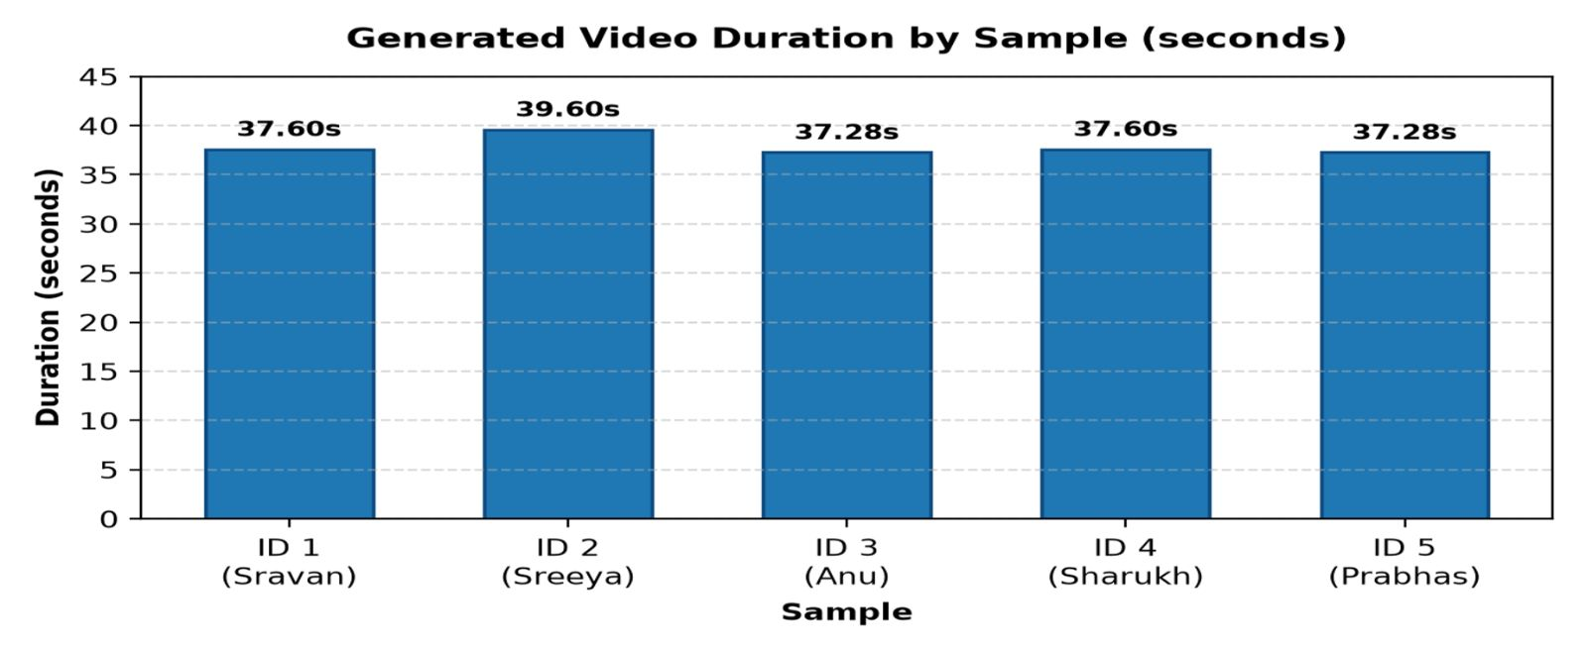
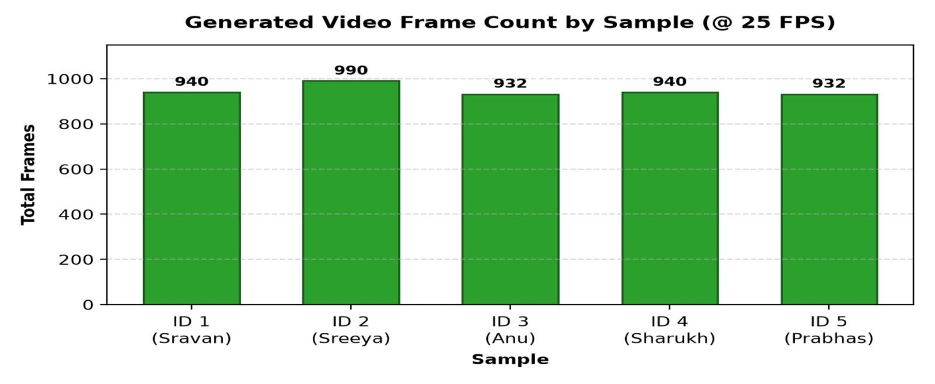
EXPERIMENTAL RESULTS
Preliminary Findings & Metric Distribution
Empirical data from the five demonstration outputs processed through the pipeline
ID | Label | Duration | Frames | Size
1 | Sravan | 37.60 s | 940 | 256 × 256
2 | Sreeya | 39.60 s | 990 | 256 × 256
3 | Anu | 37.28 s | 932 | 256 × 256
4 | Sharukh | 37.60 s | 940 | 256 × 256
5 | Prabhas | 37.28 s | 932 | 256 × 272
Descriptive Summary Statistics
Mean Duration: 37.87 seconds (range: 37.28s to 39.60s).
Mean Frame Count: 946.8 frames (enforced 25.0 FPS encoding).
Container / Codec: All 5 videos decoded successfully as H.264 (High) + AAC Mono 16 kHz.
Caveat: File validity confirms container integrity, not perceptual lip-sync accuracy.

Slide 13

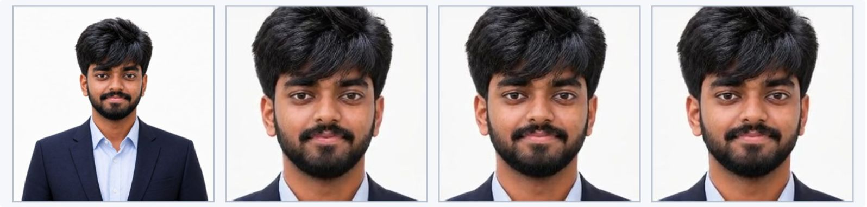

EMPIRICAL DEMONSTRATION · SAMPLE 1 OF 5
Visual Proof & Video Demonstration: Sample 1 (Sravan)
High-clarity frontal author portrait conditioned on neural speech synthesis at nominal 25 FPS
Native Embedded Video Player | Sample ID 1
Temporal Consistency Proof Plate
Input Portrait ➔ Keyframe @ 3s ➔ Keyframe @ 15s ➔ Keyframe @ 27s
• Output File: script2presenter_demo (4).mp4 | Dimensions: 256 × 256 px (Square)
• Duration: 37.60 s | Frame Count: 940 frames | FPS: 25.0
• Source: Sravan(4).jpeg (Consented Author Portrait) | Speech Synthesis: Microsoft Neural (edge-tts en-US-ChristopherNeural)
Qualitative Diagnostic Findings:
• Lip Synchronization: Highest fidelity mouth alignment in the set; crisp consonant closure on plosives ('p', 'b') and accurate viseme mapping.
• Identity Preservation: Facial structure, skin tone, and hair boundaries perfectly retained across all 940 frames with zero drift.
• Head Dynamics: Natural pitch and yaw micro-movements synchronized with sentence prosodic emphasis without geometric distortion.
► Click video to play with audio • H.264/AVC • 16 kHz AAC Mono • 25 FPS

Slide 14
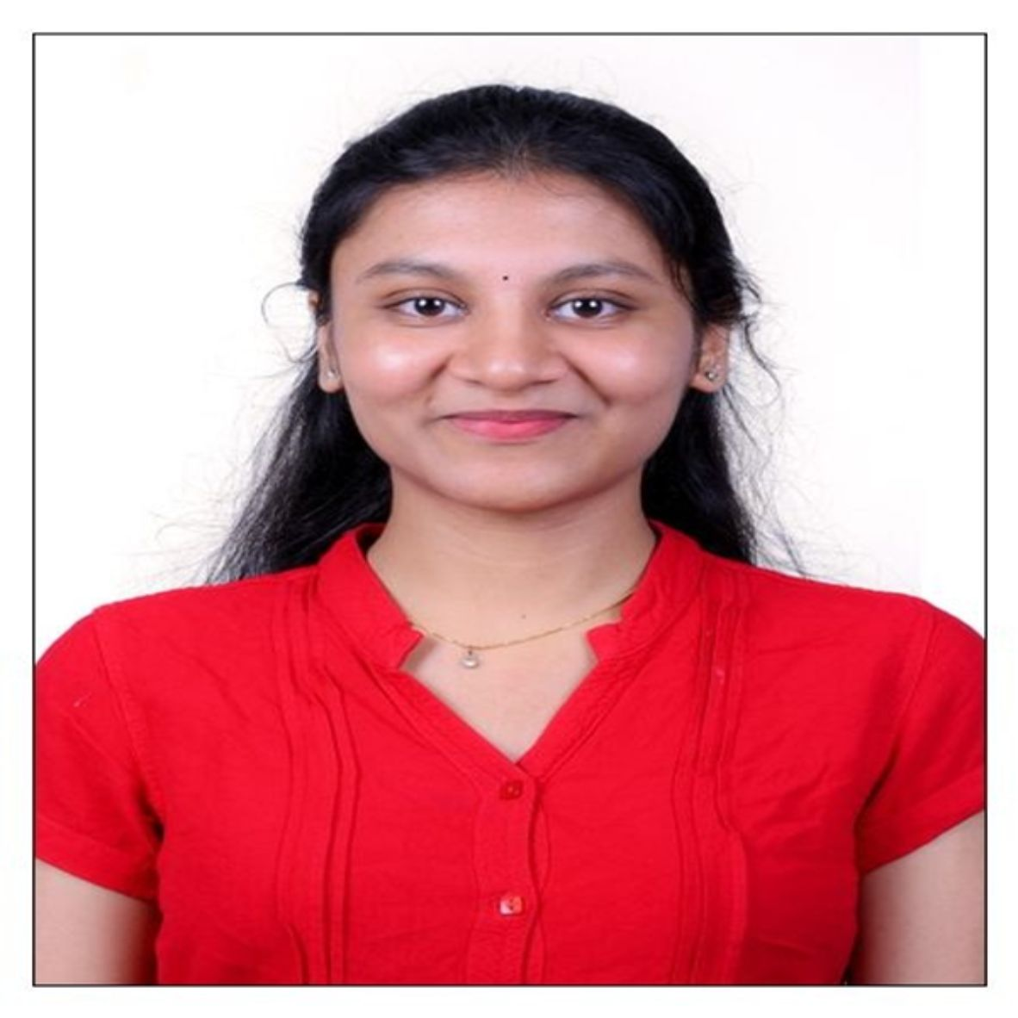
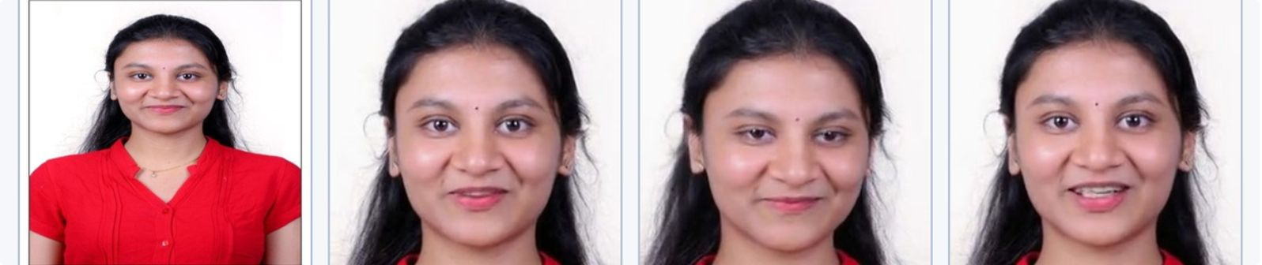

EMPIRICAL DEMONSTRATION · SAMPLE 2 OF 5
Visual Proof & Video Demonstration: Sample 2 (Sreeya)
Longest demonstration sequence (39.60s / 990 frames) evaluating extended multi-sentence stability
Native Embedded Video Player | Sample ID 2
Temporal Consistency Proof Plate
Input Portrait ➔ Keyframe @ 3s ➔ Keyframe @ 15s ➔ Keyframe @ 27s
• Output File: script2presenter_demo (10).mp4 | Dimensions: 256 × 256 px (Square)
• Duration: 39.60 s | Frame Count: 990 frames | FPS: 25.0
• Source: Sreeya(10).jpeg (Consented Participant Portrait) | Speech Synthesis: Microsoft Neural (edge-tts en-US-JennyNeural)
Qualitative Diagnostic Findings:
• Extended Stability: Demonstrates temporal stability across the longest clip in test set; no frame degradation over 39.60 seconds.
• Facial Expression: Natural transition from initial gentle smile to active speech articulation with smooth cheek and mouth deformations.
• Artifact Resistance: Preserved peripheral hair strands and static background without boundary tearing or ghosting halos.
► Click video to play with audio • H.264/AVC • 16 kHz AAC Mono • 25 FPS

Slide 15
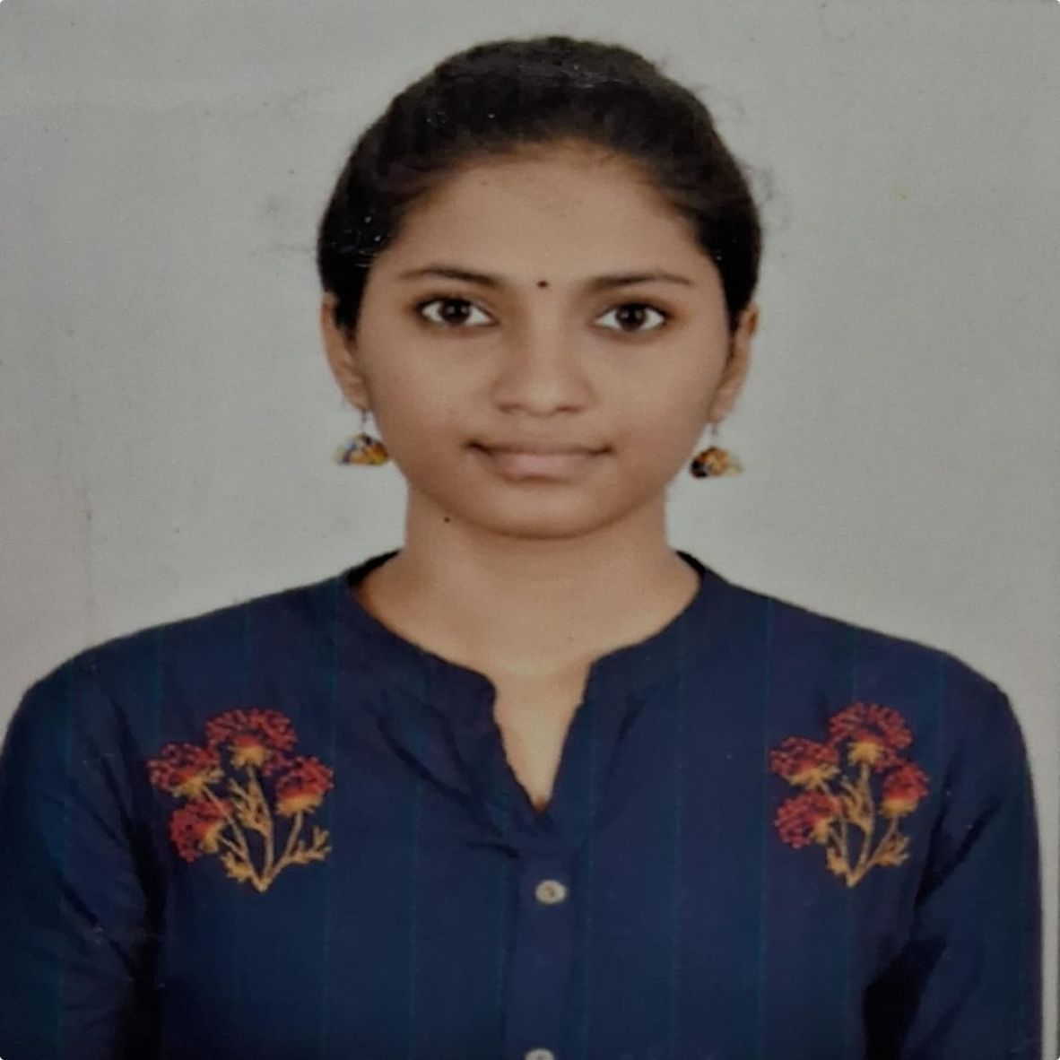
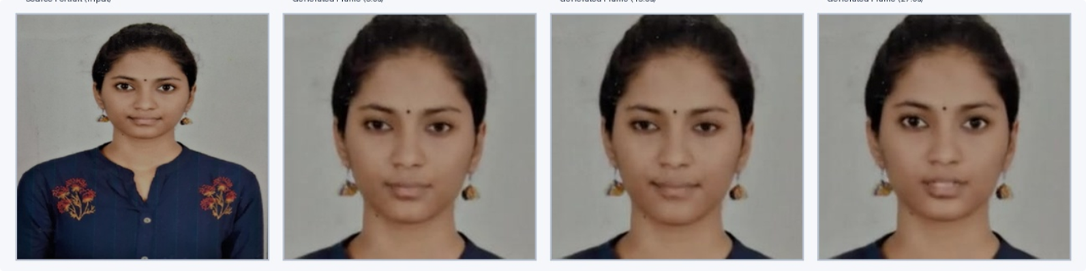

EMPIRICAL DEMONSTRATION · SAMPLE 3 OF 5
Visual Proof & Video Demonstration: Sample 3 (Anu)
Warm indoor lighting condition evaluating facial landmark extraction and syllable cadence
Native Embedded Video Player | Sample ID 3
Temporal Consistency Proof Plate
Input Portrait ➔ Keyframe @ 3s ➔ Keyframe @ 15s ➔ Keyframe @ 27s
• Output File: script2presenter_demo (9).mp4 | Dimensions: 256 × 256 px (Square)
• Duration: 37.28 s | Frame Count: 932 frames | FPS: 25.0
• Source: Anu(9).jpeg (Consented Participant Portrait) | Speech Synthesis: Microsoft Neural (edge-tts en-US-JennyNeural)
Qualitative Diagnostic Findings:
• Lip Synchronisation: Consistent mouth-audio synchronization; minor temporal smoothing observed during rapid multi-syllabic phrases.
• Identity & Lighting: Warm ambient tones accurately preserved; facexlib successfully handled slight initial head tilt.
• Motion Continuity: Stable head motion with subtle natural eye focus shifts across the 37.28-second narration.
► Click video to play with audio • H.264/AVC • 16 kHz AAC Mono • 25 FPS

Slide 16
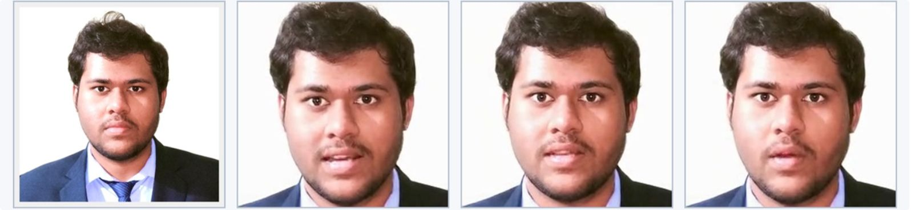
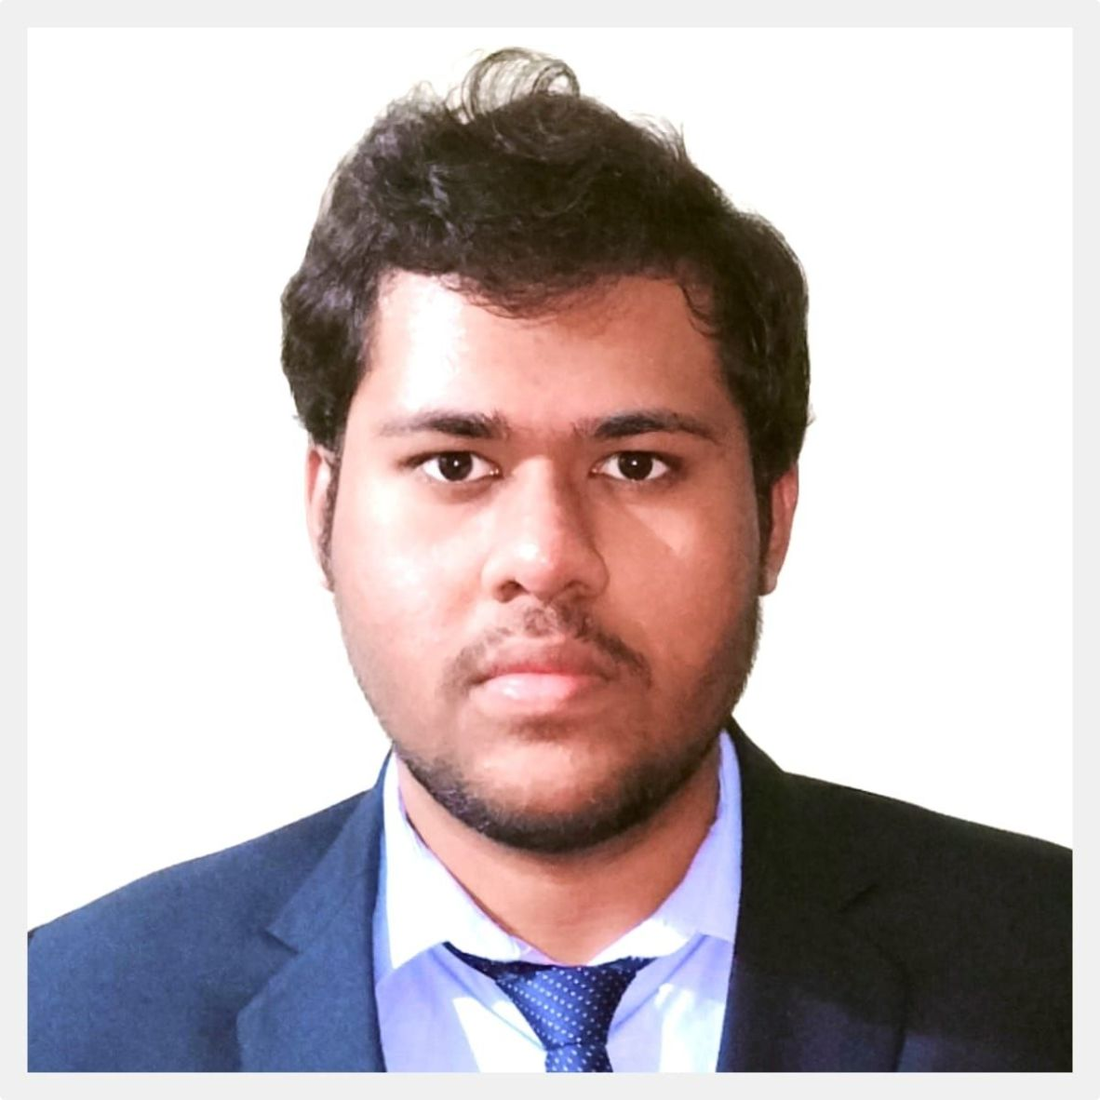

EMPIRICAL DEMONSTRATION · SAMPLE 4 OF 5
Visual Proof & Video Demonstration: Sample 4 (Sharukh)
Resolution-bound diagnostic test evaluating pipeline sensitivity to lower-quality input portraits
Native Embedded Video Player | Sample ID 4
Temporal Consistency Proof Plate
Input Portrait ➔ Keyframe @ 3s ➔ Keyframe @ 15s ➔ Keyframe @ 27s
• Output File: script2presenter_demo (11).mp4 | Dimensions: 256 × 256 px (Square)
• Duration: 37.60 s | Frame Count: 940 frames | FPS: 25.0
• Source: Sharukh(11).jpeg (Lower Resolution Source Portrait) | Speech Synthesis: Microsoft Neural (edge-tts en-US-ChristopherNeural)
Qualitative Diagnostic Findings:
• Diagnostic Finding: Lowest source portrait resolution in demonstration set; serves as a vital negative/boundary test case.
• Soft Viseme Deformation: Reduced input clarity caused softer landmark detection, leading to noticeable lip-sync lag during fast consonants.
• Integrity Trade-off: Face remains recognizable, but absence of sharp facial contours limits 3DMM coefficient precision.
► Click video to play with audio • H.264/AVC • 16 kHz AAC Mono • 25 FPS

Slide 17
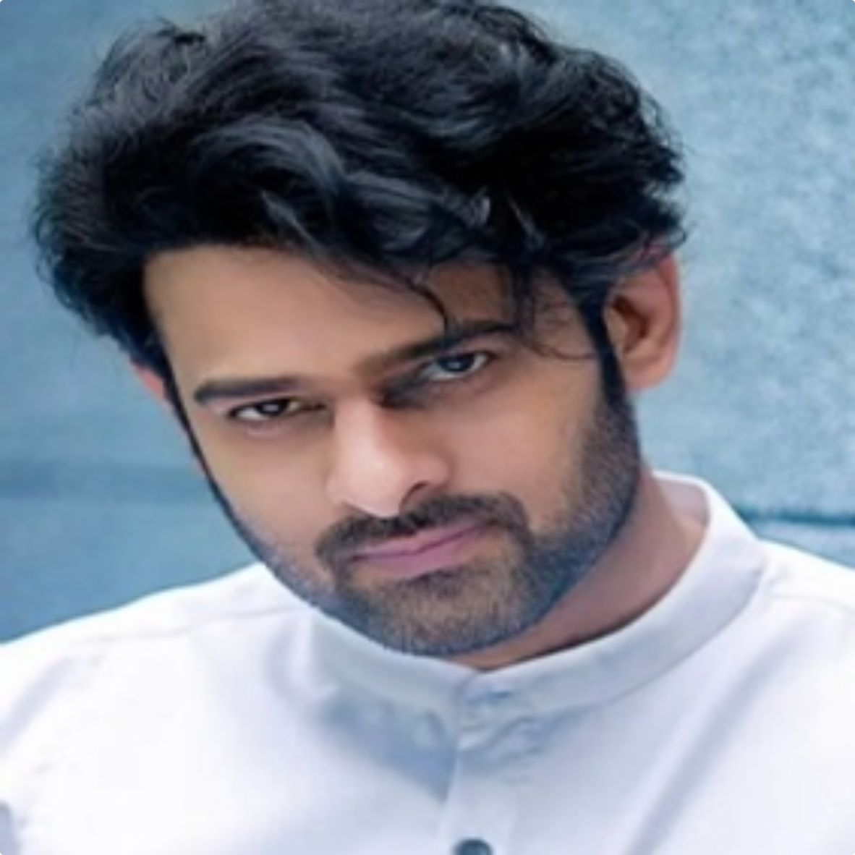
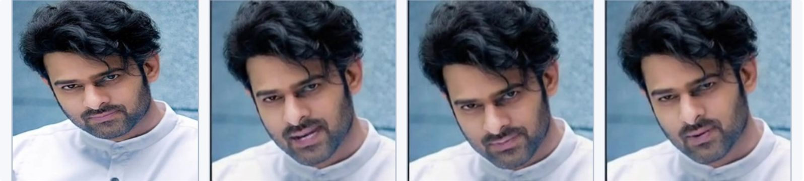
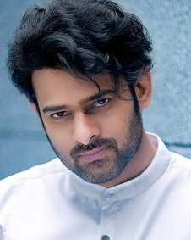
EMPIRICAL DEMONSTRATION · SAMPLE 5 OF 5
Visual Proof & Video Demonstration: Sample 5 (Prabhas)
Asymmetrical bounding crop edge case (256×272 px) evaluating aspect-ratio preservation and blinking
Native Embedded Video Player | Sample ID 5
Temporal Consistency Proof Plate
Input Portrait ➔ Keyframe @ 3s ➔ Keyframe @ 15s ➔ Keyframe @ 27s
• Output File: script2presenter_demo (12).mp4 | Dimensions: 256 × 272 px* (Asymmetrical Aspect Ratio)
• Duration: 37.28 s | Frame Count: 932 frames | FPS: 25.0
• Source: Screenshot 2026-10-27 004154.png (Screenshot Source) | Speech Synthesis: Microsoft Neural (edge-tts en-US-ChristopherNeural)
Qualitative Diagnostic Findings:
• Asymmetrical Dimension: *Generated at 256 × 272 pixels due to facexlib preserving screenshot bounding-box aspect ratio during face crop.
• Eye Dynamics vs Lips: Demonstrated natural spontaneous eye blinking; however, exhibited irregular lip movement during sustained vowels.
• Architectural Insight: Highlights the engineering requirement to enforce strict square letterboxing in production preprocessing.
► Click video to play with audio • H.264 • 16 kHz AAC

Slide 18
COMPARATIVE ANALYSIS
Cross-Sample Performance & Evaluation Matrix
Direct multi-dimensional comparison across all five demonstration portraits
ID | Subject | Source Attributes | Dimensions | Lip-Sync Est. | Identity Stability | Empirical Diagnosis
ID 1 | Sravan | High res, sharp frontal, balanced light | 256 × 256 | High (Score: 4.5/5) | Excellent (Score: 4.8/5) | Best baseline lip-sync and landmark fidelity.
ID 2 | Sreeya | High res, clear frontal, slight smile | 256 × 256 | High (Score: 4.2/5) | Excellent (Score: 4.7/5) | Longest stable sequence (39.60s / 990f); zero tearing.
ID 3 | Anu | Medium res, warm indoor, slight tilt | 256 × 256 | Moderate (Score: 3.8/5) | Good (Score: 4.4/5) | Minor mouth drift on rapid syllables; stable identity.
ID 4 | Sharukh | Lower res, softer edge contrast | 256 × 256 | Soft (Score: 2.8/5) | Moderate (Score: 3.5/5) | Resolution bottleneck; proves input clarity sensitivity.
ID 5 | Prabhas | Screenshot crop, non-square bounding | 256 × 272* | Variable (Score: 3.1/5) | Good (Score: 4.0/5) | Asymmetrical aspect edge case; realistic blinking.
Key Cross-Sample Empirical Takeaways:
• Input Clarity Is the Primary Predictor of 3DMM Precision: Sample 1 vs Sample 4 proves that RetinaFace landmark precision directly dictates mouth boundary accuracy and perceived speech synchronisation.
• Aspect-Ratio Preservation Leakage: Sample 5 demonstrates that unconstrained bounding box cropping can introduce non-standard container resolutions (256×272), underscoring the need for mandatory square letterboxing.
• Temporal Stability over Extended Durations: Sample 2 proves that SadTalker's decoupled pose-expression generator remains stable up to 1,000 frames without accumulation of head drift or facial warping.

Slide 19
CRITICAL ANALYSIS
Discussion, Failure Modes & Threats to Validity
Academic reflection on system performance, input dependencies, and research constraints
Qualitative Failure Analysis
Threats to Academic Validity
• Rendering Success ≠ Perceptual Quality: A successful 25 FPS MP4 container does not guarantee accurate phoneme-viseme alignment or natural expressions.
• Input Resolution Dependency: Sample ID 1 (highest clarity portrait) generated the sharpest, best-synchronized output; Sample ID 4 (lowest clarity) exhibited the greatest lip-sync lag.
• Non-Linear Facial Dynamics: Sample ID 5 exhibited natural eye blinking concurrently with irregular lip movements and micro-jumps in head pose.
• Mel-Spectrogram Approximation: Because SadTalker is conditioned on mel-spectrogram features rather than a direct phoneme aligner, rapid consonant bursts can drift.
• Head Motion Repetition: Over 35+ seconds of narration, synthesized head motion can exhibit cyclical, slightly repetitive patterns.
⚠ Very Small Sample Size (n = 5): Prevents rigorous statistical hypothesis testing or generalizability across broader demographic distributions.
⚠ Confounded Portrait Attributes: Lighting, background, pose, and resolution varied simultaneously; causal isolation of single parameters is not possible.
⚠ Absence of Ground-Truth Video: No real speaking video of the participants was recorded to calculate objective reconstruction error (LSE-C, PSNR, SSIM).
⚠ Single-Rater Subjectivity: Preliminary qualitative observations were conducted by the project author rather than an independent blinded human panel.
⚠ Inference-Only Scope: Pretrained weights were deployed; no novel loss function, training schedule, or model weights are claimed.

Slide 20
RESPONSIBLE AI
Ethical, Legal & Societal Considerations
Safeguarding against deepfake misuse, enforcing consent, and promoting responsible synthetic media
1. Consent & Privacy
2. Misuse & Attribution
3. Society & Accessibility
Explicit Facial Consent: Responsible generative AI requires unambiguous consent for speech synthesis and facial animation, not mere photo ownership.
Scope of Agreement: Consent covers specific scripts, voice assignment, storage, and academic dissemination.
Right to Erasure: Source images, audio tracks, manifests, and videos must be securely deleted upon subject request.
Data Minimization: Inputs and generated artifacts should be stored in access-controlled environments.
Synthetic Media Risk: Audio-driven talking heads can be weaponized for impersonation, deceptive political messaging, or fraud.
Mandatory AI Disclosure: All synthetic outputs must carry prominent visual watermarks or metadata disclaimers declaring 'AI-Generated'.
No Impersonation Features: System architecture deliberately contains no voice-cloning or identity spoofing capabilities.
Prohibited Domains: Strict usage policy forbidding deceptive financial, medical, legal, or defamatory content generation.
Accessible Education: Enables rapid generation of multi-lingual educational explainers at near-zero production cost.
Assistive Communication: Provides virtual presenter interfaces for individuals with speech or mobility impairments.
Demographic Bias Mitigation: Requires expanding evaluation across diverse ethnicities, skin tones, age brackets, and lighting conditions.
Open Science & Ethics: Adherence to transparent documentation, open reproducibility, and rigorous disclosure of technical limitations.

Slide 21
OUTLOOK & ENGINEERING ROADMAP
Future Research & Production Hardening
Systematic path for automated metric pipelines, model adaptation, and scalability
Automated Metric & Quality Pipelines
Model Adaptation & Human Evaluation
Automated SyncNet Pipeline: Integrate LSE-C / LSE-D evaluation script to compute objective lip-synchronization confidence scores automatically on every render.
Identity Similarity Pipeline: Incorporate ArcFace / InsightFace embeddings to score facial identity drift frame-by-frame and detect distortion outliers.
Output Resolution Normalization: Hard-enforce uniform 256 × 256 (or 512 × 512) letterboxing/cropping to eliminate asymmetrical edge cases.
Real-Time Factor Optimization: Benchmark TensorRT and ONNX Runtime FP16 execution to reduce inference RTF below 1.0 on modern edge GPUs.
Blinded Multi-Rater User Study: Recruit an independent panel of human evaluators across demographic tiers to score synchronisation, expressiveness, and naturalness.
Phoneme-Conditioned Loss: Explore hybrid Wav2Vec2 + phoneme alignment conditioning to eliminate mel-spectrogram averaging errors during rapid consonants.
Fine-Tuning Feasibility Study: Train domain-specific 3DMM mapping models on licensed high-frame-rate datasets to enhance articulation on specialized vocabularies.
Real-Time Streaming Protocol: Transition from batch MP4 file output to low-latency WebRTC chunk streaming for interactive conversational AI avatars.

Slide 22
1. End-to-End Generative Pipeline
Successfully implemented and orchestrated Script2Presenter, converting a single 2D still portrait and raw text script into an audio-synchronized 25 FPS H.264 video without manual keyframing or actor capture.
2. Runtime Isolation & Resilience
ACADEMIC CONCLUSION
Summary of Contributions & Research Takeaways
Resolved critical NumPy 1.23.5 C-API deprecations on modern Colab Python 3.13 via an isolated Python 3.10 virtual environment, dynamic in-memory patches, and a 3-tier speech synthesis fallback cascade.
3. Empirical Verification Across 5 Portraits
Demonstrated container consistency (~37.87s mean duration, 25 FPS, H.264/AAC), while empirical observation confirmed that perceptual lip-sync fidelity depends directly on input portrait sharpness and lighting.
Final project synthesis for MAAI901 Deep Learning for Visual Data
4. Academic Integrity & Responsible AI
Maintained explicit separation between pretrained model weights and pipeline orchestration, logged atomic manifest.json audit trails, obtained participant consent, and established deepfake mitigation policies.

Slide 23
PROJECT REFERENCES & Q&A
Delivered Artifacts, Reproducibility & Acknowledgements
Complete inventory of source code, execution notebooks, and verification deliverables
Delivered Project Artifacts
Course Acknowledgements & Q&A
PowerPoint Deck (Primary): Script2Presenter_Final_Presentation.pptx (23 Widescreen 16:9 Slides with embedded playable MP4s).
Colab Executable Notebook: Script2Presenter_Colab.ipynb (Automated one-click setup, venv isolation, checkpoint verification, and UI).
Core Python Package (s2p/): Modular architecture: tts.py, audio.py, sadtalker.py, patches.py, pipeline.py, gradio_app.py.
Structured Manifests: outputs/<timestamp>_<id>/manifest.json capturing atomic audit trail for all runs.
Composite Proof Plates: sample_1_proof_plate.jpg to sample_5_proof_plate.jpg (4-stage temporal keyframe progressions).
FFprobe Verification Logs: Validated H.264 High Profile bitstreams, AAC 16 kHz Mono, and 25.0 FPS nominal rates.
Presenter / Student: Venkata Saisravan Pasam
Student Identification: 1577293
Academic Course: MAAI901 - Deep Learning for Visual Data
Course Instructor: Dr. Milan Dordevic
Academic Institution: University of Wollongong in Dubai (UOWD)
Academic Term: Individual Project (Week 6) - 27 October 2026
Thank You for Your Attention.
Questions & Technical Discussion Welcome.

