Slide 1

ALUMNI CONNECT
Connect .. Learn.. Grow

Slide 2
Problem Statement :
A web based alumni connect platform for a college that helps alumni register , connect and share success stories . Focusing on clean, responsive platform that promotes engagement and ease of use.
Outcomes :
1. A web based platform for alumni to connect , share and explore the success stories.
2.Easy and responsive UI which helps the users to easily explore through the web application.
3.A place to share all the success stories of the alumni students , faculties.
4.Improves network and engagement of the people.

Slide 3
Overview :
Students find it difficult to connect with the alumni from their college to learn or to get successful in their careers. Connecting with existing alumni and grow the network seems difficult. Building an web based application where all the alumni can connect , share their experiences and stories so that the students get motivation and path to their careers. This platform not only helps in connecting people but also creates an interactive environment for the people to engage and grow in life.

Slide 4
Challenges in existing solution
1. Managing of personal contacts or whatsapp group is difficult with overloaded messages and contacts.
2. May not be able to connect personally with the alumni to listen to their success stories, improving network and seeking guidance from them.
3. Difficult to manually manage or add every alumni data , it is easier to use an application which helps to manage the data of the alumni people.
4. Less interactive or user friendly for the end users.

Slide 5
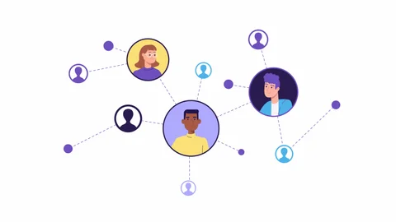
Flow Chart
Register
(new user)
Login
(old user)
Home page
Connect Page
Message/ add to your network
People Page
Story Page
Create own story
Post the story

Slide 6


Solution
1. A web application which is capable of connecting the alumni people of college .
2. Displays the success stories of the successful alumni .
3. Encourages others by the success stories.
4. Helps to connect and grow the network.
5. The admin have control over the application.
6. Easy and responsive UI which helps in easier navigation .
The application contains the following pages:
1. Register/Login page - Page for entering into the application validated against the database data.
2. Home page – Displays a hero section with “connect..Grow..Learn” hero section and displays all the navigation buttons.
3. Connect page- List of alumni profiles with connect option.
4. Story Board – Displays the list of stories as well as a textbox to create your own story.

