Slide 1

Department of Electronics & Communication Engineering
AN INTERNSHIP PRESENTATION
ON
EMBEDDED SYSTEMS
TRAINING CARRIED OUT BY
APSSDC
Presented by
NAGULA LAKSHMI BHAVANI
23NG5A0416
Under the Faculty Guidance of
DR.B.NANCHARAIAH

Slide 2
OUTLINE
Introduction
Company Overview
Internship Objectives
Tasks and Responsibilities
Proposed Solution
Achievements and Outcomes
Challenges and Lessons Learned
Future Scope
Conclusion

Slide 3
INTRODUCTION TO EMBEDDED SYSTEMS
Definition:
An embedded system is a microcontroller or microprocessor-based system, designed to perform a specific function or task within a larger system.
Performs a dedicated function.
Responds to inputs within a defined time limit.

Slide 4
Optimized for power, cost, and performance.
Includes both hardware (e.g., sensors, actuators) and software (firmware).
Applications:
Consumer electronics
Healthcare devices
Industrial automation
Defense and aerospace system.

Slide 5
OVERVIEW OF THE ORGANIZATION
Andhra Pradesh State Skill Development Corporation (APSSDC) is a public–private partnership that promotes skill development and entrepreneurship.
The organization collaborates with leading technology companies to offer industry-relevant virtual internships, including EMBEDDED SYSTEMS.
Policy Focus :Skill development,
Entrepreneurship ,and technical education.

Slide 6
INTERNSHIP OBJECTIVES
Understand the fundamentals of Embedded systems.
Gain hands-on experience with proteus and keil.
Implement some projects like lcd display ,led’s patterns etc.
Learn to about sensors ,lcd display ,buzzer etc.
Enhance teamwork, project management, and communication skills.

Slide 7
TASKS AND RESPONSIBILITES
Simulated and tested embedded circuits using tools
such as Proteus and Tinkercad.
Implemented embedded C programs for real-time
control and monitoring applications.
Analyzed hardware and software integration
for efficient system performance.
Documented circuit designs, flowcharts, and
code for project development.

Slide 8
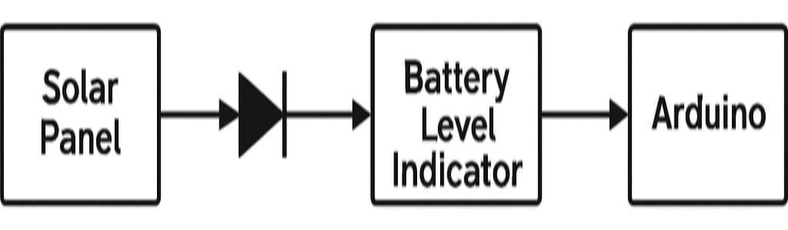
PROPOSED SOLUTION

Slide 9
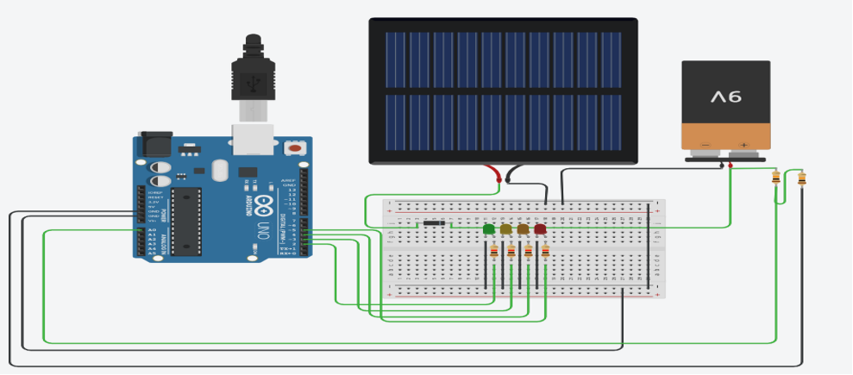
CIRCUIT DIAGRAM:

Slide 10

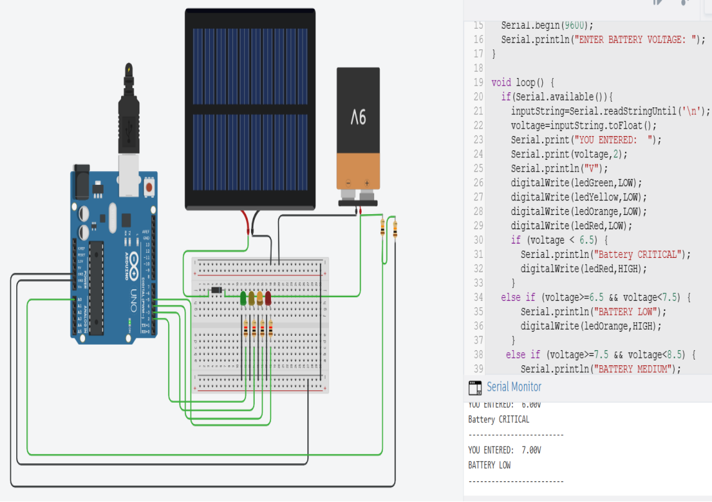
ACHIEVEMENTS

Slide 11

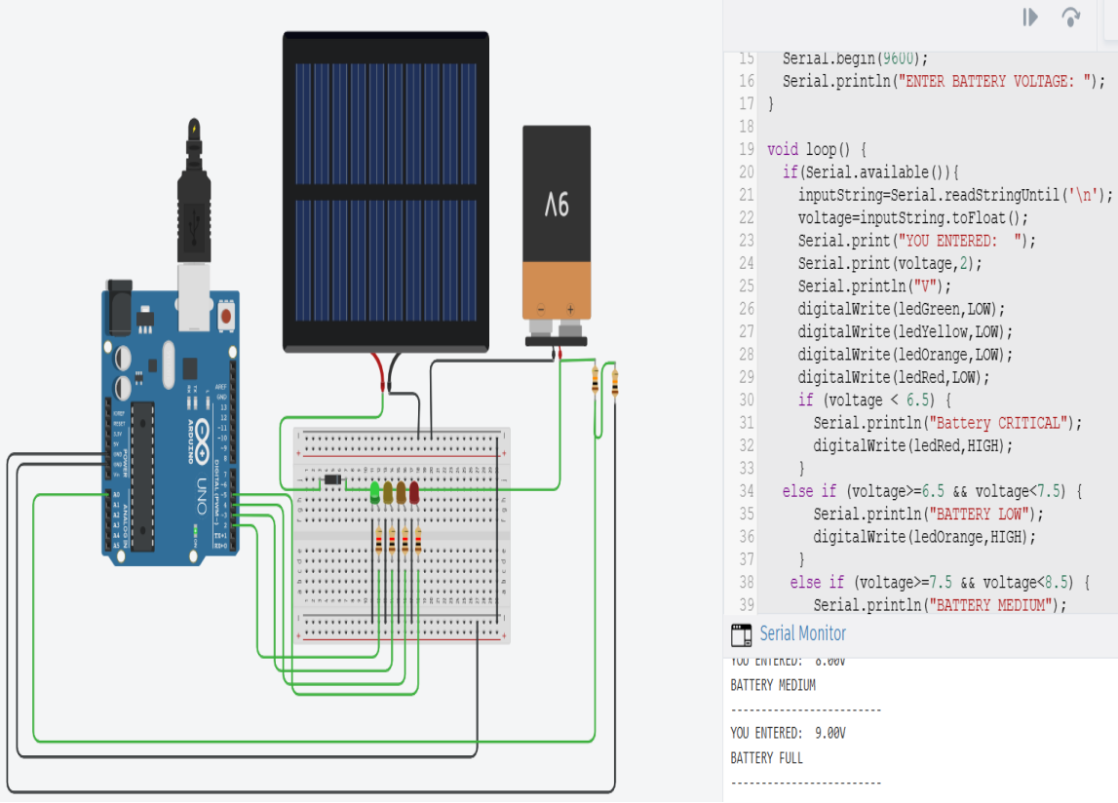
ACHIEVEMENTS

Slide 12
ACHIEVEMENTS AND OUTCOMES
Successfully deployed a Solar charger.
Gained practical understanding of ARDUINO AND TINKER CAD.
Improved keil , proteus, Arduino and tinker cad skills.
Learned the use of embedded system technology.

Slide 13
CHALLENGES AND LESSONS LEARNED
Faced difficulties in debugging hardware connections and circuit faults during testing.
Overcame programming errors while writing and compiling embedded C code.
Learned to properly interface sensors and actuators with microcontrollers.
Managed timing and synchronization issues in real-time embedded applications.

Slide 14
FUTURE SCOPE
Growing demand for embedded engineers in industries like automotive, IoT, robotics, and healthcare.
Integration of AI and IoT for developing smart and connected embedded devices.
Opportunities to work with ARM, RISC-V, and FPGA-based systems for advanced applications.
Development of low-power and energy-efficient embedded solutions.

Slide 15
CONCLUSION
This internship provided valuable hands-on experience in embedded system design and development.
Enhanced practical knowledge of microcontroller programming, sensor interfacing, and circuit simulation.
Improved understanding of how hardware and software work together in real-time systems.

Slide 16
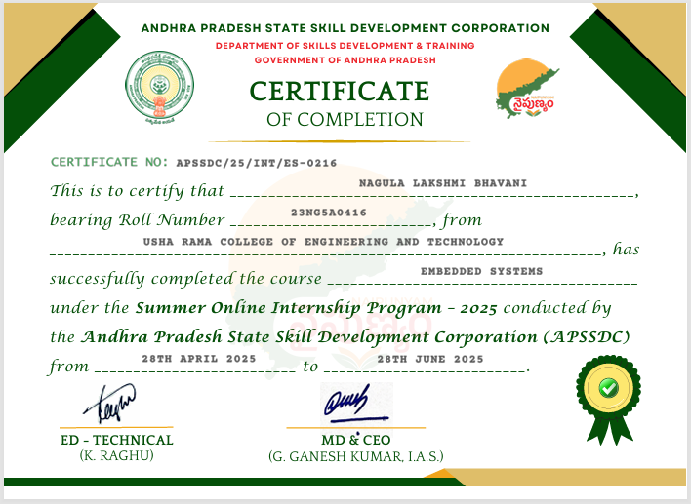

Slide 17
Thank you

