Slide 1

Four-Element UWB MIMO Antenna System With a Square Frame Decoupling Structure for Enhanced Isolation and Polarization Diversity Characteristics
by
Batch no: C5
T.LAKSHMI DURGA (23NG5A0427)
D.KISHORE (22NG1A04F1)
SK.NAGUR SAIDA (23NG5A0423)
K.SYAM PRASAD (22NG1A04G0)
Under the Esteemed Guidance of
Dr. A. Suneel Kumar M.Tech,(Ph.D)
Associate professor
Department of Electronics and Communication Engineering

Slide 2
CONTENTS
Abstract
Existing system (Methodology/Algorithm/Protocol)
Proposed system (Block Diagram) & it’s working
Expected outcomes (Results/outputs)
Requirements: Software / & Hardware
Advantages
Applications
References

Slide 3
ABSTRACT
A cost-effective antenna is proposed for Ultrawideband (UWB) applications, focusing on compactness and performance.
Achieves a wide operating range from 3.7 GHz to 15.7 GHz (12 GHz bandwidth)
A four-element MIMO setup is arranged orthogonally to enhance diversity and spatial performance.
MIMO mode, bandwidth improves to 2.9 GHz to 16.2 GHz, covering more UWB spectrum.
Delivers a maximum gain of 5.5 dBi at 14 GHz with >80% total efficiency across the resonance band
A geometric parasitic element between antenna elements boosts isolation by 15 dB, reducing mutual coupling.
Compact design — 20×26 mm² for a single element and 46×48 mm² for the full MIMO array.

Slide 4
EXISTING SYSTEM
Single element UWB antennas like monopole and slot designs supported wide bandwidth but lacked MIMO diversity.
Multi-element MIMO antennas suffered from strong mutual coupling when elements were placed close together.
Many designs used a common ground plane without modification, which reduced isolation.
The operating bandwidth was often limited to around 3–10 GHz, not covering higher frequencies.
Antenna size was relatively large, making it unsuitable for compact devices.
Some systems used multilayer substrates or expensive materials, making them less cost-effective.
MIMO antennas are widely used to improve channel capacity, reliability, and spectral efficiency.

Slide 5
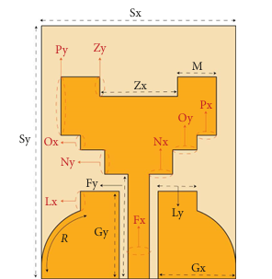
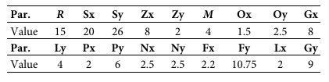
Single Element:
Table 1: Proposed antenna dimensions
Figure 1: Proposed CPW UWB antenna

Slide 6
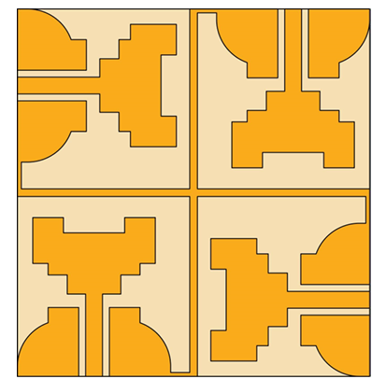
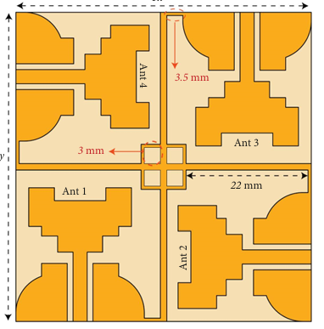
MIMO Configuration:
(a) Structure 1
(b) Structure 2

Slide 7
EXISTING SYSTEM DRAWBACKS:
High mutual coupling between antenna
Moderate gain
Some antennas are expensive to fabricate
Low efficiency at higher frequencies

Slide 8
PROPOSED SYSTEM & IT’S WORKING
Start
Select substrate material
Create substrate and ground
Create patch and feedline
HFSS simulation
Verify design model and its parameters
Assign excitation and boundary
Fabrication process
Validate performance for WIFI/WiMAX applications
VNA Testing
END

Slide 9
EXPECTED OUTCOMES
Maintaining total efficiency above 85% across the resonance bandwidth
Stable MIMO performance metrics (ECC, MEG, DG) within acceptable limits
Suitability of the proposed UWB–MIMO antenna for diverse UWB wireless applications.
Arrange elements more symmetrically for stable polarization.
Use simple matching methods to cover more frequency range.

Slide 10
REQUIREMENTS:
Software:
High-frequency structure simulator (HFSS)Software.
Hardware:
Antenna fabrication
Vector Network Analyzer (VNA) Hardware testing.

Slide 11
ADVANTAGES
Small size, easy to fit in devices
Four antennas improve signal quality and reliability
Special structure reduces interference between antennas
Provides good signal strength
Low cost because it uses FR4 material
Suitable for many wireless applications

Slide 12
APPLICATIONS
Wireless communication systems
High-speed data transfer
Mobile and portable devices
Wireless sensor networks
Radar and imaging systems
Internet of Things (IoT) devices
Medical monitoring and imaging

Slide 13
REFERENCES
1. A. A. Ibrahim and M. F. Abo Sree, “Uwb Mimo Antenna with 4-element, Compact Size, High Isolation and Single Band Rejection for High-Speed Wireless Networks,” Wireless Networks 28, no. 7(2022): 3143–3155, h
2. C. Suresh, T. S. Reddy, B. T. P. Madhav, et al., “A Novel Design of Spike-Shaped Miniaturized 4 × 4 MIMO Antenna for Wireless UWB Network Applications Using Characteristic Mode Analysis,” Micromachines 14, no. 3 (2023): 612, https:// do
3. A. C. Suresh, T. S. Reddy, B. T. P. Madhav, et al., “A Novel Design of Spike-Shaped Miniaturized 4 × 4 MIMO Antenna for Wireless UWB Network Applications Using Characteristic Mode Analysis,” Micromachines 14, no. 3 (2023): 612, https:// doi.org/10.3390/mi14030612.i.org/10.3390/mi14030612.ttps://doi.org/10.1007/ s11276-022-03019-4.
4. T. Addepalli, G. N. Kumar, C. J. Rani, et al., “A Defected Substrate 4-Element MIMO Antenna With Higher Diversity Characteristics for 5G Sub-6 GHz N77/N78 Band Applications,” Wireless Networks 31, no. 2 (2024): 1931–1947, https:// doi.org/10.1007/s11276-024-03864-5.
5. C.S. Anki reddy , T.S. Reddy, and B .Madhav, “Design and Verification of an Umbrella Shaped Narrow Band- Uwb Antenna Pair for Mimo Applications Using Characteristic Mode Analysis ,” E-Prime-Advances in Electrical Engineering, Electronics and Energy 8 (2024): 100545, https://doi.org/ 10.1016/j.prime.2024.100545.

Slide 14
QUERIES ?

Slide 15
THANK YOU

