Slide 1
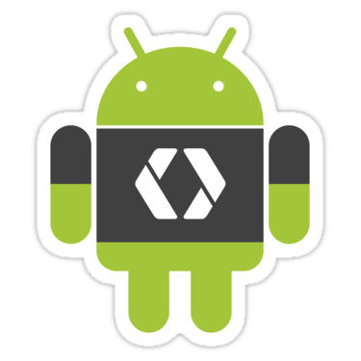
Introduction To Android
#Day 1

Slide 2
WHAT IS ANDROID?
It is a open source software platform and operating system for mobile devices
Based on the Linux kernel
Developed by Google and later the Open Handset Alliance (OHA)
Allows writing code in the Java ,C++ and Kotlin
Android has its own virtual machine,ART(Android Run Time) earlier DVM(Dalvik Virtual Machine),which is used for executing the android application

Slide 3
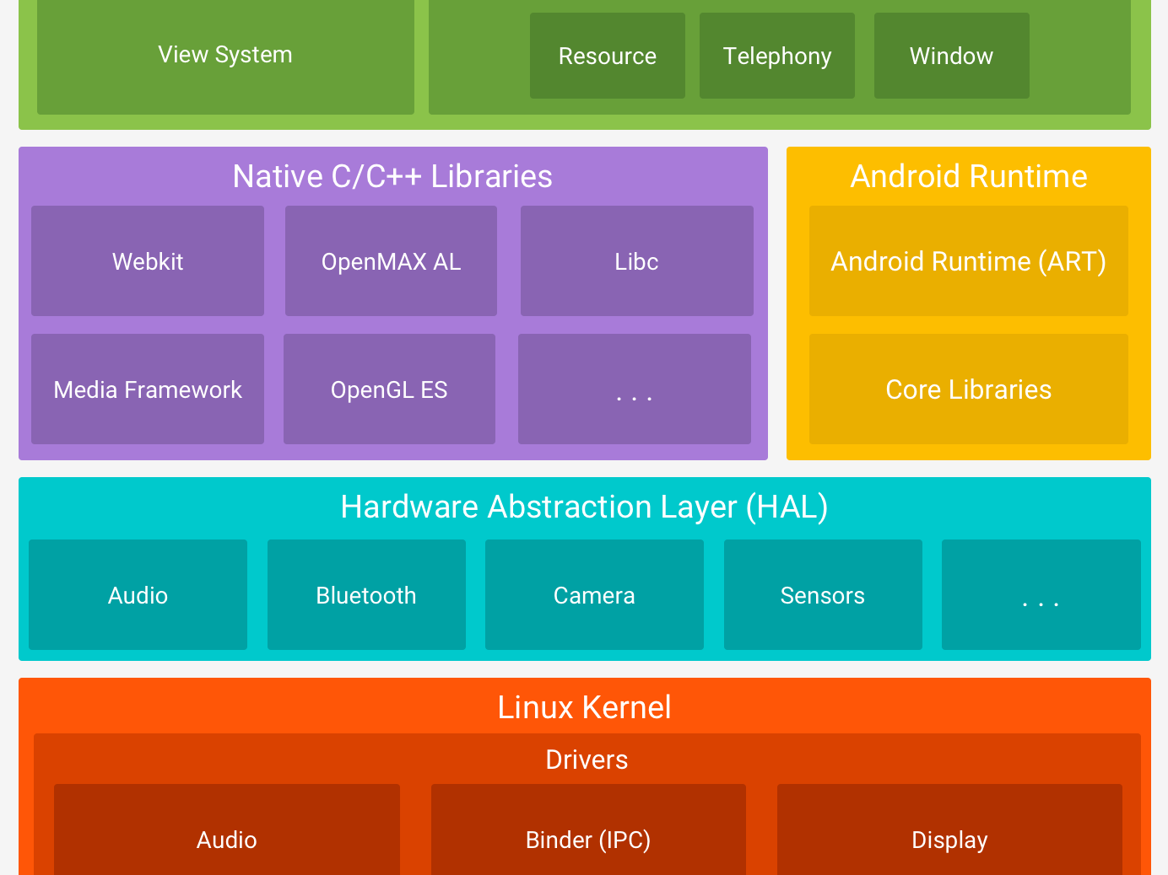
Android Architecture

Slide 4
Supported Platforms
Smartphone OS
Wear OS
Android TV
Android Auto
Android Things
Chrome OS Devices

Slide 5
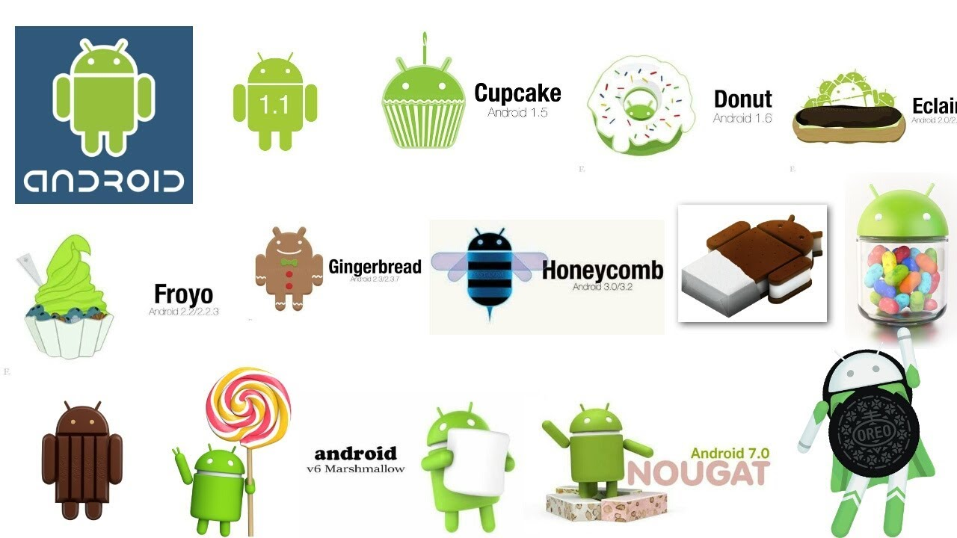
ANDROID VERSIONS

Slide 6
Android Studio Installation
Install JDK
Visit https://developer.android.com/studio/ and get Android Studio

Slide 7
Components of Android Application
Activities
Services
Broadcast Receivers
Content Providers

Slide 8
Hello World Application
(Demo)

Slide 9
Resources
https://developer.android.com/
https://www.youtube.com/watch?v=QAbQgLGKd3Y&list=PL6gx4Cwl9DGBsvRxJJOzG4r4k_zLKrnxl

