Slide 1

Pathfinding Algorithms for Game Optimization
Nakka Lakshmi prasanna
Richa patel
Sravanthi

Slide 2

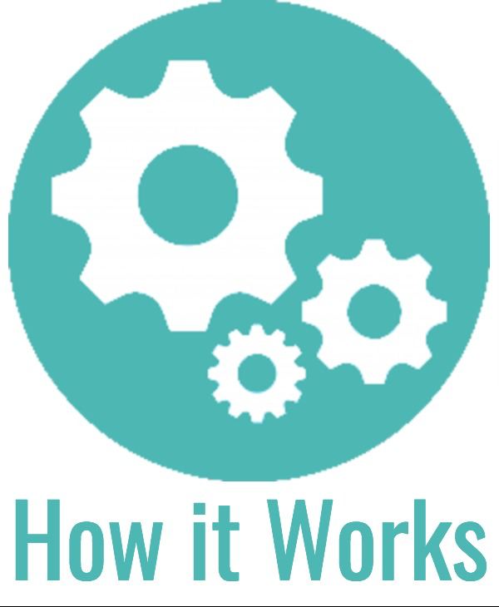
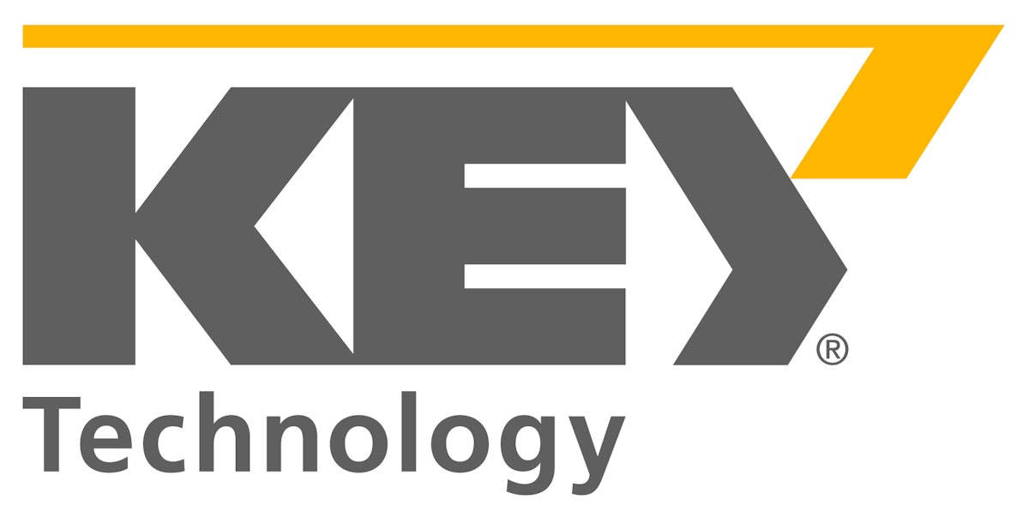
1. Introduction to the Project
uses Q-learning to improve its strategy over time.
type of reinforcement-learning, to improve its decision-making
Tic-Tac-Toe is a two-player game where each player takes turns to place their symbol (either 'X' or 'O') on a 3x3 grid

Slide 3
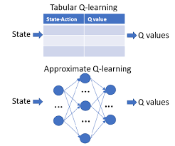
Overview of the Q-learning Approach
Reinforcement Learning:
Q-learning and its role in your project:
Q-Table
Q-Table
Action Selection:
Action Selection:
Exploration
Exploitation
Q-Table Update

Slide 4
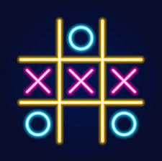
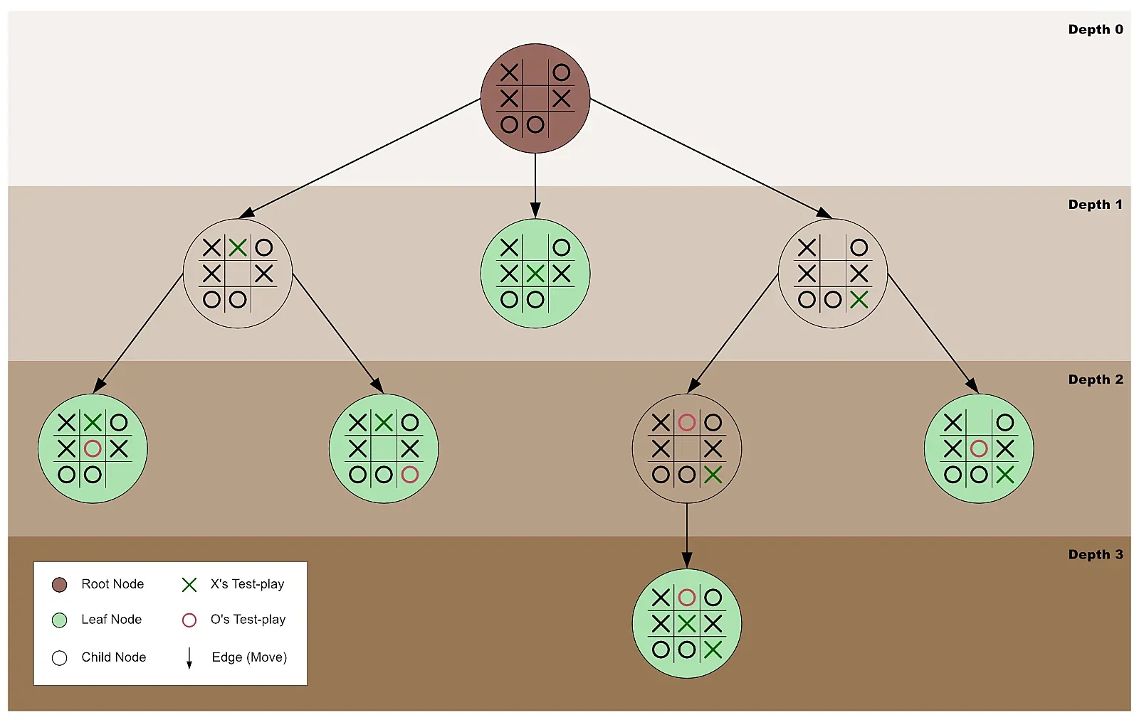
Game Flow and AI Behavior
AI Move
Game Start
Win/Tie Check
End of Game
Training Mode

Slide 5
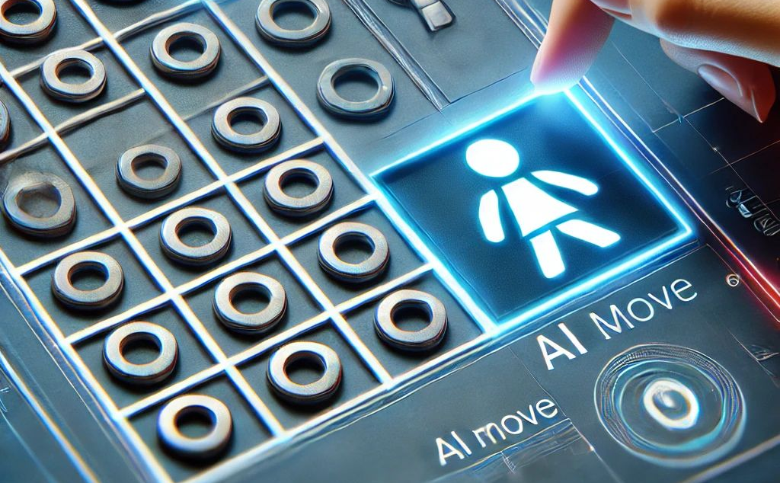
AI vs Human Gameplay
Once the AI is trained, explain how a human player can play against the AI:
• Human-Player Interaction: "After training, the human player can play against the AI by clicking on the grid to place their 'X' symbol. The AI plays as 'O'. After each human move, the AI selects its move based on the Q-table."
• Game Flow: "The game alternates turns between the human player and the AI, displaying the updated board and the current game status after each move."

Slide 6
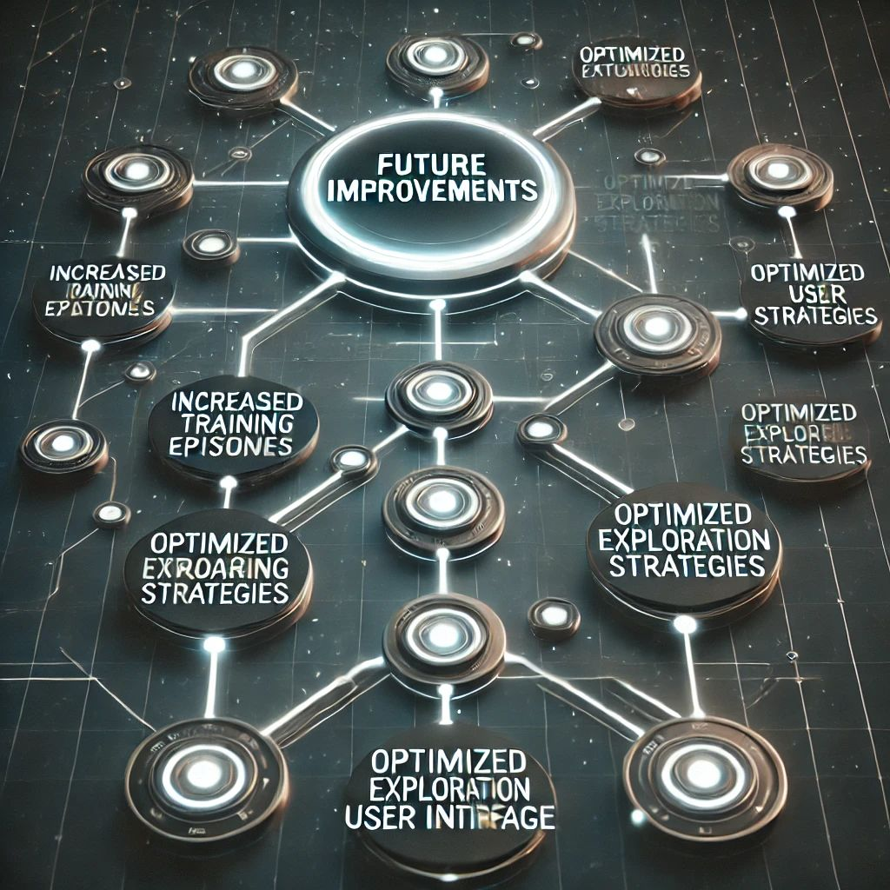
Future Improvements and Next Steps
Discuss potential improvements you could make to your project:
• Increased Training Episodes: "Training the AI for more episodes will help improve its performance by providing more opportunities for it to learn from different game scenarios."
• Optimizing the AI: "Exploration can sometimes make the AI perform sub-optimally. I could experiment with different exploration-exploitation strategies (such as decaying epsilon over time)."
• User Interface Enhancements: "Improving the user interface(UI) for smoother interaction, including a restart button or AI difficulty levels, could make the game more engaging."

Slide 7
Why Q-learning May Be Better Than Minimax
• Q-learning adapts and improves over time through experience, while Minimax relies on a fixed strategy.
• Q-learning works well in large, complex, or uncertain environments, where it’s difficult to evaluate every possible future state (e.g., larger state spaces or games with imperfect information).
• Minimax requires evaluating all possible outcomes, which is computationally expensive for larger games. Q-learning can scale better by learning incrementally.
• Q-learning is more flexible in handling real-time decision-making and dynamic environments.

Slide 8
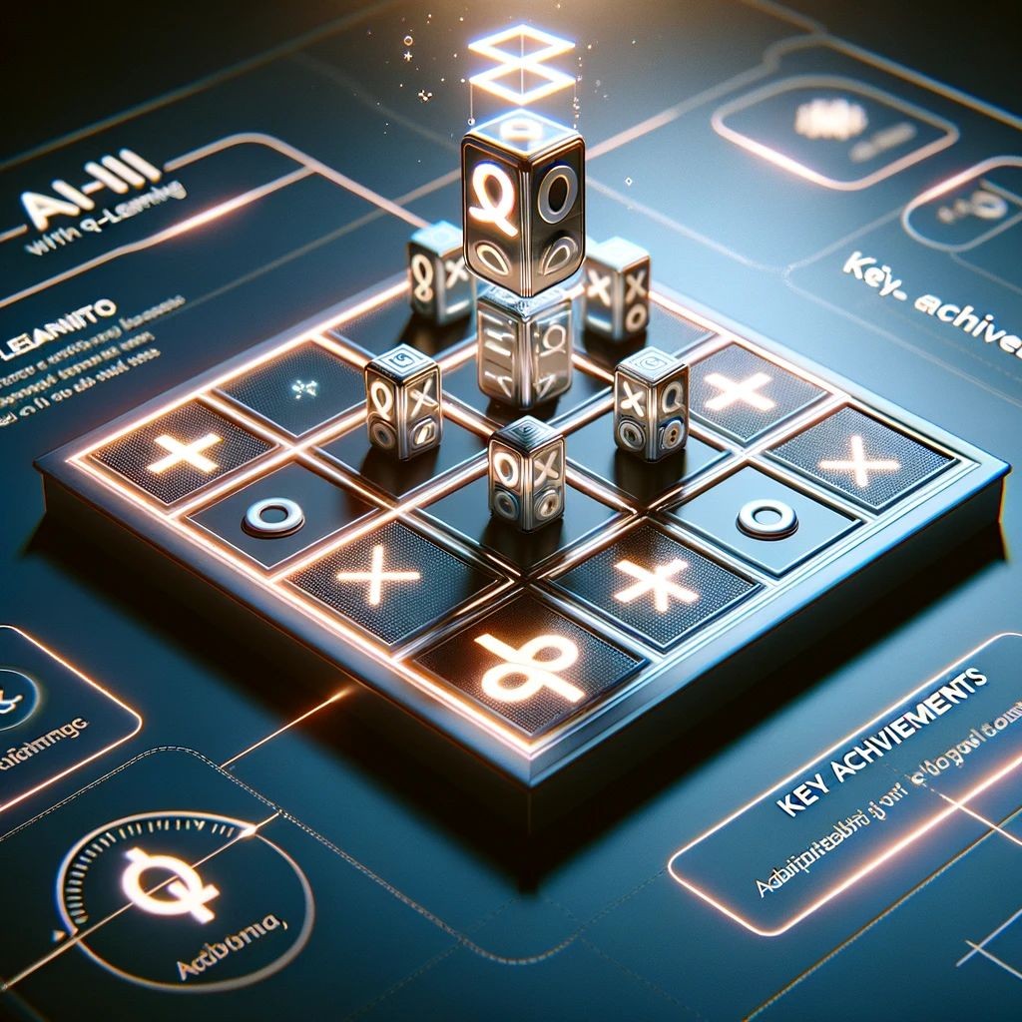
Conclusion
Q-learning tends to be better for dynamic, adaptive, and large-scale learning environments where the agent learns from experience, especially in complex or imperfect information games. On the other hand, Minimax is perfect for smaller, simpler games with perfect information where the optimal strategy can be computed exhaustively.
"In this project, I successfully implemented a Tic-Tac-Toe game where the AI learns to play using Q-learning. Through training, the AI improves its gameplay and gradually becomes more strategic. This project has provided me with valuable insights into both reinforcement learning and game development."

Slide 9
Thank you
Sravanthi Kadari
Nakka Lakshmi Prasanna
Richa Patel

