Slide 1
FarmChainX AI-Driven Agricultural Traceability Network
Frontend Showcase

Slide 2
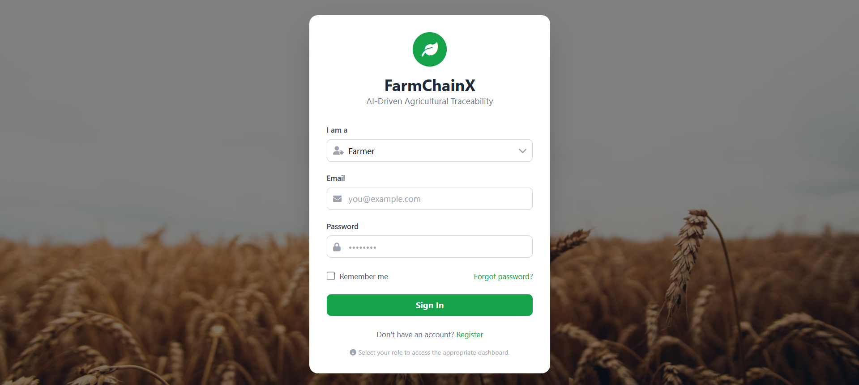
Title and Content Layout with List
Add your first bullet point here
Add your second bullet point here
Add your third bullet point here

Slide 3
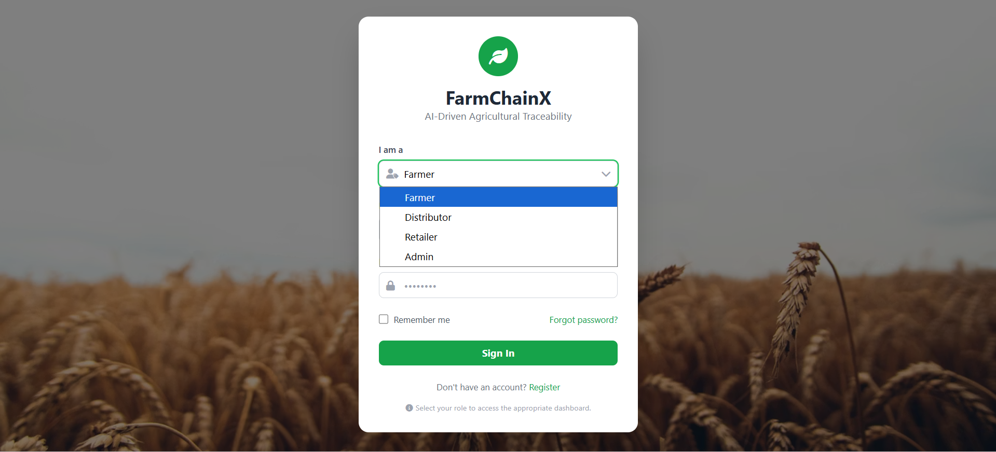
Title and Content Layout with Chart

Slide 4
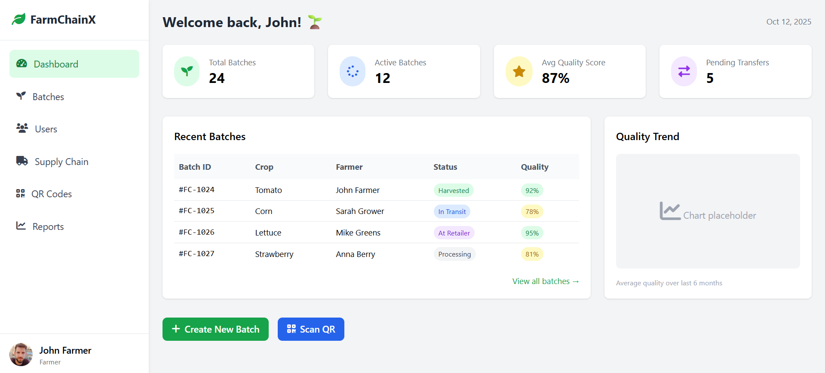
Two Content Layout with Table
First bullet point here
Second bullet point here
Third bullet point here
Class | Group A | Group B
Class 1 | 82 | 95
Class 2 | 76 | 88
Class 3 | 84 | 90

Slide 5
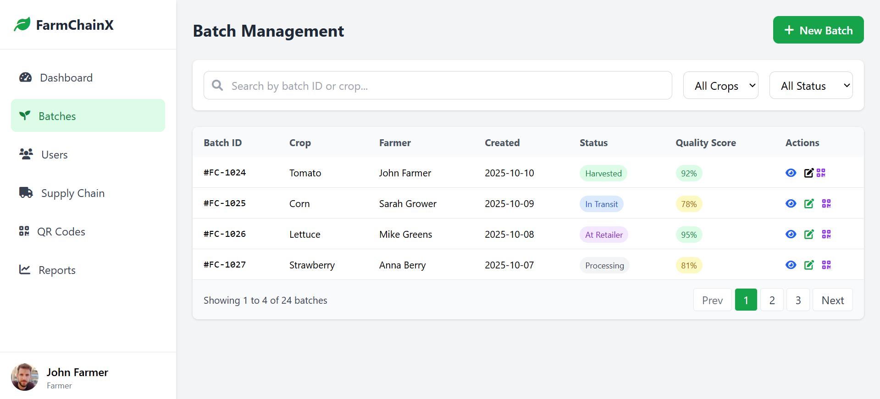
Two Content Layout with SmartArt
First bullet point here
Second bullet point here
Third bullet point here
Group A
Task 1
Task 2
Group B
Task 1
Task 2
Task 3
Task 4
Task 3

Slide 6
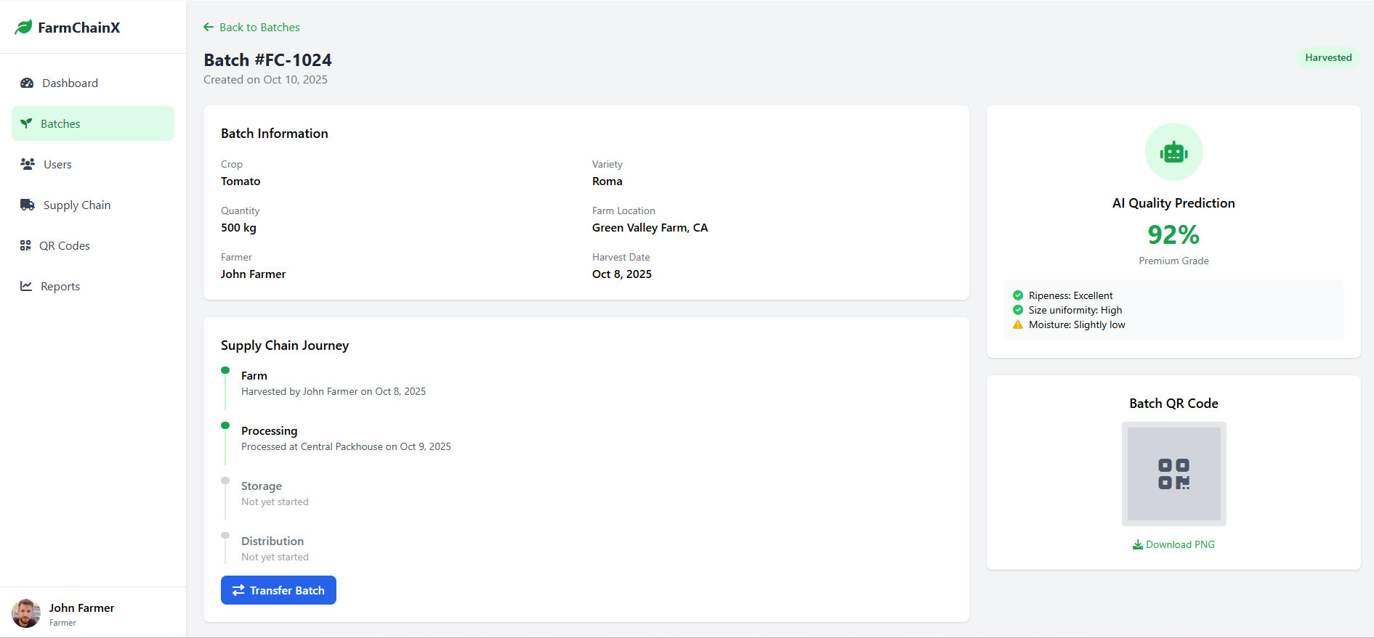
Add a Slide Title - 1

Slide 7
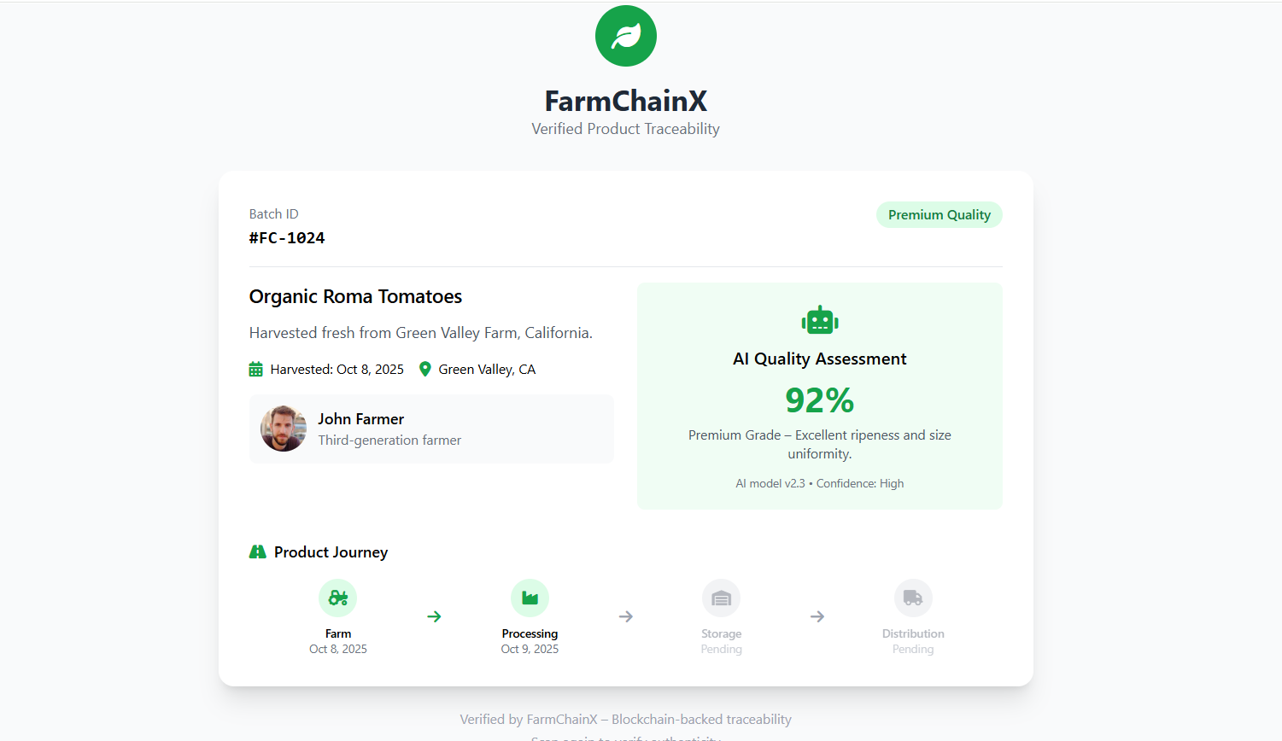
Add a Slide Title - 2

