Slide 1
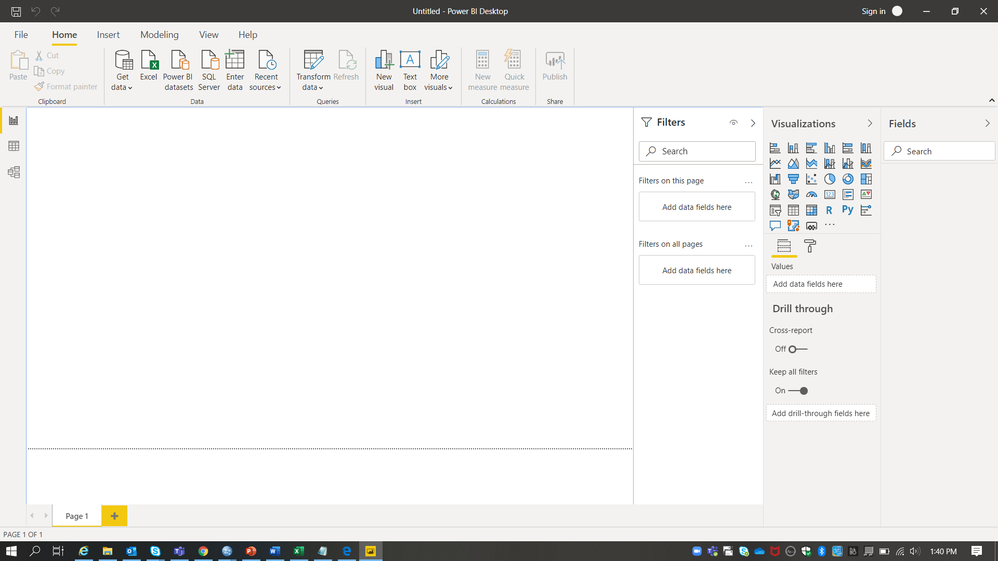
1. Install Power BI Desktop and share the final screenshot of the report view page which appears when power desktop starts.
Report View Page.

Slide 2
2. Prepare a document and with the following screenshot
I. Report View

Slide 3
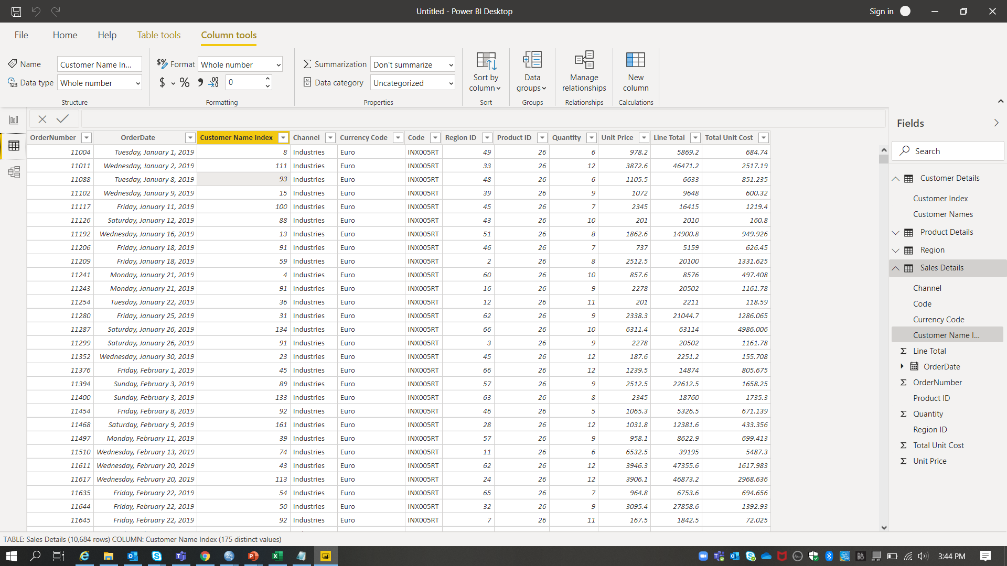
II . Data View

Slide 4
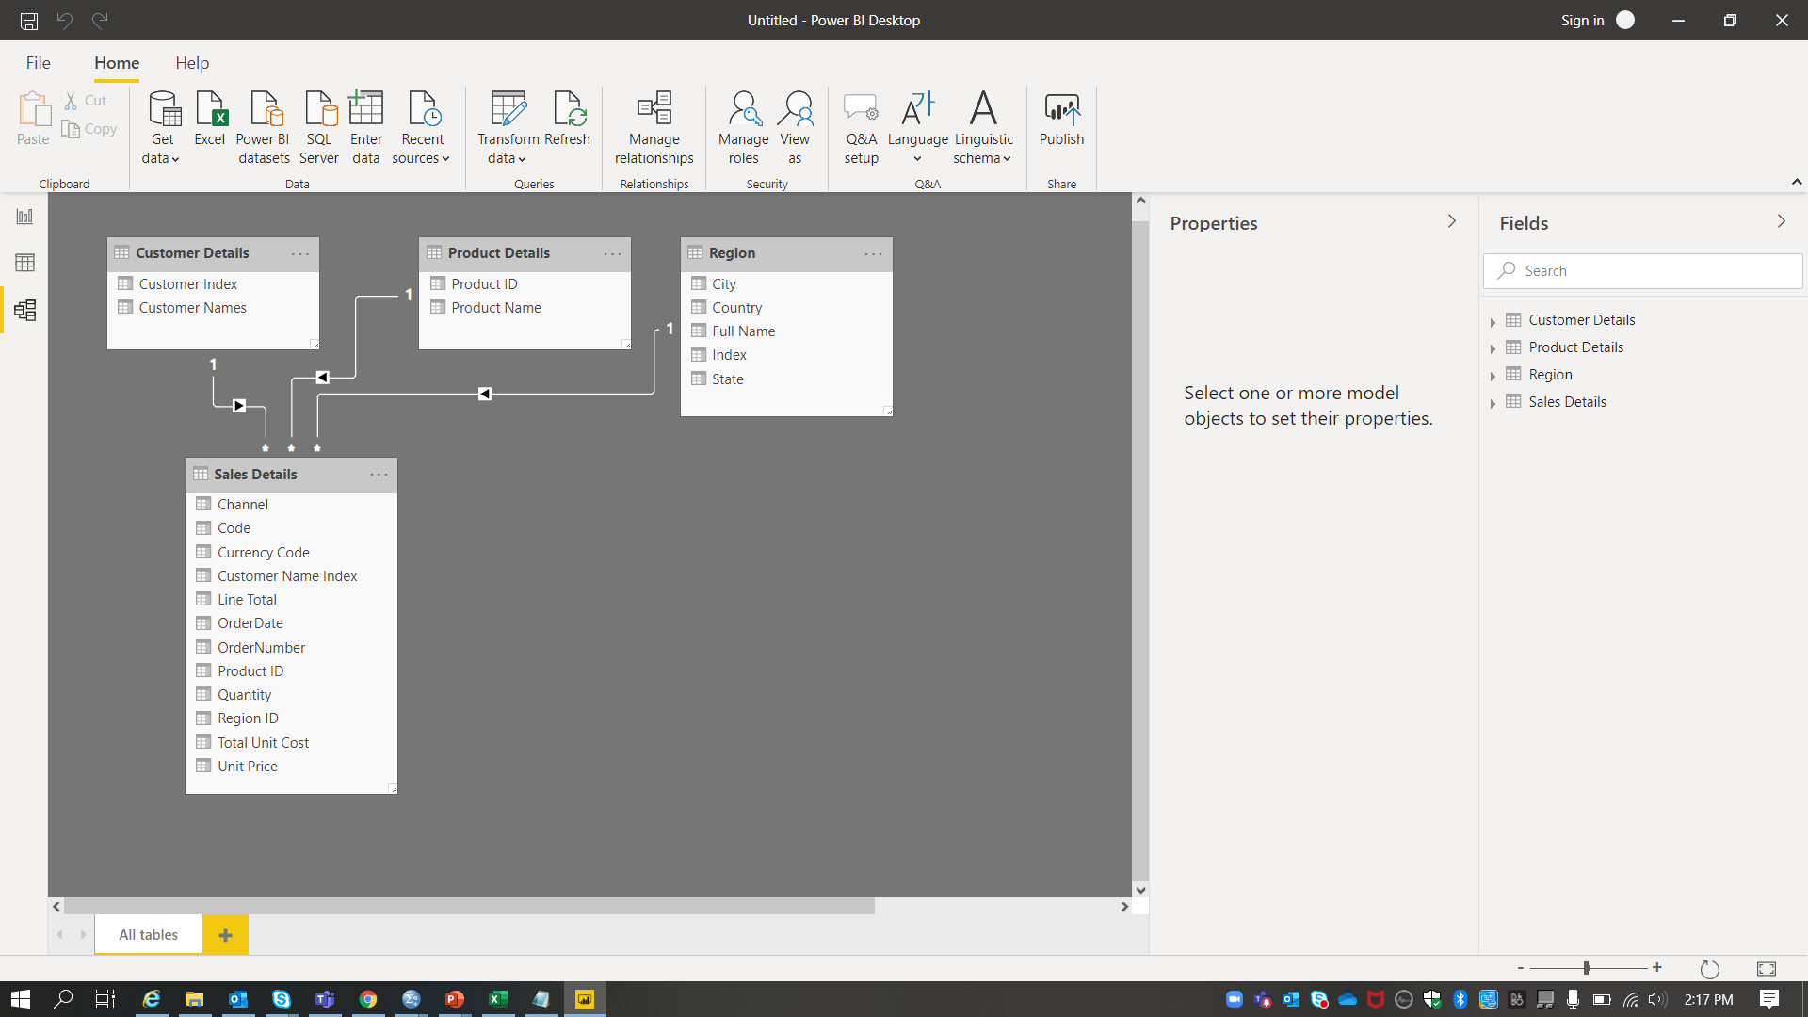
III . Model View

Slide 5
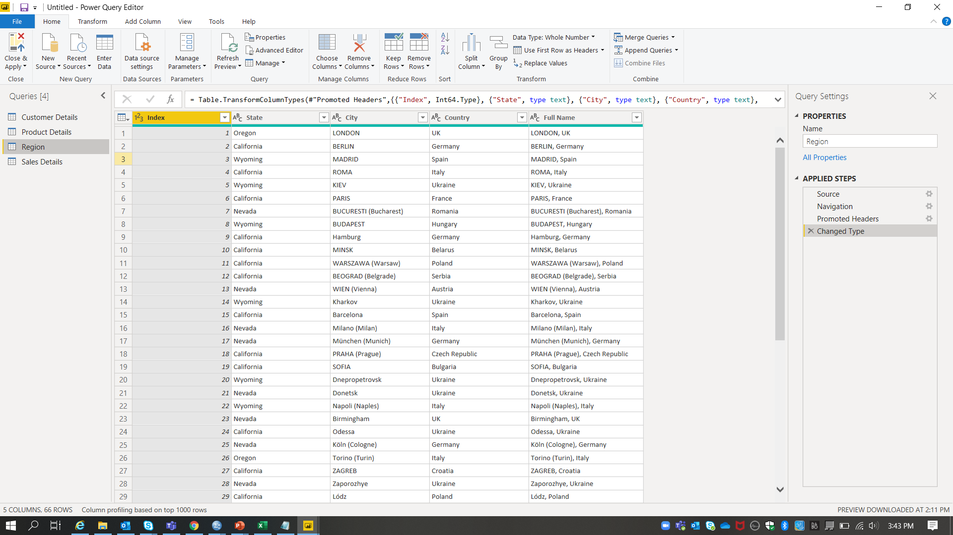
IV . Power Query Editor

Slide 6
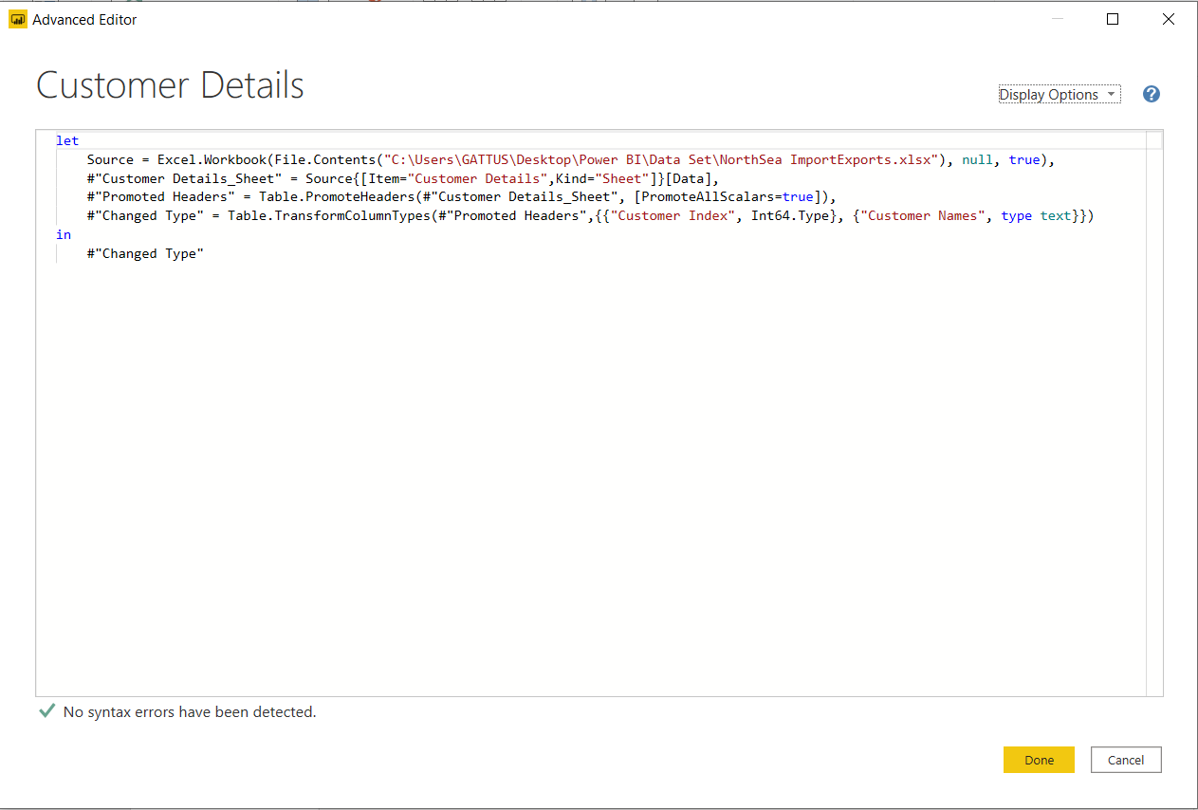
V . Advance Editor

Slide 7
3. Prepare a document with details of the following along with their price − Power BI Desktop − Power BI Pro − Power BI Premium
Power BI Desktop
This is a self service BI tool used for authoring reports & prepare, model & create data visualizations.
Monthly price per user - $0
Power BI Pro
This is a self service BI tool works for collaborating, Publishing, Sharing & Ad-hoc analysis.
Monthly price per user - $10
Power BI Premium
This is an Enterprise BI, Big data analytics, Cloud & On-Premises reporting tool.
It has advanced administration & deployment controls.
Dedicated cloud compute & storage resources.
Monthly price per user - $5000

