Slide 1


K O M M U R I P R ATA P R E D D Y I N S T I T U T E OF TECHNOLOGY
( UGC-A u t o n o m o u s Institution )
G h a n p u r ( V ) , G h a t k e s a r ( M ) , M e d c h a l ( D ) , Hyderabad-500088
DEPARTMENT OF COMPUTER SCIENCE ENGINEERING (AI&ML)
IOMP REVIEW – 02
MULTI- AGENT CODE REVIEW AND REFACTORING ASSISTANT
UNDER THE GUIDANCE OF :
PRESENTED BY :
G. DIVYA ASSISTANT PROFESSOR
DEPARTMENT OF CSE (AI & ML)
K SRAVYA (23RA1A66B4)
N. PUJITHA (23RA1A6676)
K. YESHWANTH (23RA1A66D9)
P. VINITH (23RA1A66D2)

Slide 2
PROBLEM STATEMENT
Continuous Code Review Required
Code Quality Issues Increase
Security Vulnerabilities Need Detection
Complexity Affects Code Maintainability
Manual Analysis Is Time-Consuming
Refactoring Requires Developer Effort
Testing Remains a Separate Task
Need Integrated Multi-Agent Workflow

Slide 3
ABSTRACT
This project proposes a Multi-Agent Code Review and Refactoring Assistant, an AI-powered system that automates code review, refactoring, and test generation using specialized intelligent agents. A Code Reviewer Agent detects code quality issues, security vulnerabilities, and complexity problems using LLMs and tools such as Pylint and Bandit. A Refactoring Agent suggests optimized improvements, while a Test Generation Agent creates unit tests to validate the changes. Using LangGraph or CrewAI for agent coordination and human approval for modifications, the system aims to improve code quality, security, reliability, and developer productivity while supporting integration with modern CI/CD workflows.

Slide 4
LITERATURE SURVEY
1 . Code Reviewer — Li et al. ( 2022 )
Pretrained model for automating code - review activities.
Performs code- quality estimation, review - comment generation, and code refinement.
Supports the Code Reviewer Agent of the proposed system.
2 . Chat Dev — Qian et al. ( 2024 )
Introduced a multi- agent framework for software development.
Specialized LLM agents collaborate on tasks such as design, coding, and testing.
Provides the conceptual foundation for the multi - agent architecture .
3 . Auto Code Rover — Zhang et al. ( 2024 )
Uses LLMs, code search, and program structure for autonomous program improvement.
Generates modifications to improve existing source code.
Supports the Refactoring Agent in the proposed system.

Slide 5
Code Agent — Ta ng et al. ( 2024 )
  Multi- agent LLM framework for automated code review.
  Identifies vulnerabilities, inconsistencies, and coding - style violations.
  Supports automated quality and security analysis through specialized agents.
5 . Chat Uni Test — Chen et al. ( 2024 )
LLM- based framework for automated unit - test generation.
Uses code context with generation, validation, and repair mechanisms.
Supports the Test Generation Agent of the proposed system.
RESEARCH GAP :
Existing studies mainly focus on individual code- review, refactoring, multi- agent, or test- generation tasks .
The proposed system integrates these capabilities into a single coordinated workflow :
Code Review → Refactoring → Test Generation → Human Approval

Slide 6
EXISTING SYSTEM
Static Code Analysis Tools
Rule-Based Code Review
LLM-Based Code Suggestions
Automated Code Refactoring
Automated Unit-Test Generation
Specialized Review Agents
Separate Maintenance Tools
Limited Workflow Integration

Slide 7
DISADVANTAGES OF EXISTING SYSTEM
Task-Specific Software Solutions
Separate Review And Testing
Limited Code Context Understanding
AI Suggestions Need Verification
Generated Tests Need Validation
Increased Developer Intervention

Slide 8
PROPOSED SYSTEM
Integrated Code Improvement Workflow
Specialized AI Agents
Automated Code Issue Detection
AI-Based Refactoring Suggestions
Human Approval Before Changes
Automated Unit-Test Generation
AI With Static Analysis
Coordinated Agent Orchestration

Slide 9
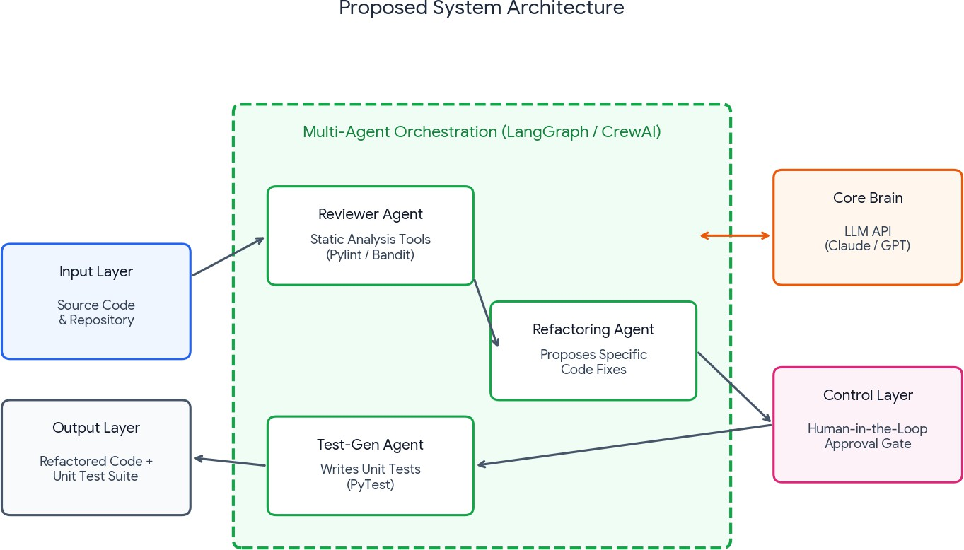
PROPOSED SYSTEM ARCHITECTURE DIAGRAM

Slide 10
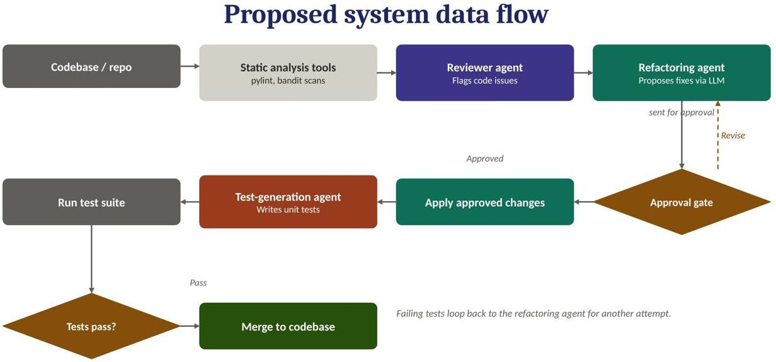
PROPOSED SYSTEM DATA FLOW DIAGRAM

Slide 11
METHODOLOGY
Code Input & Analysis Module
  Accepts source code from the selected repository.
  Parses and analyzes the code for structure and dependencies.
  Performs initial static analysis.
2 . Code Review Module
Identifies bugs, code smells, quality issues, and security vulnerabilities.
Generates detailed review findings and improvement suggestions.
3 . Refactoring Module
Uses review f indings to identify areas requiring improvement.
Generates suitable refactoring suggestions for the existing code.

Slide 12
Test Generation Module
  Generates unit test cases for the reviewed/ refactored code.
  Validates the generated tests and identifies potential issues.
5 . Va lidation & Human Approval Module
Presents the proposed changes and generated tests for human verification.
Applies approved changes and sends rejected changes back for revision.
Produces the f inal improved code and unit - test suite.
Input & Analysis → Code Reviewer Agent → Refactoring Agent → Test Generation Agent → Human Approval & Final Output

Slide 13
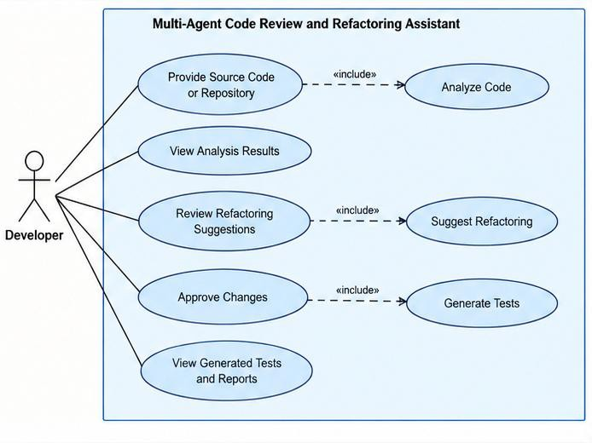
UML DIAGRAMS
1. Use Case Diagram

Slide 14
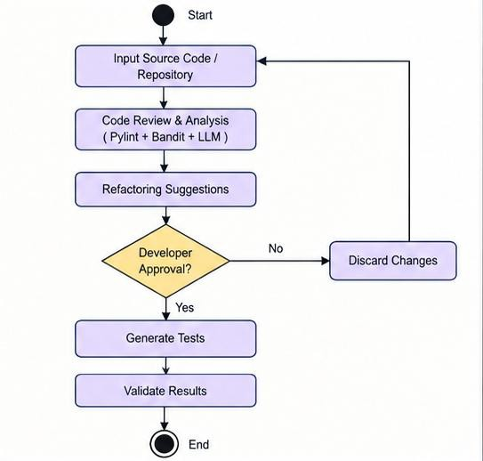
2. Activity Diagram

Slide 15
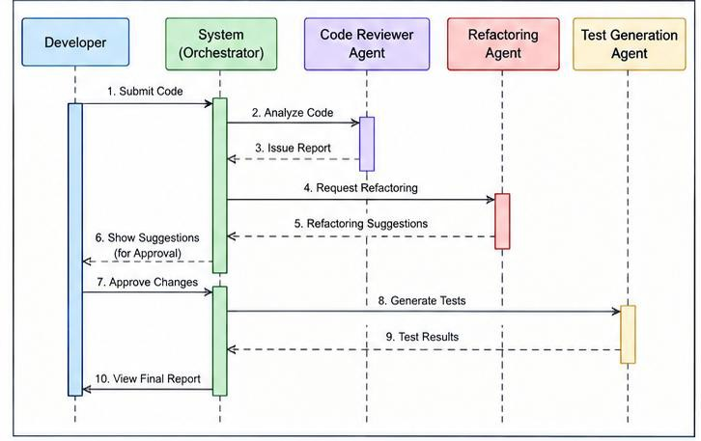
3. Sequence Diagram

Slide 16
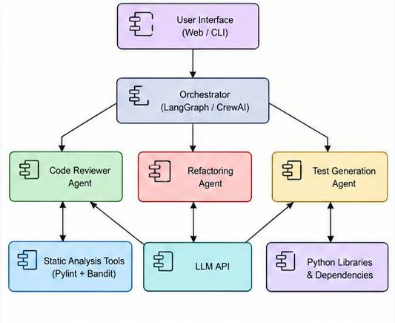
4. Component Diagram

