Slide 1


KOMMURI PRATAP REDDY INSTITUTE OF TECHNOLOGY
( UGC-Autonomous Institution )
Ghanpur(V), Ghatkesar(M), Medchal(D), Hyderabad-500088
DEPARTMENT OF COMPUTER SCIENCE ENGINEERING (AI&ML)
IOMP REVIEW – 02
MULTI-AGENT CODE REVIEW AND REFACTORING ASSISTANT
UNDER THE GUIDANCE OF :
G. DIVYA
ASSISTANT PROFESSOR
DEPARTMENT OF CSE (AI & ML)
PRESENTED BY :
K SRAVYA (23RA1A66B4)
N. PUJITHA (23RA1A6676)
K. YESHWANTH (23RA1A66D9)
P. VINITH (23RA1A66D2)

Slide 2
PROBLEM STATEMENT
Modern codebases require continuous review to identify code-quality issues, security vulnerabilities, and code complexity.
Existing review processes often depend on manual analysis, making them time-consuming and difficult to scale.
Detecting an issue is not enough; refactoring the code and creating tests to validate the changes also require developer effort.
Existing tools often handle code analysis, refactoring, and testing as separate tasks, lacking an integrated workflow.
Therefore, an intelligent system is needed to coordinate code review, refactoring, and test generation through specialized AI agents, while keeping human approval before applying changes.

Slide 3
ABSTRACT
This project proposes a Multi-Agent Code Review and Refactoring Assistant, an AI-powered system that automates code review, refactoring, and test generation using specialized intelligent agents. A Code Reviewer Agent detects code quality issues, security vulnerabilities, and complexity problems using LLMs and tools such as Pylint and Bandit. A Refactoring Agent suggests optimized improvements, while a Test Generation Agent creates unit tests to validate the changes. Using LangGraph or CrewAI for agent coordination and human approval for modifications, the system aims to improve code quality, security, reliability, and developer productivity while supporting integration with modern CI/CD workflows.

Slide 4
LITERATURE SURVEY
1. CodeReviewer — Li et al. (2022)
Pretrained model for automating code-review activities.
Performs code-quality estimation, review-comment generation, and code refinement.
Supports the Code Reviewer Agent of the proposed system.
2. ChatDev — Qian et al. (2024)
Introduced a multi-agent framework for software development.
Specialized LLM agents collaborate on tasks such as design, coding, and testing.
Provides the conceptual foundation for the multi-agent architecture.
3. AutoCodeRover — Zhang et al. (2024)
Uses LLMs, code search, and program structure for autonomous program improvement.
Generates modifications to improve existing source code.
Supports the Refactoring Agent in the proposed system.

Slide 5
4. CodeAgent — Tang et al. (2024)
Multi-agent LLM framework for automated code review.
Identifies vulnerabilities, inconsistencies, and coding-style violations.
Supports automated quality and security analysis through specialized agents.
5. ChatUniTest — Chen et al. (2024)
LLM-based framework for automated unit-test generation.
Uses code context with generation, validation, and repair mechanisms.
Supports the Test Generation Agent of the proposed system.
RESEARCH GAP :
Existing studies mainly focus on individual code-review, refactoring, multi-agent, or test-generation tasks.
The proposed system integrates these capabilities into a single coordinated workflow :
Code Review → Refactoring → Test Generation → Human Approval

Slide 6
EXISTING SYSTEM
Existing code-review systems use static analysis and rule-based techniques to detect bugs, code-quality issues, and security vulnerabilities.
LLM-based approaches have been developed to automate code review and suggest code improvements.
Multi-agent systems such as CodeAgent use specialized agents and supervisory mechanisms for automated code-review tasks.
Automated program-improvement approaches use LLMs along with code search and program-structure information to modify existing code.
LLM-based frameworks such as ChatUniTest support automated unit-test generation, including validation and repair of generated tests.
However, these approaches generally address specific stages of software maintenance separately, rather than providing one coordinated workflow for review, refactoring, and test generation.

Slide 7
DISADVANTAGES OF EXISTING SYSTEM
Existing solutions often focus on specific software-development tasks rather than the complete code-improvement workflow.
Code review, refactoring, and test generation may require separate tools or processes.
Static-analysis tools may rely heavily on predefined rules and patterns, limiting their ability to understand complex code context.
LLM-based systems may generate incorrect or unsuitable suggestions that require developer verification.
Automatically generated tests may require validation and correction to ensure their correctness and usefulness.
Lack of a unified workflow can increase developer effort and manual intervention during code improvement.

Slide 8
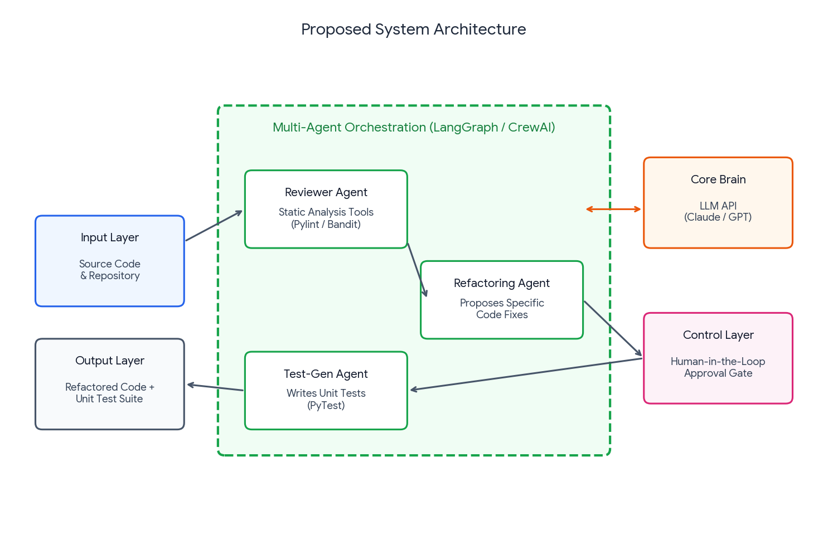
PROPOSED SYSTEM ARCHITECTURE DIAGRAM

Slide 9
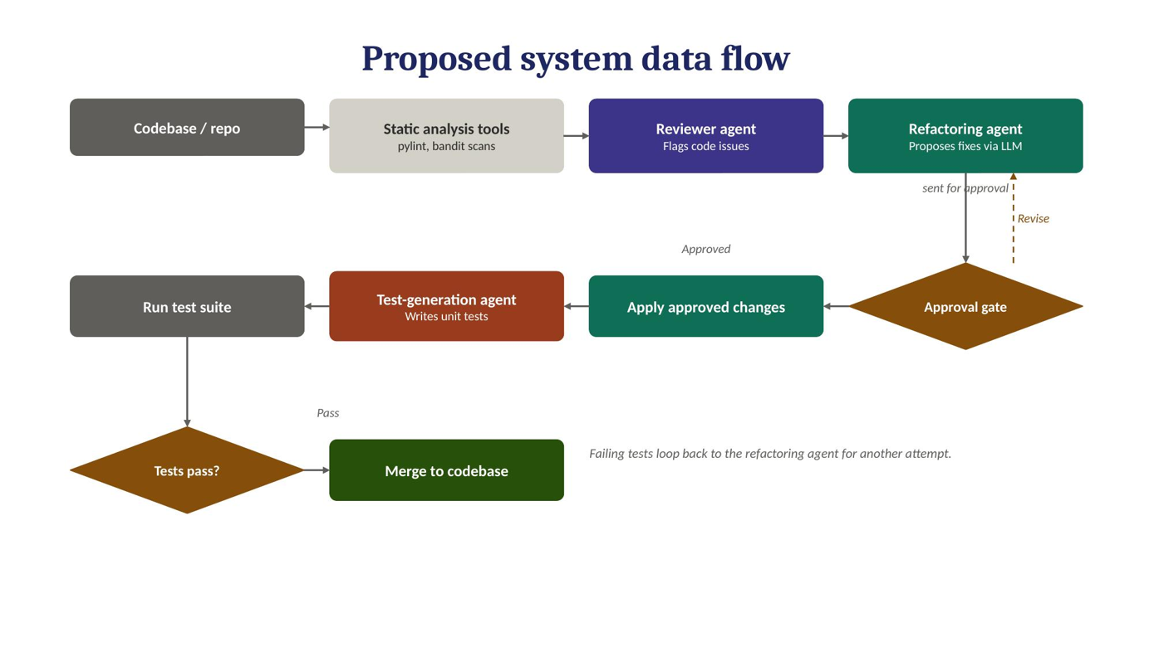
PROPOSED SYSTEM DATA FLOW DIAGRAM

Slide 10
METHODOLOGY
1. Code Input & Analysis Module
Accepts source code from the selected repository.
Parses and analyzes the code for structure and dependencies.
Performs initial static analysis.
2. Code Review Module
Identifies bugs, code smells, quality issues, and security vulnerabilities.
Generates detailed review findings and improvement suggestions.
3. Refactoring Module
Uses review findings to identify areas requiring improvement.
Generates suitable refactoring suggestions for the existing code.

Slide 11
4. Test Generation Module
Generates unit test cases for the reviewed/refactored code.
Validates the generated tests and identifies potential issues.
5. Validation & Human Approval Module
Presents the proposed changes and generated tests for human verification.
Applies approved changes and sends rejected changes back for revision.
Produces the final improved code and unit-test suite.
Input & Analysis → Code Reviewer Agent → Refactoring Agent → Test Generation Agent → Human Approval & Final Output

