Slide 1
DRUG OVERPLAY
PROJECT TERM PAPER

Slide 2
OUR TEAM
190030904-K.SRAVYA
190030858-K.SUREKHA
190031535-VEDA SAHITHI

Slide 3
Problem Statement
Identifying Drug comsumers using sentimental Analysis

Slide 4
Abstract
Drug addiction affects both brain and behavior. It has multifaceted impacts on the patients’ body, mind, and nervous system. Drug with psychologically active is used to induce consciousness. This can be modifying the perceptions, feelings, and emotions of the user. When a psychological active drug intake to the body, it induces an intoxicating effect. Some of the persons may use recreational and medical practitioner suggested drugs without becoming addicted, many persons who start using drugs converted to physically and emotionally dependent on them. So the Drug abuse causes vary greatly, depending on each individual and the extent of his or her addiction. The psychological effects of drug addiction come from the reason the user is addicted to drugs, as well as the changes that take place in the brain once a person becomes a drug addict. Initially, many people start using drugs to cope with stress or pain an effect of drug addiction is creation of a cycle where anytime the user encounters stress or pain, they feel the need to use the drug.

Slide 5
Introduction
Sentiment Analysis is an important algorithm in Natural Language Processing which is used to detect sentiment within some text.
In our project, we had chosen to work on analyzing reviews of various drugs which have been reviewed in form of texts and have also been given a rating on a scale from 1-10
Our intention was mainly to implement supervised machine learning classification algorithms that predict the class of the rating using the textual review.

Slide 6
Stages of Drug comsumer
Early Phase:
In this phase, the person is preoccupied with thoughts of drugs. He or she is always thinking about “when to take drugs” and “how to buy drugs.” When anyone talks about drugs, the addict feels guilty and moves away. The addict does many things while under the influence of drugs. Later he or she forgets all that was done under the influence of drugs.
Middle Phase:
The addict keeps giving reasons for taking drugs or lies to defend himself or herself and to hide the habit. The addict may stop taking drugs for a period of time thinking it is not difficult to give up the habit

Slide 7
Continuation
Chronic Phase:
The addict keeps stocks of drugs because he is afraid to be without them. He or she does not care anymore about what others think when it comes to his or her drug use. He or she experiences severe withdrawal symptoms.

Slide 8
Software Requirements
Jupyter Notebook or Google colab
Python
Keras
TensorFlow
Numpy

Slide 9
Data Set
We have taken a data set which suits our project.In the data set we have taken parameters namely
Age
Types of Drugs
Number
Gender

Slide 10
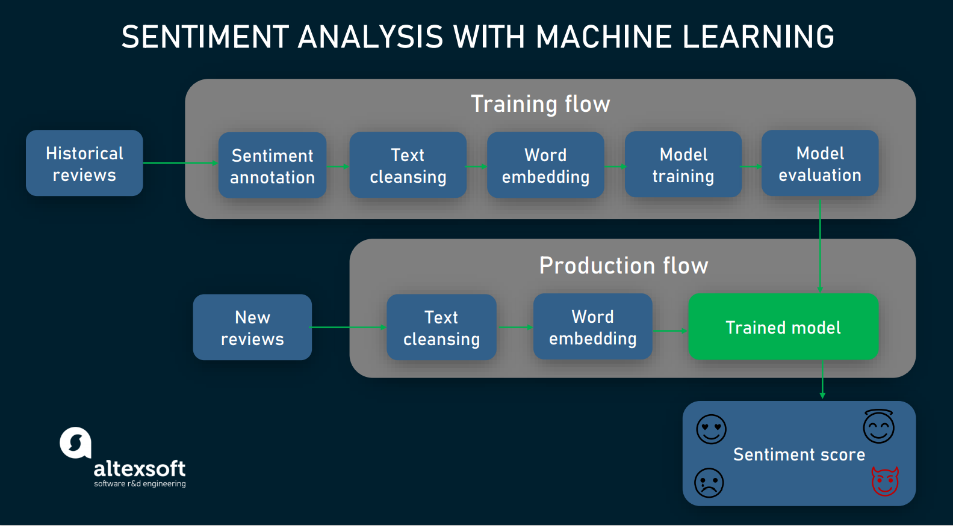
Project Model

Slide 11
Literature Survey
We have read no of research papers published from various countries.
One of the countries says that Consumption of drug in teenagers is more, other countries research papers speak that consumption is more in teenagers. consumption is more in male when compared to female. same Pakistan papers say that students consume drugs due to stress in education.in America old agers consume drugs because they are not taken care by their children.so we have com to conclusion that every age group consume drug due to various ill reasons.
It also depends on region in which they are living and availability of drugs in their region, education (or) proper knowledge regarding the effects of drugs, their living conditions, the level of security(or)protection their area posses.

Slide 12
The need of project to the society
This project is about the drug usage in varing conditions, how drugs are being exploited.It helps us understand various factors that are contributing to drug exploitation. these factors include – age group, gender, drug type, drug availability, side effects, signs of drug abuse. these helps in understanding how each drug is exploited and do the needful .we can understand which type of drug is available/grown at certain part of country. We can understand the signs of that specific drug abuse, identify the candidates based on that. The possible victims of the drug can be identified and treated.
It helps us understand need of a certain drug the certain age group, availability of the drug based on geographical conditions, how the younger generations are being affected in both physically and mentally because of this.

Slide 13
Factors for drug consumption may be many
Family
Depression
Business
Mischievous friends etc

Slide 14
Rearch Papers
https://www.ncbi.nlm.nih.gov/pmc/articles/PMC4476010/
https://pdf.sciencedirectassets.com/277811/
https://www.ncbi.nlm.nih.gov/books/NBK232965/

Slide 15
Thank You

