Slide 1
AI-Based Chatbot for Hotel Management Homepage
Sravya Pola

Slide 2
OVERVIEW :
Natural-language input & NLP slot-filling Guests describe destination, dates, party size and preferences in plain text—and the bot auto-detects and extracts all key details.
Real-time availability & star-rating filters Instantly queries inventory and lets users refine by star count.
Price-range & amenity filters Apply dynamic price caps and choose amenities (Wi-Fi, pool, pet-friendly, etc.).
Quick-reply buttons & guided room selection Matching hotels appear as tappable options, leading seamlessly into room type and guest-count prompts.
In-chat spa & room-service bookings Request spa packages or order room service directly within the conversation.
Housekeeping scheduling & loyalty-discount offers Book housekeeping slots and automatically receive personalized loyalty discounts if eligible.
One-tap discount response & instant subtotal recalculation Guests accept or decline offers with a tap, and the total updates in real time.
Seamless booking confirmation & simulated payment “Yes, book it” plus typing “paid” completes the reservation—no page reloads.
Post-booking feedback & optional comments One-tap 1–5 rating followed by free-text feedback, all captured and saved.
Human-agent escalation & context preservation Typing “agent” triggers name/phone collection, saves the ticket, and hands off the full chat state.
Multilingual support & intelligent upsells over secure JWT-protected APIs Conversations auto-detect language, offer history-based recommendations, and run on OAuth2/JWT-secured REST endpoints.

Slide 3
Tech Stack:
Java-Based Backend: Spring Boot and Spring AI powering core business logic and LLM orchestration
OpenAI Integration: Calls to OpenAI’s APIs for natural-language understanding, slot filling, and dynamic response generation
Data Persistence: PostgreSQL database enhanced with pgvector for fast embedding storage and similarity searches
Security: Spring Security with JWT for fully stateless, token-based authentication on every request
API Layer: Exposes all chat functionality via RESTful endpoints for easy integration
Optional Frontend: Lightweight JavaScript & jQuery UI using Axios for responsive API calls
Containerization & Orchestration: Docker containers managed by Kubernetes for scalable deployment
Cloud Hosting: Flexible deployment on AWS, Azure, or GCP based on your infrastructure
CI/CD Pipelines: Automated build, test, and deployment pipelines for rapid, reliable releases

Slide 4
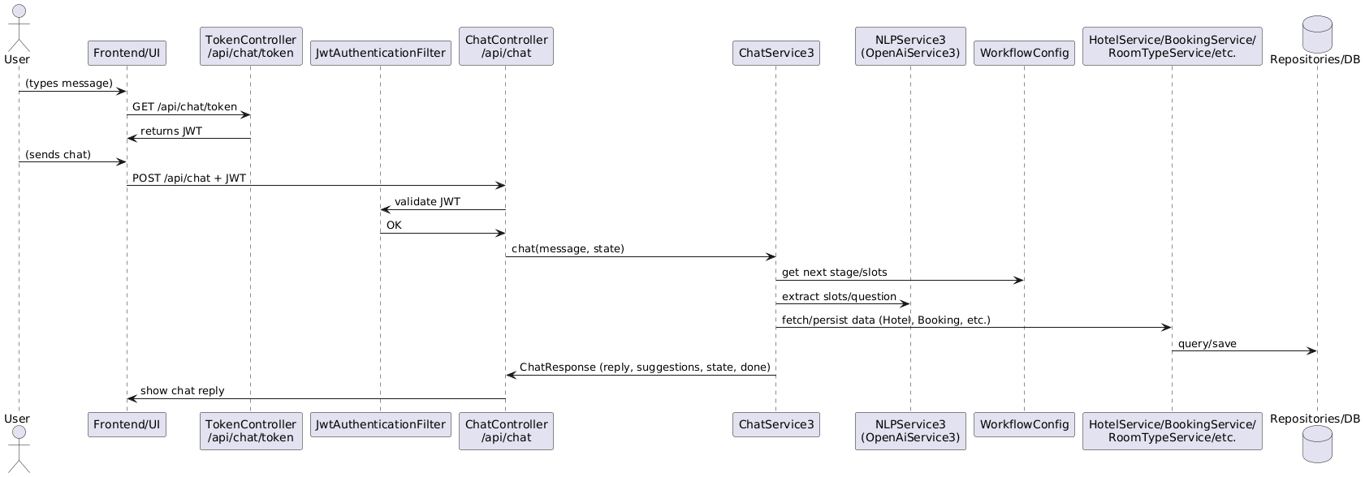
Complete Workflow for Hotel ChatBot Application :

Slide 5
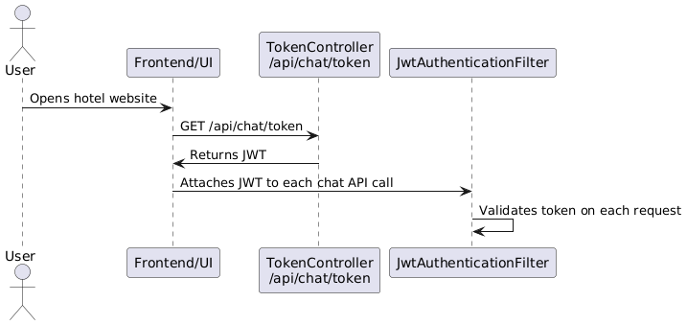
JWT Authentication :
To ensure secure and personalized interactions, the chatbot implements robust authentication using JSON Web Tokens (JWT). Each user session is assigned a short-lived token that protects sensitive operations and maintains privacy throughout the chat experience.

Slide 6
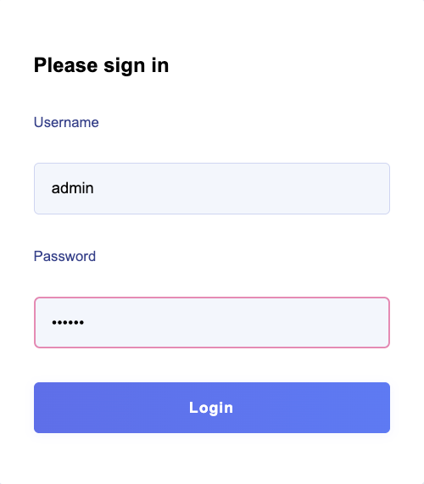
Session Management :
Users authenticate via the Login Page (POST /api/auth/login)
Backend issues a JWT (accessToken) on successful login
Session Duration: JWT expires after 1 hour
Key Rotation: Signing keys rotated every 7 days for enhanced security
JWT stored in an HttpOnly cookie (or secure in-memory store)
Each API call (search, chat, etc.) includes Authorization: Bearer <token>
JwtAuthenticationFilter verifies signature, expiry, and validity
Logout” button clears the access Token cookie (or storage)
Frontend then redirects back to the Login Page

Slide 7
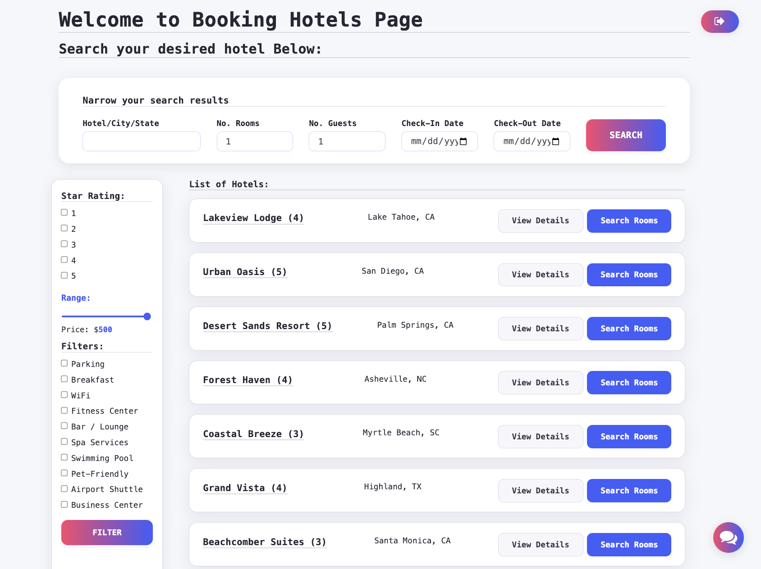
User Initiation & Homepage Functionality :
24/7 Availability AI-powered support is online around the clock on desktop, tablet, and mobile.
Quick Search & Booking
Top search bar accepts destination (hotel/city/state), dates, number of rooms and guests. “Search” button returns live availability.
Powerful Filtering Left sidebar lets users refine by star rating (1–5), price range (up to $500), and amenities (Wi-Fi, parking, pool, etc.).
Clear Results & Next Steps Central panel shows each hotel’s name, star count, and location. “View Details” & “Search Rooms” buttons guide guests seamlessly onward.
Continuous AI Assistance
Chatbot icon remains in the bottom-right on every page, ready to help at any stage.
Instant Chat Access
Chat widget auto-appears on page load—no extra clicks or logins needed.Guests simply click the bubble or start typing to begin.

Slide 8
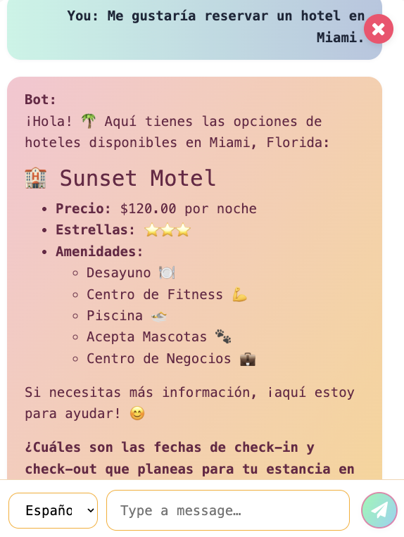
Multilingual Support :
Automatic Language Detection On the first user message, the chatbot detects the message’s language (e.g., English, Spanish, French, German).
Seamless Reply Localization All bot responses and button labels are generated in the user’s language—no manual translation needed.
Manual Language Override A visible dropdown lets guests switch languages on the fly (e.g. English ↔ Español ↔ Français ↔ Deutsch).
Persistent Session Language Once set (auto or manual), the chosen language remains for the entire chat session. If user wanted to switch in between it's always available.
UI & Emoji Consistency Translated quick-replies, suggestions, and even localized emojis/emblems keep the experience natural and engaging.

Slide 9
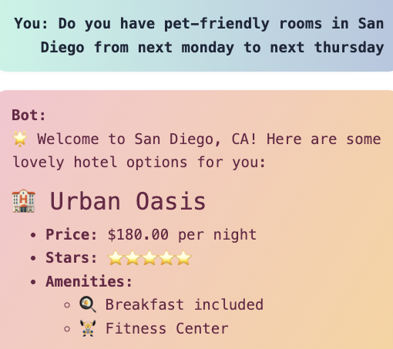
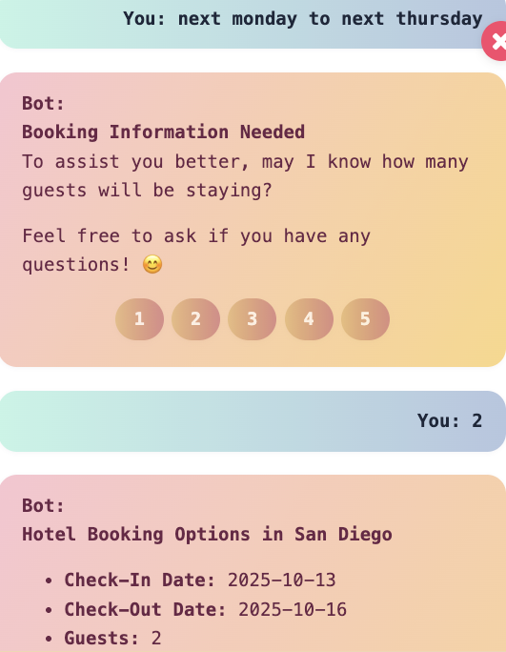
Guest Query Handling – Instant FAQs & Slot Extraction
Instant FAQ Answers Answers on room availability, pricing, check-in/out policies, amenities in under 1 second
AI-Driven Slot Filling Extracts key details (city, check-in/check-out dates, number of guests, room preferences) from any free-form text
Built-In Validation Converts dates to ISO format, sums adults/children into a single “guests” value, enforces price caps Eg: maximum price above $500 is reset to $500 automatically.
State-Driven Follow-Ups If any required slot is missing or invalid, the bot asks one concise question (e.g., “Which dates would you like?”)
Natural Conversation Flow Guests never feel like they’re filling out a form—each prompt reads like a human follow-up

Slide 10
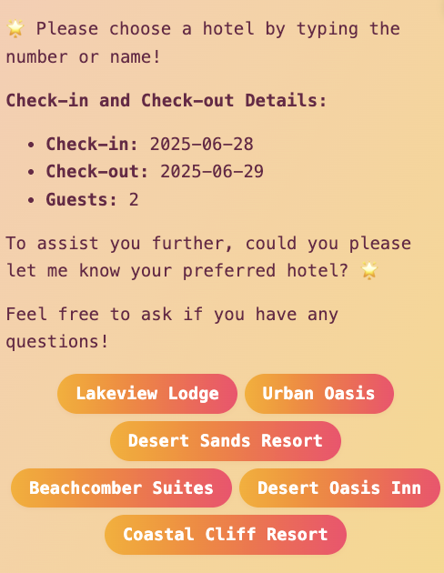
Booking Assistance :
A)Real-Time Availability & Reservation
In-Chat Availability Check Guests type requests like “Show me rooms June 10–12” directly in chat Bot calls your REST endpoint (/api/booking) under the hood
Live Room & Rate Display Lists available room types, room number after confirmation, policies everything is real time
Seamless Reservation Trigger “Yes, Book Now” button in chat sends a booking request to your backend No page reloads—everything stays within the conversation
B)Context-Aware Suggestions & Quick-Reply Buttons
Dynamic Suggestion Chips Presents user with button choices (e.g. hotel names, date ranges) based on context
Reduces Typing Effort & Errors Guests click “Lakeview Lodge” instead of typing the name
Localized to User’s Language Button labels auto-translate to match chat language
Consistent, Friendly UI Visually distinct, color-coded chips guide the next step

Slide 11
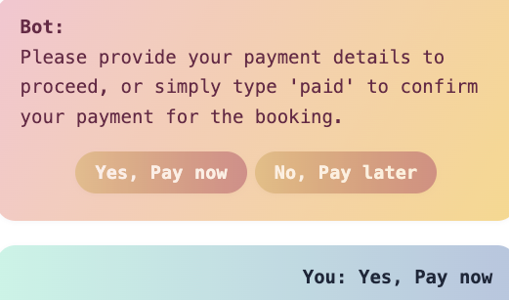
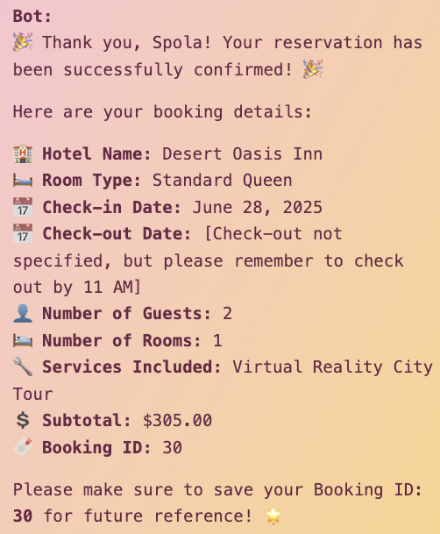
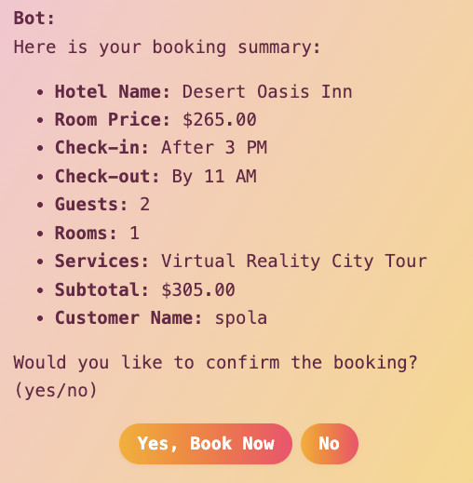
Booking Assistance :
C)End-to-End In-Chat Booking :
Room Selection & Details Choose room type and specify number of rooms Enter guest names or confirm default guest count
Booking Summary & Subtotal Calculates total cost (room × nights × rooms) Applies loyalty discounts automatically if eligible
Confirmation & Payment Guest confirms booking by clicking “Yes, book it” Simulated payment: guest types “paid” or clicks “Pay Now”
Booking ID & Receipt Bot returns reservation ID and summary in chat Encourages guest to save or screenshot their booking

Slide 12
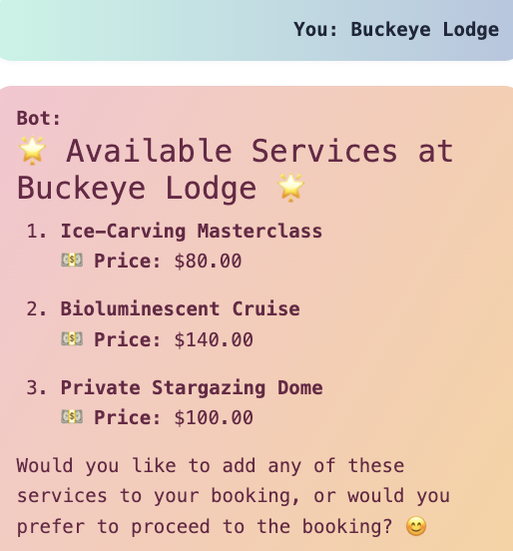
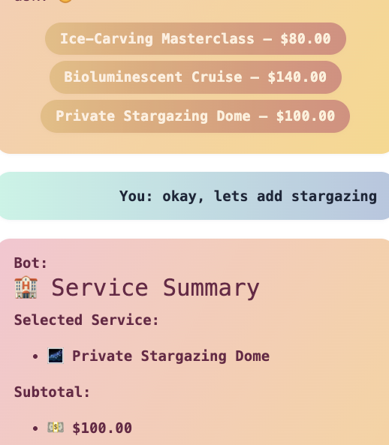
Integration with Hotel Services :
Ancillary Services Catalog
Comprehensive, numbered list of add-on offerings (e.g. Ice-Carving Masterclass, Private Stargazing Dome). Each entry features itemized pricing and iconography for quick recognition
Dynamic Confirmation Panel
Immediately displays the guest’s chosen service(s) with subtotal calculation. Ensures transparent pricing and next-step clarity within the same chat interface
Seamless Backend Invocation
Selection triggers REST API calls to the corresponding hotel service modules (room service, spa reservations, etc.)

Slide 13
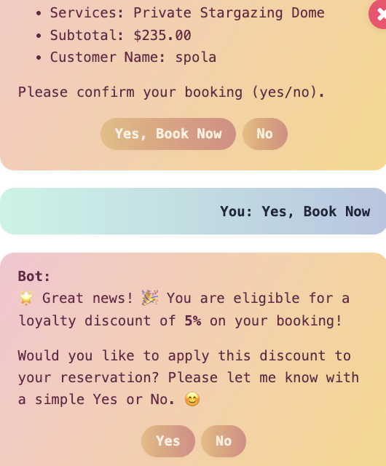
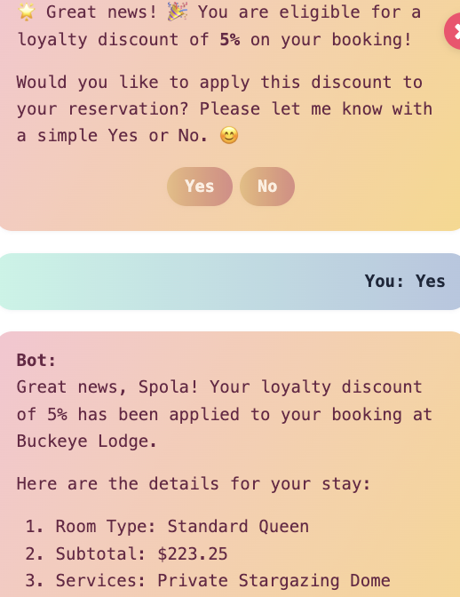
Smart Recommendations – AI-Powered Personalized Offers
Automatic Eligibility Detection Bot checks user Has Booked Hotel Before(...) and room discount rate
In-Chat Discount Offer 🎉 “Great news! You’re eligible for a 5 % loyalty discount on your booking!” Yes / No quick-reply buttons
Instant Discount Application On Yes, recalculates subtotal = subtotal × (1 – discount) Persists via booking Service.create(...)
Booking Confirmation “Your loyalty discount of 5 % has been applied to your booking at Buckeye Lodge.” Shows updated subtotal, room type, services
Next Steps Invite user to save booking ID, book another stay, or request support

Slide 14
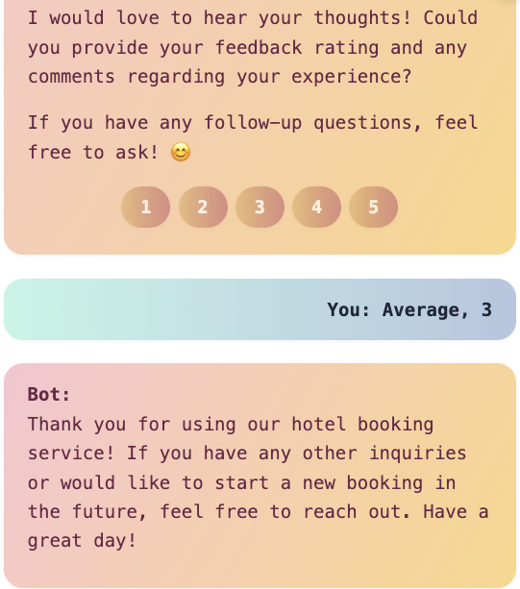
Customer Support – Feedback Collection
Post-Stay Feedback Prompt “Please rate your experience (1–5) and share any comments.”
One-Tap Ratings & Free-Text Comments Clickable buttons 1–5 minimize friction Optional comment field for open-ended insights
AI-Driven Slot Extraction LLM parses numeric rating into feedback Rating Captures feedback Comments verbatim
Seamless Persistence feedback@Service.save(rating, comments) Aggregates data for real-time dashboards and analytics
Friendly Acknowledgment “Thank you for your feedback! How else can I assist you today?”

Slide 15
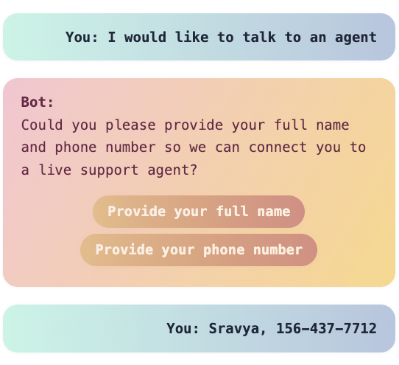
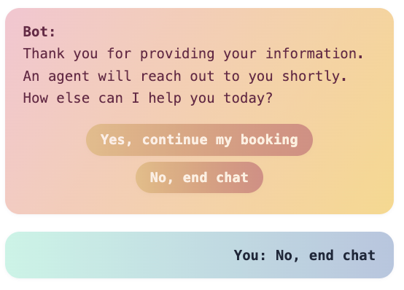
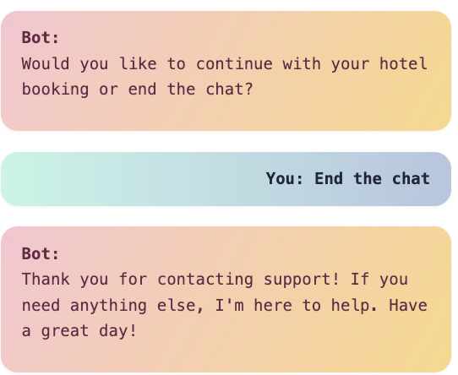
Human Escalation & Agent Handoff :
Escalation Trigger Guest types “agent,” “representative,” or “human” at any point
Context Preservation Bot records previous Stage so no data is lost
Contact Info Collection Asks for Full Name & Phone Number via LLM slot-filling
Ticket Creation Calls supportService.save(new AgentRequest(name, phone))
Guest Choice Yes, continue my booking → resumes from saved stage No, end chat → thanks user and closes conversation
Seamless Handoff Your support team receives full transcript + state Agents pick up the conversation exactly where the bot left off

Slide 16
Thank you!

