Slide 1
Sravya Pola
Ticketing Gateway System

Slide 2
About the Project:
The Ticketing Gateway System is a full-stack, microservices-based application designed to streamline the end-to-end lifecycle of support tickets across organizational roles (USER, MANAGER, ADMIN). Built with Java Spring Boot on the backend and a lightweight HTML/jQuery/AJAX frontend, it offers secure authentication, role-based dashboards, and a robust workflow for ticket creation, approval, resolution, and closure.

Slide 3
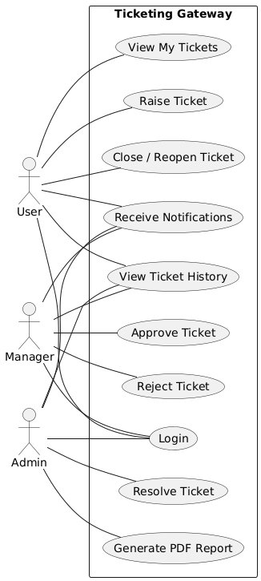
User – any employee who can raise tickets and track their own requests.
Manager – reviews and approves or rejects tickets submitted by Users.
Admin – resolves approved tickets, generates reports, and closes or reopens tickets as needed.

Slide 4
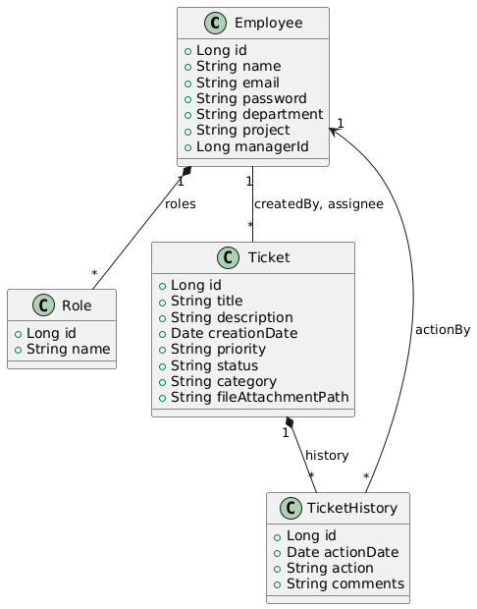
Employee:
Many-to-many with Role (an Employee can have USER, MANAGER, or ADMIN roles).
One-to-many with Ticket as both creator and assignee.
One-to-many with Ticket History as the actor of history entries.
Role:
Many-to-many with Employee.
Ticket:
Many-to-one to Employee as createdBy (the User who raised it).
Many-to-one to Employee as assignee (the Admin or IT who resolves it).
One-to-many with Ticket History to record every status change.
Ticket History:
Many-to-one with Ticket (which ticket the action belongs to).
Many-to-one with Employee as actionBy.

Slide 5
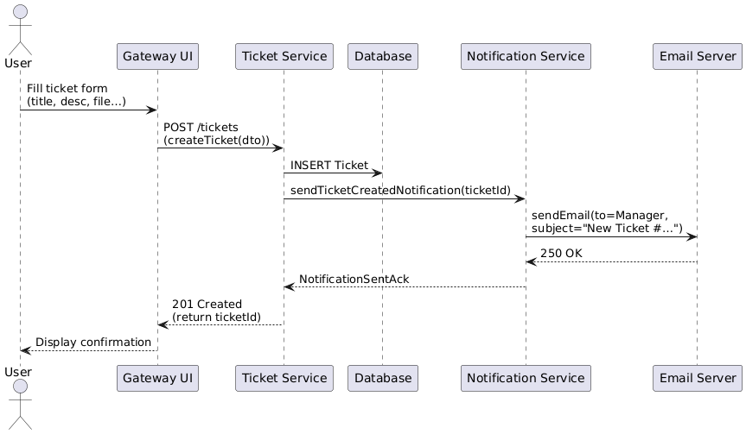

Slide 6
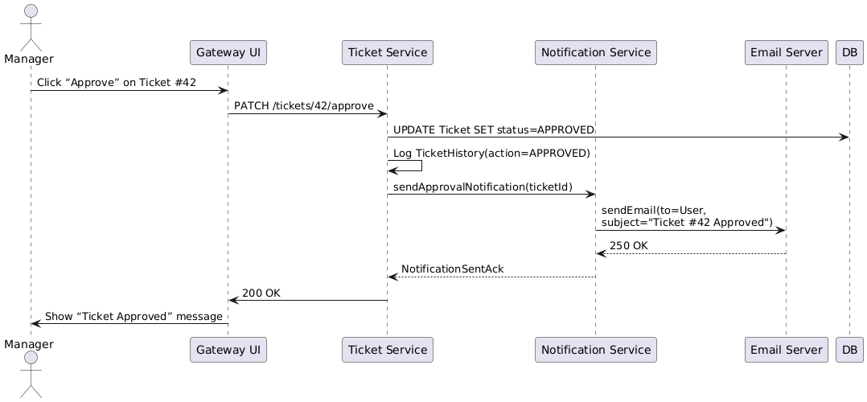

Slide 7
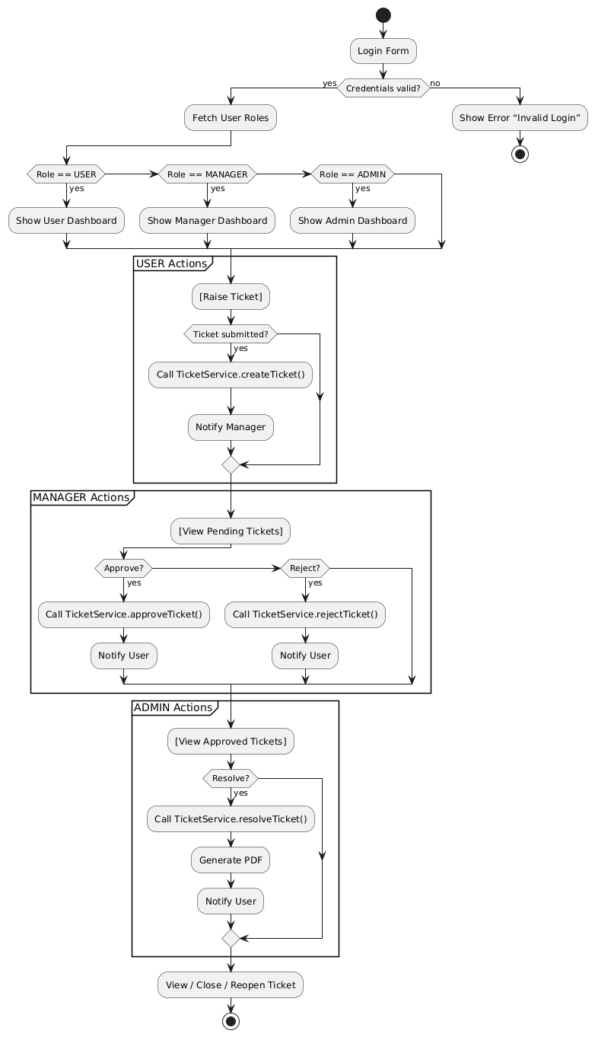
Users, Managers, and Admins all log in and are sent to their own dashboards based on role.
Users can create new tickets, view their status, and close or reopen them.
Managers see pending tickets and can approve or reject requests, which sends an email notification.
Admins handle approved tickets, mark them as resolved, generate a PDF report, and notify the user.
A daily scheduler reminds Managers about tickets older than 7 days, and any “Resolved” ticket left open for 5 days is automatically closed.

Slide 8
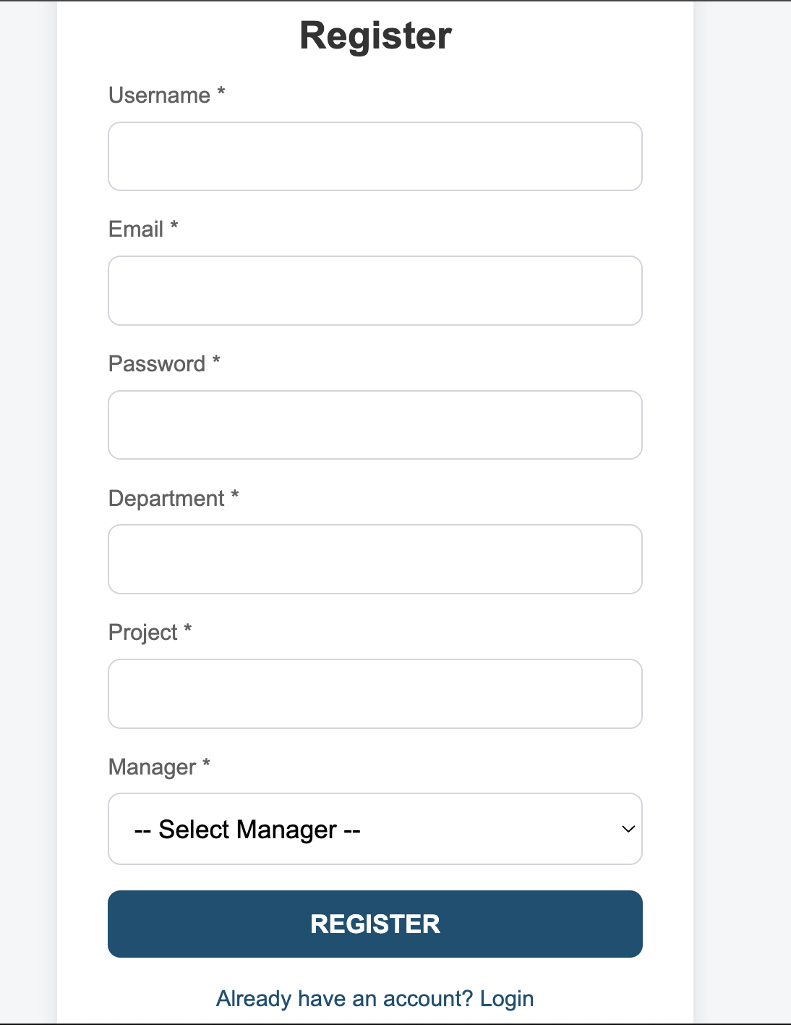
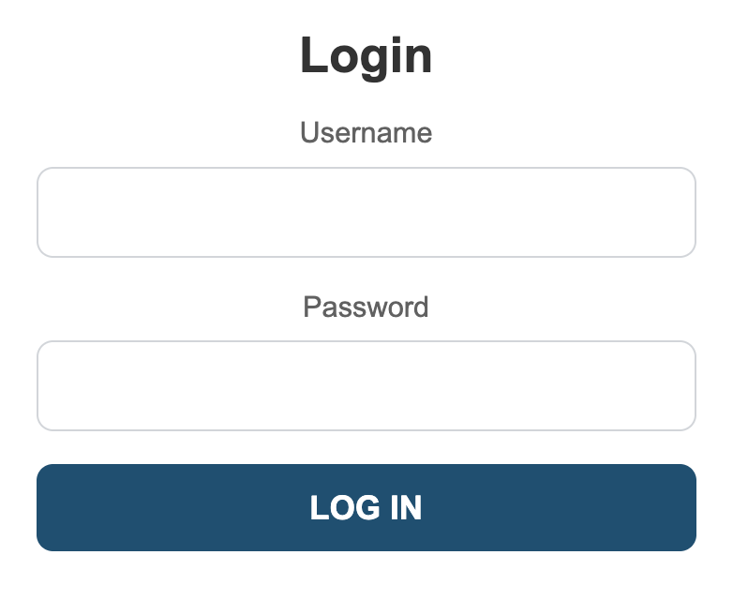
Register And Login Pages:

Slide 9
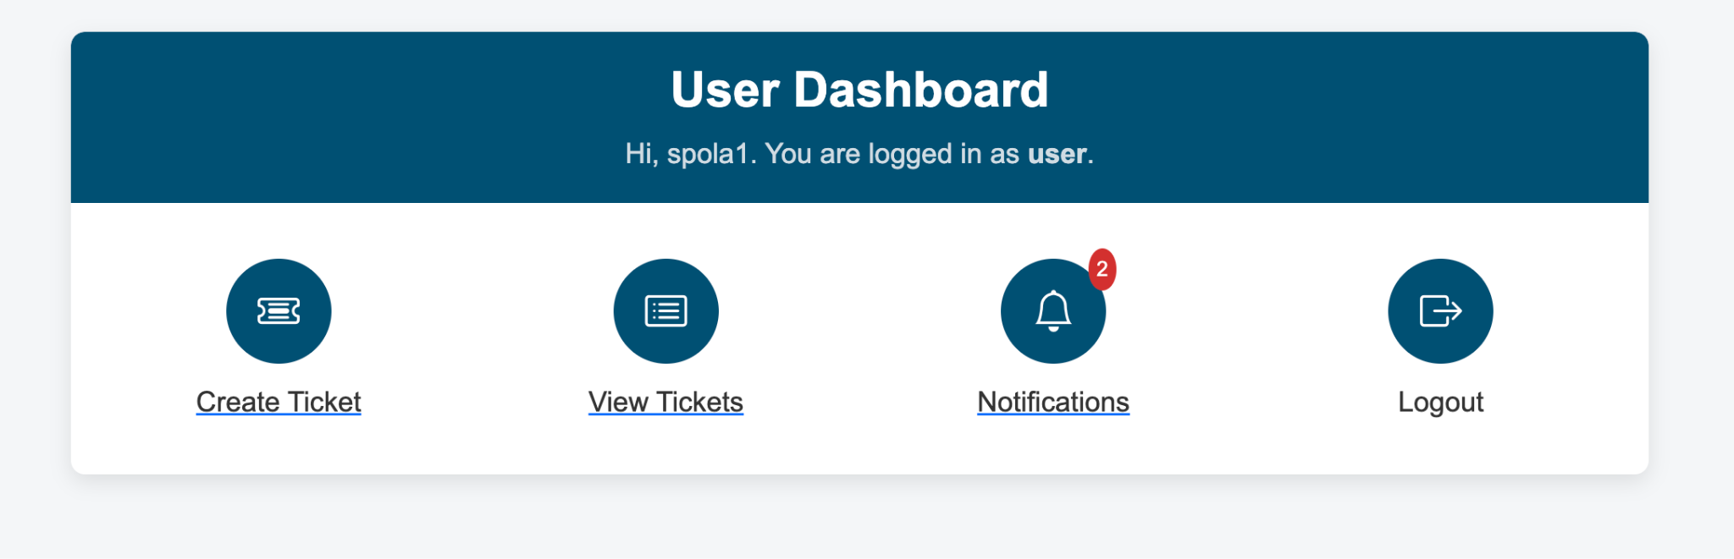
User Dashboard:
User can create ticket, view tickets, view notifications and logout.

Slide 10
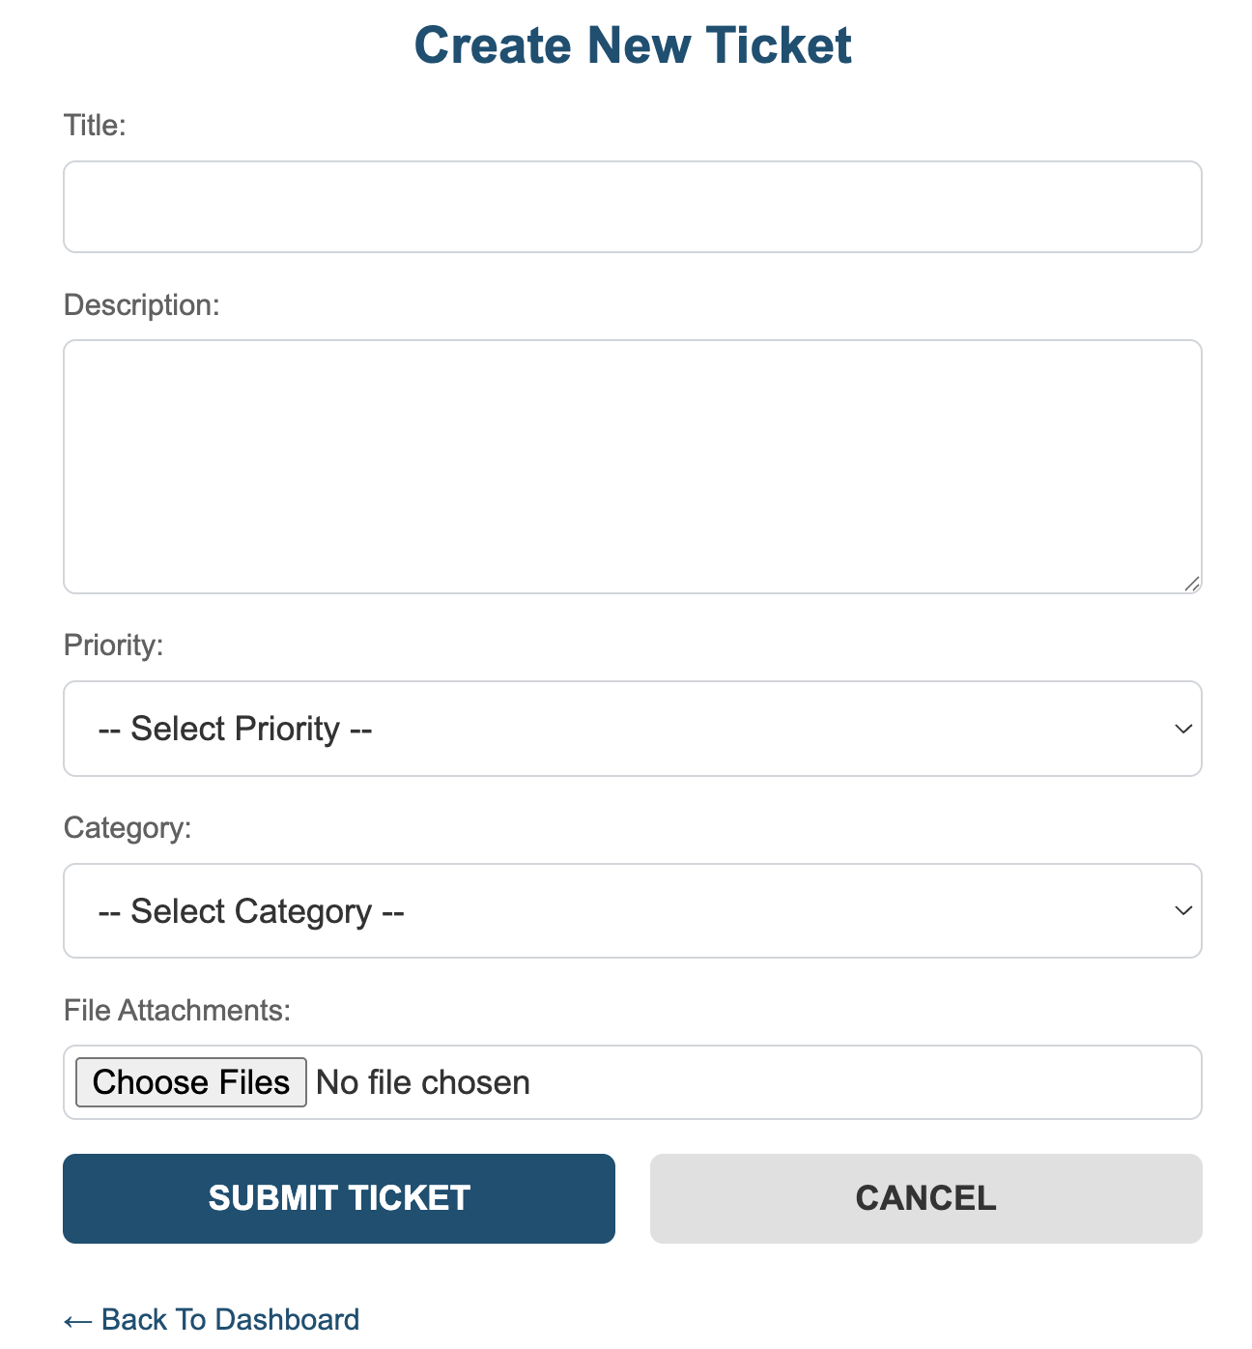
Creation Of Ticket:
Use this form to submit a new support request into the Ticketing Gateway System. Once submitted, user will receive an email confirmation, and the User’s Manager will be notified to review and approve or reject the user’s ticket.

Slide 11
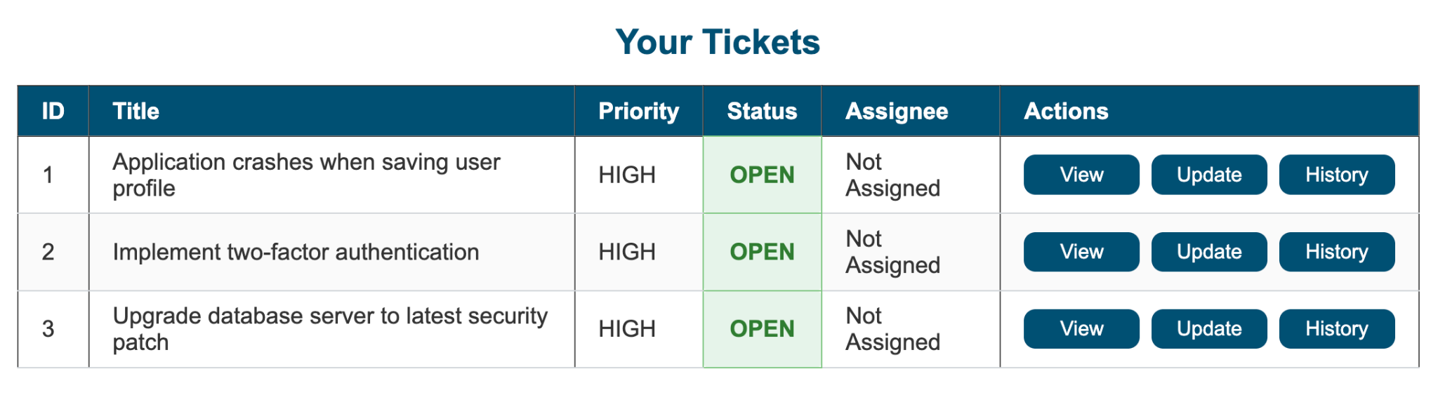
View Tickets Page:
The “Your Tickets” dashboard presents each ticket ID, title, priority, status, and current assignee in a single table. From here you can quickly View all details, Update its status (close or reopen), or check the full History of actions and comments.

Slide 12
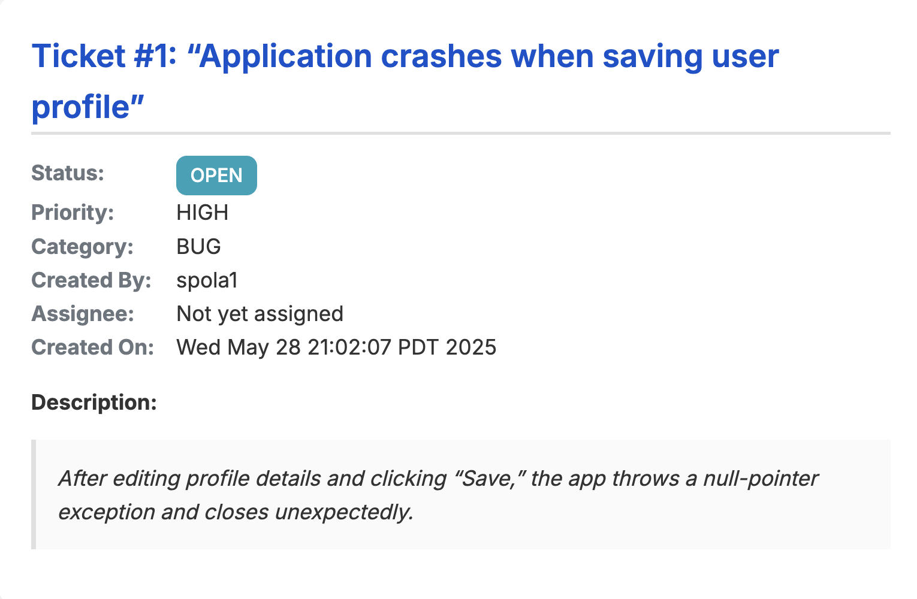
View Particular ticket:

Slide 13
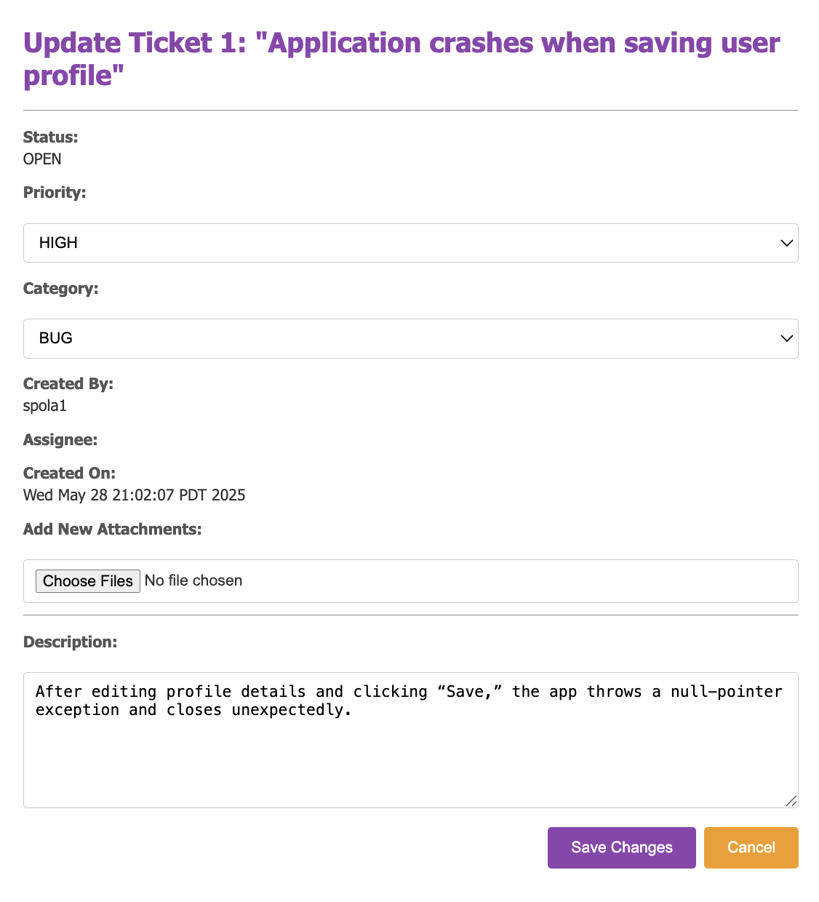
Update Particular Ticket:
The “Update Ticket” screen displays all current ticket details—status, priority, category, creator, assignee, and creation timestamp—and lets you modify any editable fields. You can attach new files or review the original description to add context. After making changes, click Save Changes to submit updates or Cancel to return without saving. This form preserves the ticket’s audit trail while allowing you to refine its details before moving it along the workflow.

Slide 14
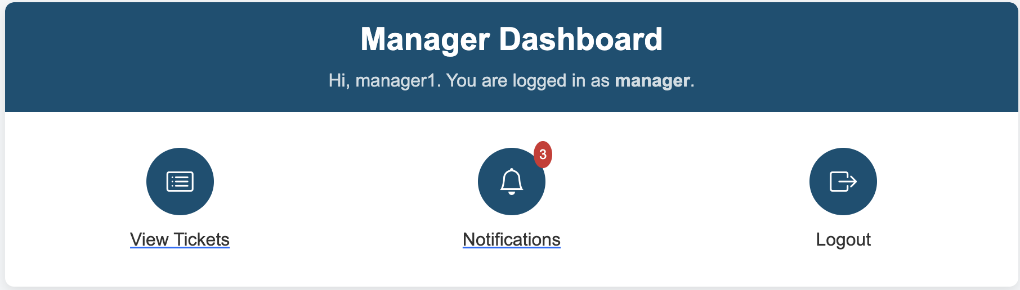
Manager Dashboard:
The Manager Dashboard provides a personalized landing page for managers as soon as they log in. It greets you by name and confirms your role, then offers three clear, icon-driven options: View Tickets to access all pending and in-progress requests, Notifications (with a badge showing unread alerts) for new ticket actions and reminders, and Logout to end your session securely.

Slide 15
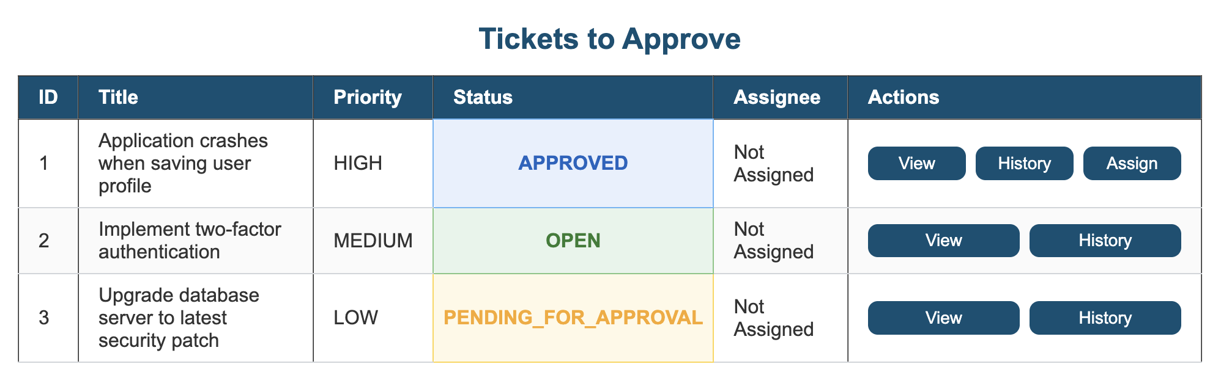
Manager View tickets:
On the “Tickets to Approve” screen, new submissions first appear as OPEN awaiting your initial review. If you reject a ticket and escalate it back to the user for more information, its status changes to PENDING_FOR_APPROVAL once the user resubmits, clearly flagging it for re-evaluation. Approving a ticket then moves it to APPROVED, indicating your sign-off is complete but assignment to Admin/IT is still pending.

Slide 16
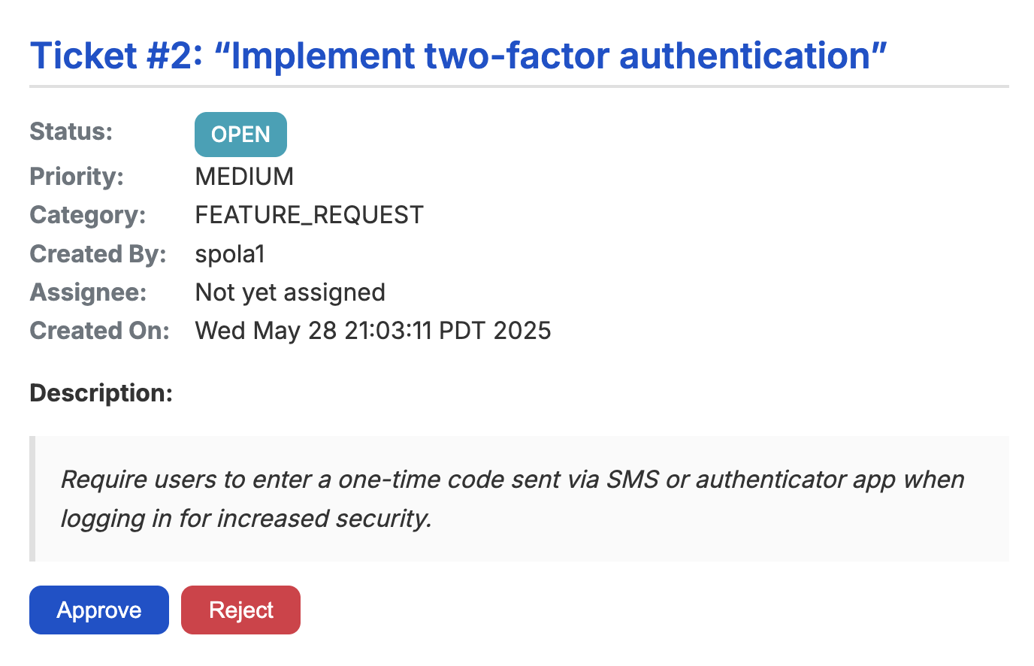
Manager View Ticket:
At the bottom, managers can click Approve to greenlight the work or Reject if it doesn’t align with our current roadmap. On click of Reject, managers must provide a reason before the rejection is finalized.

Slide 17
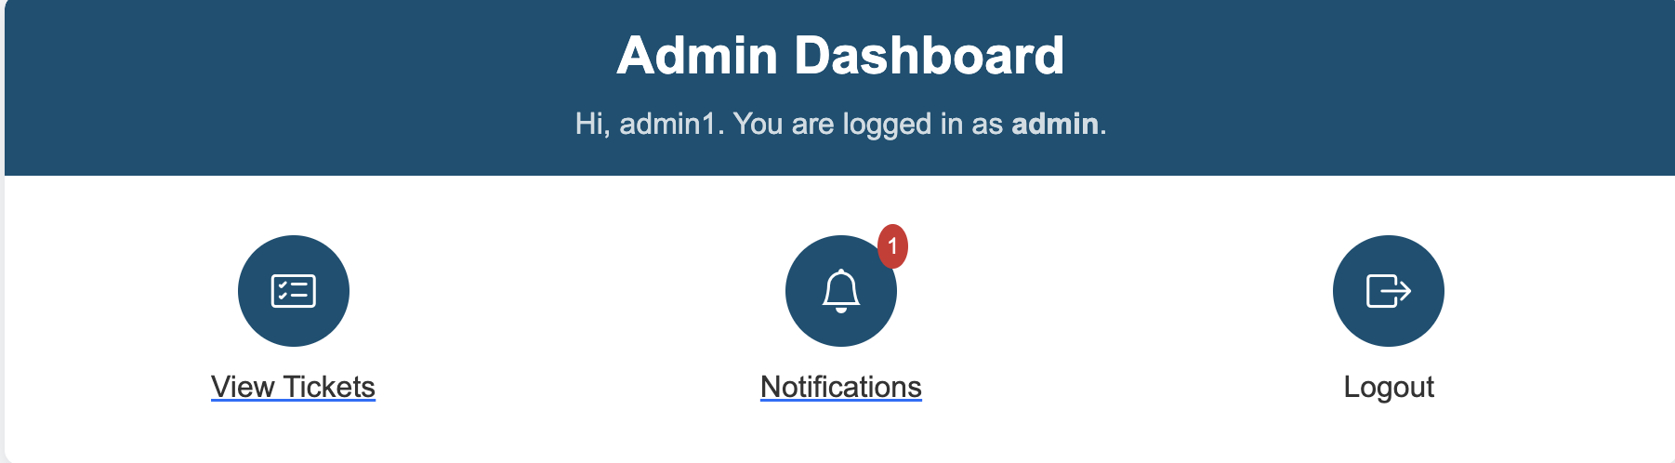
Admin Dashboard:
Once a manager assigns a ticket, the admin logs in and lands on the Admin Dashboard. Three large icons let the admin quickly View Assigned Tickets, check Notifications (with a badge for new alerts), or Logout.

Slide 18
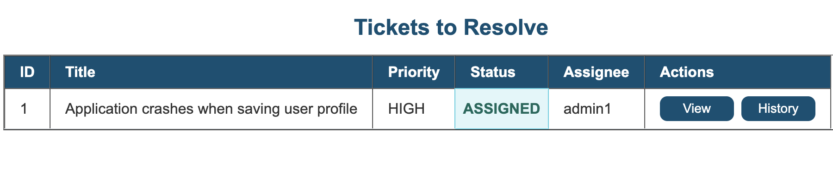
Admin View Ticket:
The Tickets to Resolve table lists every ticket assigned to the admin—whether newly assigned or reopened—showing its ID, title, priority, status, and assignee and actions – view and history.

Slide 19
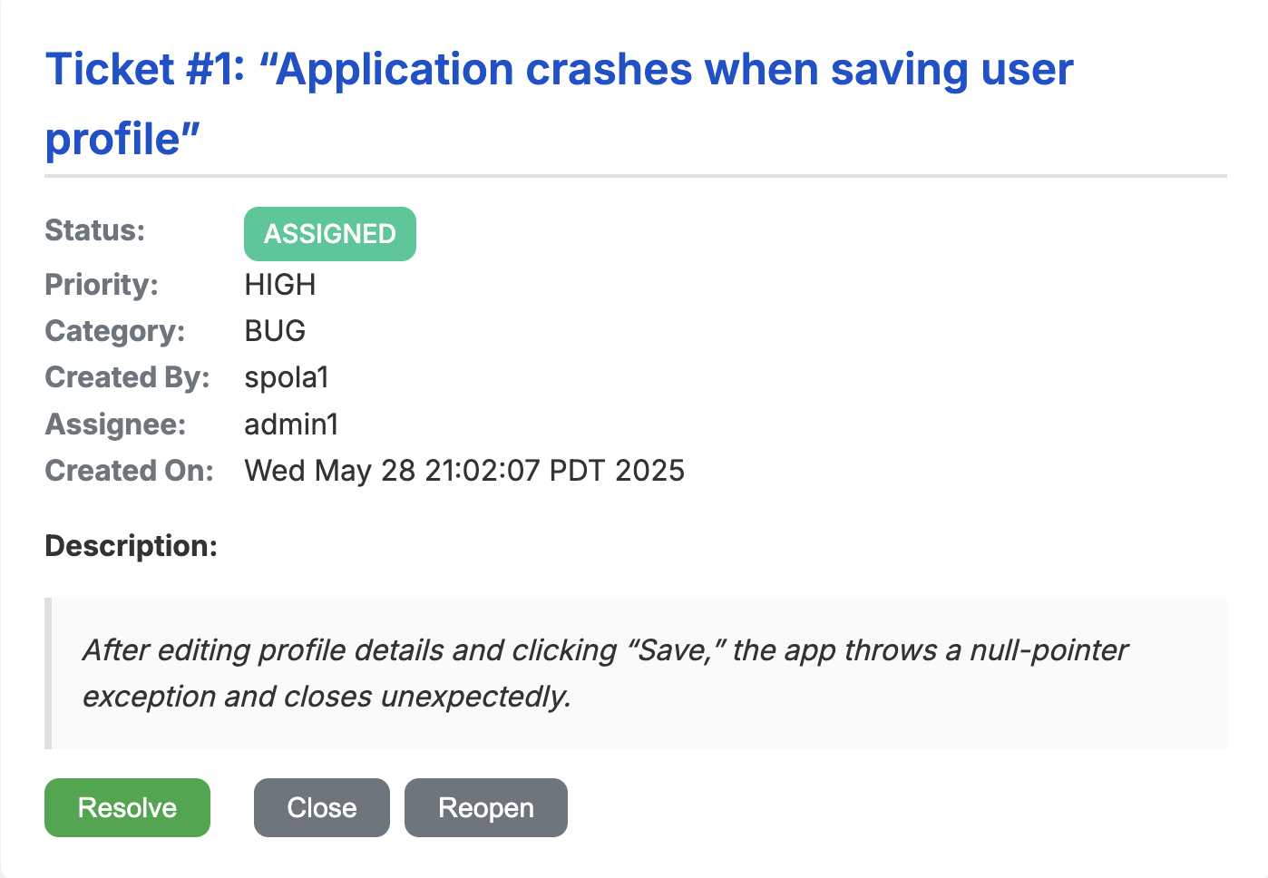
Admin View Ticket:
This detail view gives the admin three actions—Resolve, Close, and Reopen—to manage the ticket.
Clicking Resolve opens a mandatory resolution-comment field that must be filled out before hitting Submit.
Close immediately marks the ticket closed, and Reopen moves it back into the active queue.

Slide 20
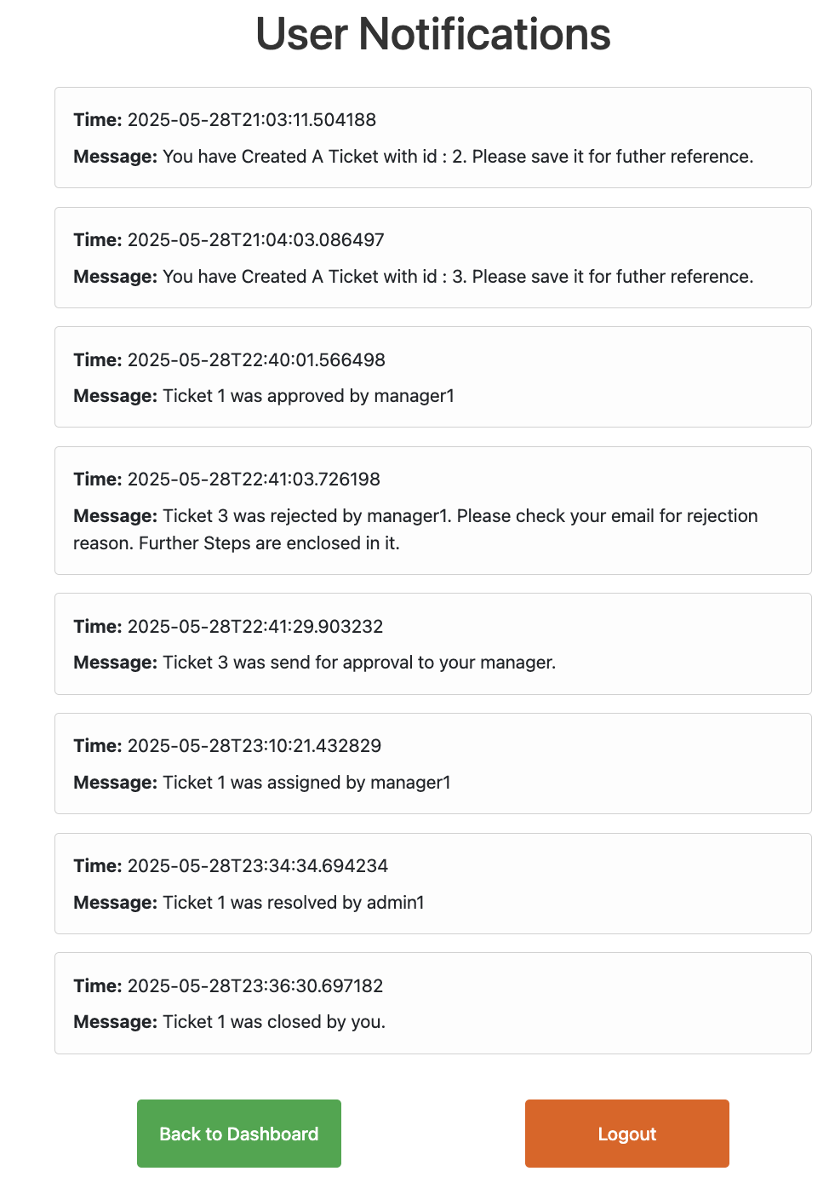
Notifications Dashboard for User, Manager, Admin:
The Notifications page shows a real-time, timestamped feed of every key ticket event—creation, approval, rejection, assignment, resolution, and closure—so users, managers, admins always know exactly what’s happening.
Each notification clearly states the action taken and when it occurred.
At the bottom, Back to Dashboard and Logout buttons let you navigate away once you’ve viewed your updates.

Slide 21
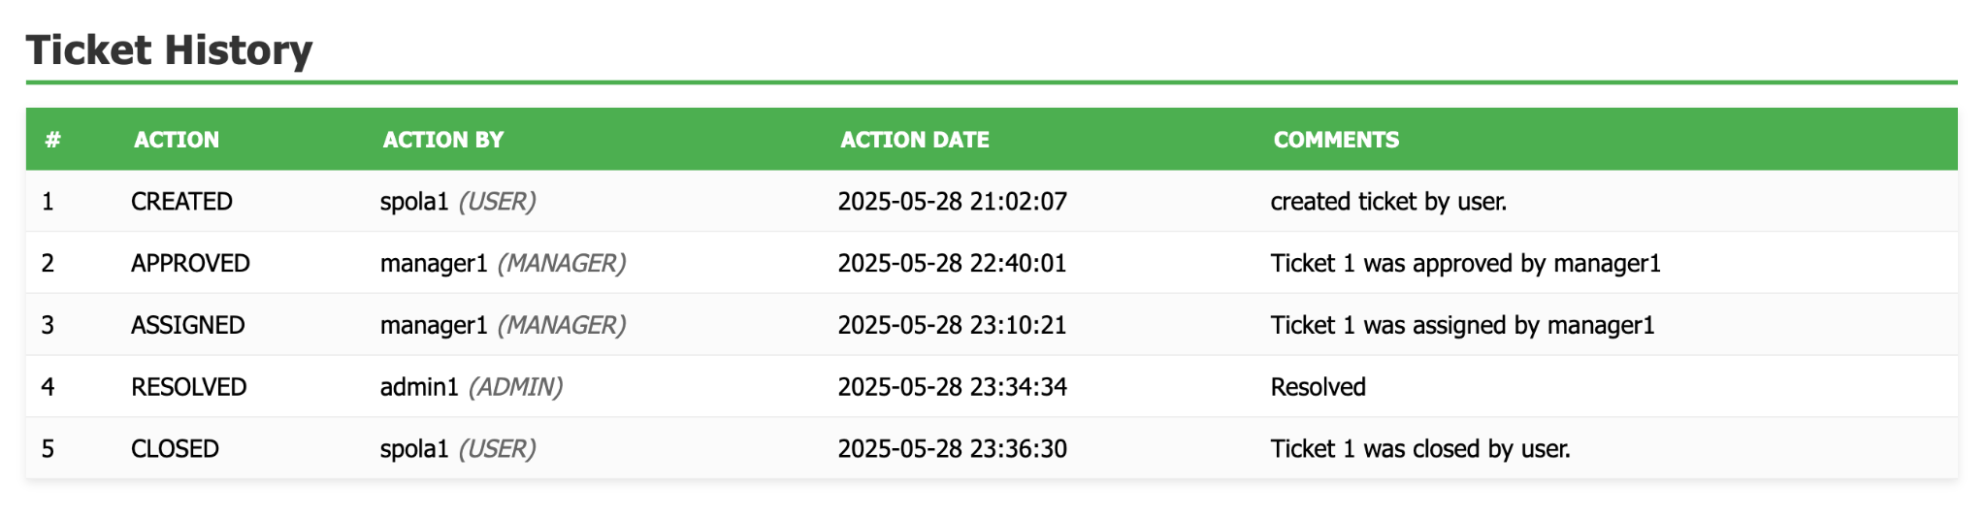
Ticket History:
The Ticket History table is a full audit trail of every lifecycle event—creation, approval, assignment, resolution, and closure—each tagged with who (and their role), when it happened, and any comments.
Rows 1–5 show the flow from spola1 creating the ticket, manager1 approving and assigning it, admin1 resolving it, and finally the user closing it.
This clear, chronological log ensures complete transparency and traceability for every ticket action.

Slide 22
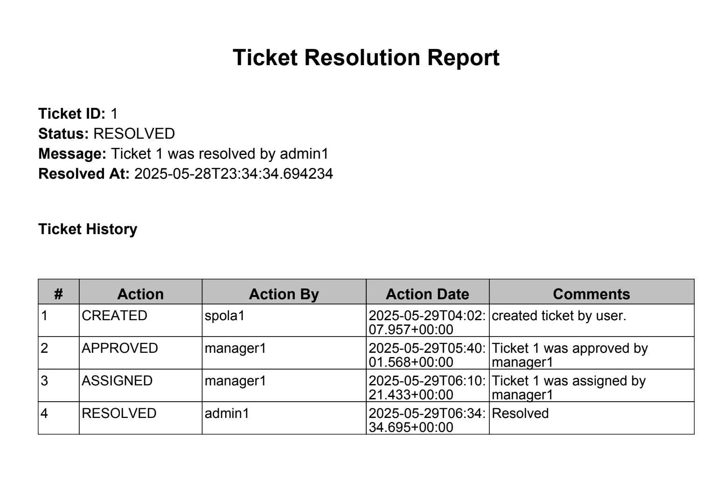
Email Services:
When the ticket is marked RESOLVED, the system generates a detailed PDF of the resolution (including timestamps, actions taken, and comments) and attaches it to the closing email sent to the user.
This ensures everyone receives both real-time notifications and a formal, downloadable record of how the issue was handled.

Slide 23
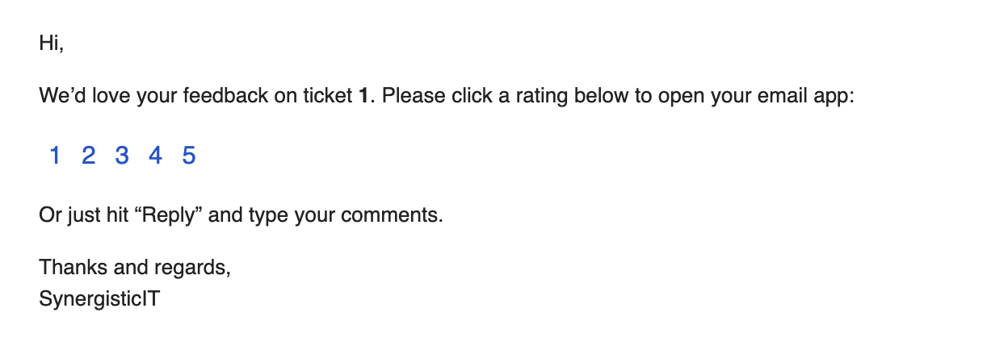
Feedback Email:
As soon as a ticket is closed, the system automatically sends the user a feedback email—branded from “SynergisticIT”—asking them to rate their experience on a 1–5 scale via clickable links. Each link opens the user’s email client with a pre-filled rating message, or they can simply hit “Reply” to type open-ended comments. All submitted ratings and comments are captured in the dashboard to monitor support quality and drive continuous improvement.

Slide 24
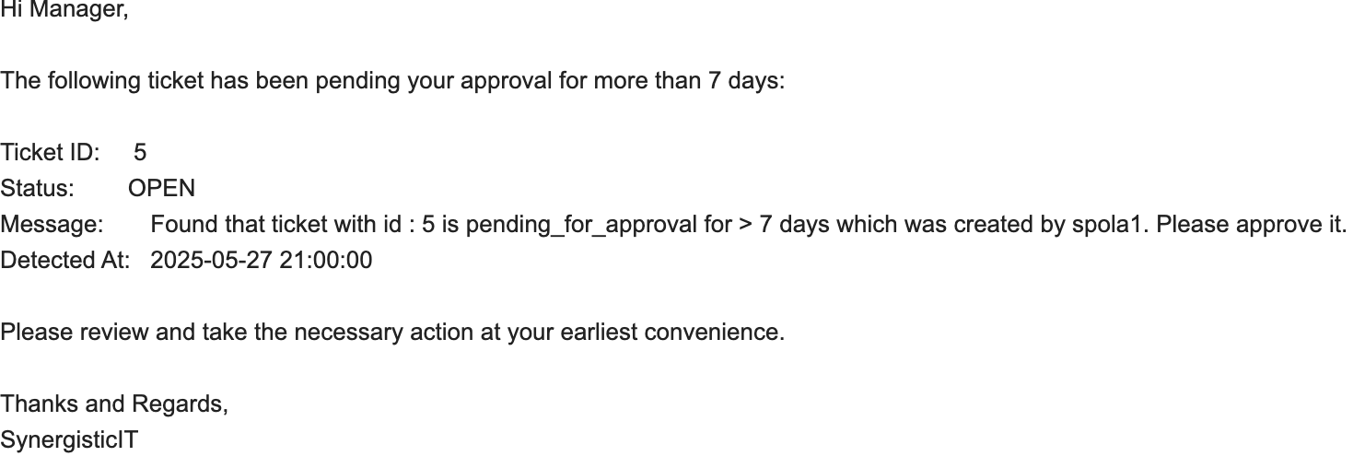
Cron Scheduler:
Every day at 9:00 PM, a scheduled job scans for any tickets still in OPEN status that were created over seven days ago and are awaiting manager approval. This daily reminder helps ensure no approval request falls through the delay.

Slide 25
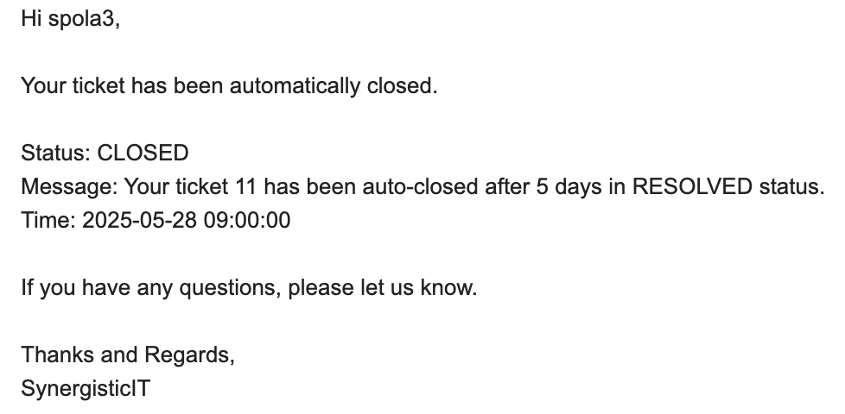
Cron Scheduler:
Every day at 9:00 AM, a background job scans for tickets that have sat in RESOLVED status for more than five days.Any such ticket is automatically moved to CLOSED, and an email is sent to the user.This cleanup automation prevents stale tickets from lingering and keeps users informed of the closure.

Slide 26
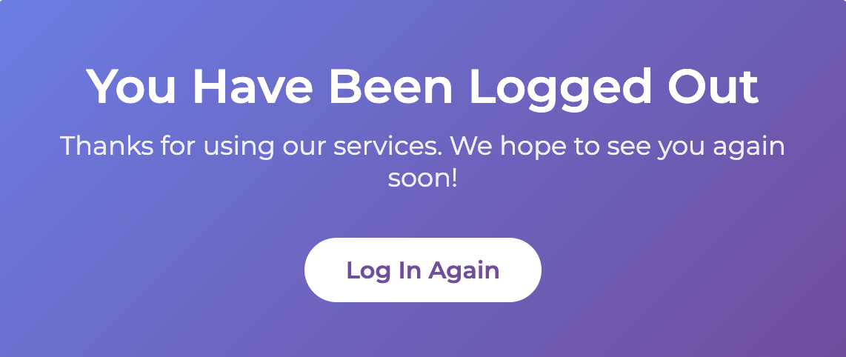
Thank you !

