Slide 1
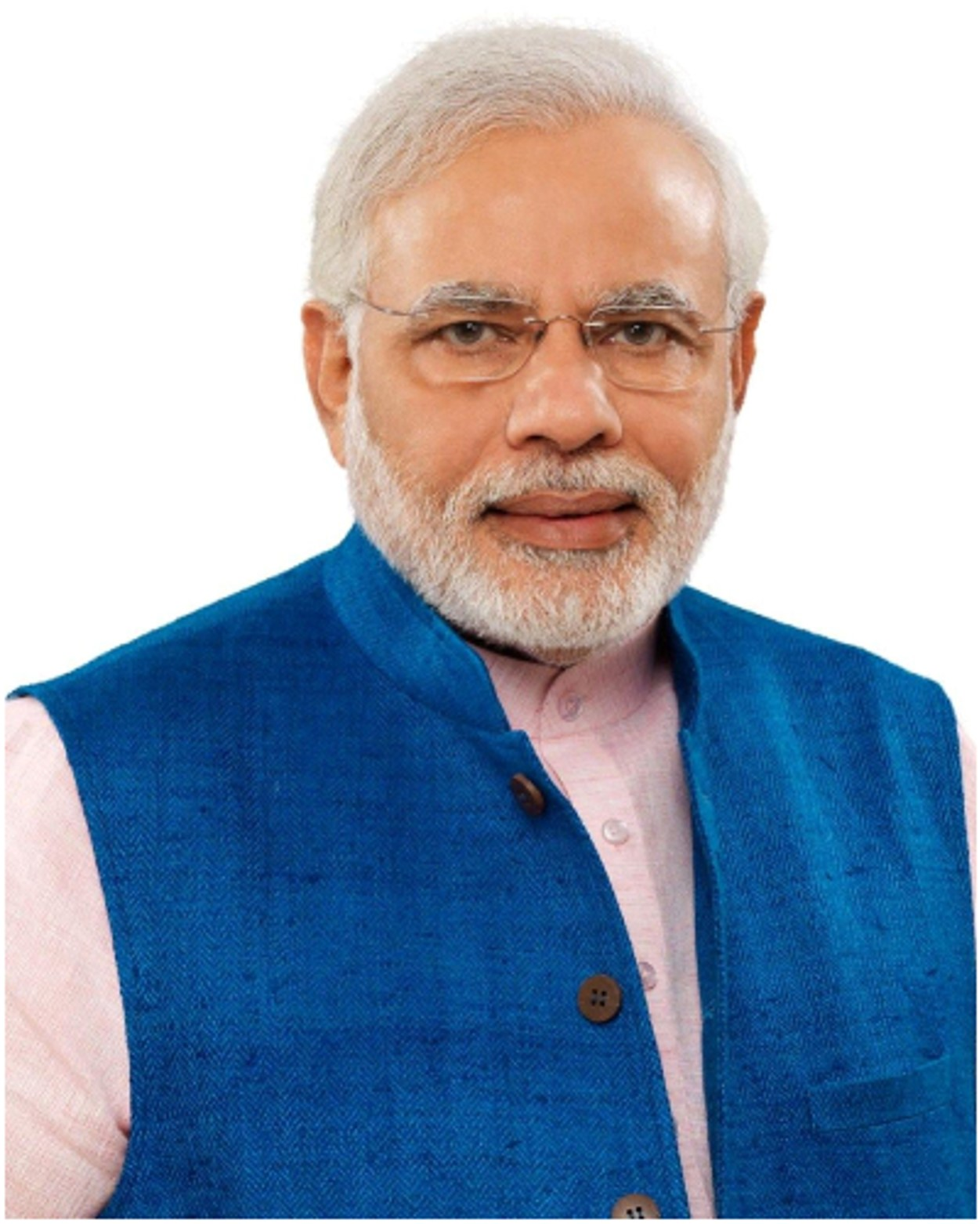


Home
About us
User
Sitemap
Contact us
Latest Posts
Ayurveda
Yoga and Naturopathy
Unani
Siddha
Homeopathy
Visitor Count -

Slide 2
Home
About us
User
Sitemap
Contact us
Latest Posts
Ayurveda
Yoga and Naturopathy
Unani
Siddha
Homeopathy
Visitor Count -

Slide 3
Home
About us
User
Sitemap
Contact us
Latest Posts
Ayurveda
Start Up
Yoga and Naturopathy
Government Officials
Unani
Siddha
Homeopathy
Visitor Count -

Slide 4
Home
About us
User
Sitemap
Contact us
Ayurveda
Login
Yoga and Naturopathy
UserID:
Unani
Password:
New user ?
signup
Forgot Password
Siddha
Homeopathy
Submit
Visitor Count -

Slide 5
Home
About us
User
Sitemap
Contact us
Ayurveda
Login
Yoga and Naturopathy
Enter Email:
@gmail.com
Send OTP
Unani
Enter OTP:
Siddha
Verify
Homeopathy
Login
Visitor Count -

Slide 6
Home
About us
User
Sitemap
Contact us
Ayurveda
Login
Yoga and Naturopathy
UserID:
G-
Unani
Password:
Forgot Password
Siddha
Homeopathy
Submit
Visitor Count -

Slide 7
Home
About us
User
Sitemap
Contact us
Ayurveda
Login
Yoga and Naturopathy
Enter Email:
______gov@gmail.com
Send OTP
Unani
Enter OTP:
Siddha
Verify
Homeopathy
Login
Visitor Count -

Slide 8

Home
About us
User
Sitemap
Contact us
Signup
Ayurveda
Name:
Yoga and Naturopathy
Email:
Mobile:
Unani
Verify
Siddha
Homeopathy
Visitor Count -

Slide 9
Home
About us
User
Sitemap
Contact us
Signup
Ayurveda
Name:
Yoga and Naturopathy
Email:
Mobile:
Unani
Verify
Enter OTP:
Siddha
Resend OTP
Homeopathy
Verify
Sector:
send
Visitor Count -

Slide 10
Home
About us
User
Sitemap
Contact us
Signup
Ayurveda
Name:
Yoga and Naturopathy
Email:
Your ID
AASU***
Mobile:
Unani
Verify
Enter OTP:
Siddha
Resend OTP
Homeopathy
Verify
Create Password
Confirm Password
Submit
Visitor Count -

Slide 11
Home
About us
Register
Sitemap
Contact us
Ayurveda
Your current status: ---
Yoga and Naturopathy
Unani
Siddha
Homeopathy
Visitor Count -

Slide 12
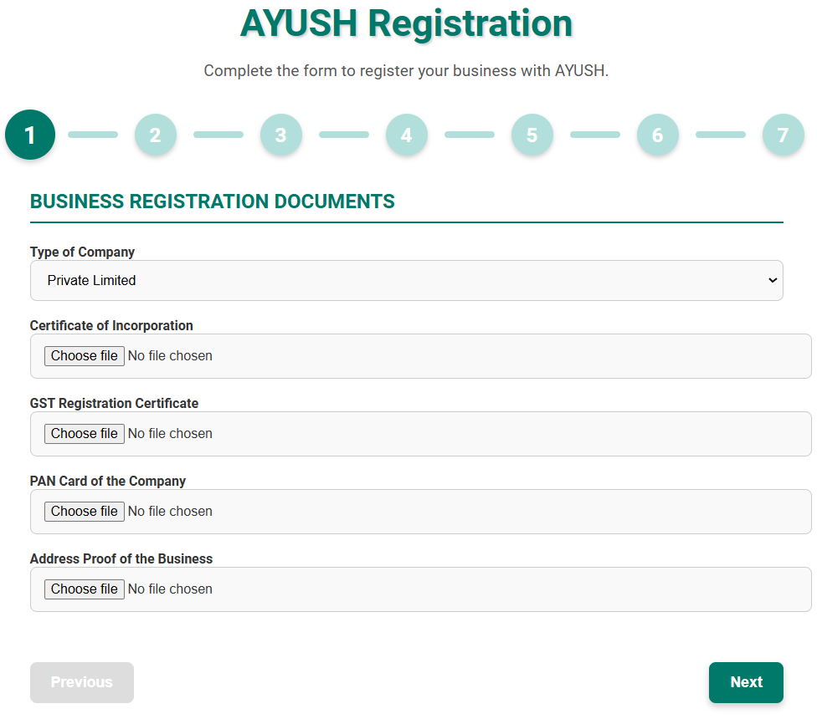
Home
About us
Register
Sitemap
Contact us
Ayurveda
Yoga and Naturopathy
Unani
Siddha
Homeopathy
Next
Visitor Count -

Slide 13
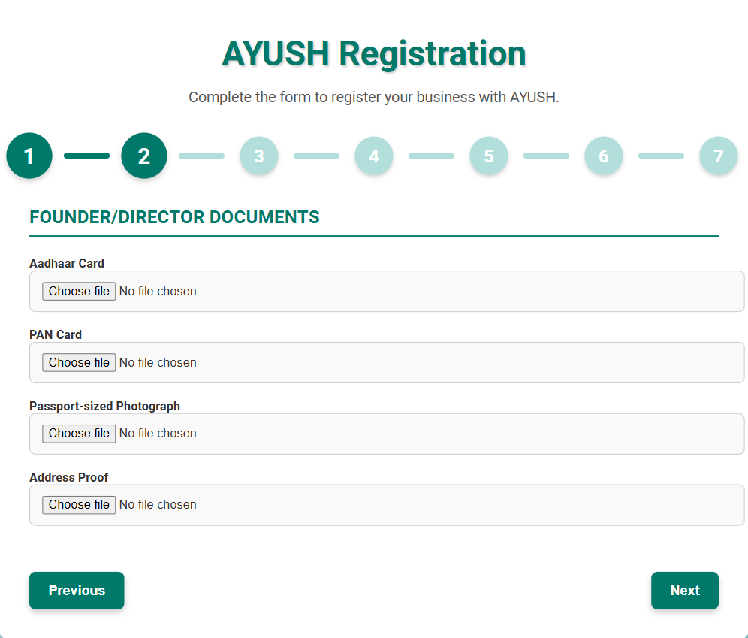
Home
About us
Register
Sitemap
Contact us
Ayurveda
Yoga and Naturopathy
Unani
Siddha
Homeopathy
Previous
Next
Visitor Count -

Slide 14
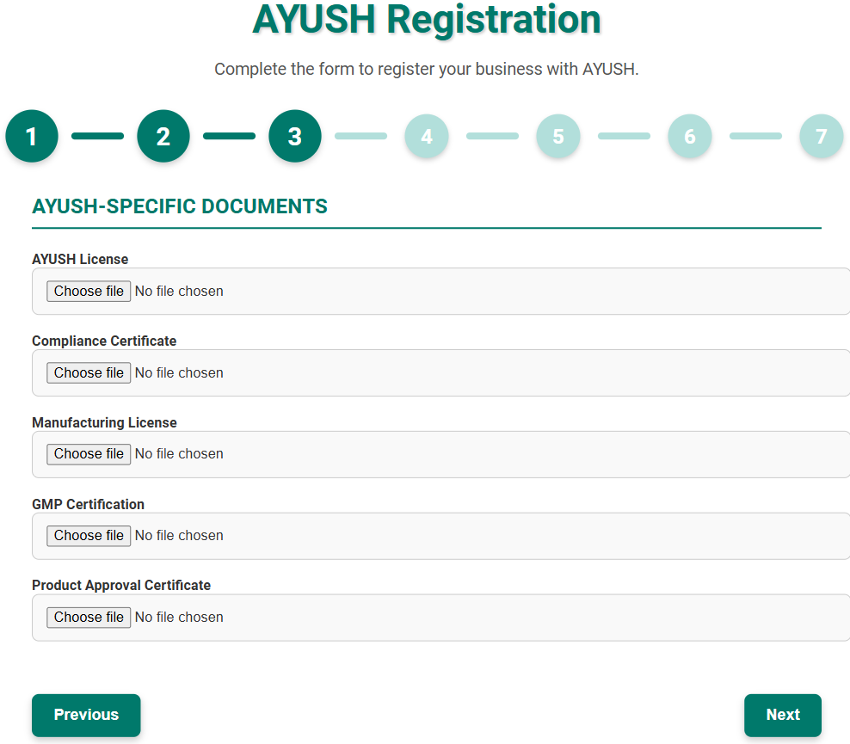
Home
About us
Register
Sitemap
Contact us
Ayurveda
Yoga and Naturopathy
Unani
Siddha
Homeopathy
Previous
Next
Visitor Count -

Slide 15
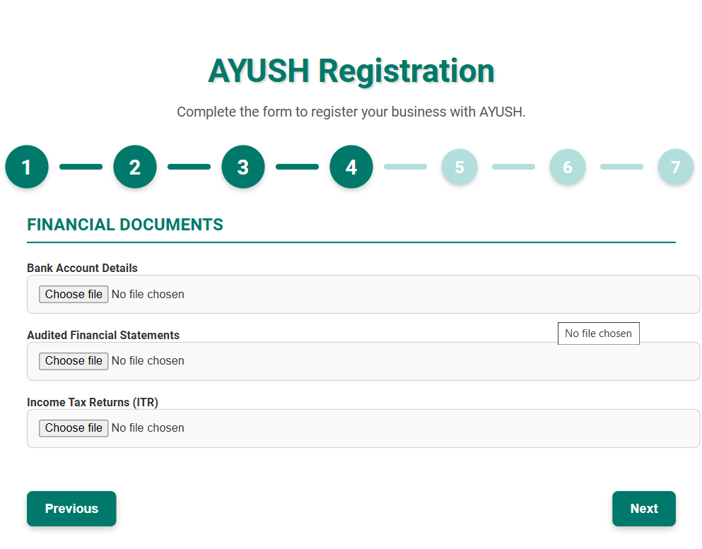
Home
About us
Register
Sitemap
Contact us
Ayurveda
Yoga and Naturopathy
Unani
Siddha
Homeopathy
Previous
Next
Visitor Count -

Slide 16
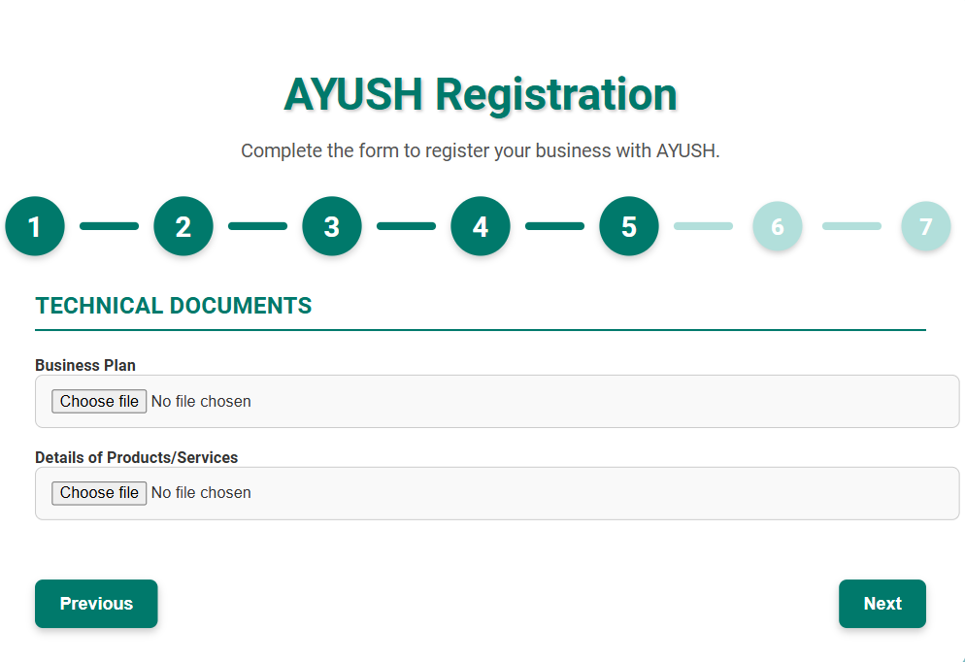
Home
About us
Register
Sitemap
Contact us
Ayurveda
Yoga and Naturopathy
Unani
Siddha
Homeopathy
Previous
Next
Visitor Count -

Slide 17
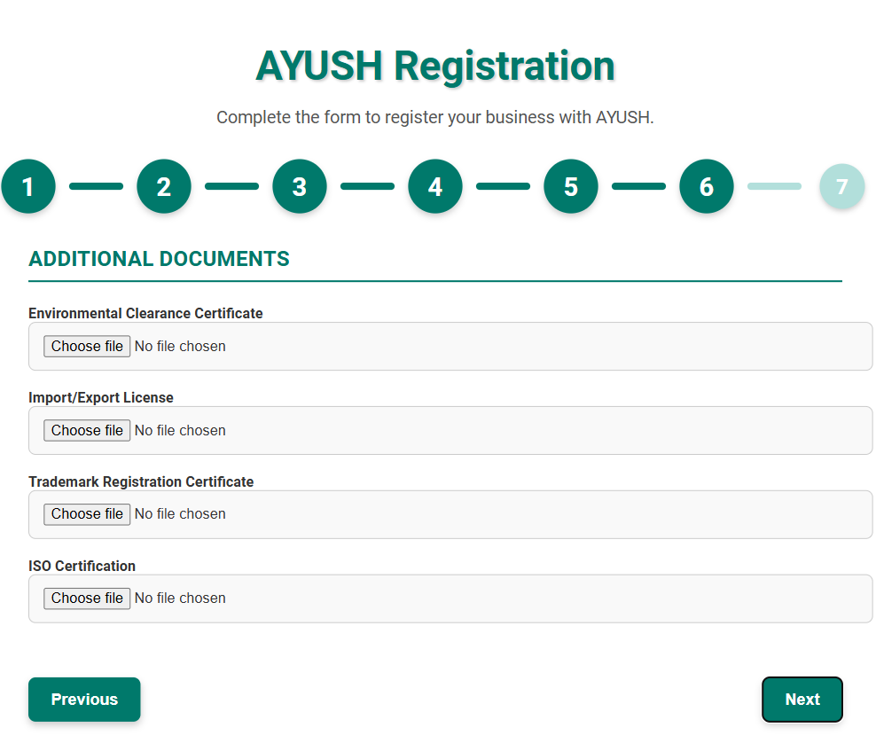
Home
About us
Register
Sitemap
Contact us
Ayurveda
Yoga and Naturopathy
Unani
Siddha
Homeopathy
Previous
Next
Visitor Count -

Slide 18
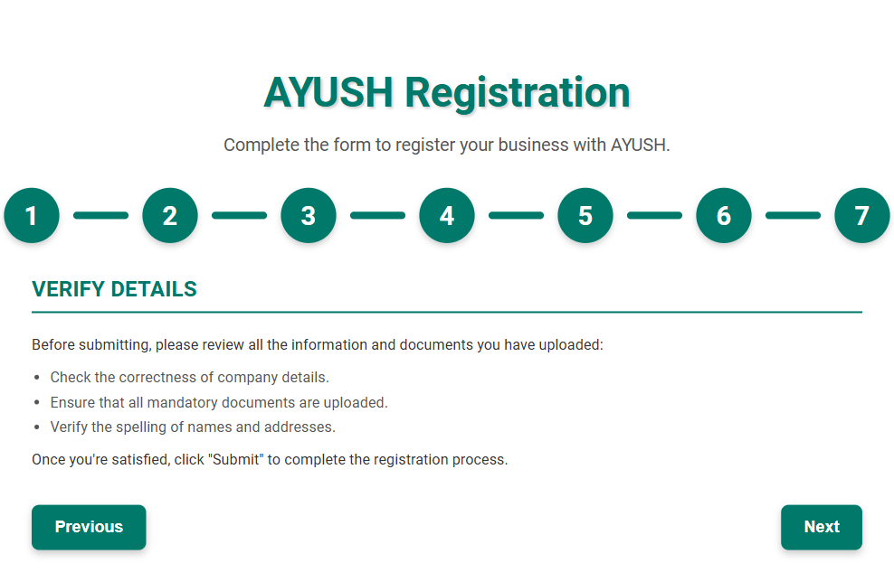
Home
About us
Register
Sitemap
Contact us
Ayurveda
Yoga and Naturopathy
Unani
Siddha
Homeopathy
Previous
Next
Visitor Count -

Slide 19
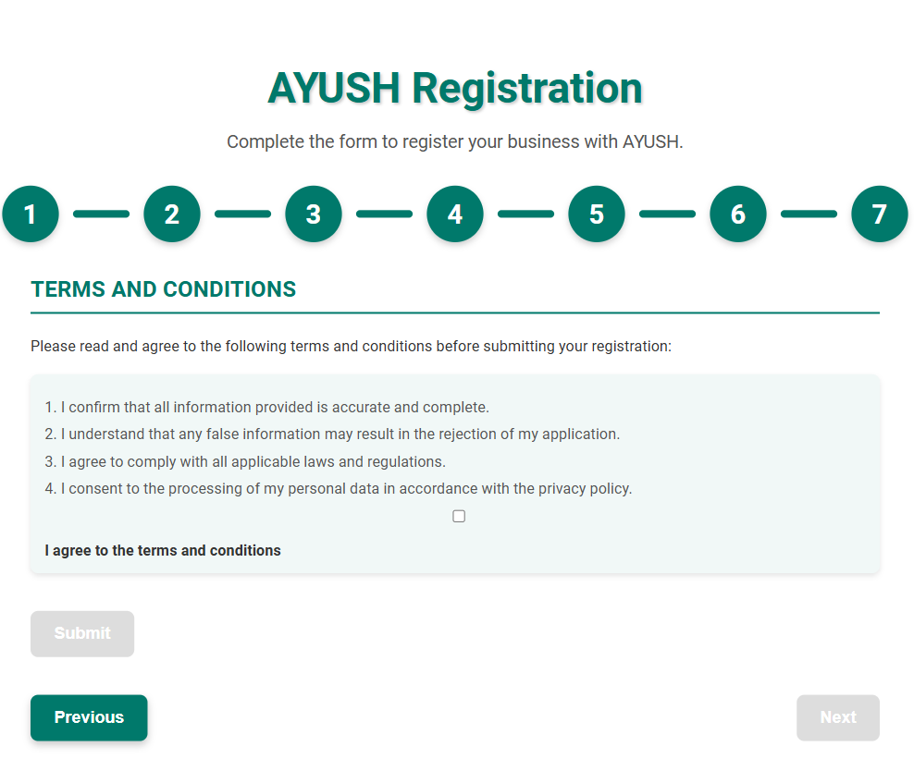
Home
About us
Register
Sitemap
Contact us
Ayurveda
Yoga and Naturopathy
Unani
Siddha
Homeopathy
Previous
Visitor Count -

Slide 20
Home
About us
User
Sitemap
Contact us
AYURVEDHA
Latest Posts
Ayurveda
Total Number of Registered Start-ups:
Yoga and Naturopathy
Total Number of Approved Start-ups:
Approved startups:
Unani
Siddha
Homeopathy
Visitor Count -

Slide 21
Home
About us
User
Sitemap
Contact us
YOGA AND NATUROPATHY
Latest Posts
Ayurveda
Ayurveda
Total Number of Registered Start-ups:
Yoga and Naturopathy
Yoga and Naturopathy
Total Number of Approved Start-ups:
Unani
Approved startups:
Unani
Siddha
Siddha
Homeopathy
Homeopathy
Visitor Count -

Slide 22
Home
About us
User
Sitemap
Contact us
UNANI
Latest Posts
Ayurveda
Ayurveda
Total Number of Registered Start-ups:
Yoga and Naturopathy
Yoga and Naturopathy
Total Number of Approved Start-ups:
Unani
Approved startups:
Unani
Siddha
Siddha
Homeopathy
Homeopathy
Visitor Count -

Slide 23
Home
About us
User
Sitemap
Contact us
SIDDHA
Latest Posts
Ayurveda
Ayurveda
Total Number of Registered Start-ups:
Yoga and Naturopathy
Yoga and Naturopathy
Total Number of Approved Start-ups:
Unani
Approved startups:
Unani
Siddha
Siddha
Homeopathy
Homeopathy
Visitor Count -

Slide 24
Home
About us
User
Sitemap
Contact us
HOMEOPATHY
Latest Posts
Ayurveda
Ayurveda
Total Number of Registered Start-ups:
Yoga and Naturopathy
Yoga and Naturopathy
Total Number of Approved Start-ups:
Unani
Approved startups:
Unani
Siddha
Siddha
Homeopathy
Homeopathy
Visitor Count -

Slide 25
Home
About us
User
Sitemap
Contact us
Contact Us
Ayurveda
Name:
Yoga and Naturopathy
Email:
Unani
Enter Query:
Siddha
Send
Homeopathy
reachout us at:
E-mail: aayushstart@gov.in
Mob:+91 **********
Visitor Count -

