Slide 1
BIA 500-B Business Analytics: Data, Models, and Decisions
Tuesday 6:30 – 9:00 pm
Spring 2025
Instructor: Brian Muller

Slide 2

Coffee Trade Analysis: A Comparative Study of Africa and Global Coffee Production
Course Project by Group 4:
Janvi Pravinkumar Lakhani (20027851)
Harshitha Tankasala (20037178)
Amala Koppu (20025580)
Sravya Goli (20036249)

Slide 3
Project Objective
Analyze global coffee production patterns from 1961 to 2022 using real-world data.
Evaluate Africa's role in the global coffee trade by comparing it with major producing continents: Americas, Asia, and Oceania.
Examine key agricultural indicators:
- Production Volume (tons)
- Area Harvested (hectares)
- Production Yield per Hectare (tons/hectare)
Identify leading and lagging countries within Africa and assess how they compare with global leaders like Brazil, Colombia, and Vietnam.
Identify performance gaps and improvement opportunities.

Slide 4
Project Overview
Conducted a comprehensive, longitudinal analysis of global coffee production from years 1961–2022.
Focused on regional comparisons among key coffee-producing continents: Africa, Americas, Asia, and Oceania.
Utilized Microsoft Excel for data processing, cleaning, and building pivot tables for structured analysis.
Applied feature engineering such as decade grouping, efficiency level categorization to simplify complex historical data.
Developed dynamic visualizations like line charts, column charts, donut charts- to uncover patterns, anomalies, and regional disparities.
Identified long-term trends such as increasing global production, Africa’s consistent yield lag, and shifts in continental dominance.
Highlighted Africa’s unique challenges in the coffee trade, including low yield efficiency despite growing land use.
Generated data-driven insights aimed at informing:
- Policy interventions- governmental reforms, farming incentives
- Investment strategies- agricultural technology, infrastructure
- Farmer support programs- education, mechanization, sustainability efforts

Slide 5
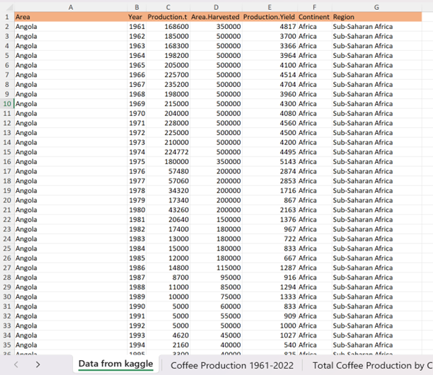
Dataset Overview
Used FAOSTAT Coffee Production Dataset (available on Kaggle).
From FAOSTAT Kaggle data used dataset is Coffee_Production_1961-2022.csv's detailed coffee production records from 1961 to 2022.
The data size is approximately 7 attributes (columns) and 4819 rows.
Attributes in the dataset:
- Area: Total geographical land area of the country.
- Year: Year of record (1961 - 2022).
- Production.t: Total coffee production (tons).
- Area.harvested: Hectares of land harvested for coffee.
- Production.yield: Yield per hectare (tons/hectare).
- Continent: Continent categorization (Africa, Americas, Asia, Oceania).
- Region: Regional categorization.
Data Characteristics:
- Global scope covering major coffee-producing regions.
- Multi-metric tracking of production quantity, land use, and productivity.
- Consistent recording over 61 years.

Slide 6
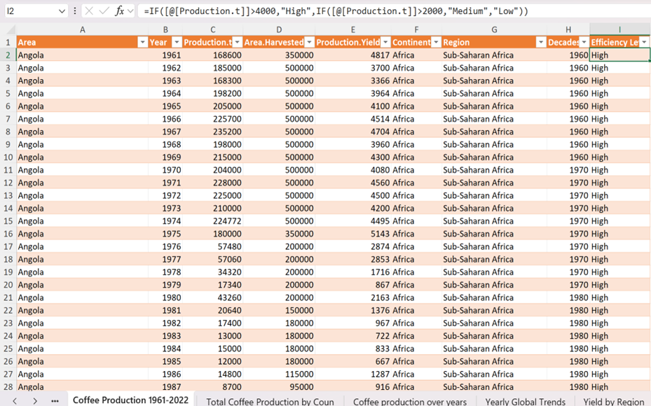
Data Analysis & Visualization
Microsoft Excel for complete data cleaning, transformation, and analysis.
Data Preparation:
- Handled missing or inconsistent values by interpolation or exclusion.
- Standardized all units across the dataset (tons for production, hectares for harvested area). Structured data into a dynamic Excel Table for easier manipulation and referencing.
Feature Engineering:
- Created a new Decade column to group years into 10-year intervals (e.g., 1960s, 1970s).
- Developed a conditional formula to classify production efficiency into three categories like High, Medium, and Low efficiency.
Analysis Techniques:
- Built multiple Pivot Tables to summarize production, yield, area harvested, and regional trends.
- Applied slicers for interactive filtering by continent and year.
- Used conditional formatting to highlight performance highs, lows, and anomalies.
Visualization Techniques:
- Developed dynamic charts like line, column, doughnut - to clearly present findings and insights.

Slide 7
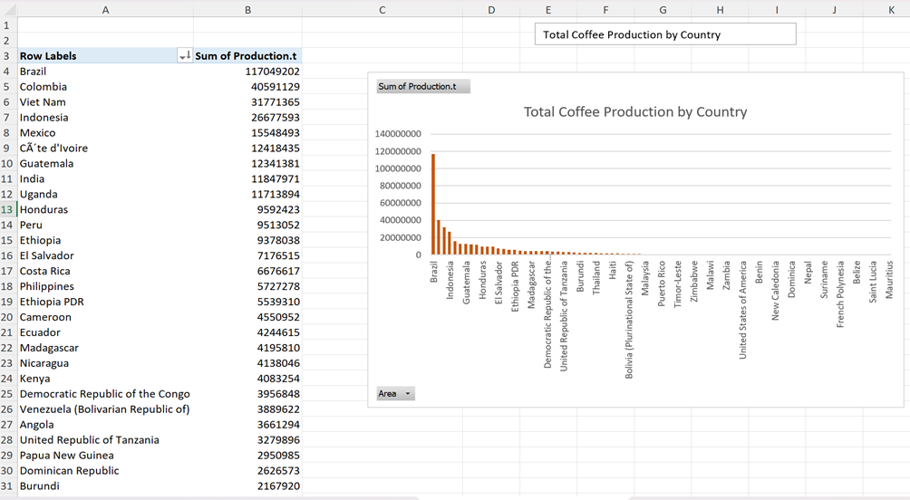
Total Coffee Production by Country
From the column chart Brazil, Vietnam and Colombia lead global coffee production by large margins.
African countries produce much less compared to global leaders.
Ethiopia and Uganda are strong regionally but lag behind internationally.
Global leaders benefit from advanced technologies and higher yield efficiencies.

Slide 8
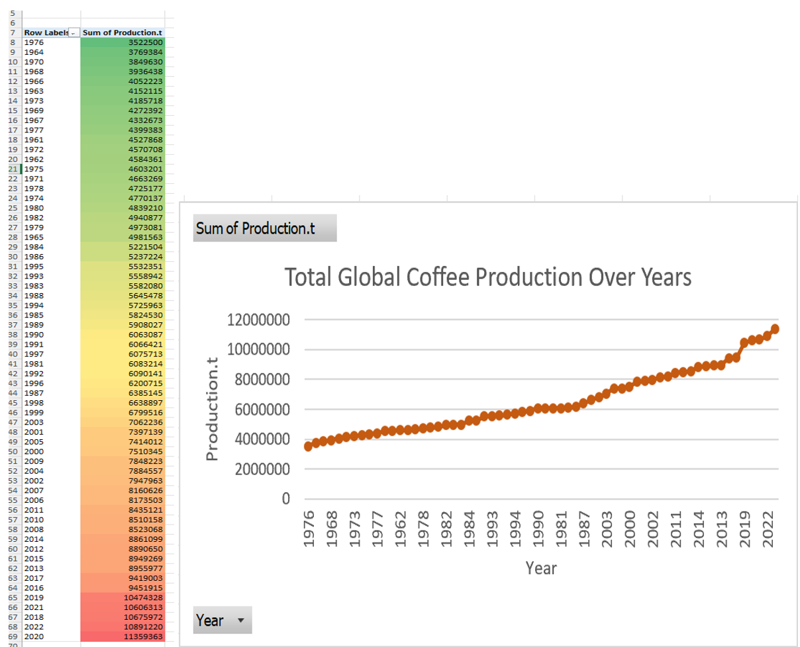
Global Production Trends Over Time (year)
Yearly production totals were analyzed using a pivot table with Year as rows and Sum of Production (tons) as values.
Global coffee production has shown a steady upward trend over the past six decades.
Conditional formatting used to highlight production highs and lows.
Line chart created to visualize the long-term global growth pattern.
Insight:
- The consistent rise reflects growing global demand, technological advancement, and increased cultivation.
- Some noticeable declines in specific years, possibly due to environmental or economic disruptions.

Slide 9
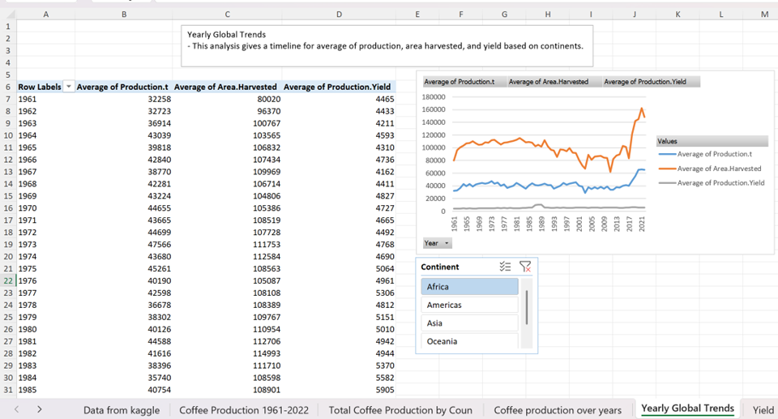
Yearly Global Trends Over Time (Avg Time)
Analyzed average yearly production (tons), area harvested (hectare) , and yield (tons per hectare) from 1961–2022.
A continent slicer was applied to enable interactive comparison across regions.
Line chart visualization helps track how each continent’s metrics evolved over time.
Insight:
- Africa shows steady growth in land under cultivation.
- However, production and yield remain significantly lower than in the Americas and Asia.
- This indicates low land-use efficiency and a need for agricultural improvement.

Slide 10
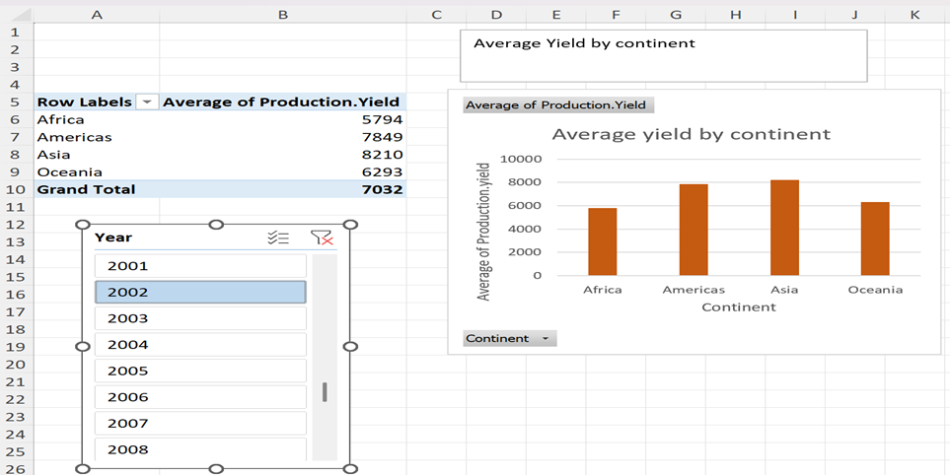
Yield by Continent
This analysis compares the average coffee yield per hectare across different continents.
A column chart was used to clearly show differences in production efficiency.
A year slicer was included to examine how yield trends vary over time.
Insight:
- Africa consistently shows the lowest average yield, even with increasing land use.
- In contrast, Americas and Asia maintain higher yields, supported by modern farming techniques and mechanization.
- The gap in yield reflects a productivity challenge for Africa’s coffee sector.
- Improving yield through better agricultural tools, training, and policy support is crucial for Africa to compete globally.

Slide 11
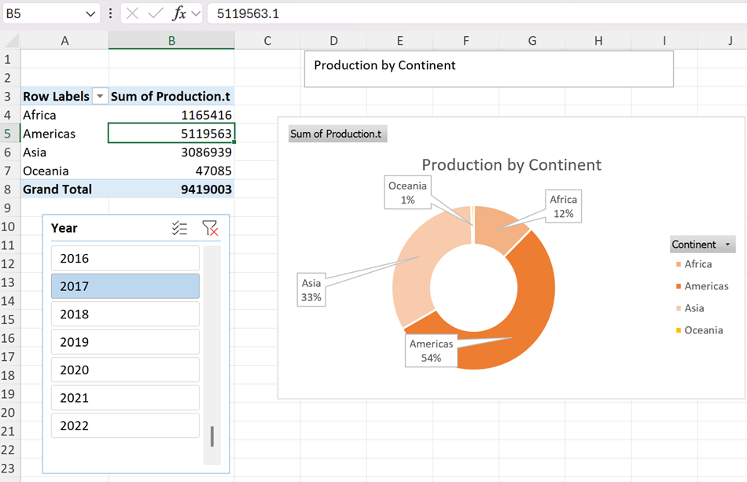
Production by Continent
This analysis shows the proportional share of total coffee production by continent.
A doughnut chart illustrates the distribution clearly, with a year slicer allowing comparisons across time.
Insight:
- The Americas dominate the global coffee market, driven by top producers like Brazil and Colombia.
- Asia also contributes a significant share, primarily due to Vietnam’s high output.
- Africa’s contribution remains modest, averaging around 12%, despite its historical importance in coffee cultivation.
- The chart reveals a global imbalance in production, pointing to untapped potential in Africa.
- This emphasizes the need for yield improvement, investment, and modern farming practices to boost Africa’s role in the global market.

Slide 12
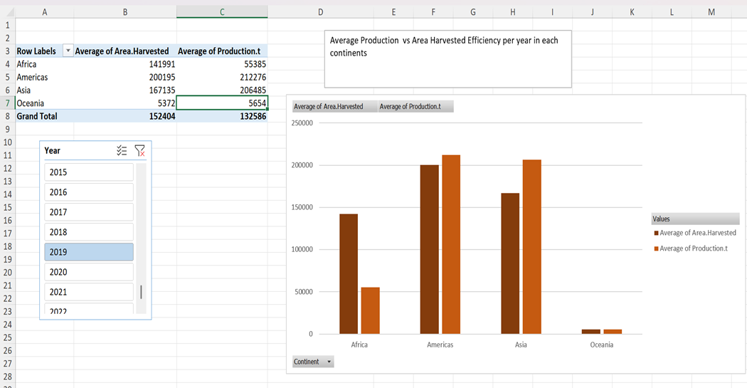
Comparative Analysis: Area Harvested vs Production.t
The analysis compares average land harvested and coffee production output across continents.
A column chart visually represents each region’s ability to convert land into production, with a year slicer included for time-based exploration.
Insight:
- Africa cultivates a significant amount of land for coffee yet records lower output compared to other continents.
- Americas and Asia produce more coffee using less land, showing higher land-use efficiency.
- This highlights a yield gap, rather than a lack of land availability in Africa.
- So, Africa’s lower efficiency is likely due to limited mechanization, lack of access to modern farming tools, and insufficient agricultural support, emphasizing the need to focus on improving yield rather than expanding farmland.

Slide 13
Challenge & Solution
Challenges:
- Missing or incomplete data across different years and countries
- Inconsistent units and formatting, making comparisons difficult
- Managing a large dataset spanning over 61 years
- Difficulty comparing yields across diverse agricultural environments
- Presenting complex results clearly across multiple metrics and time periods
Solution:
- Handled missing values using interpolation or excluded unreliable entries
- Standardized units (tons for production, hectares for area)
- Grouped data by decade and continent for better summarization
- Introduced Efficiency Level to enable fair comparisons
- Improved clarity with pivot tables, slicers, and varied chart types

Slide 14
Conclusion
This project analyzed global coffee production trends with a focus on Africa’s performance compared to other continents from 1961 to 2022.
The findings revealed that despite its vast agricultural potential, Africa contributes a relatively small share to global coffee output due to low yield efficiency and outdated practices.
Countries like Ethiopia and Uganda lead within the continent but still lag global leaders such as Brazil and Vietnam.
By using pivot tables, calculated metrics, and dynamic visualizations, the study identified key gaps and opportunities for improvement.
These insights can support policymakers in shaping agricultural reforms, guide development organizations in targeting resources effectively, inform investors about growth markets, and help farmers and cooperatives enhance productivity.
Overall, the project provides a valuable foundation for data-driven strategies aimed at boosting Africa’s competitiveness and sustainability in the global coffee trade.

Slide 15
Reference
Kaggle: https://www.kaggle.com/
FAOSTAT Coffee Production Data 1961-2022:
https://www.kaggle.com/datasets/junkochida/faostat-coffee-production-data-1961-2022?select=Coffee_Production_1961-2022.csv
Report for reference: Africa_s_Coffee_Sector_Status__Challenges_and_Opportunities_for_Growth

Slide 16


