Slide 1
CS6384 PROJECT Real-time Object Detection and Tracking for Autonomous Surveillance
Group 35:
Nagaveda Sai Kumar Reddy Gajjala(NSG230000)
Yamini Sunkari(YXS220036)
Harsha Vardhan Chowdary Vundavalli(HXV230008)
Sravya Meghana Mitta(SMM230008)

Slide 2
Introduction
Purpose: Advanced surveillance system with real-time object detection and tracking
Core technology: Computer vision + deep learning for intelligent monitoring
Key features: Real-time processing, multi-object tracking, web dashboard, performance analytics
Applications: Security monitoring, crowd analysis, traffic management, anomaly detection

Slide 3
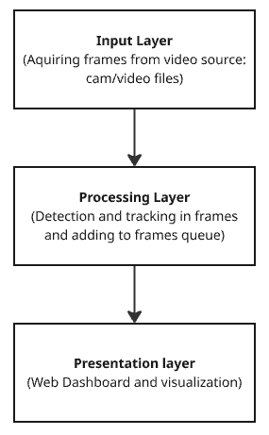
System Architecture
Three-tier architecture:
Input Layer
Processing Layer.
Presentation Layer.

Slide 4
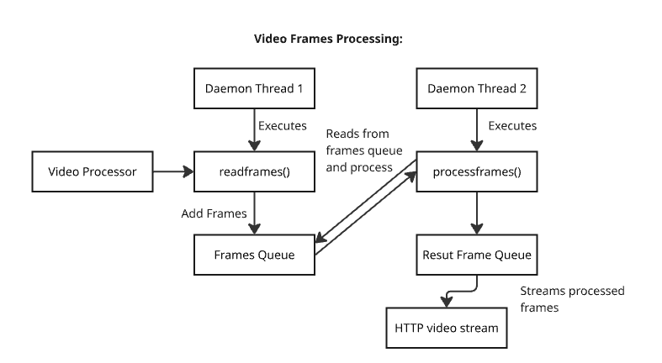
Key design principles:
Multi-threaded processing for real-time performance
Decoupled components for modularity and maintainability
Producer-consumer pattern with frame queues

Slide 5
Technical Components
Core Modules:
Video Processor
Object Detection
Object Tracking
Web Dashboard
Analytics Engine
Technologies Used:
Python + OpenCV for image processing
YOLOv8 for object detection
Custom Kalman filter for motion prediction
Flask for web server implementation
HTML/CSS/JavaScript for interactive dashboard

Slide 6
Object Detection Module
Technical approach:
YOLOv8 neural network model for object detection trained on COCO dataset.
Device optimization based on availability (CPU/GPU/MPS)(apple silicon)
Detection capabilities:
Identifies 80+ object classes (people, vehicles, etc.)
Provides bounding boxes with confidence scores
Processes frames independently without temporal context
Performance optimization:
Confidence threshold filtering to reduce false positives
Hardware acceleration when available

Slide 7
Object Tracking Module
Core Components:
Kalman Filter: Predicts object motion.
Hungarian Algorithm (Optimal Matching): Matches detections to tracks based on IOU scores.
Track Manager: Handles creation, updating, and deletion of tracks.
Working:
Prediction: Each existing track predicts its next position using a Kalman Filter.
Matching:
Compute the IOU-based cost matrix between predicted tracks and detections. (Intersection over Unions)
Apply the Hungarian Algorithm to find the best matching that minimizes total cost.
Update:
Matched tracks are updated with new detections.
New tracks are created for unmatched detections.
Tracks are deleted if they are unmatched for a specified number of frames.
Output: Updated object tracks with consistent IDs across frames.

Slide 8
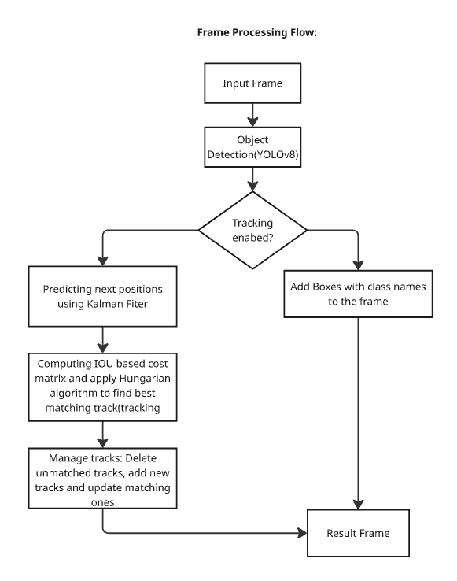
Frame Processing

Slide 9
Web Dashboard
Features:
Live video feed with detection/tracking visualization
Real-time statistics (FPS, active tracks, uptime)
Tracking logs with timestamp and object information
Object count by class
Interactive controls (toggle tracking, capture snapshots)
Data visualization:
Color-coded bounding boxes by object class
Track IDs and confidence scores

Slide 10
Analytics and Logging
Performance metrics:
Frames per second (FPS)
Number of active tracks
System uptime
ID switches (tracking accuracy indicator)
Logging capabilities:
CSV tracking log with timestamp, track ID, class, and position
Console and file logging for system events
Historical data for post-processing and analysis

Slide 11
Real-time Processing Pipeline
Processing workflow:
Frame acquisition from video source
Frame queuing for asynchronous processing
Object detection on each frame
Association of detections with existing tracks
Track state update and prediction
Visualization with bounding boxes and track IDs
Results streaming to web dashboard

Slide 12
System Performance
Quantitative metrics:
Processing speed: 15-30 FPS on commodity hardware
Tracking reliability: <10% ID switches in standard scenarios
Latency: <100ms end-to-end processing time
Qualitative results:
Robust tracking through partial occlusions
Stable object identification in varying lighting conditions
Accurate classification of common surveillance objects

Slide 13
Thank you
Questions ?

