Slide 1
Functional JavaScript
Follow me twitter: @djidja8
This deck online with live code editing: functional-js

Slide 2
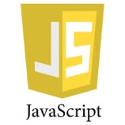
JavaScript Overview
Type System
Primitive Values
Objects
Inheritance
Functions
Closures

Slide 3
JavaScript Overview – Type System
JavaScript has dynamic and loosely typed type system with two main types:
Primitive (value) types:
number
string
boolean
null
Undefined
Object (reference) types:
Object
Function
Array
Date
RegExp
*Wrappers for primitives: Boolean, Number, String

Slide 4
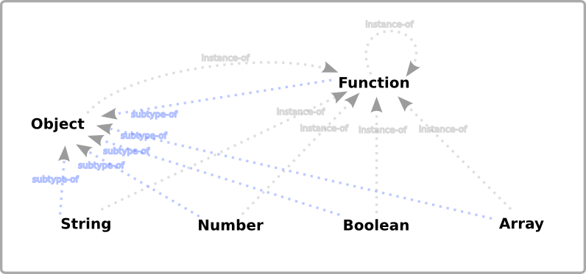
JavaScript Overview – Type System
@vijayan blog: JavaScript Type Model

Slide 5
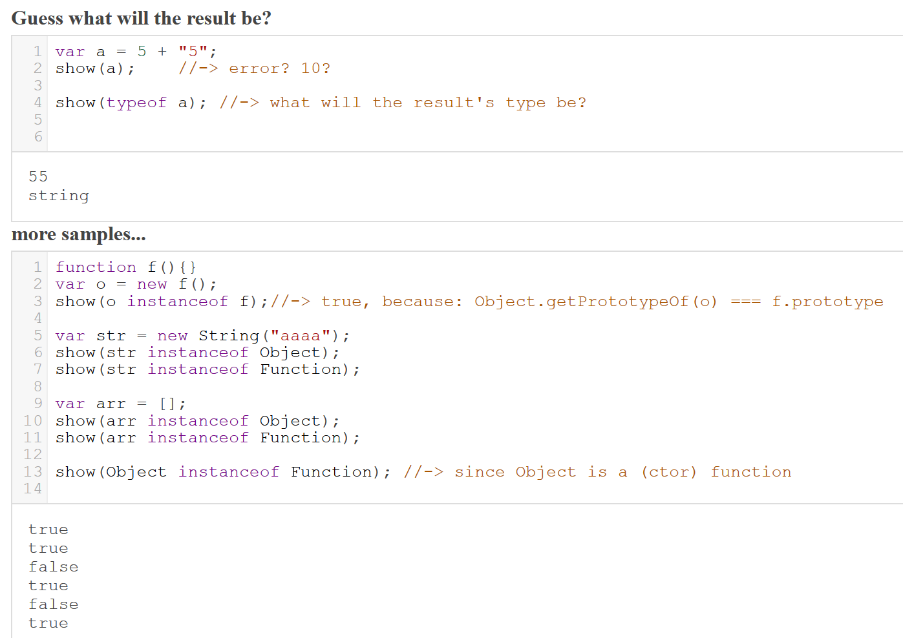
JavaScript Overview – Type System

Slide 6
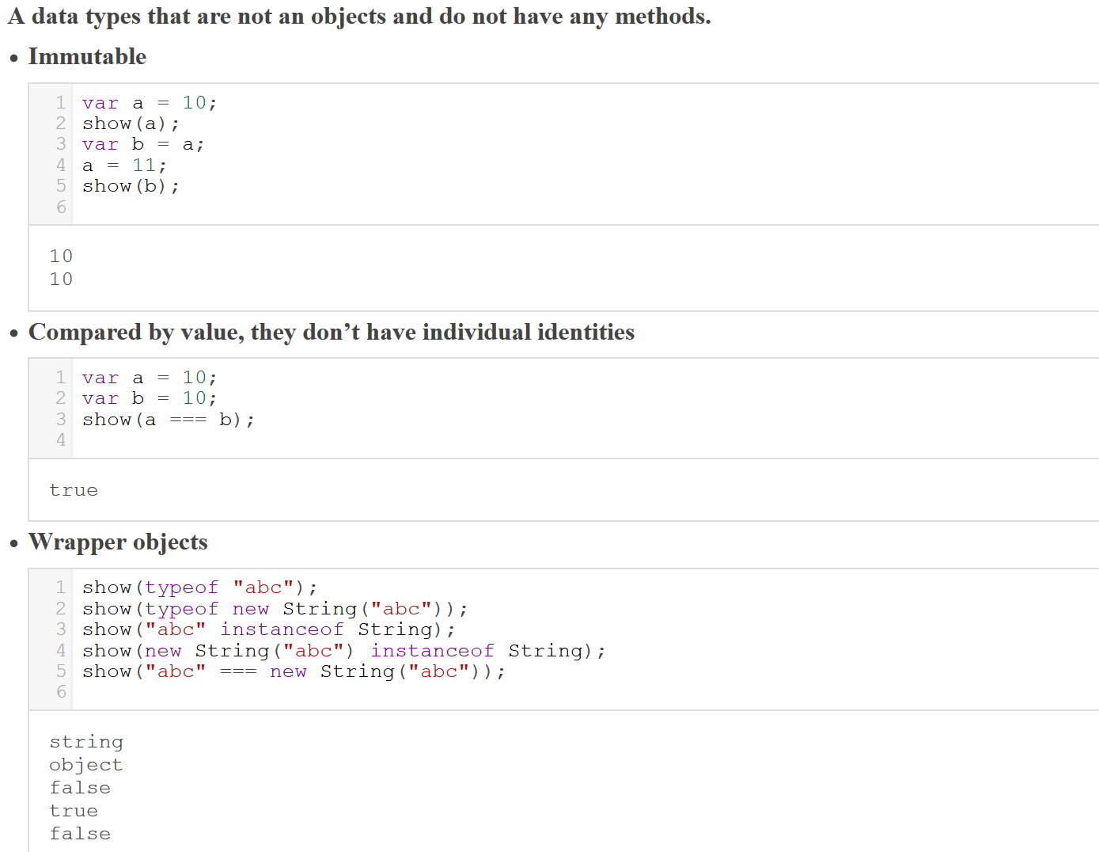
JavaScript Overview – Primitive Values

Slide 7
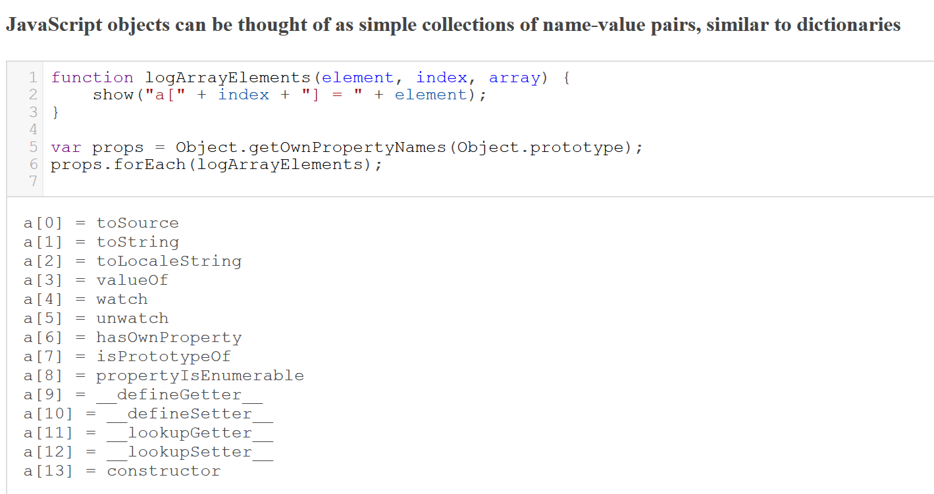
JavaScript Overview - Objects

Slide 8
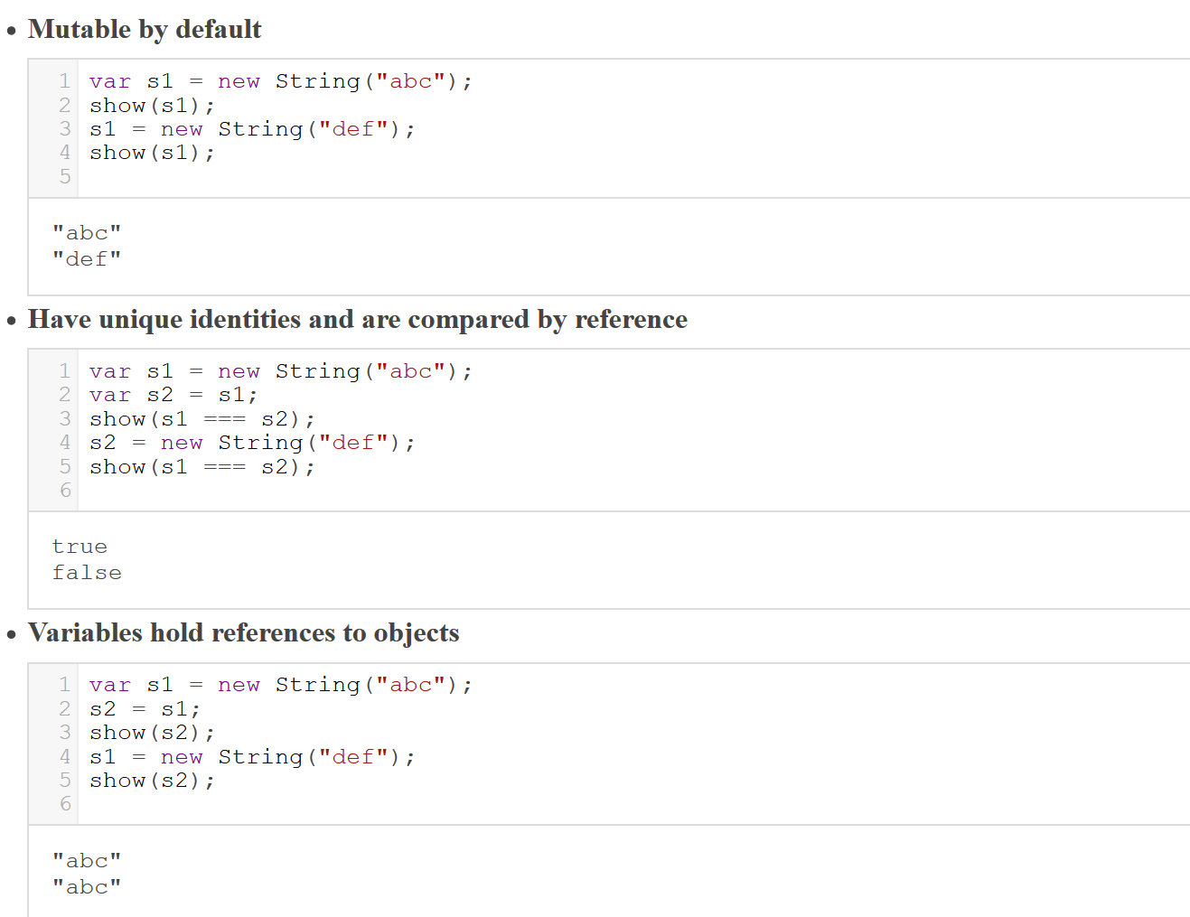
JavaScript Overview - Objects

Slide 9
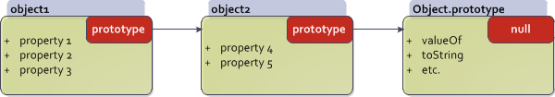
JavaScript Overview - Inheritance
JavaScript supports a prototype-based inheritance.
Inheritance is performed by creating new objects directly, based on existing ones, existing object is assigned as the prototype of the new object and then inherited behavior can be changed or new behavior can be added to the new object.
The prototype of an object is a simple reference to another object which has its own prototype reference set to yet another object
All objects are descended from 'Object' and they inherit properties from Object.prototype, but they may be overridden
'null', by definition, has no prototype, and acts as the final link in this prototype chain
New objects are created by copying the structure of an existing prototype object
Inheritance in JavaScript

Slide 10
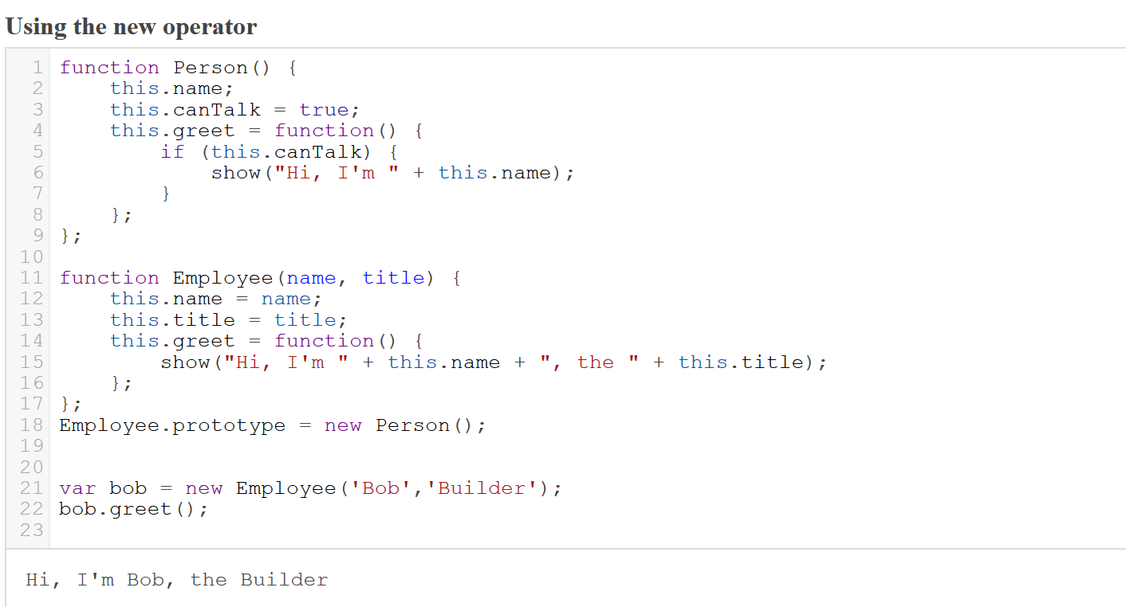
JavaScript Overview - Inheritance

Slide 11
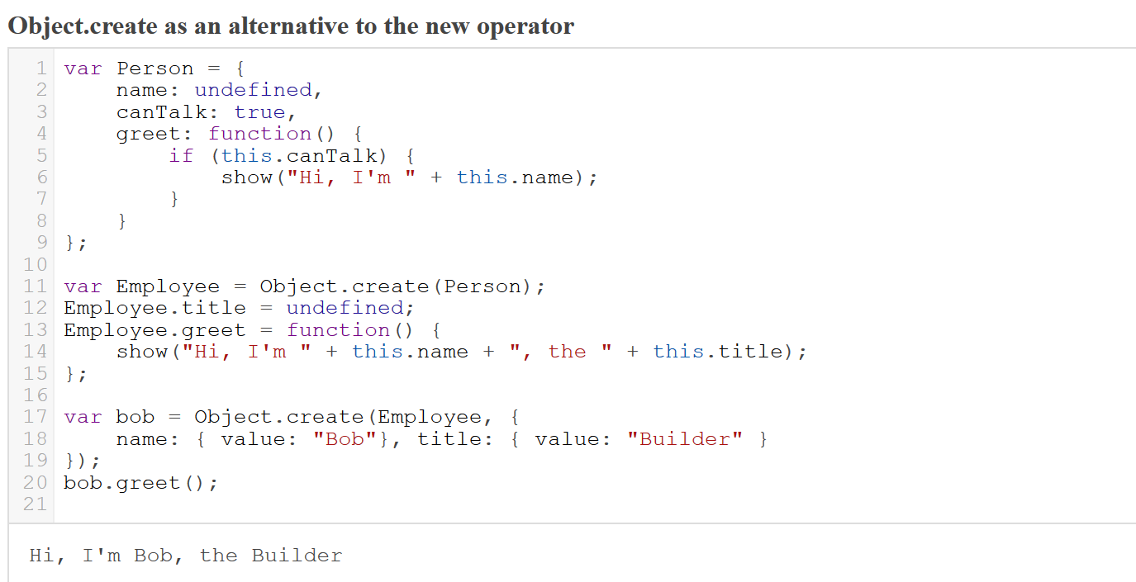
JavaScript Overview - Inheritance

Slide 12
JavaScript Overview - Functions
In JavaScript, functions are objects and are used to perform a task or calculates a value.
Functions have properties and methods that they inherit from the Function object. It is possible to add new properties and methods to functions.
Functions are values that can be bound to names, passed as arguments, returned from other functions
Functions are applied to arguments
The arguments are passed by sharing, which is also called “pass by value”
Function bodies have zero or more expressions
Function application evaluates whatever is returned with the return keyword, or to 'undefined'
Function application creates a scope. Scopes are nested and free variable references are closed over
Variables can shadow variables in an enclosing scope

Slide 13
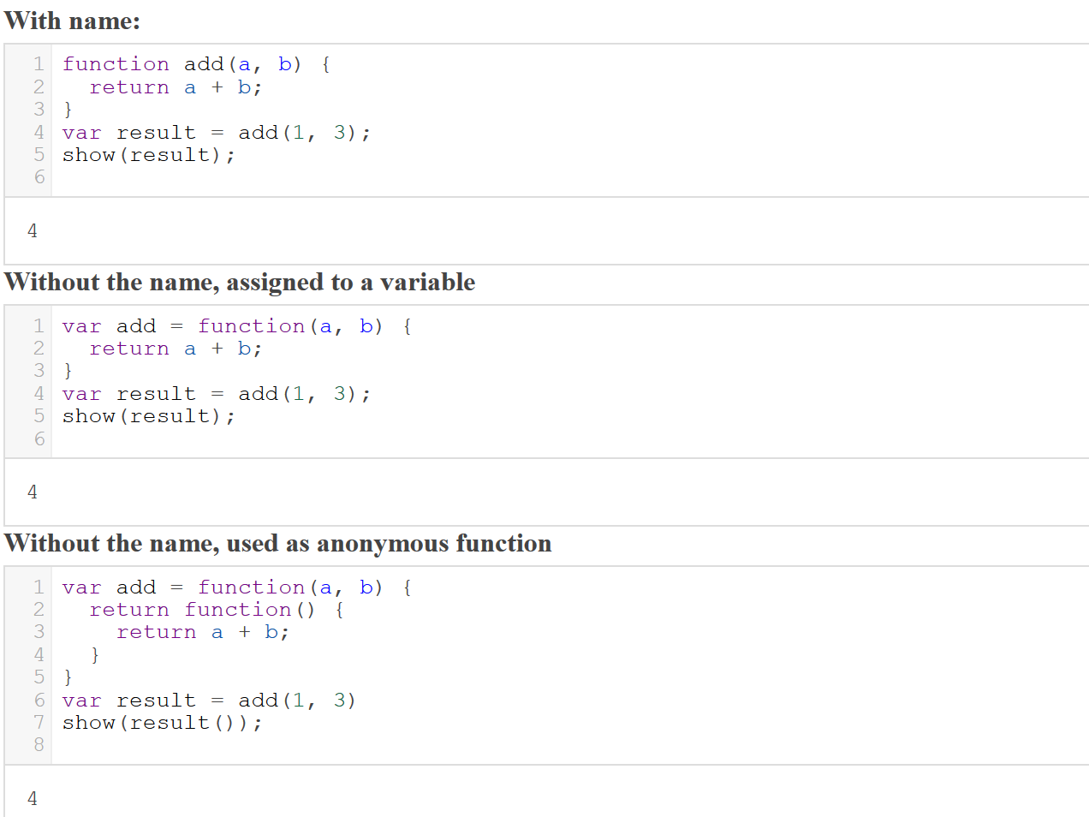
JavaScript Overview - Functions
Function declarations (they are hoisted — moved in their entirety to the beginning of the current scope)

Slide 14
JavaScript Overview - Functions
Function object (all functions inherit from it) has the following properties:
arguments: An Array/object containing the arguments passed to the function
arguments.length: Stores the number of arguments in the array
arguments.callee: Pointer to the executing function (allows anonymous functions to recurse)
length: The number of arguments the function was expecting
constructor: function pointer to the constructor function
prototype: allows the creation of prototypes
Function object has the following methods:
apply: A method that lets you more easily pass function arguments
call: Allows you to call a function within a different context
bind: creates a new function that, when called, has its 'this' set to the provided value, with a given sequence of arguments preceding any provided when the new function is called
toString: Returns the source of the function as a string

Slide 15
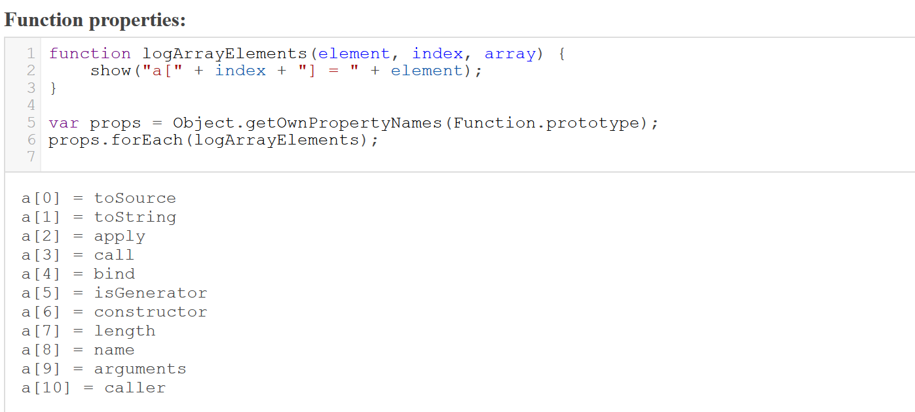
JavaScript Overview - Functions

Slide 16
JavaScript Overview - Closures
Closures are functions that refer to independent (free) variables.
Function defined in the closure 'remembers' the environment in which it was created. A closure, unlike a plain function pointer, allows a function to access those free variables even when invoked outside its immediate lexical scope.
Simply accessing variables outside of your immediate lexical scope creates a closure
Inner function get full access to all the values defined in the outer function, not the other way around

Slide 17
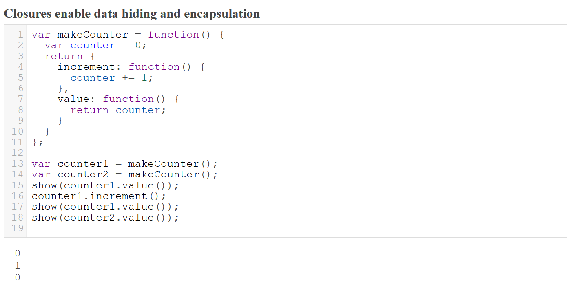
JavaScript Overview - Closures

Slide 18

Functional Programming Overview
What is functional programming?
Why Functional?
A motivating example(?)

Slide 19
Functional Programming Overview – What is functional programming?
First Class Functions:
stored in variables, passed as arguments to functions, created within functions and returned from functions
Higher Order Functions:
Function that can accept functions as arguments, and/or can return a function
No Side Effects:
Function that does something other than returning the result is said to have side effects
Referential Transparency:
For a given set of arguments, the same code should always output the same value, only by changing arguments can a output value be different
Immutability:
Inability for variables to change their values once created. In other words, all things created stay constant
Currying / Partial Application:
Ability of a function to return a new function until it receives all it's arguments. Calling a curried function with only some
of its arguments is called partial application
Tail Call Optimization:
Ability to avoid allocating a new stack frame for a function call. The most common use is tail-recursion, where a recursive function uses constant stack space.

Slide 20
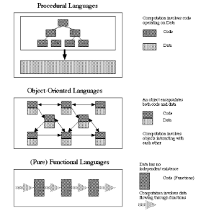
Functional Programming Overview – What Is functional programming?
"Functional programming isn't the goal. The goal is to simplify the complicated."
Write less code
Fewer errors
Easy concurrency
Testability

Slide 21
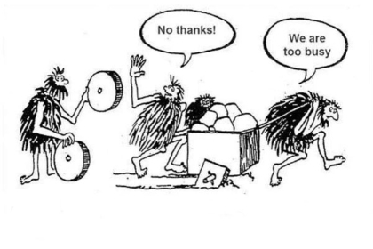
Functional Programming Overview – Why functional programming?
... but who has time to learn new stuff (all the time)?

Slide 22
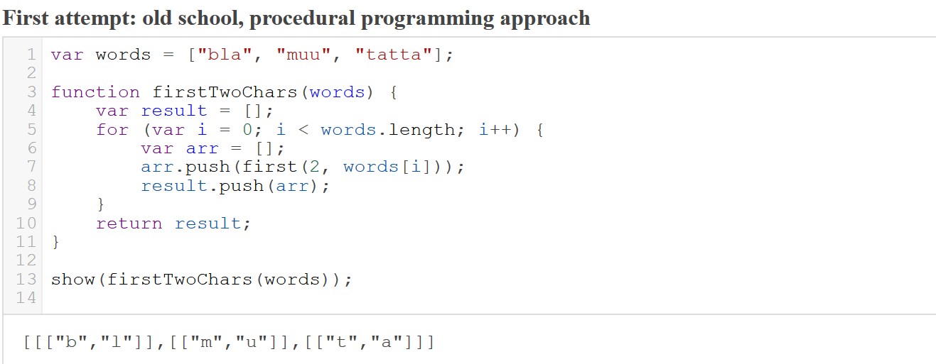
Functional Programming Overview – Motivating example *
*Hat tip to Brian Lonsdorf, aka @drboolean. Watch his videos, great fun and motivating stuff!
Hey Underscore, You're Doing It Wrong! Functional programming patterns for the non-mathematician!

Slide 23
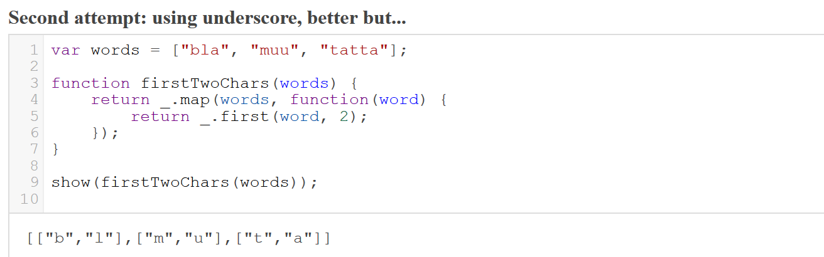
Functional Programming Overview – Motivating example

Slide 24
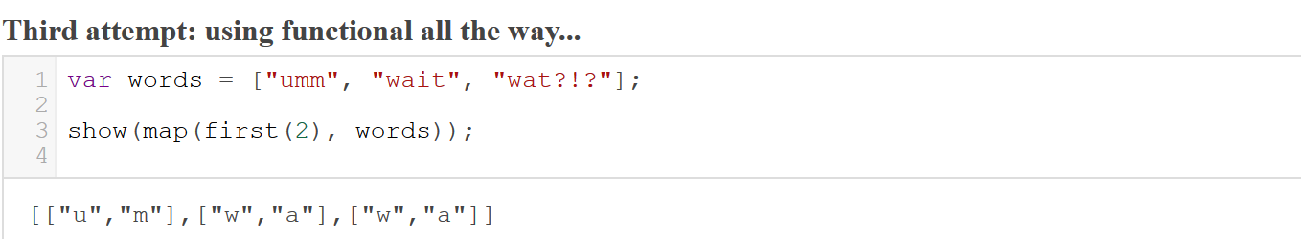
Functional Programming Overview – Motivating example

Slide 25
Functional Programming Techniques
Functional JavaScript
Pure Function, Higher Order Functions
Composition, Combinators
Currying/Partial Application
Filter, Map, Reduce
Try it out yourself...

Slide 26
Functional Programming Techniques – Functional JavaScript
JavaScript allows a variety of different programming paradigms: OO, functional, procedural
Although not a pure functional programming language, it allows one to program in a functional way.
Supports:
First Class Functions
Higher Order Functions
Anonymous functions
Closures

Slide 27
Functional Programming Techniques – Functional JavaScript
JavaScript allows a variety of different programming paradigms: OO, functional, procedural
Although not a pure functional programming language, it allows one to program in a functional way.
Does not support directly, but possible with some discipline :)
Pure functions
Immutability
No Side Effects

Slide 28
Functional Programming Techniques – Functional JavaScript
JavaScript allows a variety of different programming paradigms: OO, functional, procedural
Although not a pure functional programming language, it allows one to program in a functional way.
Does not support directly, but possible with use of libraries or with ES6:
Currying/Partial Application
Tail call optimization
Pattern matching
Lazy Evaluation

Slide 29
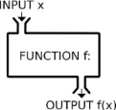
Functional Programming Techniques – Pure Function
A function is considered pure if the result depends only on the arguments, and it has no side effects
The only result of invoking a pure function is the return value.
Same input, same ouput
No side effects
Can be cached
Easy to test
Allows code to run in parallel

Slide 30
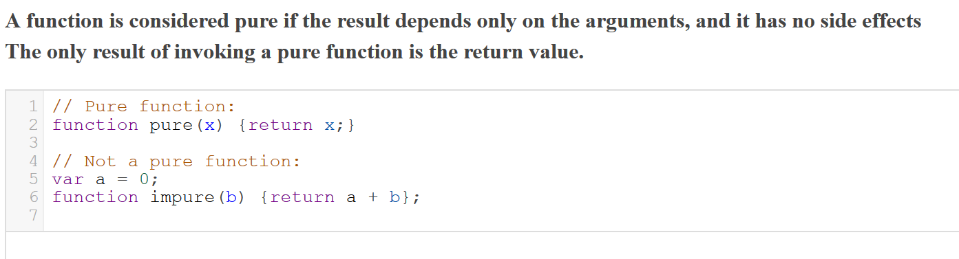
Functional Programming Techniques – Pure Function

Slide 31
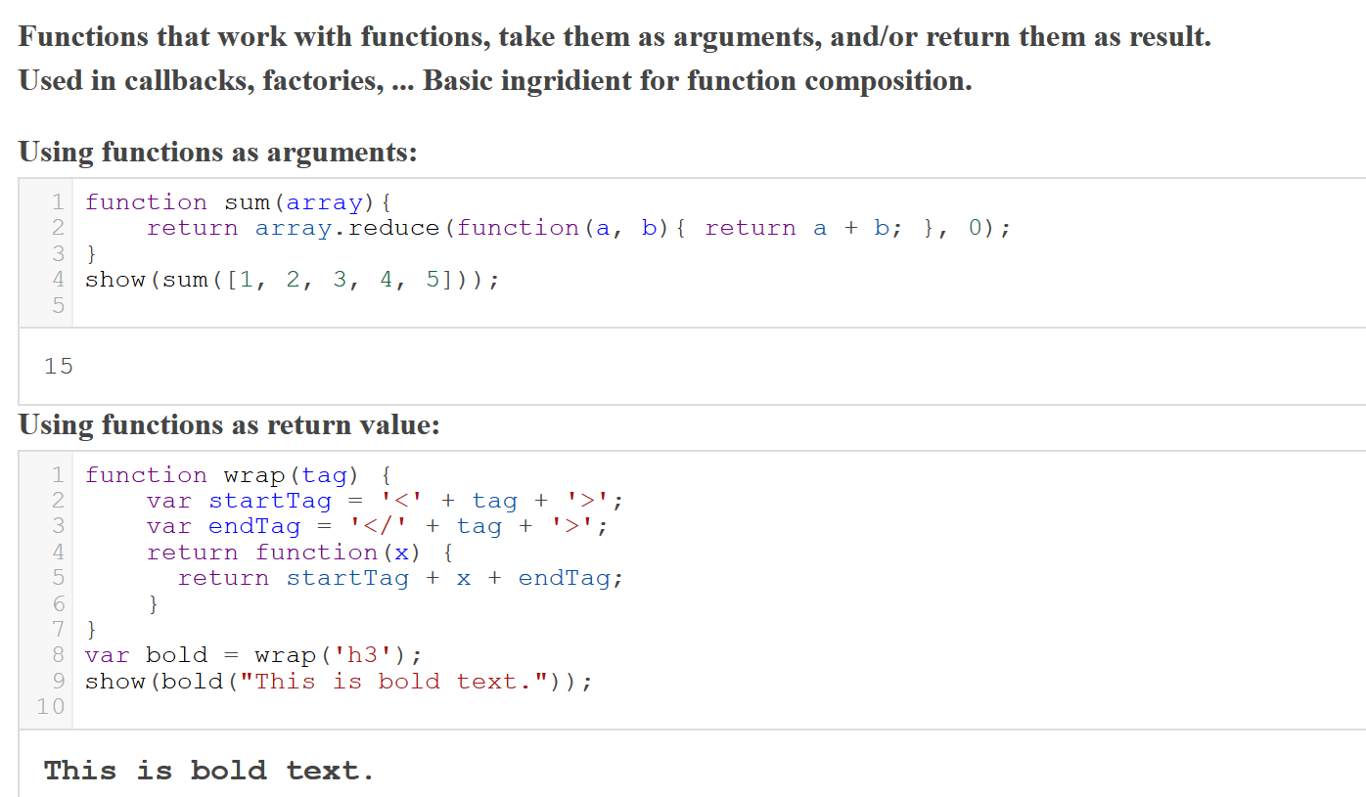
Functional Programming Techniques – Higher Order Function

Slide 32
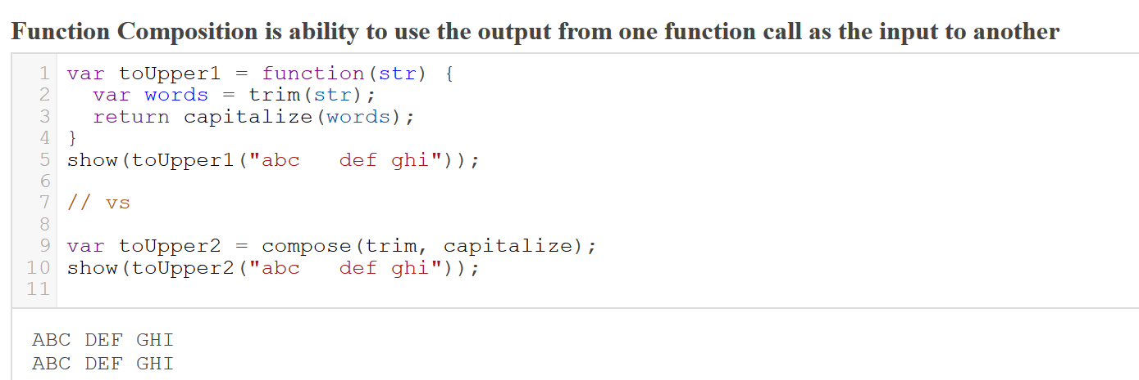
Functional Programming Techniques - Composition

Slide 33
Functional Programming Techniques - Combinators
Ability to use functions as building blocks to make new functions
Function composition is simply one of many combinators.
Tacit programming (point-free programming) is a programming paradigm in which a function definition does not include information regarding its arguments, using combinators and composition in the function declaration instead of arguments
Some Examples*:
splat
get
pluck
*Taken from Reginald Braithwaite's, aka @raganwald, article: Combinator Recipes for Working With Objects in JavaScript
Be sure to check out his projects and books!

Slide 34
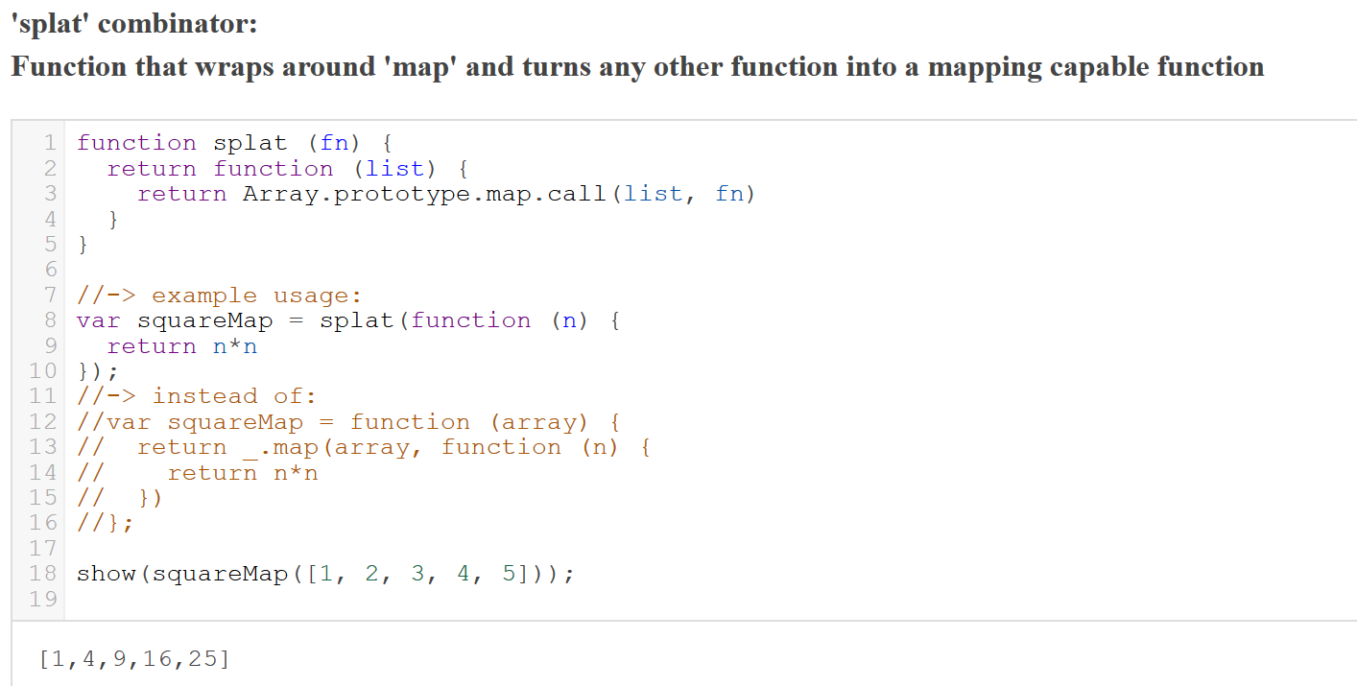
Functional Programming Techniques - Combinators

Slide 35
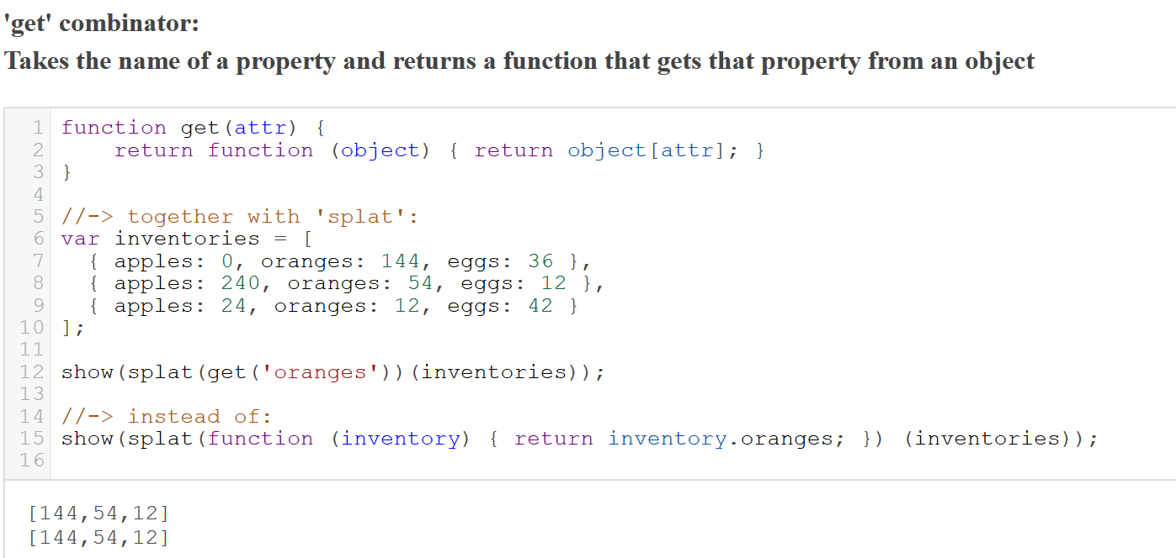
Functional Programming Techniques - Combinators

Slide 36
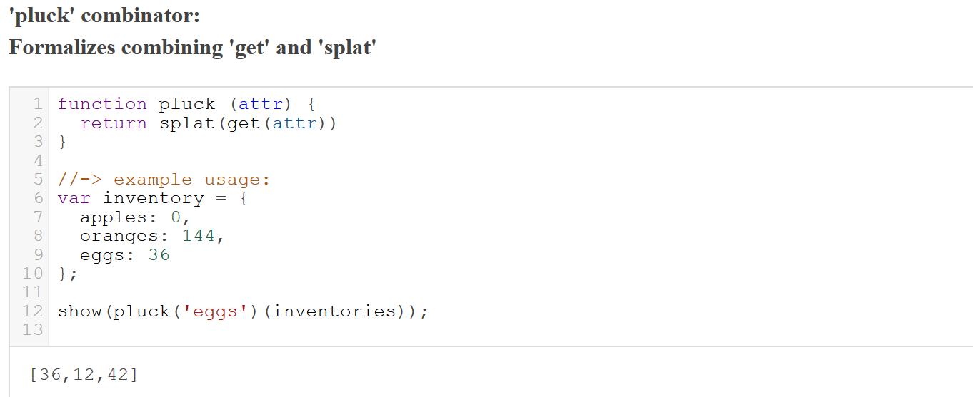
Functional Programming Techniques - Combinators

Slide 37
Functional Programming Techniques - Currying / Partial application
Currying produces a function that will return a new function until it receives all it's arguments
Currying enables Partial Application, and together they help:
Making generic functions
Building new functions by applying arguments
Better granularity of functions
More powerful function composition

Slide 38
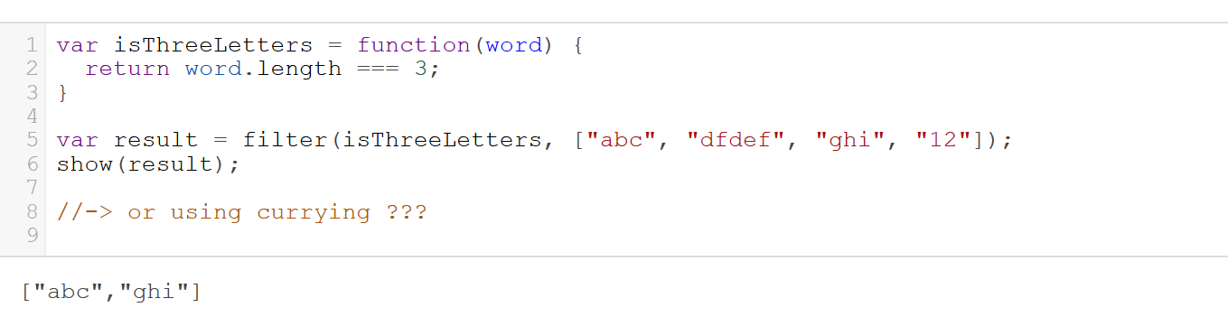
Functional Programming Techniques – Example: Filter
The filter method transforms an array by applying a predicate function to all of its elements, and building a new array from the elements for which predicate returned true.

Slide 39
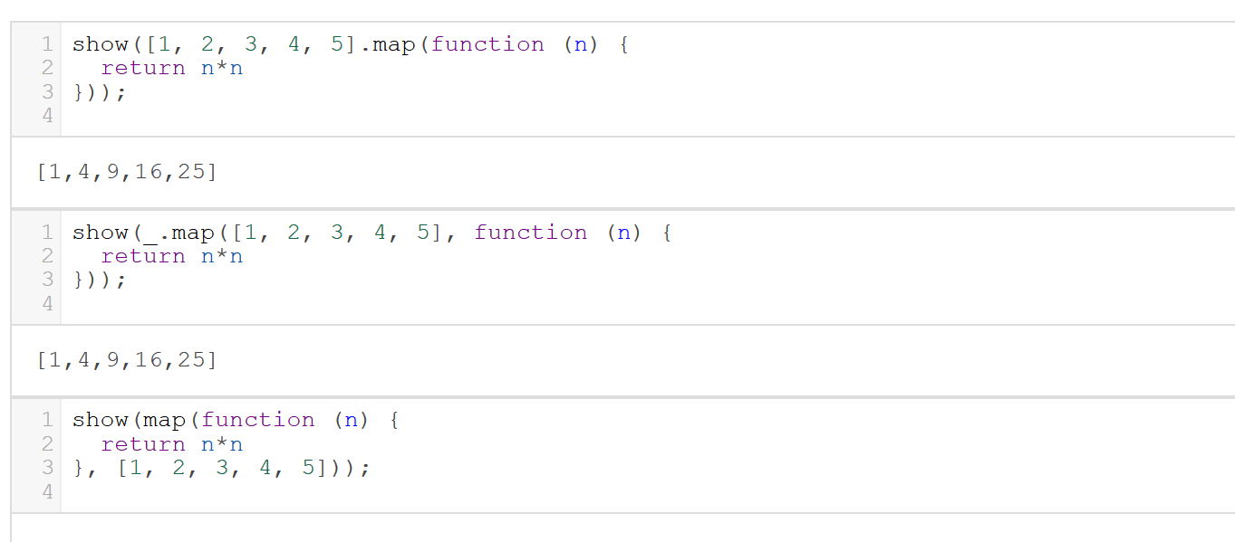
Functional Programming Techniques – Example: Map
Map takes a function as an argument, and applies it to each of the elements of the array, then returns the results in a new array

Slide 40
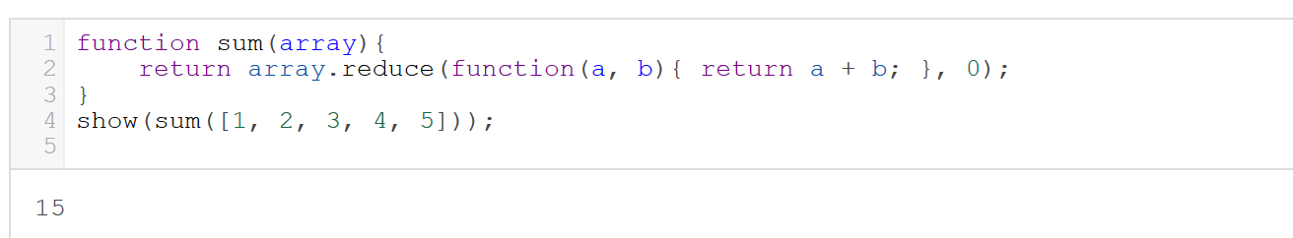
Functional Programming Techniques – Example: Reduce (Fold)
Reduce applies a function against an accumulator and each value of the array (from left-to-right) to reduce it to a single value

Slide 41
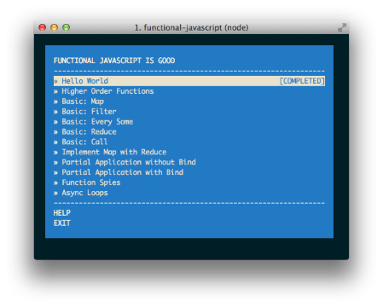
Functional Programming Techniques – Try it yourself
@timoxley: functional-javascript-workshop

Slide 42
Resources
This presentation: Functional Javascript/
Original Deck/CodeMirror plugin by Irene Ros: deck.js-codemirror
Javascript Functional (and not so functional*) programming libraries:
allong.es: http://allong.es/
Ramda: https://github.com/CrossEye/ramda
LambdaJs: https://github.com/loop-recur/lambdajs/
Falktale: http://folktale.github.io/
*Underscore: http://underscorejs.org/
*Lo-Dash: http://lodash.com/
Books on Functional JavaScript
Functional JavaScript, Michael Fogus
Eloquent JavaScript, Marijn Haverbeke
JavaScript Allongé, Reginald Braithwaite

