Slide 1

Automation Project
Sree Lakshmi K Enrolment No : EBEON0623811634

Slide 2
SCOPE OF PROJECT
HackerRank automation project aims to write tests based on keyword-driven testing. HackerRank is a technology-based website that focuses on competitive programming challenges.
In this project we are using keyword-driven testing in four modules of HackerRank website. Signup, login module, request demo and start preparation page.

Slide 3
SELENIUM
Selenium is an open-source suite of tools and libraries aimed at supporting browser automation.
It allows users to test their websites functionally on different browsers. Selenium is a robust open-source framework designed to facilitate the automation of web applications for testing purposes, ensuring software quality through meticulous validation.
TEST NG
TestNG is a testing framework for the Java programming language inspired by JUnit and NUnit. TestNG provides advanced features such as annotations, data-driven testing, test sequencing, and parallel testing to help you organize and execute your Selenium tests more efficiently and effectively.

Slide 4
KEYWORD-DRIVEN TESTING
Build a keyword-driven framework that allows testers to write tests using simple keywords and parameters, making test cases more readable and reusable
Keyword Driven Testing is a scripting technique that uses data files to contain the keywords related to the application being tested. These keywords describe the set of actions that is required to perform a specific step.

Slide 5
ADVANTAGES OF KEYWORD-DRIVEN TESTING
It helps to reduce maintenance cost
Avoids duplicated specifications
Achieve more testing with less or same effort
Greater reuse of function scripting
Better testing support and portability It allows functional testers to plan test automation before the application is ready
Tests can be developed without programming knowledge
It is not dependent on a specific programming language or tool
Compatible with any automation tools available in the market

Slide 6
DISADVANTAGES OF KEYWORD-DRIVEN TESTING
Quality of the test is depended on the automation skills of the Implementing team
Data validation is a time-consuming task when testing large amount of data.
Maintenance is a big issue as large amount of coding needed for Data-Driven testing.
High-level technical skills are required. A tester may have to learn an entirely new scripting language.
There will be more documentation. Mostly related to scripts management tests infrastructure and testing results.

Slide 7
LOCATORS USED FOR SIGNUP PAGE
ELEMENT | LOCATOR
USERNAME | ID
EMAIL | ID
PASSWORD | ID
CHECKBOX | NAME
BUTTON | XPATH

Slide 8
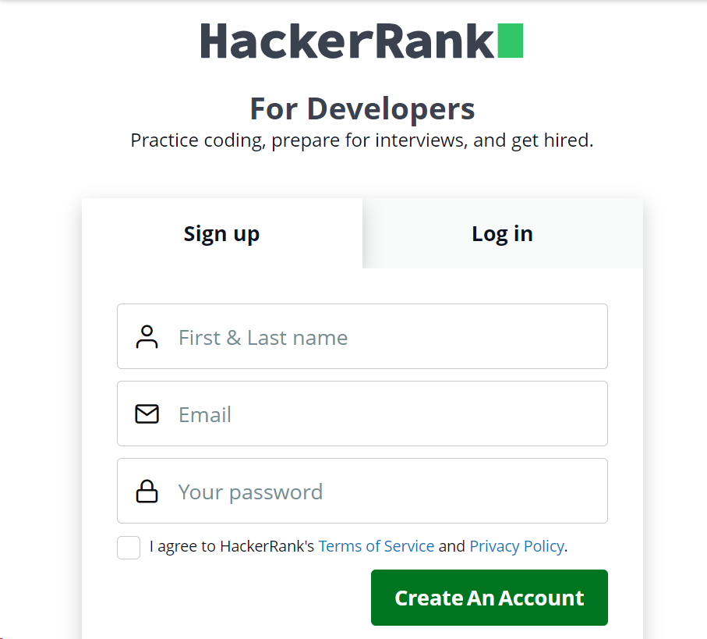
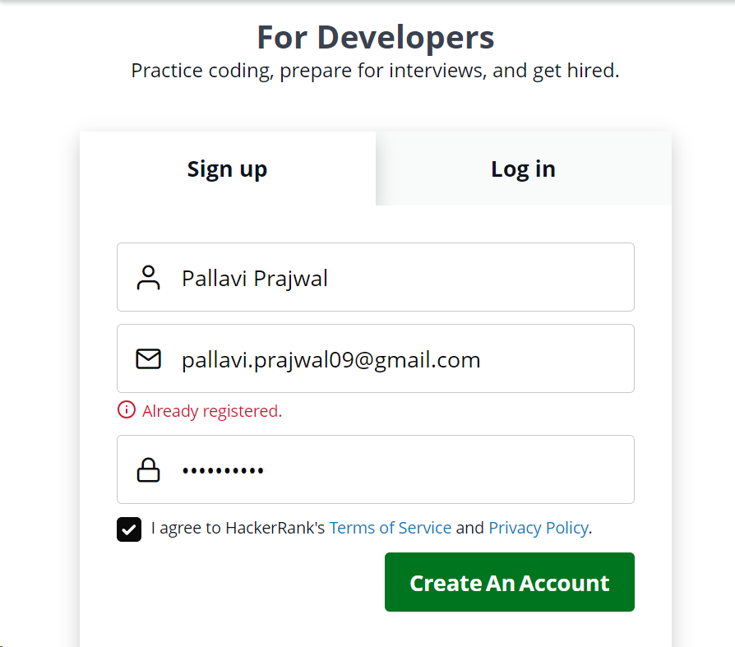
Test Cases for Signup page
HackerRank Signup TestCase 1

Slide 9
LOCATORS USED FOR LOGIN PAGE
ELEMENT | LOCATOR
EMAIL | NAME
PASSWORD | NAME
CHECKBOX | CLASS NAME
BUTTON | XPATH
ASSERT TITLE | XPATH

Slide 10
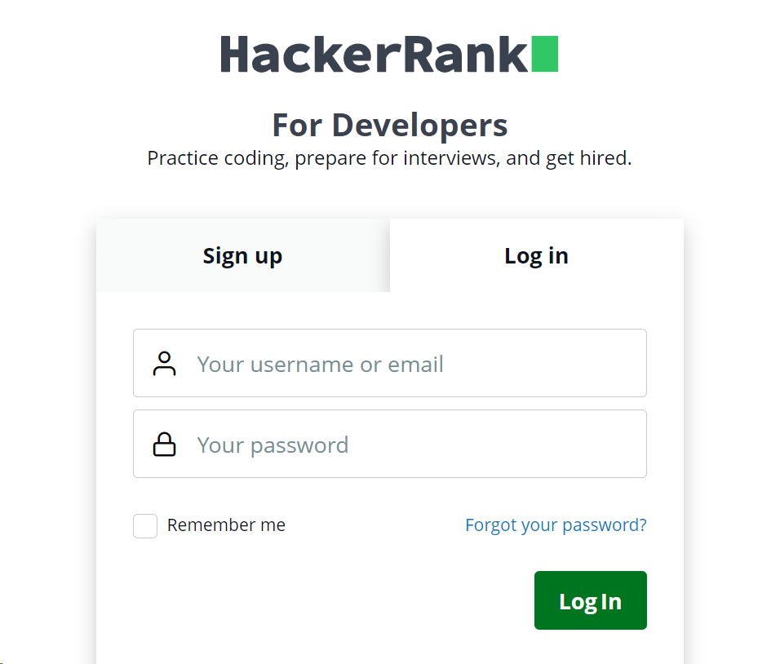
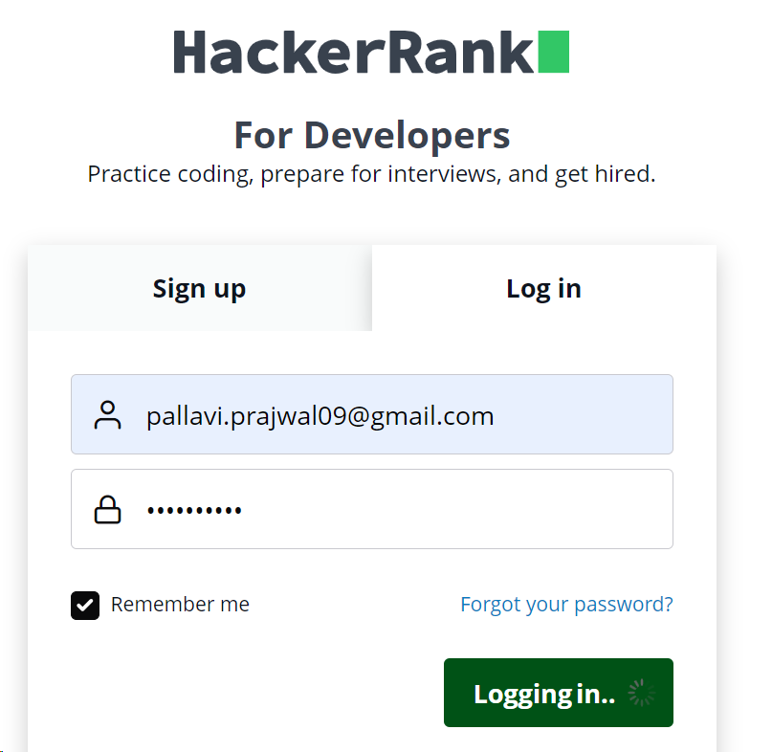
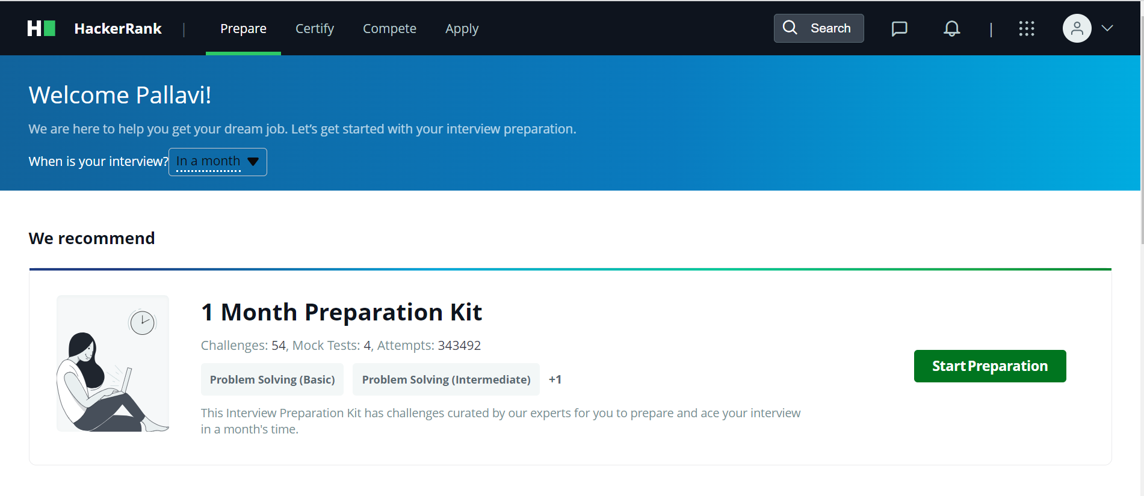
Test Cases for Log In page
HackerRank Log In TestCase 1

Slide 11
LOCATORS USED FOR REQUEST DEMO PAGE
ELEMENT | LOCATOR
FIRST NAME | ID
LAST NAME | ID
EMAIL | ID
COMPANY | ID
TITLE | ID
SIZE | ID
PHONE | ID
COUNTRY | ID
BUTTON | CLASS NAME
ASSERT TITLE | XPATH

Slide 12
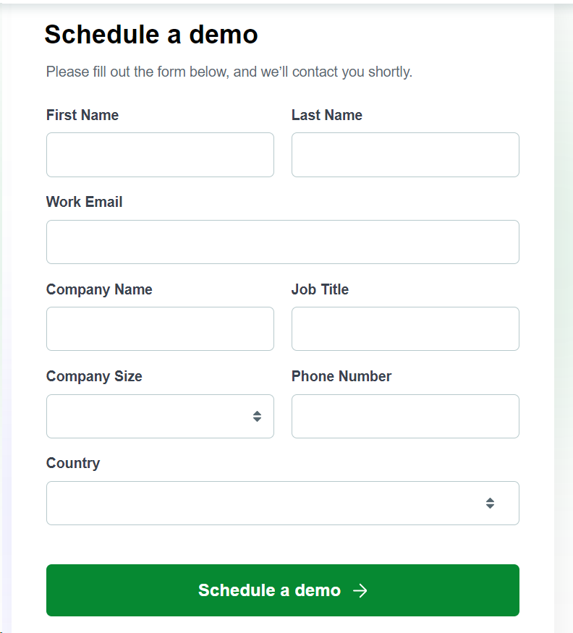
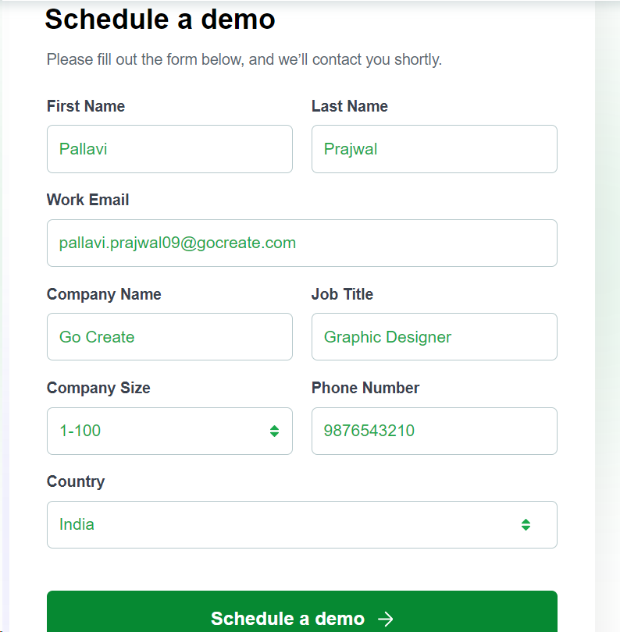
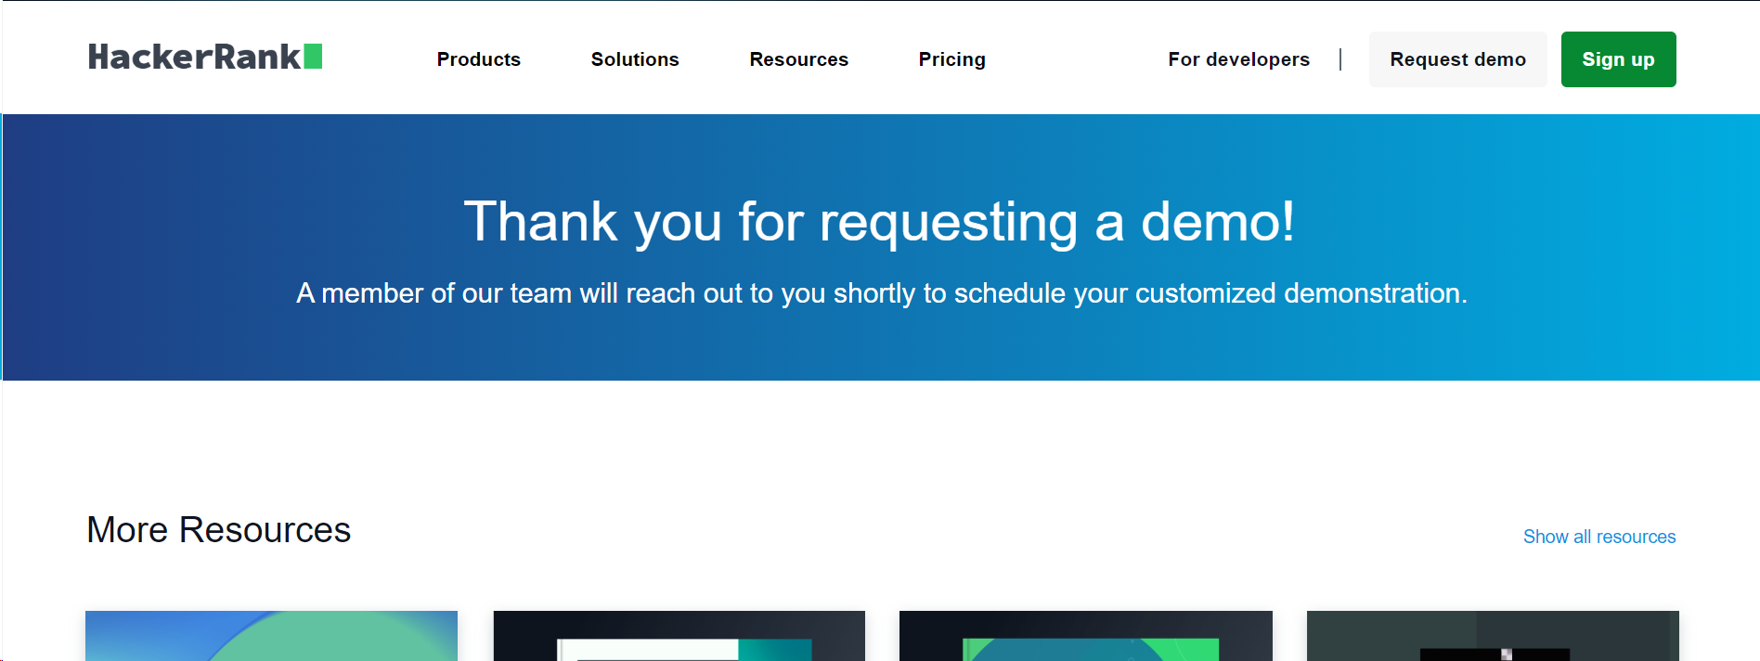
Test Cases for Request Demo page
HackerRank Request Demo TestCase 1

Slide 13
LOCATORS USED FOR START PREPARATION PAGE
ELEMENT | LOCATOR
SOLVE CHALLENGE | ID
LOGIN TAB | ID
EMAIL | ID
PASSWORD | ID
LOGIN BUTTON | XPATH
LEADER BOARD | XPATH
ASSERT TITLE | XPATH

Slide 14
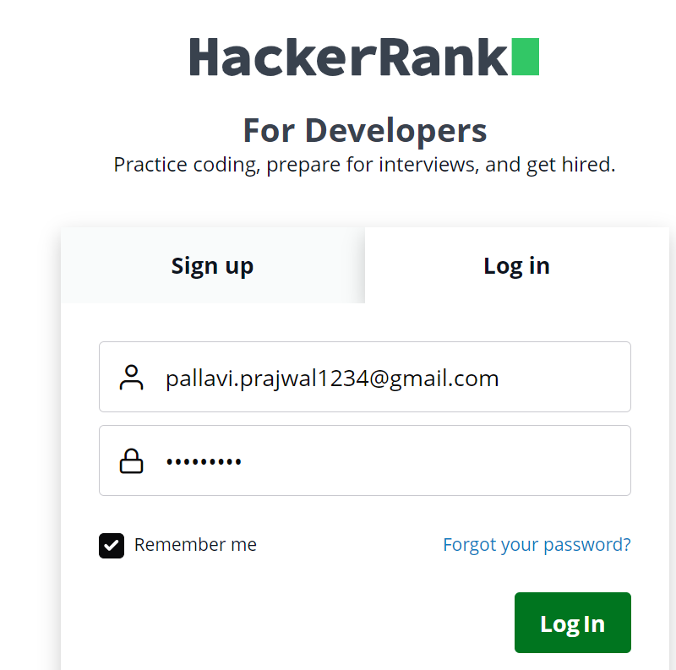
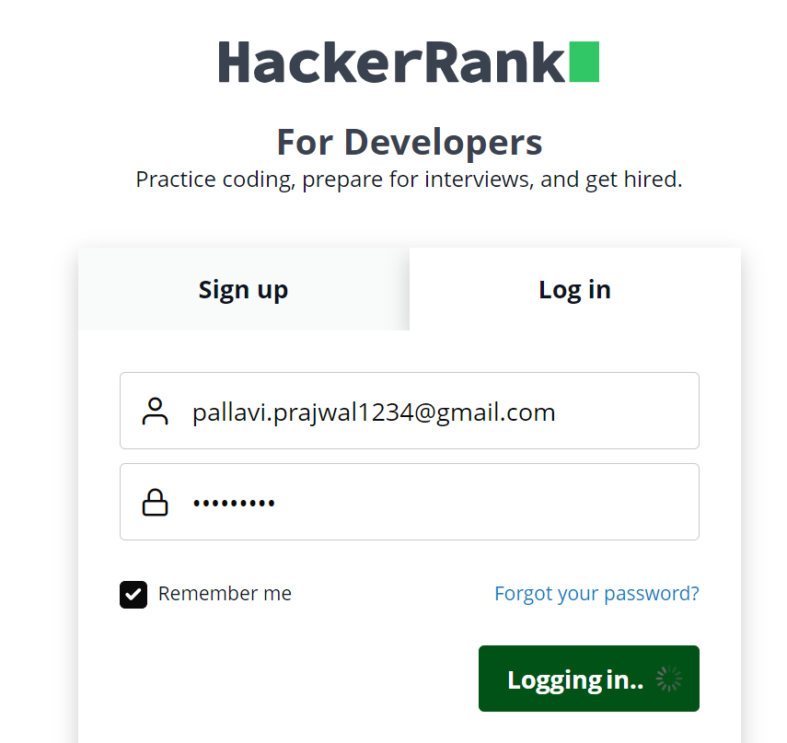

Test Cases for Log In page
HackerRank Log In TestCase 1

Slide 15
SUMMARY
A keyword-driven testing is a scripting technique that uses data files to contain the keywords related to the application being tested
A keyword-driven testing usually performed by automated testing.
Tests can be developed without programming knowledge
Tests are compatible with any automation tools available in the market

Slide 16
THANK YOU

