Slide 1
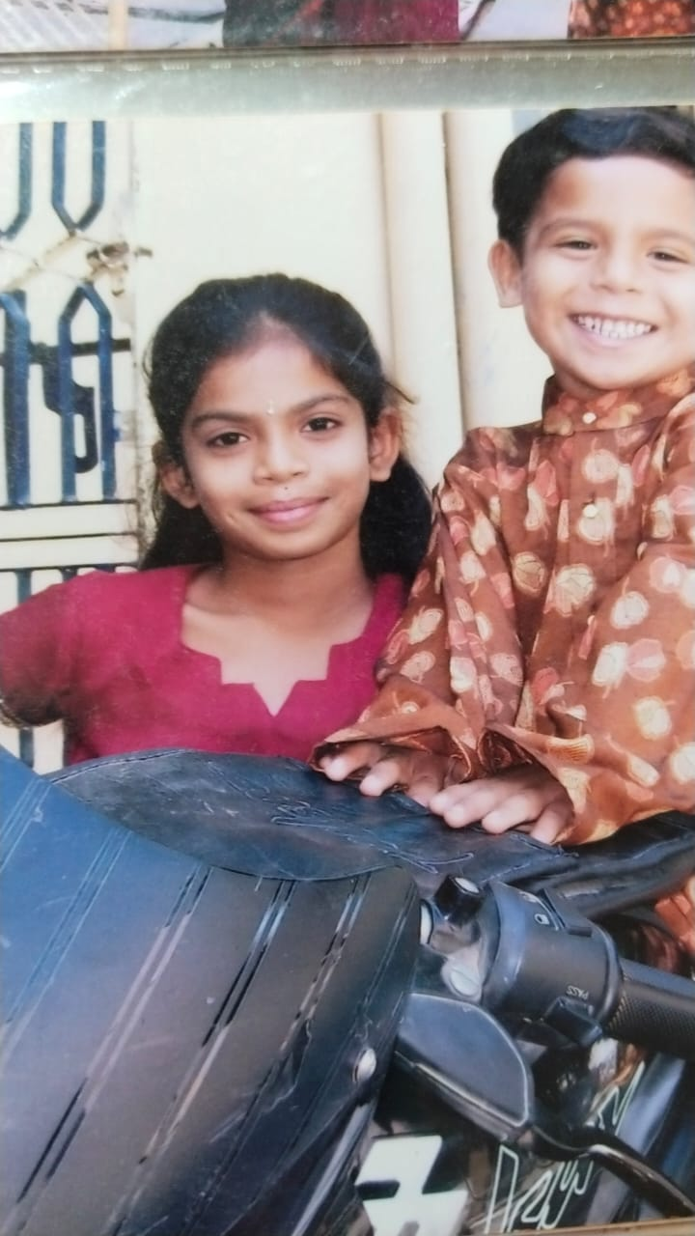
It’s the 2nd birthday of my brother. I acted as a toy for him.

