Slide 1
Edge AI: Enabling Real-Time Intelligence on IoT Devices (PPT Content)
Seminar Title: Edge AI: Enabling Real-Time Intelligence on IoT Devices
Student Name: Gandrakoti Dinesh
Roll Number: 22EG105N21
Branch & Year: CSE - 4th year
Guide Name, Designation: Dr .N.Swapna Goud, Assistant Professor
Date: 18-04-2026

Slide 2
Introduction
Introduction:
Edge AI combines Artificial Intelligence with Edge Computing
Processes data closer to IoT devices instead of cloud
Reduces latency and improves response time
Enables real-time decision making
Used in smart devices like cameras, sensors, wearables
Supports intelligent automation in modern systems

Slide 3
Introduction :
IoT devices generate huge amounts of data
Cloud processing causes delay and bandwidth issues
Edge AI solves these problems by local processing
AI models run directly on edge devices
Improves efficiency and system performance
Essential for real-time applications

Slide 4
Problem Statement
Traditional IoT systems rely on cloud computing for data processing, which leads to high latency, bandwidth consumption, and security risks. Real-time applications require faster response and local intelligence. Hence, there is a need for Edge AI systems that can process data locally and provide real-time decision-making.

Slide 5
Literature Survey
Paper | Main Focus | Technologies Used | Strengths | Limitations
Shi et al., 2016 | Edge computing concept | Edge + IoT | Reduces latency | Limited AI Integration
Deng et al.,2020 | Edge Intelligence | AI + Edge | Real-time processing | Resource constraints
Zhou et al., 2019 | Edge AL Systems | ML + IoT | Efficient analytics | High complexity
Li et al., 2021 | Edge AI in IoT applications | AL + Edge + IoT | Improves efficiency and reduces cloud dependency | Limited scalability and device constraints

Slide 6
Existing System
Cloud-based IoT architecture
Data sent to centralized servers
Processing done in cloud
Devices act as data collectors
Requires constant internet connectivity
High dependency on cloud infrastructure

Slide 7
Existing System
Limitations
High latency in data processing
Increased bandwidth usage
Data privacy and security risks
Network dependency issues
Slow response for real-time systems
High operational costs

Slide 8
Proposed System
Edge AI-based architecture
AI models deployed on edge devices
Local data processing and analysis
Reduced cloud dependency
Real-time decision making
Efficient and intelligent system

Slide 9
Working Principle
Phase 1: Data Collection
IoT devices collect real-time data
Phase 4: Decision Making
Instant results and actions generated
Phase 2: Data Processing
Edge devices preprocess and filter data
Phase 5: Cloud Support
Important data sent to cloud
Phase 3: AI Analysis
AI models analyze data locally

Slide 10
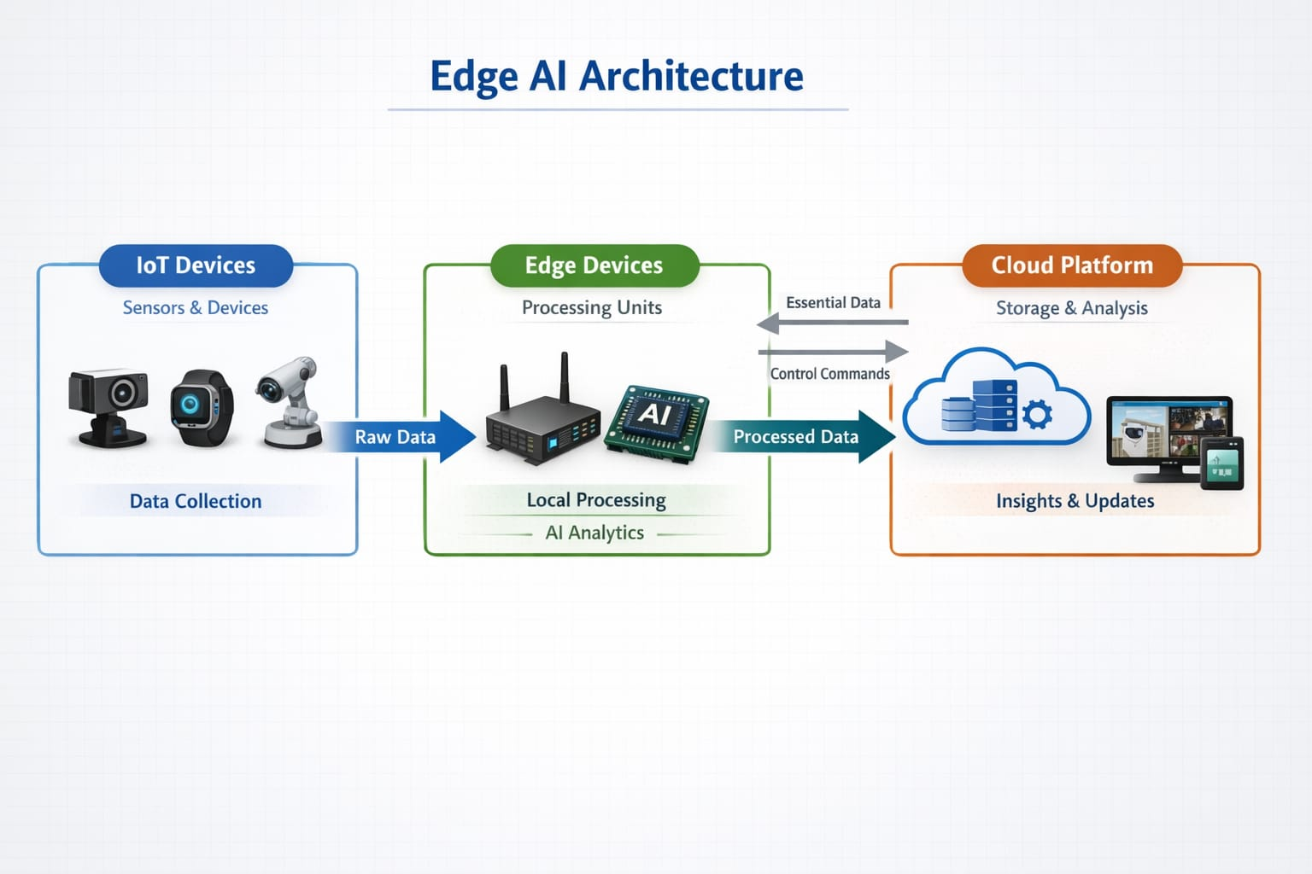
Architecture Diagram
IoT Devices (Sensors)
Edge Devices (Processing Units)
Communication Network
Cloud Platform
User Applications

Slide 11
TECHNOLOGY
Edge Computing
Artificial Intelligence & Machine Learning
IoT Architecture
Edge Hardware (GPU, NPU)
Communication Technologies (5G, Wi-Fi)
Data Analytics* Security Mechanisms

Slide 12
Software Tools
Python
TensorFlow Lite
OpenCV
Edge Impulse
Visual Studio Code / PyCharm
Docker* MQTT

Slide 13
Advantages
Real-time processing
Reduced latency
Lower bandwidth usage
Improved data privacy
Faster response time
High scalability
Reliable system performance

Slide 14
Disadvantages
Limited processing power
Energy consumption issues
Model optimization complexity
Higher initial cost
Security risks at device level
Maintenance challenges

Slide 15
Applications
Smart cities
Healthcare monitoring
Autonomous vehicles
Industrial automation
Smart surveillance
Agriculture (smart farming)
Home automation

Slide 16
Future Scope
Integration with 5G/6G
TinyML for low-power devices
Federated learning for privacy
Advanced AI hardware
Autonomous edge systems
Smart city integration

Slide 17
Conclusion
References
Edge AI enables real-time intelligence in IoT systems
Reduces latency and improves efficiency
Enhances privacy and reduces cloud dependency
Supports multiple real-world applications
Future technology for smart and intelligent systems
Shi et al., IEEE IoT Journal
Deng et al., IEEE Edge Intelligence
Zhou et al., Edge AI Research
TensorFlow Lite Documentation
NVIDIA Edge AI Platforms

Slide 18



