Slide 1
RT Project 18/19
Ultrasonic 3D measurement
Group-18
Channabasayya.CB(1274194)
Kapula Sahithi Sree Ravali(1274152)
Anish Joys Yesuadimai Michael(1280214)
Ultrasonic 3D measurement - Group 18
Ultrasonic 3D measurement - Group 18
2/5/2019

Slide 2
Agenda
Aim
Principle
Time Diagram
Control Flow
Project plan
Components
1D implementation
2d implementation
3d implementation
Constraints and Enhancements
Demo
Ultrasonic 3D measurement - Group 18
2/5/2019

Slide 3
Ultrasonic 3D measurement
Aim
To find the exact distance between the source and the object using ultrasonic
To track 2D movement of an object using ultrasonic
To track 3D movement of an object using ultrasonic
Ultrasonic 3D measurement - Group 18
Ultrasonic 3D measurement - Group 18
Ultrasonic 3D measurement - Group 18
2/5/2019

Slide 4
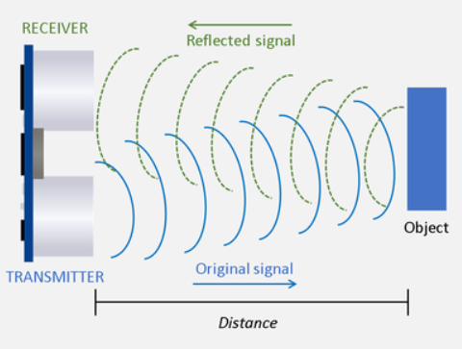
Principle
Ultrasonic Sensor used in our project is HC- SR04
Pins in HC – SR04
VCC - +5 V supply
TRIG – Trigger input of sensor. Arduino applies 10 us trigger pulse to the HC-SR04 ultrasonic module.
ECHO – Echo output of sensor. Arduino reads this pin to detect the obstacle or to find the distance.
GND – Ground
Fig. 1. Ultrasonic senor principle
Ultrasonic sensor transmitter generates ultrasound (ultrasonic) waves.
When this wave hits the object it reflects as echo which is sensed by the receiver of ultrasonic sensor
The distance calculated by measuring the time required for the echo to reach to the receiver.
Ultrasonic 3D measurement - Group 18
2/5/2019

Slide 5
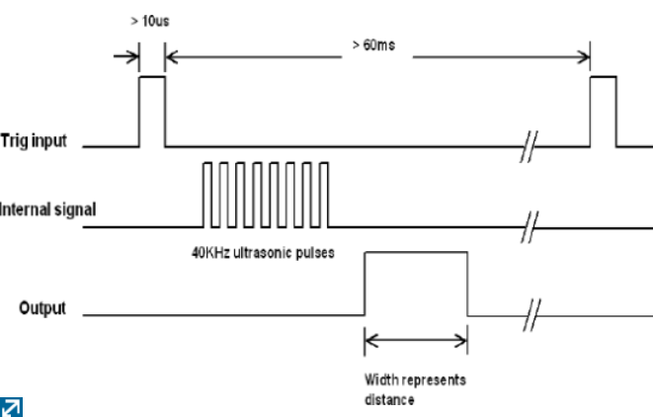

Time diagram (HC-SR04)
Fig. 2. Time diagram of the ultrasonic sensor (HC-SR04)
Distance = Time * Speed
The speed of sound waves is 343 m/s.
Distance =
Ultrasonic 3D measurement - Group 18
Ultrasonic 3D measurement - Group 18
2/5/2019

Slide 6
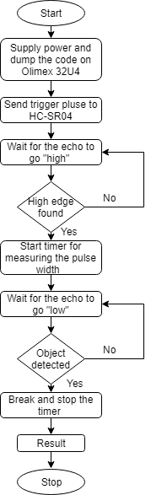
Control Flow
Ultrasonic 3D measurement - Group 18
2/5/2019
Notes:
Aaa

Slide 7
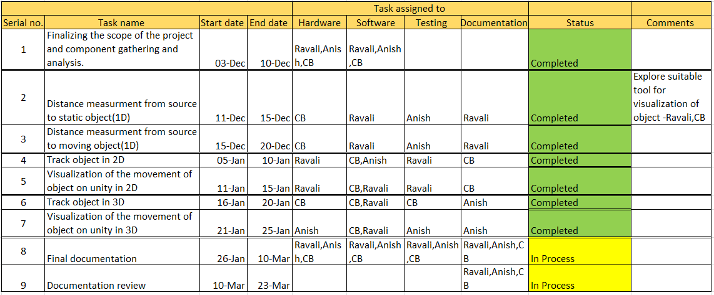
Project plan
Project plan
Ultrasonic 3D measurement - Group 18
Ultrasonic 3D measurement - Group 18
Ultrasonic 3D measurement - Group 18
2/5/2019

Slide 8
Components
Hardware
  HC-SR04 – 3
    Specifications
    Power supply: 5V DC
    Quiescent current: <2mA
    Effectual angle: <15°
    Ranging distance: 2cm – 500 cm
    Resolution: 1 cm
    Ultrasonic Frequency: 40k Hz
  Arduino Olimex 32U4 - 1
  Bread Board
  Connecting wires
Software and IDE used
  C, Arduino IDE
  Unity
  C#, Visual Studio
Documentation
  Latex
Ultrasonic 3D measurement - Group 18
Ultrasonic 3D measurement - Group 18
Ultrasonic 3D measurement - Group 18
2/5/2019

Slide 9
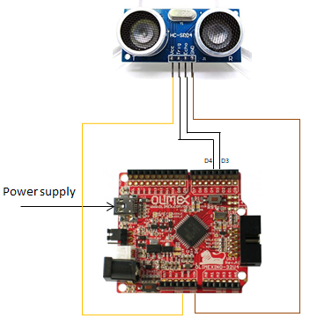
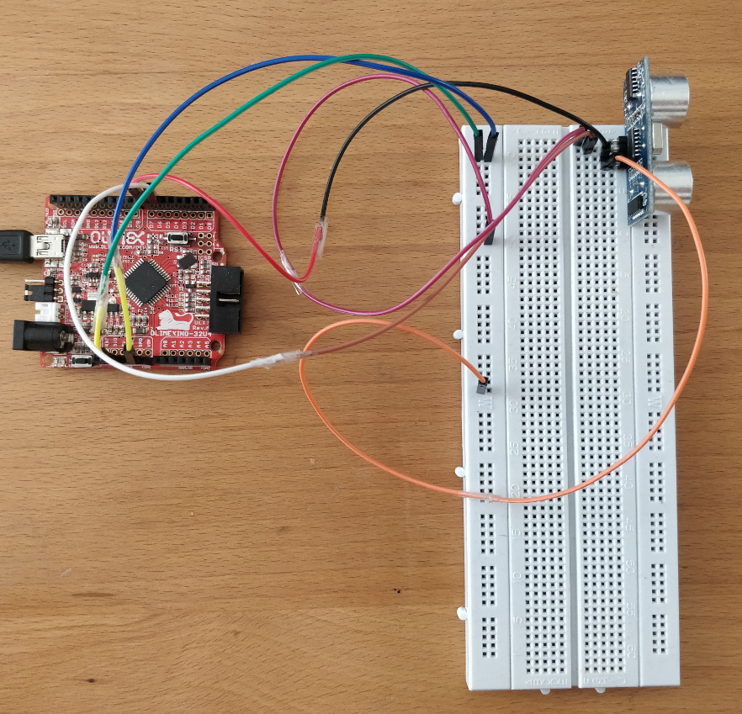
1D Implementation
Fig. 3. 1d circuit connections
Fig. 4. 1d working model
Ultrasonic 3D measurement - Group 18
Ultrasonic 3D measurement - Group 18
2/5/2019

Slide 10
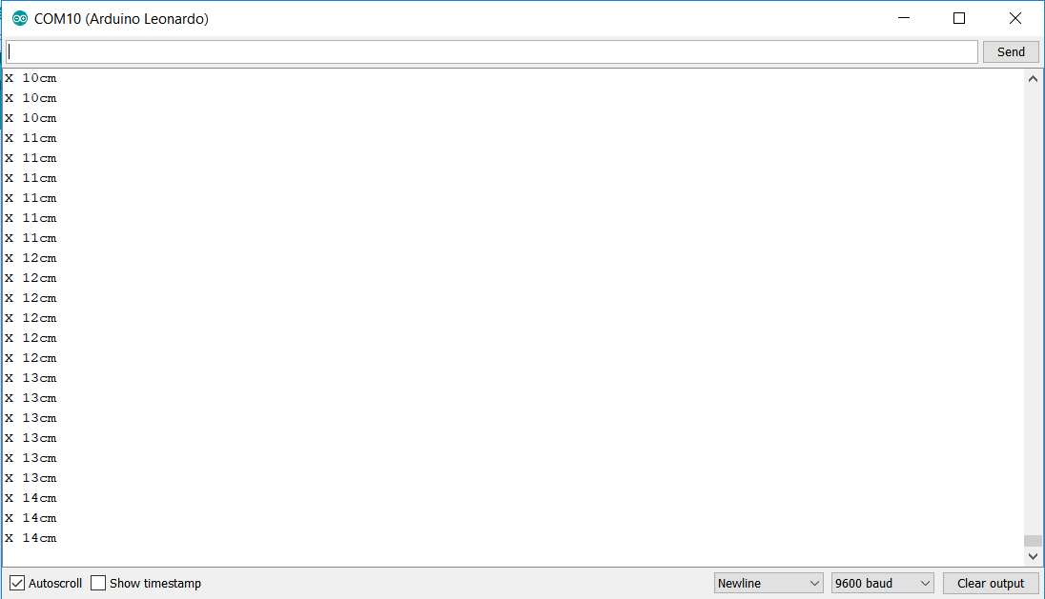
1D Output
Fig. 5. 1d output
Ultrasonic 3D measurement - Group 18
2/5/2019

Slide 11
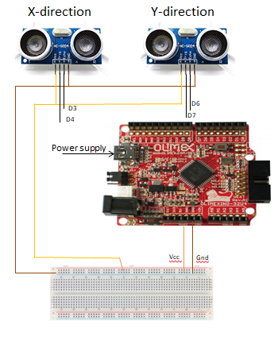
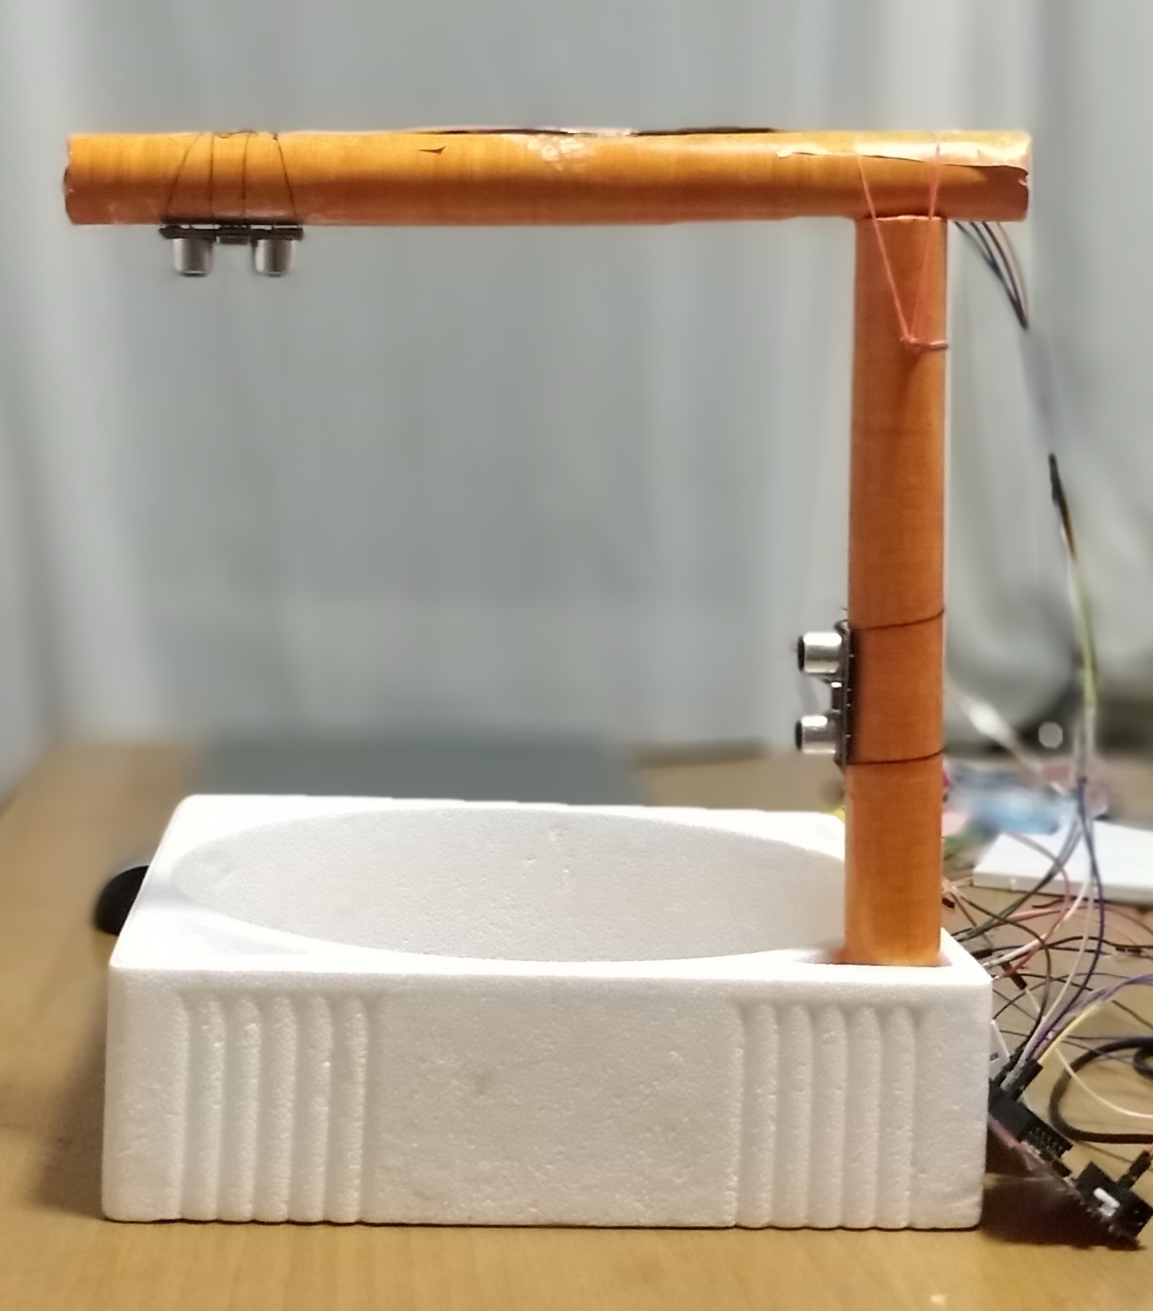
2D Implementation
Fig. 6. 2d circuit connections
Fig. 7. 2d working model
Ultrasonic 3D measurement - Group 18
Ultrasonic 3D measurement - Group 18
2/5/2019

Slide 12
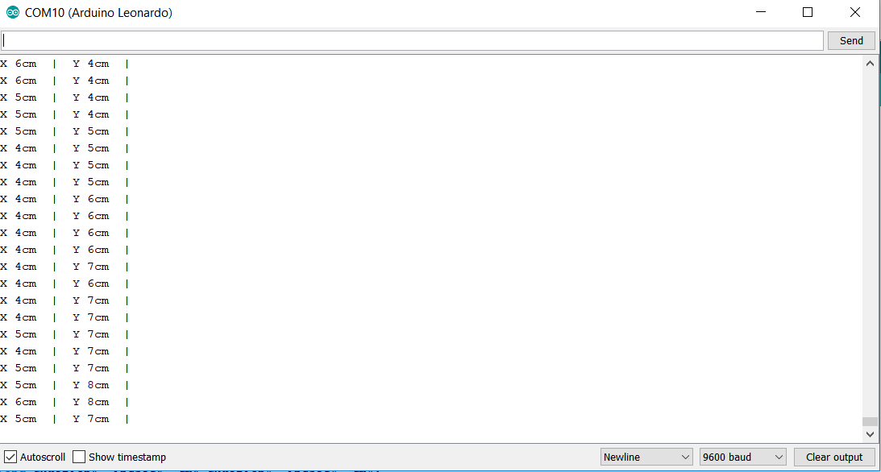
2D Output
Fig. 8. 2d output
Ultrasonic 3D measurement - Group 18
2/5/2019

Slide 13
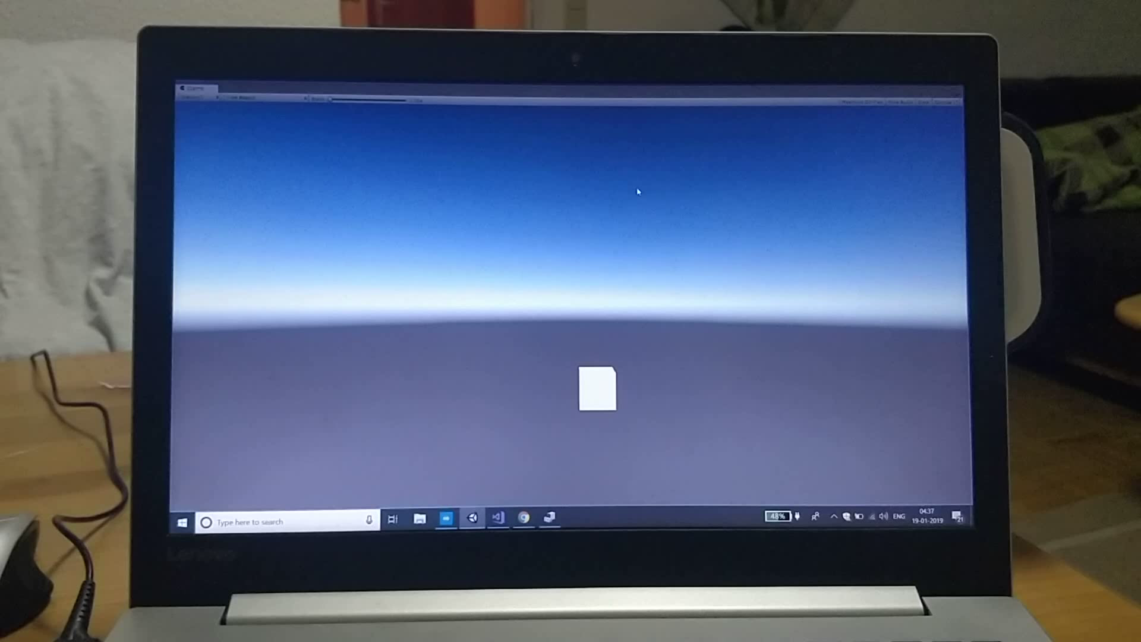
2D Visualization
Ultrasonic 3D measurement - Group 18
2/5/2019

Slide 14
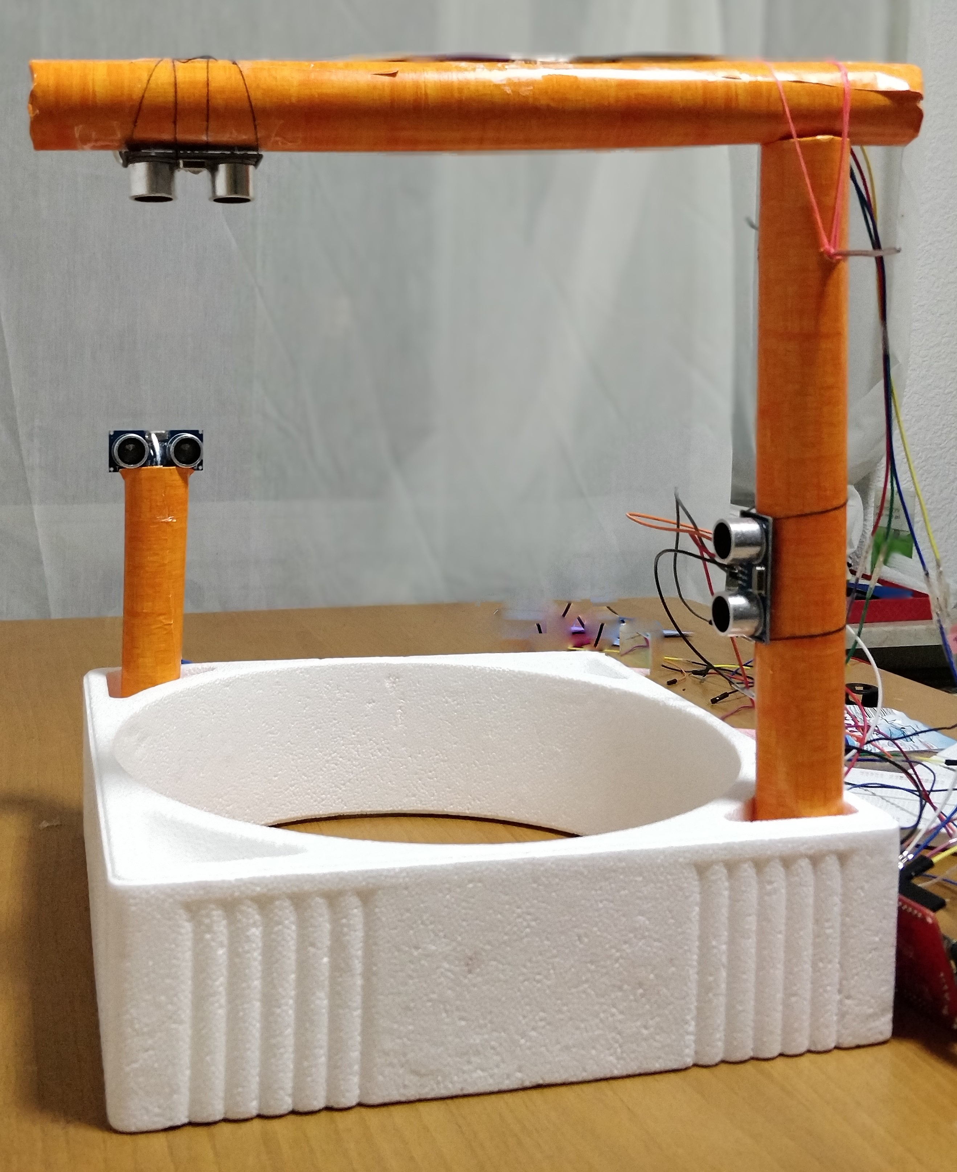
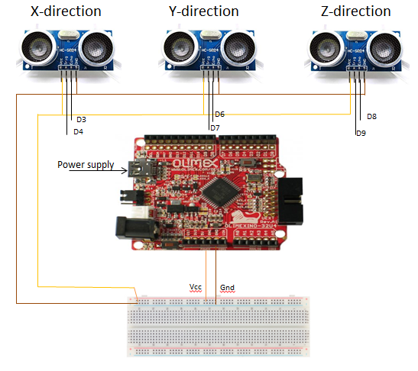
3D Implementation
Fig. 9. 3d circuit connections
Fig. 10. 3d working model
Ultrasonic 3D measurement - Group 18
2/5/2019

Slide 15
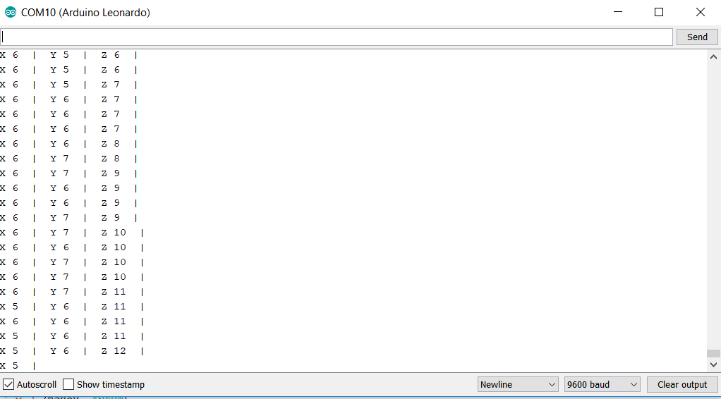
3D Output
Fig. 11. 3d output
Ultrasonic 3D measurement - Group 18
2/5/2019

Slide 16
Constraints
Small objects cant be sensed because eeffectual angle is less than 15 degrees
Enhancement
Increase the number of ultrasonic sensors in all direction to get accurate readings of smaller object.
Explore on different ultrasonic sensors with high range and accuracy
Ultrasonic 3D measurement - Group 18
Ultrasonic 3D measurement - Group 18
2/5/2019

Slide 17
Reference
https://ieeexplore.ieee.org/document/8551067
https://ieeexplore.ieee.org/document/7781400
Ultrasonic 3D measurement - Group 18
Ultrasonic 3D measurement - Group 18
2/5/2019

Slide 18

Ultrasonic 3D measurement - Group 18
2/5/2019

Slide 19
Thank you!!
Ultrasonic 3D measurement - Group 18
Ultrasonic 3D measurement - Group 18
2/5/2019

