Slide 1
Data Breach
Team:
Sree Vandana | Swetha

Slide 2
About Project & Objective
We did an implementation project. Our goal was to built a model that could classify if a credit card transaction is fraudulent or not. For this we used machine learning algorithms.
Our main objective is to focus our attention on identifying whether a breach occurred or not.
“It’s important to identify a Breach in early stages, as the damaging effect increase as the time to identify them increase”

Slide 3

Identifying a Breach is an Important Step
“Prevention is better than cure”. But data breaches are something unavoidable, even the most secured networks are hacked. Hackers are finding new sophisticated ways to breach the network and steal the data. In this case we say, making everything ready for treatment is a smart move.

Slide 4
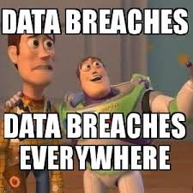
Commonality of Data breaches
We, are surrounded by data breaches. And we might be a victim of one and not even know about it. And this is more scary to not even realise what is happened to us
Data breaches are more common than we think they are.
“One massive hack after another,” this statement would probably best describe what’s happening around.

Slide 5
The Breach Collection Of 2020

Slide 6
Health Share of Oregon
November 18, 2019
February 13, 2020: The theft of an employee laptop from GridWorks IC, a third-party vendor of Health Share of Oregon, has exposed the personal and medical information of 654,000 members. The Health Share of Oregon data breach disclosed sensitive data, including names, addresses, phone numbers, dates of birth, Social Security numbers, and Medicaid ID numbers.

Slide 7
T-Mobile
March 5, 2020: An one million number of customers’ sensitive information was accessed through a T‑Mobile employee email account after a malicious attack of a third-party email vendor. The personal information of T-Mobile customers accessed includes names and addresses, Social Security numbers, financial account information, and government identification numbers, as well as phone numbers, billing and account information, and rate plans and features.

Slide 8
zoom
April 14, 2020: The credentials of over 500,000 Zoom teleconferencing accounts were found for sale on the dark web and hacker forums for as little as $.02. Email addresses, passwords, personal meeting URLs, and host keys are said to be collected through a credential stuffing attack.

Slide 9
Effects Of Data Breach.

Slide 10
Impact
The impact of breach currently is much more damaging when compared to breaches previously.
Now a single breach can affect millions, even billions of people and multiple organisations.
Whenever a breach occurs, not only one individual is affected. Infact every entity surrounding that data will be affected which includes the individual to whom the data belongs, the organisation which stores the data, the third-part vendors or company partners etc.

Slide 11
Identifying The Breach

Slide 12
Its Difficult
The effects of data breach can be damaging, their impact on victims, their cost, misuse of information and much more.
Which makes it an utmost necessity for us to identify it. But How?
We say a breach occurred, when we know that it occurred. But most of these breaches are unidentified for a long time.
And at the time of discovery of these breaches the damages have already happened.

Slide 13
All the breaches we mentioned or appeared in the news are recorded breaches.
There are many breaches which are unidentified and unrecorded (unknowingly or intentional)
So identification of the breaches becomes important. A tool is required to reduce the damaging effects of a breach. (might not prevent a breach from happening. But could reduce the after effects.)

Slide 14
Credit Card Fraud Detection.
We tried to automate the process of identifying the breach using ML Algorithms.

Slide 15
Overview Of Data Set
The datasets contains credit cards transactions that occurred in two days, which have 492 frauds out of 2,84,807 transactions.
The dataset provided in kaggles are the result of PCA transformation which generated Features V1, V2, … V28 (to protect the original data and the only features which have not been transformed with PCA are 'Time' and 'Amount'. ).

Slide 16
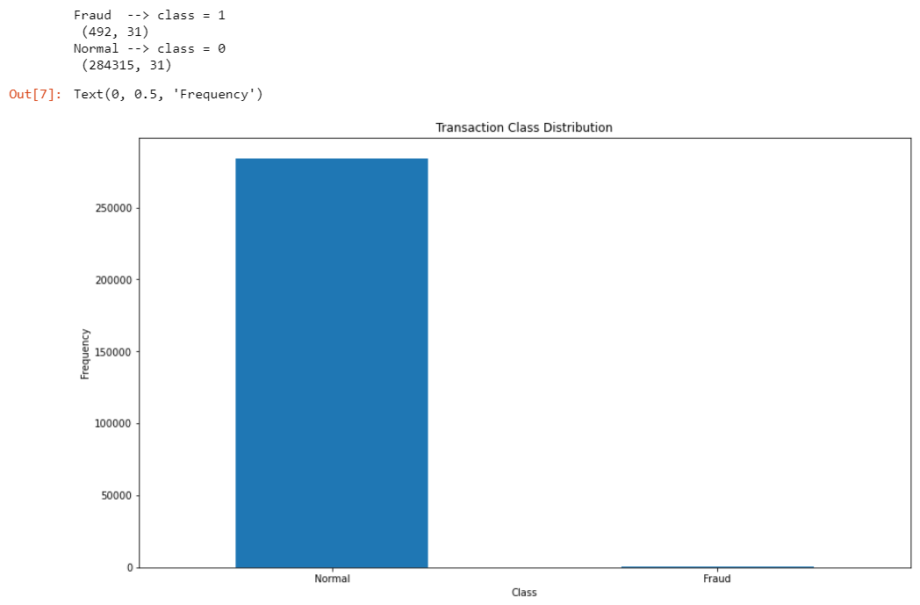

Slide 17
Choosing A Model
SVM (Support vector Machine)
Isolated Forest
Logical Regression

Slide 18

SVM (Support vector Machine)

Slide 19
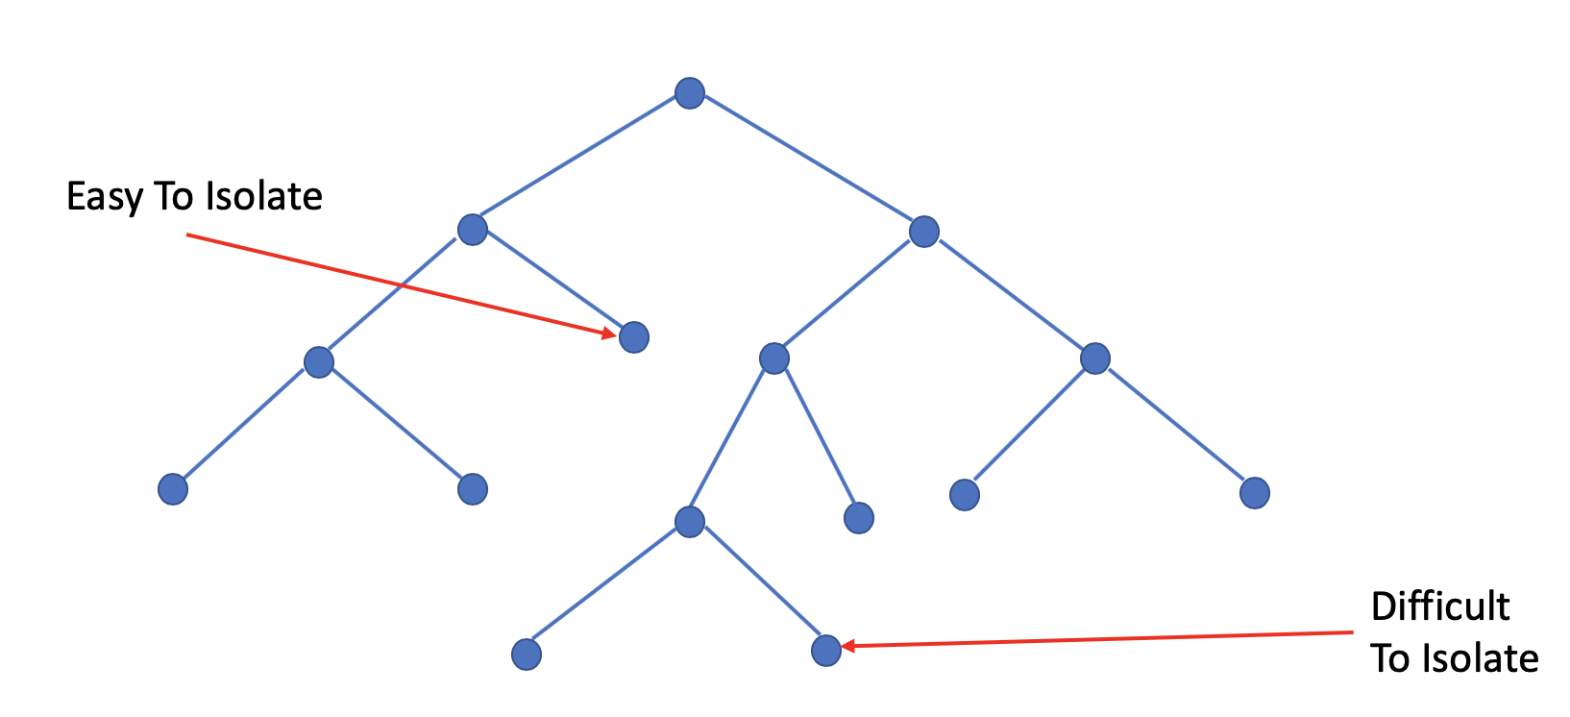
2. Isolated Forest

Slide 20
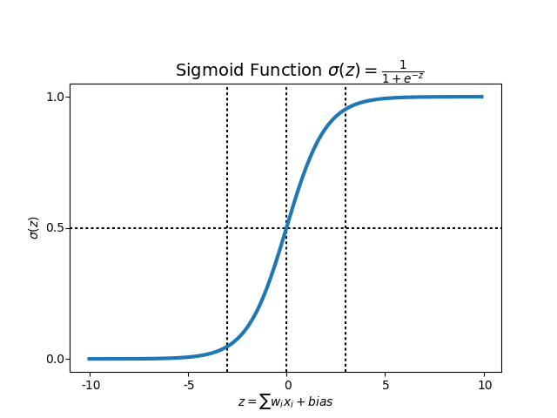
3. Logical Regression

Slide 21
Performance of the models

Slide 22
Methods to Analyze The Performance of the Models
We cannot use Accuracy of the model’s prediction to determine the models performance as this is highly imbalanced data set.
So we are going to use
1.Precision
2. Recall
3. F1 score

Slide 23
Definitions
Precision: Precision is the ratio of correctly predicted positive observations to the total predicted positive observations.
(it is the measure of correctness, measure of correctly identified positive cases from all cases).
Precision = TP/TP+FP
Recall: Recall is the ratio of correctly predicted positive observations to the all observations in actual class
(It is a measure of correctly identified positive cases from all the actual positive cases)
Recall = TP/TP+FN
F1 Score: F1 Score is the weighted average of Precision and Recall.
(it is like a Harmonic mean of precision and recall).
F1 Score = 2*(Recall * Precision) / (Recall + Precision)

Slide 24
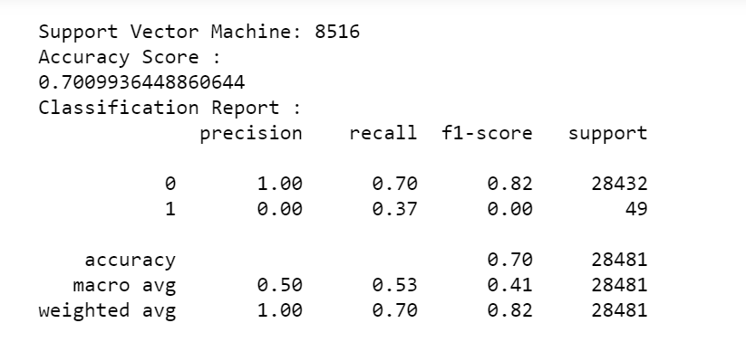
SVM (Support vector Machine)

Slide 25
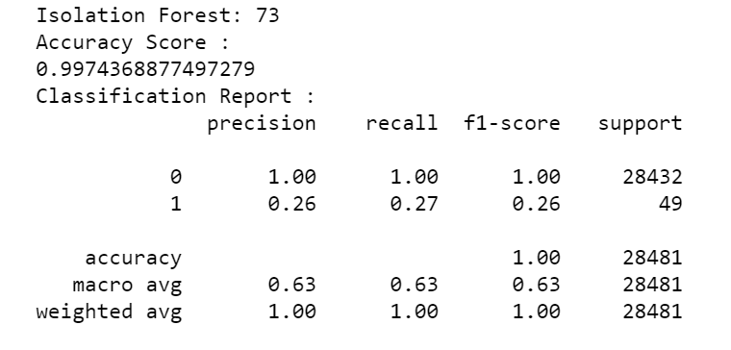
2. Isolated Forest

Slide 26
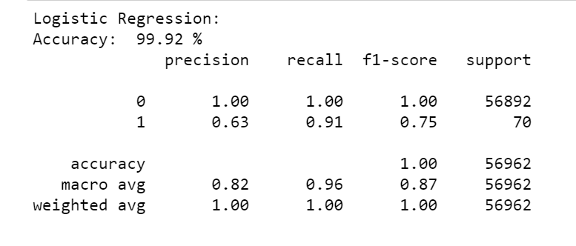
3. Logical Regression

Slide 27
Observations & Conclusion.

Slide 28
Model Conclusion.
In our implementation project we compared, different types of models linear model(SVM), tree Structured model (Isolated Forest) and Mathematical probabilistic model (Logical regression) and analyzed their performance.
We can see that the mathematical probabilistic model worked well when compared to linear and tree structured model.
The linear model (SVM) is expected to fail, as the real world data is non-linear in fashion (mostly).

Slide 29
Reference Links
Project Code:
https://github.com/Sree-Vandana/Data-Science
Research Paper: https://github.com/Sree-Vandana/Data-Science/blob/master/DataBreach-ResearchReport.pdf

Slide 30
Thank You :)

