Slide 1

STOCK MARKET FORECASTING

Slide 2
DEEP LEARNING MODELS
N- BEATS- N-BEATS is a deep learning model designed for time series forecasting that uses stacks of fully-connected layers to generate future values based on past data.
Temporal Convolutional Networks, or TCNs, utilize a specialized form of convolutional neural network architecture that is particularly suited for time-dependent data, ensuring that predictions for a certain time point are only influenced by past data.

Slide 3
Data Preparation
Data Acquisition and Merging
Downloaded historical stock data for Tesla and NASDAQ from Yahoo Finance covering the period from January 2013 to June 2021.
Incorporate significant event impacts into the dataset from a custom Excel source to assess external influences on stock prices.
Merged all datasets on the 'Date' column, ensuring consistency across data sources.

Slide 4
Data Transformation and Scaling
Data Normalization
Extract relevant features: closing prices and event impact values, aligning all data to daily frequency.
Normalize the 'tesla-Close' prices using scaling to aid in model learning efficiency and performance.

Slide 5
For the covariate
To be able to have a covariate that can help us seeing future, I looked into two things:
1. first was different relevant stocks like technology stocks, or EV- cars competitors.
2. Second was looking into historical major events and milestones of Tesla, then filling a chronological table with this information.

Slide 6
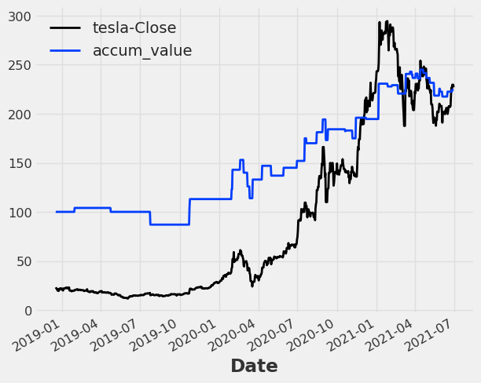
Events
We can see the trend is moving up and down with Tesla-Closing values

Slide 7
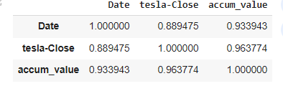
The correlation is very high between target and External features, which makes it a good candidate as a covariate feature
Correlation

Slide 8
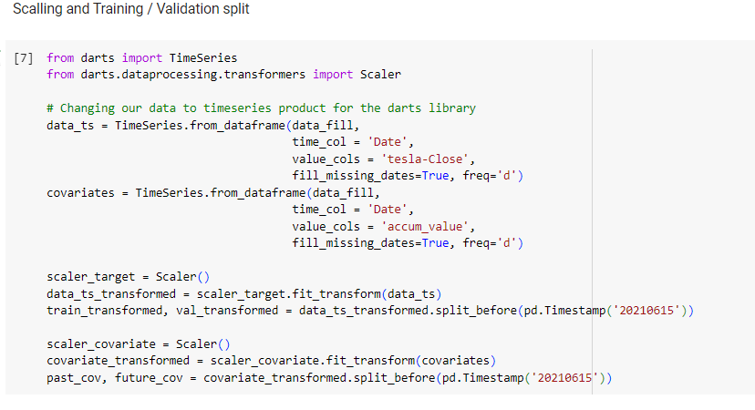
Now we split the data before modelling

Slide 9
Model Configuration and Training
N-BEATS Model Setup
Configure the N-BEATS model with 30 days input chunk, 15 days output, and 100 training epochs.
Train the model using the transformed and scaled time series data.

Slide 10
NBEATS
Deep learning model specifically designed for time series prediction.
Relies on recurrent or convolutional structures.
This decomposes the prediction task into a series of basis expansions, allowing it to capture complex and varied temporal patterns in data.

Slide 11
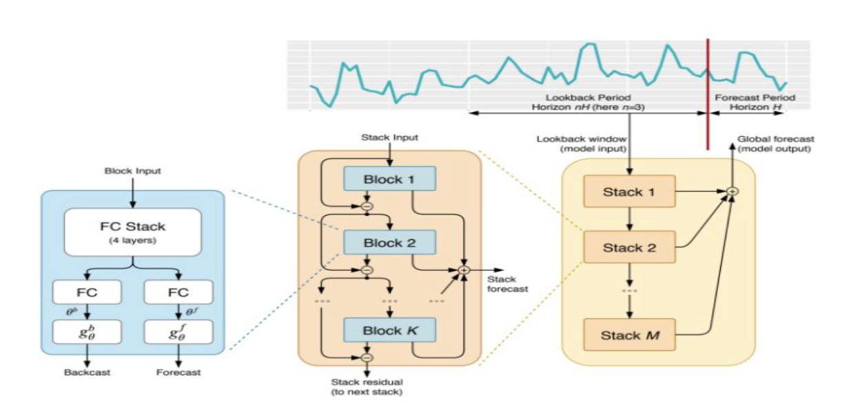
N-BEATS - Neural Basis Expansion Analysis for Time Series Forecasting Architecture
Composed of several blocks stacked together. Each block outputs two things: a forecast for the target time series and a backcast to help refine the inputs for subsequent blocks.
Blocks are organized into stacks, where each stack is trained to capture different types of patterns, such as trend or seasonality. This multi-stack structure allows N-BEATS to effectively handle a wide range of forecasting problems.

Slide 12
Mathematical Framework
BEATS uses a series of basis functions to model the time series data.
Each block in a stack is a mini neural network that predicts parameters of these basis functions
Formulation: "Mathematically, if we denote the input series by
𝑋𝑡​ and the output forecast by 𝑌(𝑡+ℎ) where ℎ is the forecast horizon, N-BEATS models the series with the formula:
Y^(t+h)​=g(Xt​,θ)
g represents the block’s network function, and 𝜃 are the parameters learned during training.
Backcasting: Each block also outputs a backcast, calculated as
X′​t=f(Xt​,θb​)
where 𝑓 is another network within the block, and 𝜃𝑏 are its parameters. The backcast is used to subtract known components of the series, allowing subsequent blocks to focus on residuals or unexplained parts."

Slide 13
NBEATS
Uses a gradient descent optimization method, minimizing a composite loss function over all forecast horizons.
Due to its fully connected nature, the model can be trained efficiently even on large datasets, making it highly scalable and adaptable to various forecasting needs.

Slide 14
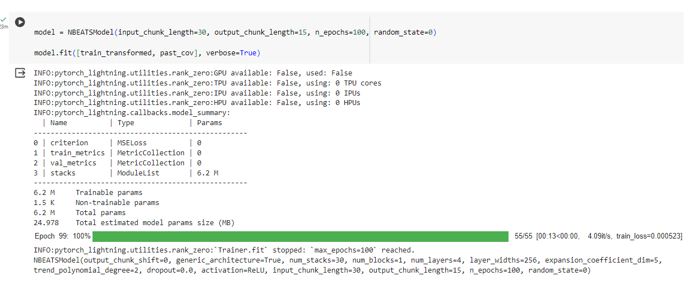
IMPLEMENTATION
-It utilized a generic architecture with 30 input and 15 output chunk lengths, and included configurations such as dropout rate, activation function, and the number of layers and blocks.
-Such a configuration was determined to capture the time dependencies and patterns in the Tesla stock price data effectively, considering both historical values and external factors.

Slide 15
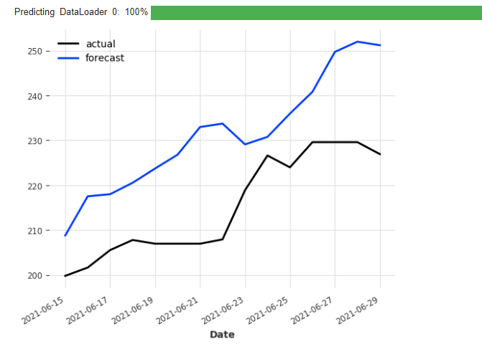
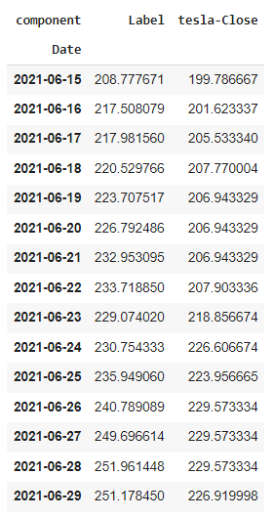

PREDICTED VALUES
ACTUAL VS PREDICTED
METRICS

Slide 16
Temporal Convolutional Networks, or simply TCN, is a variation of Convolutional Neural Networks for sequence modelling tasks, by combining aspects of RNN and CNN architectures.
Temporal Convolutional Networks
TCN is based upon two principles: 1. he fact that the network produces an output of the same length as the input, and
2. the fact that there can be no leakage from the future into the past. To accomplish the first point, the TCN uses a 1D fully-convolutional network(FCN) architecture.

Slide 17
Mathematically
Y^t​=F(Xt−L:t​,Θf​)
Mathematically, a TCN can be viewed as a function that maps an input sequence to an output sequence of the same length. The dilated convolutions enable this mapping to consider a wide context of inputs for each output element."
TCNs are often trained with a likelihood-based approach, which in this case, uses a Gaussian likelihood function. This means we’re not just predicting a single future value, but a distribution of possible future values, giving us a measure of the uncertainty in our predictions.

Slide 18
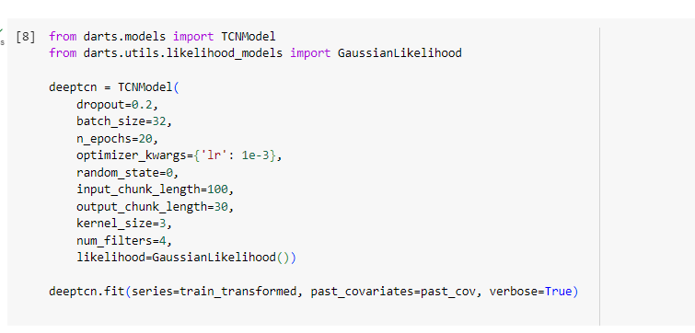
IMPLEMENTATION

Slide 19
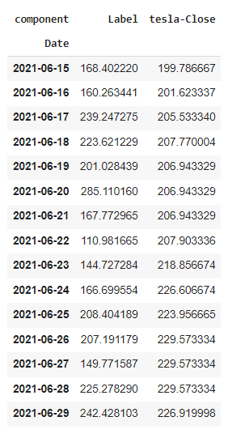
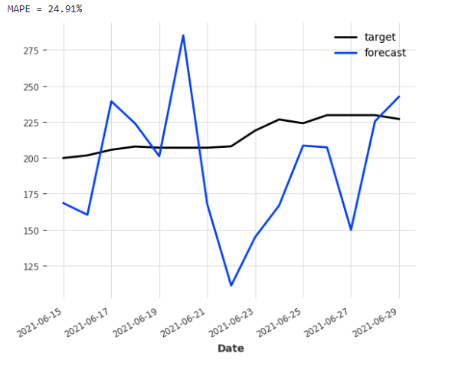

ACTUAL VS PREDICTED
FORECASTED VALUES
METRICS

Slide 20
THANK YOU

