Slide 1
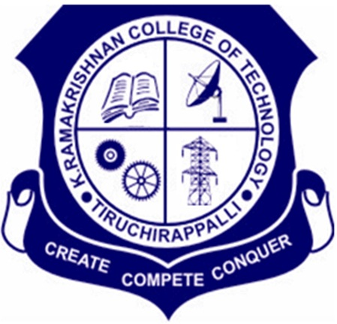
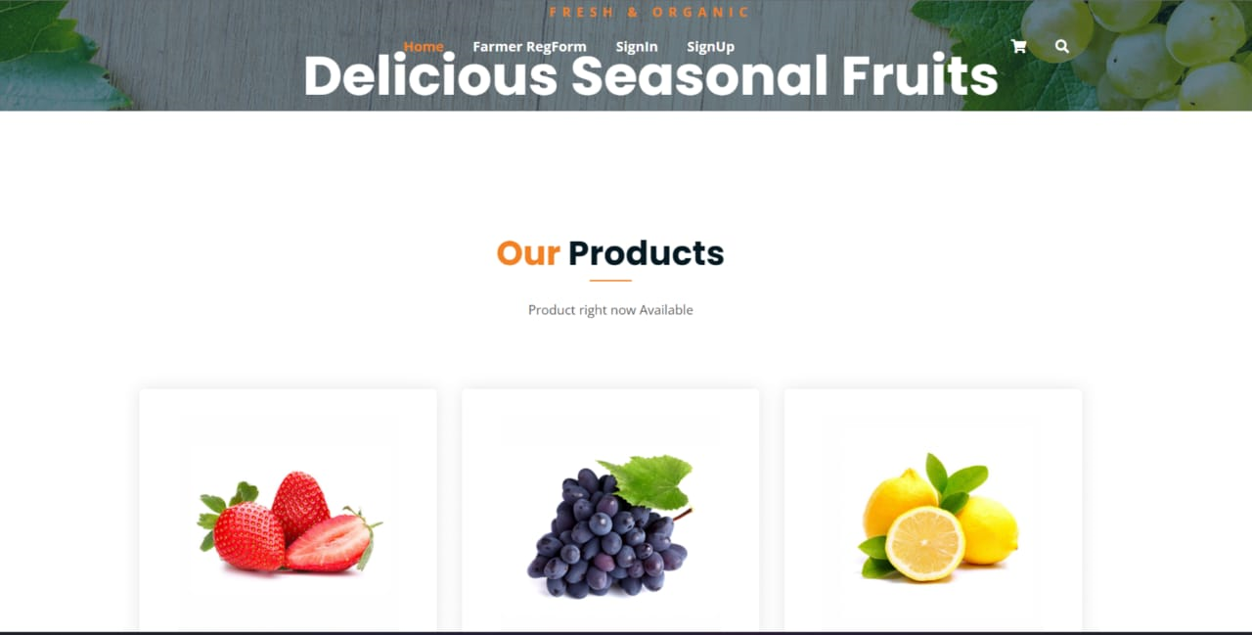
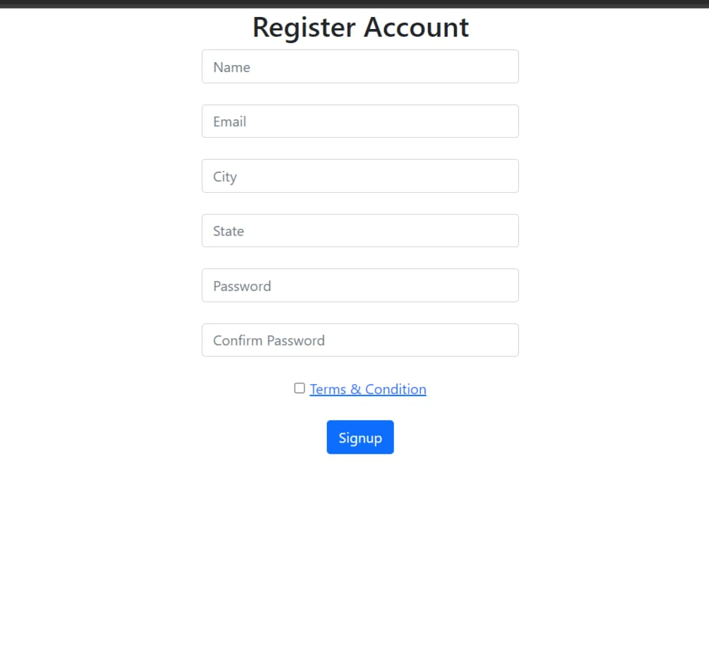
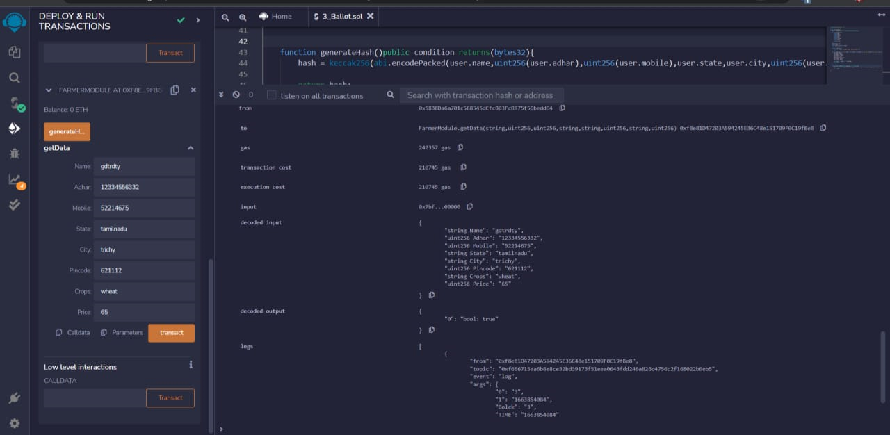
Farmer - Consumer Network Using Blockchain S. Harish Ragavendra, A.Viswesvaran, Lokeshwaran, K. Saravanakumar, S. Saravanan. K. Ramakrishnan College of Technology, Tiruchirappalli, Tamil Nadu-621 112, India.
ABSTRACT
PROBLEM STATEMENT
Agriculture is the backbone for India and also for the world, world without agriculture life on the earth wouldn’t be conceivable. Farmers are having problems because of the third-party bribery in the agriculture industries.
Therefore our application uses blockchain technology and XDC network to connect farmers and merchants directly without the use of any middle man, allowing them to save a significant amount of money and retain their data securely.
Fetching reasonable prices for their product by eliminating the intervention of middlemen in market. Analysing market trends and consumer needs.
Currently the farmer and consumer are completely separated in the market by middlemen.
SOLUTION
DEVELOPMENT
Farmers are able to determine what their harvest is currently worth and sell at a price that reflects global market conditions.
Information sharing will increase industrial competition and price will become higher.
Blockchain technology provides farmers with the ability to show what they have harvested.
Provides quicker access to funding resources and make farmers financially inclusive.
TECHNOLOGY STACK
JAVASCRPIPT
PYTHON
BLOCKCHAIN
SMART CONTRACT

