Slide 1






CODEBASICS RESUME CHALLENGE - SEPTEMBER
Designed and Presented By
Sreenath MK

Slide 2
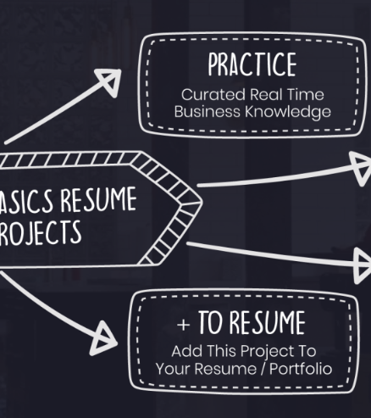
Introduction
Your Search for dataset, ends here 😀
As part of this challenge, we have to provide insights to the revenue team of AtliQ hotels by utilizing the provided data

Slide 3
AtliQ
Bangalore
Delhi
Mumbai
Hyderabad

Slide 4
AtliQ
Bangalore
Delhi
Atliq Bay
Atliq Blu
Atliq City
Atliq Exotica
Atliq Grands
Atliq Palace
Mumbai
Hyderabad
Atliq Bay
Atliq Blu
Atliq City
Atliq Grands
Atliq Palace
Atliq Bay
Atliq Blu
Atliq City
Atliq Exotica
Atliq Grands
Atliq Palace
Atliq Seasons
Atliq Bay
Atliq Blu
Atliq City
Atliq Exotica
Atliq Grands
Atliq Palace

Slide 5

Dataset Details
We are provided 3 moths booking details data of all the atliq hotels.
Dataset contains 5 excel files.
Dim_date
Dim_hotels
Dim_rooms
Fact_aggregated_bookings
Fact_bookings
Metric list excel file
Mock-up Dashboard

Slide 6
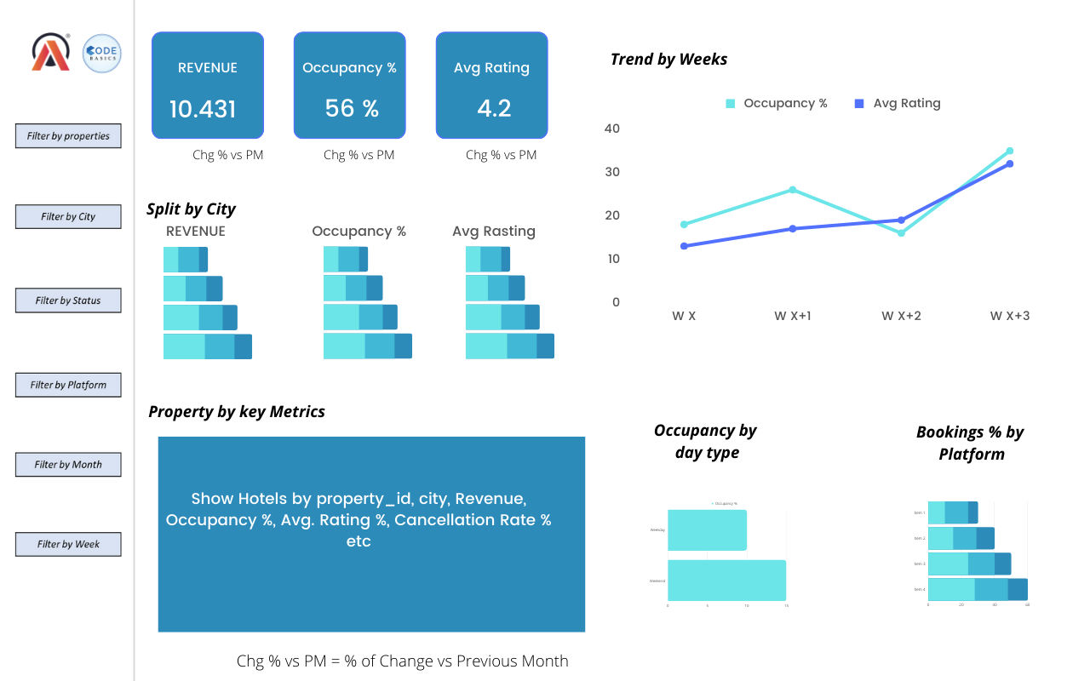
Mock-up Dashboard

Slide 7

Expected outcome after this analysis?
Regain their market share in the luxury/business hotels category.
Understanding the revenue trend by week/month/day
To get insights where business is failing and what can be done to tackle them

Slide 8
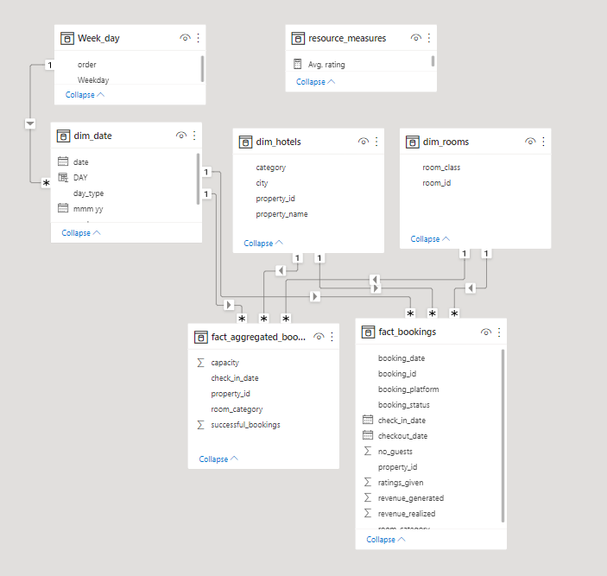
Data Model

Slide 9


Slide 10


