Slide 1


Slide 2
Prerequisites for this Course
Laptop with Good Internet
No basic knowledge is required.
Note & Pen

Slide 3
Deep Learning Algorithm
01
ARTIFICIAL NEURAL NETWORK (ANN)
02
RECURRENT NEURAL NETWORK (RNN)
03
CONVOLUTIONAL NEURAL NETWORK (CNN)
www.pantechsolutions.net

Slide 4
ANN
Learns any Non-Linear Function, It is known as Universal Function Approximators
Activation Function introduce non linear property to network, so it will identify complex relationship between input & output
Output of each neuron is the activation of weighted sum of Input, If there is no Activation function, network can't learn non-linear function
Feed Forward Neural Network – Input processed in one direction
When hidden layer is more than one, that is Deep Neural Network
Hidden
Input
Output

Slide 5
RNN
Hidden
Looping system in hidden layer of ANN is known as RNN
It captures sequential info of input data, that is dependency between words to make prediction. Whereas, ANN cannot capture sequential information
It is mostly used in NLP (Natural Language Processing)
Input
Output

Slide 6
CNN
CNN learns the filter automatically to extract the right features from the data
It captures spatial features (Arrangement of pixels) whereas ANN can’t.
It don’t have recurrent connections like RNN, instead it has convolution type of hidden layers
Convolution and pooling functions are used as activation functions
CONVOLUTION: Input image and other as Filter on input image(Kernel) produces output image.
POOLING: picking maximum value from selected region is Max pooling and vice versa.

Slide 7
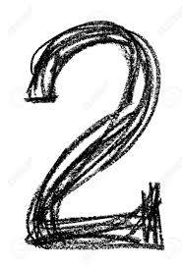
CNN Architecture
FC_4
Fully Connected
Neural Network
FC_3
Fully Connected
ReLU Activation
Conv_2
Convolution
(5x5)
Max-pooling
(2x2)
0
Conv_1
Convolution
(5x5)
Max-pooling
(2x2)
1
2
.
.
.
.
9
Output
Input
28x28x1
n1 channels
(24 x 24 x n1)
n1 channels
(12 x 12 x n1)
n2 channels
(8 x 8 x n2)
Flattened
n2 channels
(4 x 4 x n2)
n3 units

Slide 8


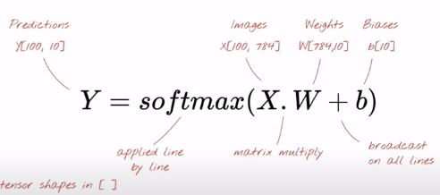
Simple Softmax Classification

Slide 9
Simple Softmax Classification
784 Pixels
….
.
.
.
.
Input
28x28x1
.
.
.
.
0
1
2
3
9

Slide 10
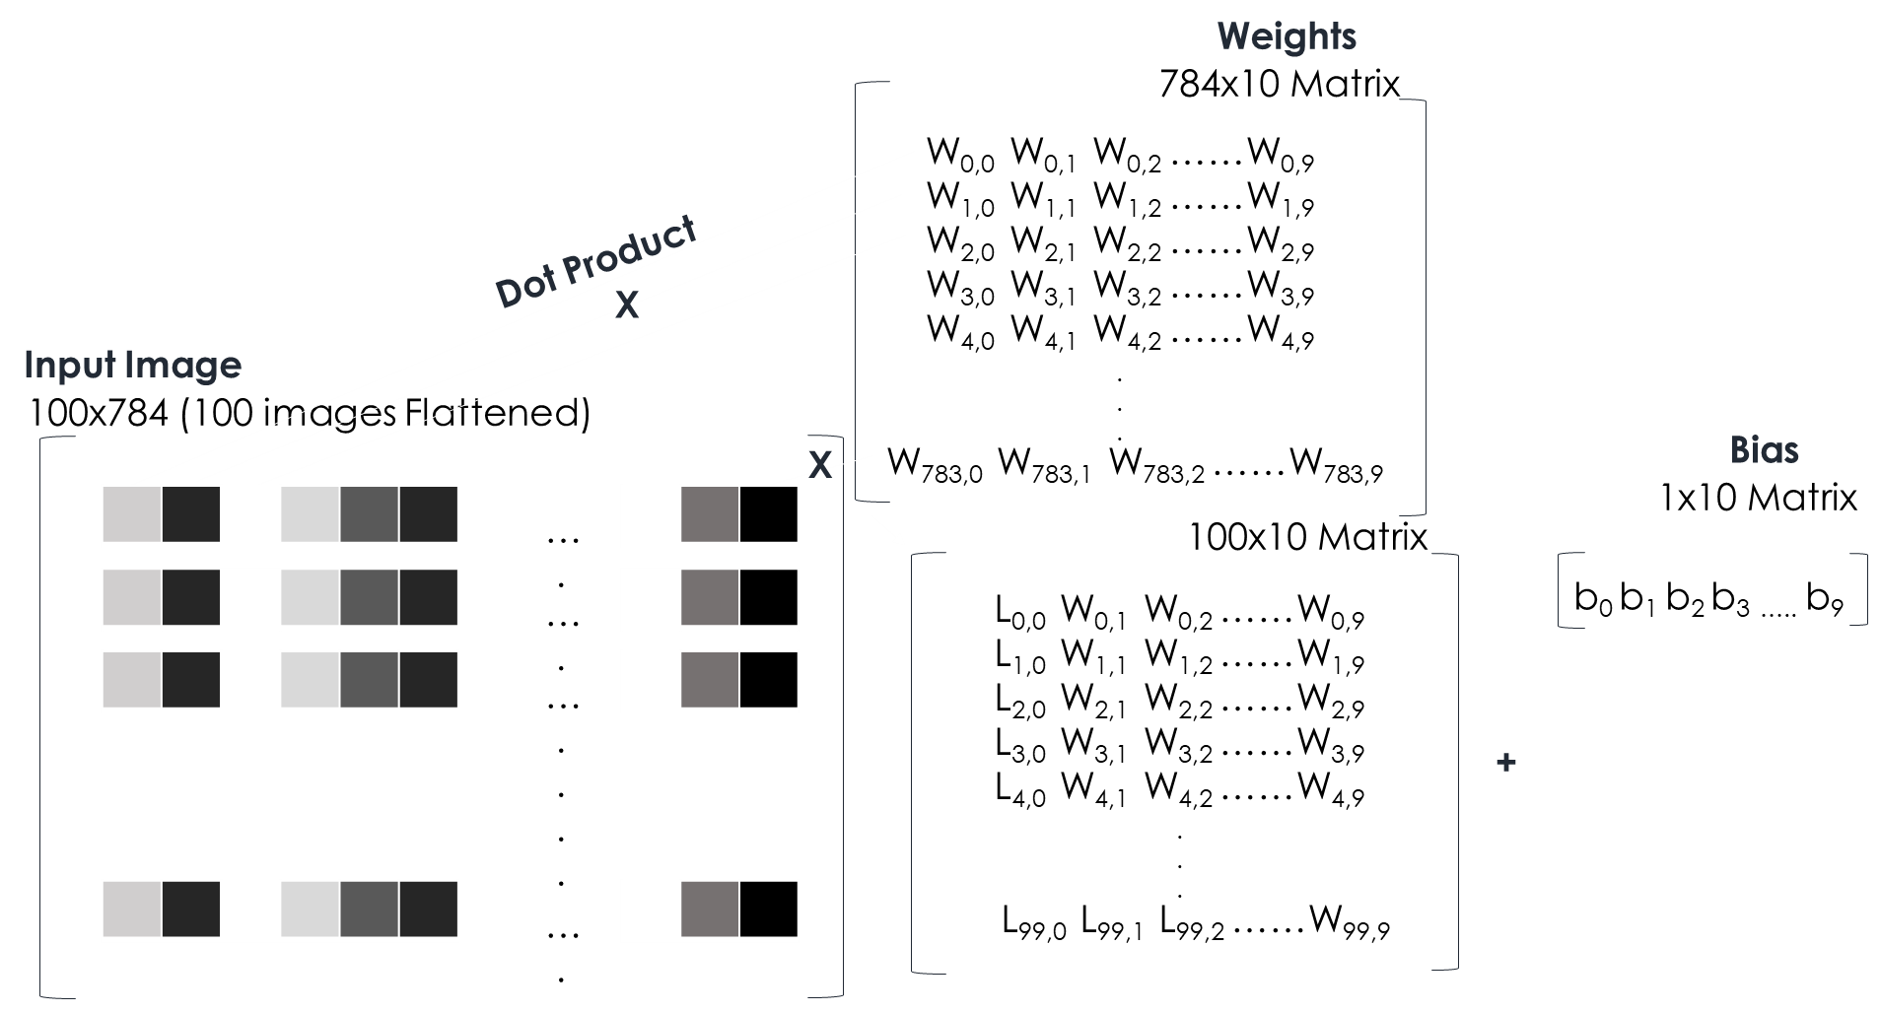
100 image at a time

Slide 11
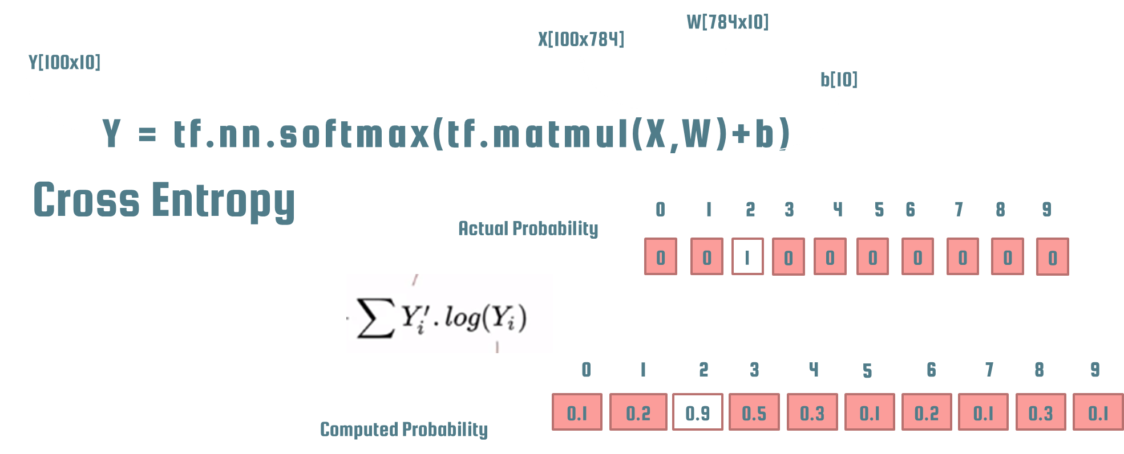
In TensorFlow

Slide 12
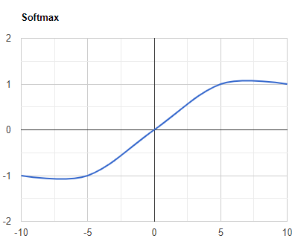
SOFTMAX Function
Softmax activation function will be applied in the last layer of Neural network, instead of ReLU, tanh, Sigmoid.
It is used to map the non-normalized output of a network to a probability distribution over predicted output class. That is it converts output of last layer into a essential probability distribution.

Slide 13
Implementation of NN
Feed Forward
Set of Input features and random weights
Weights will be optimized by back propagation
Back Propagation
Calculating error between predicted output and target output and use Gradient descent method to update weights
Gradient Descent
Machine Learning algorithm
It operates iteratively to find the optimal values for its parameters. user-defined learning rate, and initial parameter values

Slide 14
Vanishing & Exploding Gradient
It is very common problem in every Neural Network, which is associated with Backpropagation.
Weights of network are updated through backpropagation by finding gradients.
When the number of hidden layer is high, then the gradient vanishes or explodes as it propagates backward. It leads instability in network, unable to learn from training
The explosion occurs through exponential growth by repeatedly multiplying gradients through the network layers that have values larger than 1.0
It can be fixed by redesigning the network, using Long Short Term Memory networks, Gradient clipping, etc.

Slide 15
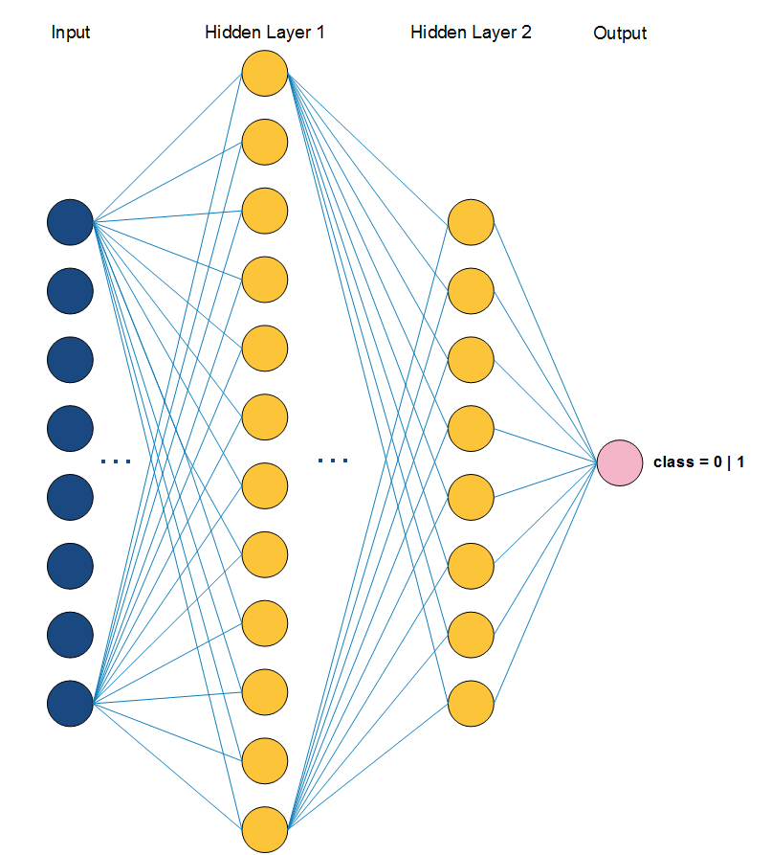
Keras Basic Syntax
Adding Layers
model.add(Dense(12, input_dim=8, init='uniform', activation='relu'))
model.add(Dense(8, activation='relu'))
Compile Model
model.compile(loss='binary_crossentropy',
optimizer='adam', metrics=['accuracy'])

Slide 16
Batch vs Epoch
Training occurs over epochs and each epoch is split into batches.
Epoch - One pass through all of the rows in the training dataset
Batch - One or more samples considered by the model within an epoch before weights are updated.
Keras Basic Syntax
Save & Load Model
Save
Load
model_json = model.to_json()
with open("model.json", "w") as json_file:
json_file.write(model_json)
model.save_weights("model.h5")
print("Saved model to disk")
json_file = open('model.json', 'r')
loaded_model_json = json_file.read()
json_file.close()
loaded_model = model_from_json(loaded_model_json)
loaded_model.load_weights("model.h5")

Slide 17




THANK YOU☺
NOVITECH COIMBATORE
novitechresearchanddevelopment

