Slide 1


Slide 2
Prerequisites for this Course
Laptop with Good Internet
No basic knowledge is required.
Note & Pen

Slide 3
CNN
CNN learns the filter automatically to extract the right features from the data
It captures spatial features (Arrangement of pixels) whereas ANN can’t.
It also follows parameter sharing like RNN, applies single filter in different part of single image. Whereas ANN can’t.
It don’t have recurrent connections like RNN, instead it has convolution type of hidden layers
Convolution and pooling functions are used as activation functions
CONVOLUTION: Input image and other as Filter on input image(Kernel) produces output image.
POOLING: picking maximum value from selected region is Max pooling and vice versa.

Slide 4
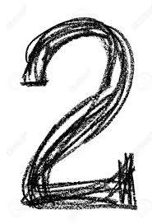
CNN Architecture
FC_4
Fully Connected
Neural Network
FC_3
Fully Connected
ReLU Activation
Max-pooling
(2x2)
0
Conv_2
Convolution
(5x5)
Max-pooling
(2x2)
1
Conv_1
Convolution
(5x5)
2
.
.
.
.
9
Output
Input
28x28x1
n1 channels
(24 x 24 x n1)
n1 channels
(12 x 12 x n1)
n2 channels
(8 x 8 x n2)
Flattened
n2 channels
(4 x 4 x n2)
n3 units

Slide 5


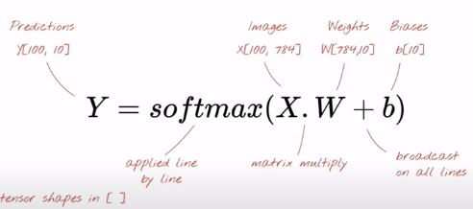
Simple Softmax Classification

Slide 6
Simple Softmax Classification
784 Pixels
….
.
.
.
.
Input
28x28x1
.
.
.
.
0
1
2
3
9

Slide 7
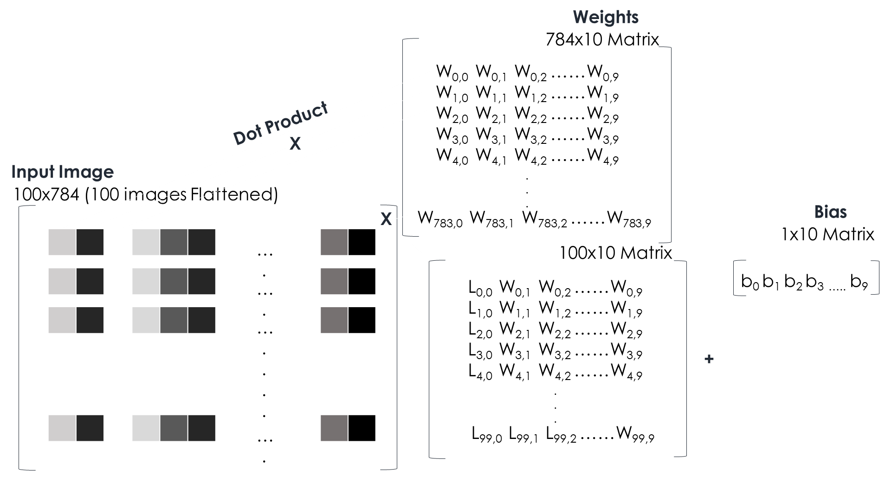
100 image at a time

Slide 8
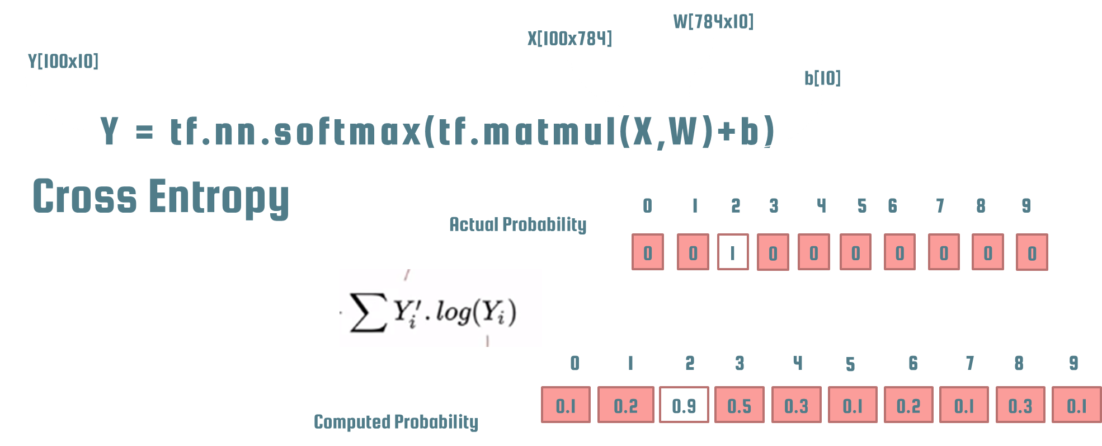
In TensorFlow

Slide 9
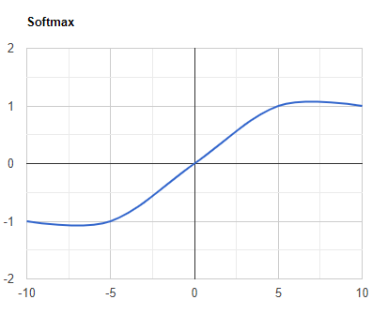
SOFTMAX Function
Softmax activation function will be applied in the last layer of Neural network, instead of ReLU, tanh, Sigmoid.
It is used to map the non-normalized output of a network to a probability distribution over predicted output class. That is it converts output of last layer into a essential probability distribution.

Slide 10
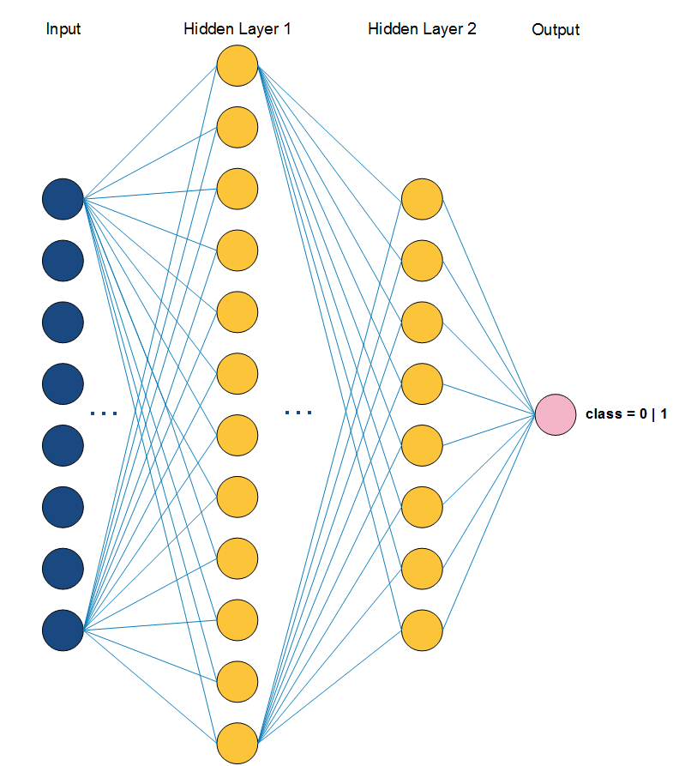
Keras Basic Syntax
Adding Layers
model.add(Dense(12, input_dim=8, init='uniform', activation='relu'))
model.add(Dense(8, activation='relu'))
Compile Model
model.compile(loss='binary_crossentropy',
optimizer='adam', metrics=['accuracy'])
Optimizer - String identifier of an existing optimizer
loss function - This is the objective that the model will try to minimize
list of metrics - For any classification problem you will want to set this to metrics=['accuracy']

Slide 11
Batch vs Epoch
Training occurs over epochs and each epoch is split into batches.
Epoch - One pass through all of the rows in the training dataset
Batch - One or more samples considered by the model within an epoch before weights are updated.
Keras Basic Syntax
Save & Load Model
Save
Load
model_json = model.to_json()
with open("model.json", "w") as json_file:
json_file.write(model_json)
model.save_weights("model.h5")
print("Saved model to disk")
json_file = open('model.json', 'r')
loaded_model_json = json_file.read()
json_file.close()
loaded_model = model_from_json(loaded_model_json)
loaded_model.load_weights("model.h5")

Slide 12
Ready For Hands On

Slide 13




THANK YOU☺
NOVITECH COIMBATORE
novitechresearchanddevelopment

