Slide 1


Slide 2
Prerequisites for this Course
Laptop with Good Internet
No basic knowledge is required.
Note & Pen

Slide 3
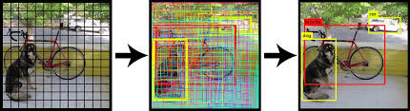
Object Recognition
Object recognition is a computer vision technique for identifying objects in images or videos. Object recognition is a key output of deep learning and machine learning algorithms. When humans look at a photograph or watch a video, we can readily spot people, objects, scenes, and visual details.

Slide 4
Implementing Object Recognition
01
PRE-TRAINED MODEL
02
TRANSFER LEARNING
03
BUILDING FROM SCRATCH

Slide 5
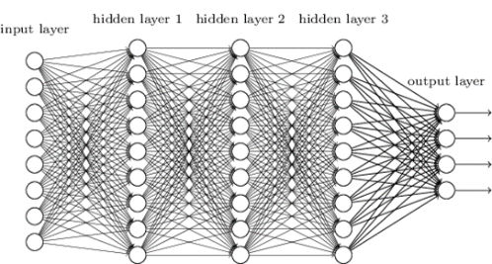
Deep Neural Network - DNN
Solve Complex Task
When it gets new information in the system, it learns how to act accordingly to a new situation.
Learning becomes deeper when tasks you solve get harder.
Helps to load pre-trained Model from DL frameworks such as
Tensorflow
Caffe
Darknet
Torch

Slide 6
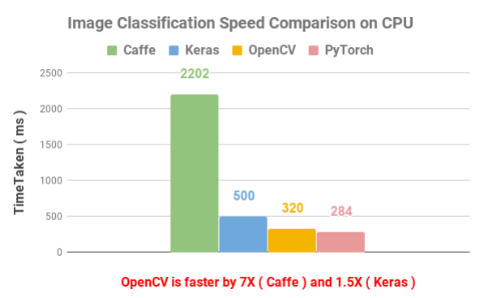
Speed Comparison on Image Classification.

Slide 7
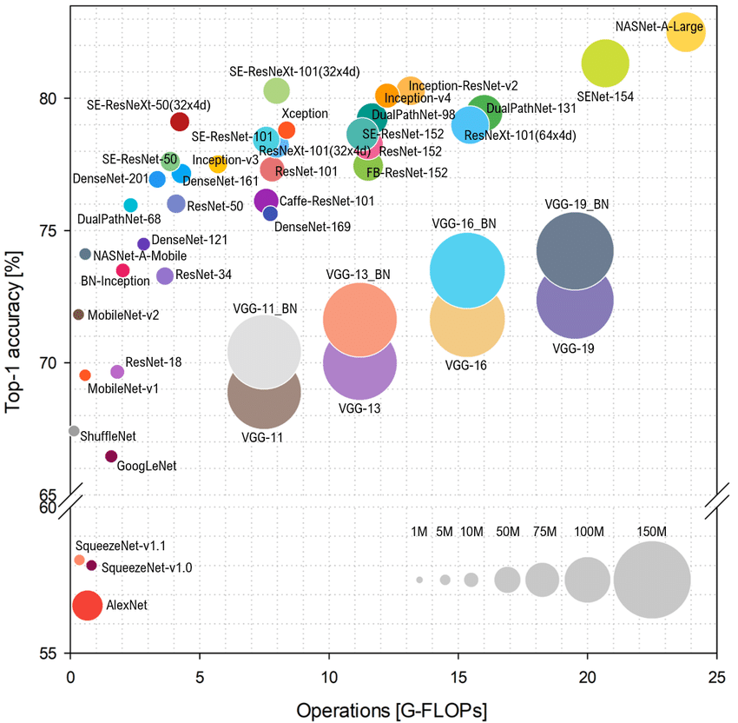
Pre-trained Model for Object recognition
MobileNet-SSD
GoogleNet
Squeezenet
Faster R-CNN
ResNet
Inception
YOLO
VGGNet

Slide 8
MobileNet SSD (Single shot Multibox Detector)
The MobileNet model is based on depthwise separable convolutions which are a form of factorized convolutions.
For MobileNets, the depthwise convolution applies a single filter to each input channel. The pointwise convolution then applies a 1 × 1 convolution to combine the outputs of the depthwise convolution.
A standard convolution both filters and combines inputs into a new set of outputs in one step. The depthwise separable convolution splits this into two layers – a separate layer for filtering and a separate layer for combining. This factorization has the effect of drastically reducing computation and model size.
The SSD architecture is a single convolution network that learns to predict bounding box locations and classify these locations in one pass. Hence, SSD can be trained end-to-end.

Slide 9
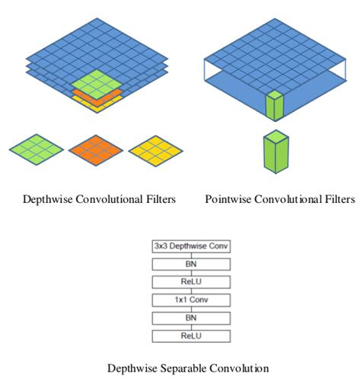
MobileNet SSD

Slide 10
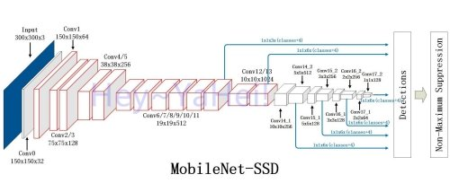
MobileNet SSD Architecture

Slide 11
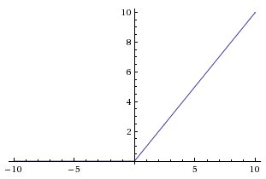
ReLu
The Rectified Linear Unit is the most commonly used activation function in deep learning models.
The function returns 0 if it receives any negative input, but for any positive value x it returns that value back. So it can be written as f(x)=max(0,x) .
the ReLu function is able to accelerate the training speed of deep neural networks compared to traditional activation functions since the derivative of ReLu is 1 for a positive input.
Due to a constant, deep neural networks do not need to take additional time for computing error terms during training phase.

Slide 12
OpenCV Basic Syntax for DNN
Loading Image from Disk to DNN
cv2.dnn.blobFromImage
cv2.dnn.blobFromImages
Import Model from various Framework
cv2.dnn.createCaffeImporter
cv2.dnn.createTensorFlowImporter
cv2.dnn.createTorchImporter
cv2.dnn.readNetFromCaffe
cv2.dnn.readNetFromTensorFlow
cv2.dnn.readNetFromTorch
cv2.dnn.readhTorchBlob
.forward` method is used to forward-propagate our image and obtain the actual classification.

Slide 13
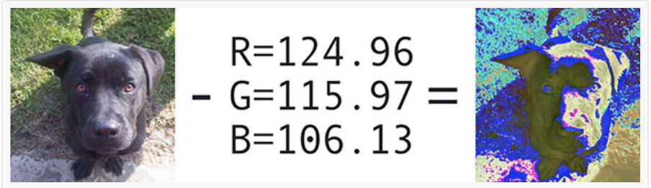
cv2.dnn.blobFromImage
Mean Subtracted Normalized Image = cv2.dnn.blobFromImage(resizedImage,scalingFactor, Spatial Size, Mean Subtraction Values)
blob = cv2.dnn.blobFromImage(imResizeBlob,0.007843, (300, 300), 127.5)

Slide 14
Block Diagram – Workflow of DNN in OpenCV
Load Model
Select Backend
Select target
Reading frame from camera
Convert to Blob
Forward
Post Process

Slide 15
Ready For Hands On

Slide 16




THANK YOU☺
NOVITECH COIMBATORE
novitechresearchanddevelopment

