Slide 1


Slide 2
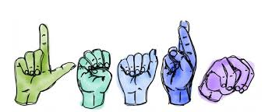
Hand Gesture Recognition
Human gestures include different components of visual actions such as motion of hands, facial expression, and torso, to convey meaning. So far, in the field of gesture recognition, most previous works have focused on the manual component of gestures.
A hand gesture recognition system provide a natural, innovative and modern way of non verbal communication. It has a wide area of application in human computer interaction and sign language

Slide 3
Early Stopping
callback_list = [ EarlyStopping(monitor='val_loss',patience=10), ModelCheckpoint(filepath="model.h5",monitor='val_loss',save_best_only=True,verbose=1)]
EarlyStopping:
monitor='val_loss': It monitors the validation loss of the model during training.
patience=10: If the validation loss does not improve for 10 consecutive epochs, training will be stopped early.
Early stopping helps prevent overfitting.
ModelCheckpoint:
filepath="model.h5": It specifies the file path where the best version of the model will be saved.
monitor='val_loss': It monitors the validation loss.
save_best_only=True: It ensures that only the best (lowest) validation loss models are saved.verbose=1: It displays a message when the model is saved.

Slide 4
Block Diagram – Workflow of Image Classification CNN
Dataset Creation
Train, Test, Val
CNN Design
Pre-Processing
Training - Model
Load Model - Test
Pre-process Input Image
Classification

Slide 5
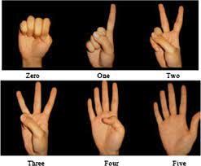
Ready For Hands On
Hand Gesture Recognition

Slide 6




THANK YOU☺
NOVITECH COIMBATORE
novitechresearchanddevelopment

Slide 7
Q & A Session?

