Slide 1
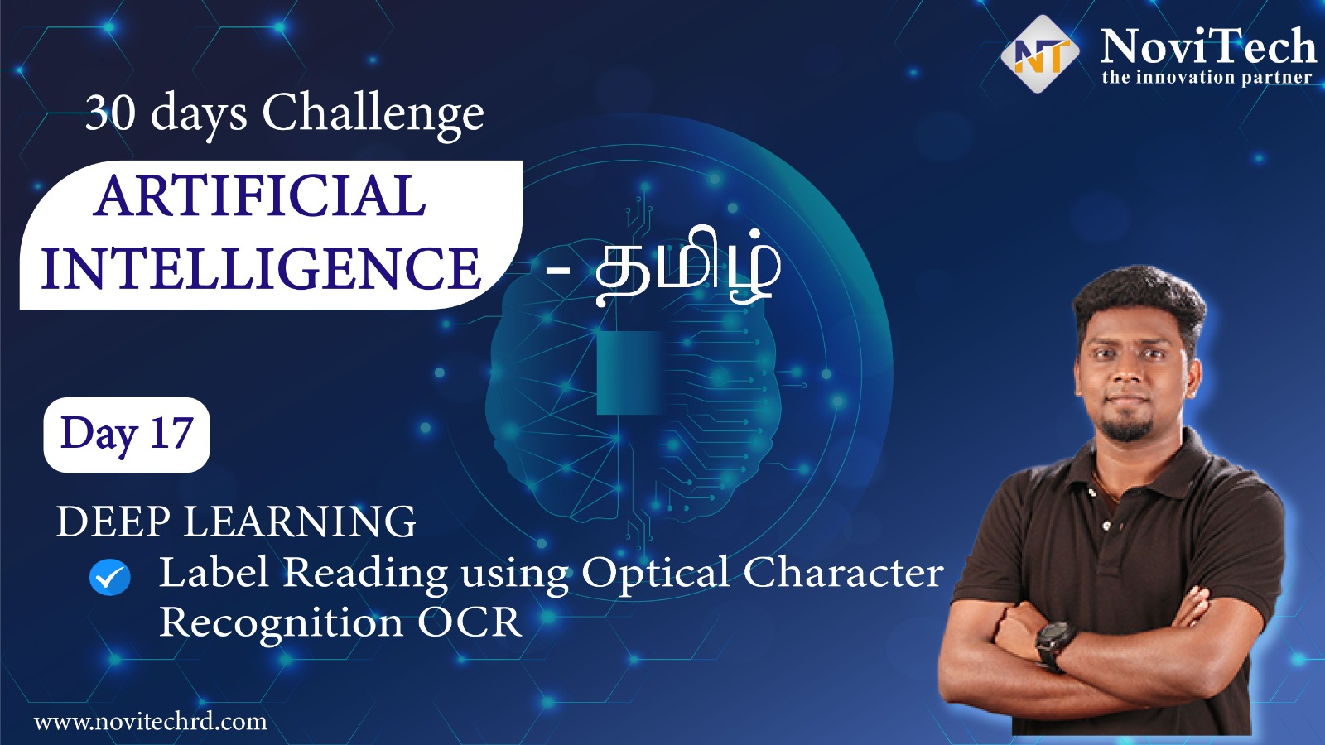

Slide 2
Prerequisites for this Course
Be ready with Sufficient Data
Laptop with Good Internet
No basic knowledge is required.
Note & Pen

Slide 3
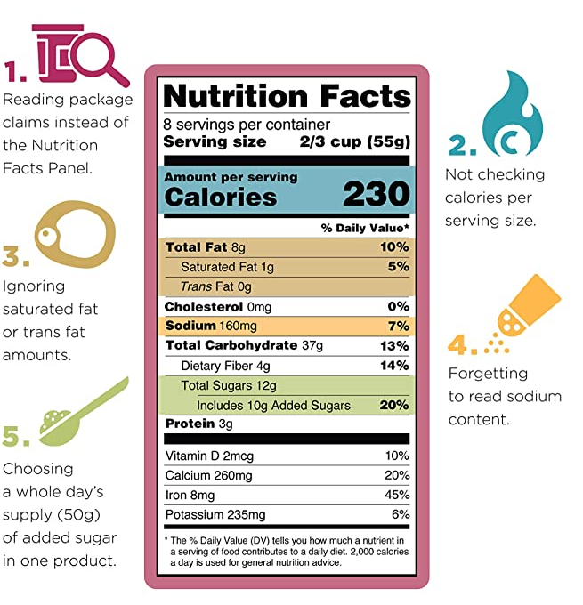
Label Reading
Label-reading skills are intended to make it easier for you to use the Nutrition Facts labels to make quick, informed food decisions to help you choose a healthy diet. Overview | Serving Information | Calories | Nutrients | The Percent Daily Value (%DV) | Nutrition Facts Label Variations.

Slide 4
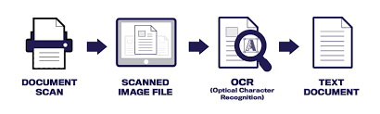
Optical Character Recognition
Optical character recognition or optical character reader is the electronic or mechanical conversion of images of typed, handwritten or printed text into machine-encoded text, whether from a scanned document, a photo of a document, a scene-photo or from subtitle text superimposed on an image.
The first step of OCR is using a scanner to process the physical form of a document.
Once all pages are copied, OCR software converts the document into a two-color, or black and white, version
The scanned-in image or bitmap is analyzed for light and dark areas, where the dark areas are identified as characters that need to be recognized and light areas are identified as background
Pattern Recognition & Feature Detection

Slide 5
Methodology of deploying Label reading
Google Vision, Amazon Recognition PAID
01
PyTesseract
FREE
02
Custom Training from Scratch with ROI
01
www.pantechsolutions.net

Slide 6
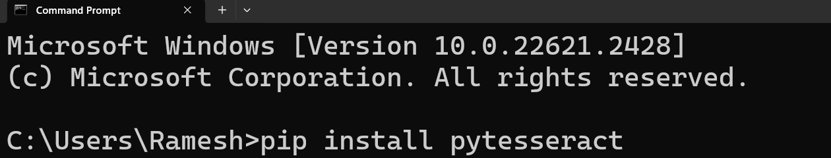
Installing Libraries
PyQt5: pip install pytesseract

Slide 7
Tesseract – OCR Executable
https://digi.bib.uni-mannheim.de/tesseract/tesseract-ocr-w64-setup-v5.0.0-alpha.20210506.exe

Slide 8




THANK YOU☺
Join our What’s app Community group
novitechresearchanddevelopment

