Slide 1


Slide 2
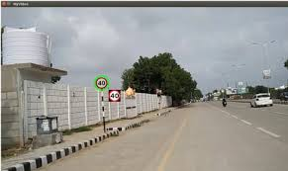
Road Sign Recognition
Traffic-sign recognition (TSR) is a technology by which a vehicle is able to recognize the traffic signs put on the road e.g. "speed limit" or "children" or "turn ahead".
This is part of the features collectively called ADAS. The technology is being developed by a variety of automotive suppliers.
Dataset - GTSRB - German Traffic Sign Recognition Benchmark

Slide 3
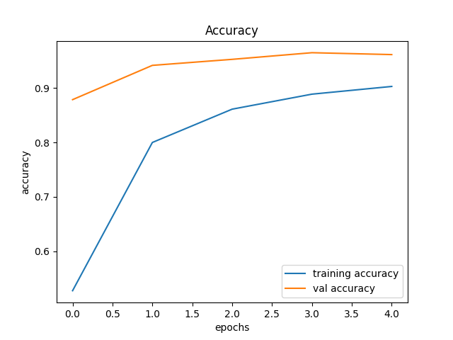
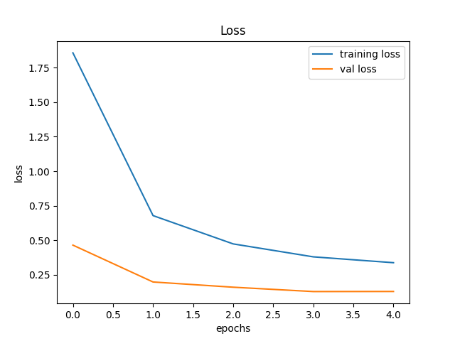
Display Accuracy & Loss Chart
history = model.fit(X_train, y_train, batch_size=32, epochs=5, validation_data=(X_test, y_test))
plt.figure(0)
plt.plot(history.history['accuracy'], label='training accuracy')
plt.plot(history.history['val_accuracy'], label='val accuracy')
plt.title('Accuracy')
plt.xlabel('epochs')
plt.ylabel('accuracy')
plt.legend()
plt.savefig('Accuracy.png')
plt.figure(1)
plt.plot(history.history['loss'], label='training loss')
plt.plot(history.history['val_loss'], label='val loss')
plt.title('Loss')
plt.xlabel('epochs')
plt.ylabel('loss')
plt.legend()
plt.savefig('Loss.png')
self.textEdit.setText("Saved Model & Graph to disk")

Slide 4
Ready For Hands On

Slide 5




THANK YOU☺
NOVITECH COIMBATORE
novitechresearchanddevelopment

